Slide 1
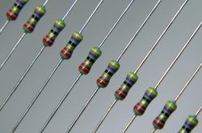
Lesson Plan:
Using Ohm’s Law to Build a
Voltage Divider

Slide 2
The Design Challenge

Slide 3
The Design Challenge
You are part of a team of engineers given the challenge of understanding how Ohm’s Law works and applying it. You’ll learn how to read resistor codes, what a breadboard is and how to calculate resistor values. Then, your team will use a breadboard to build a voltage divider circuit that can illuminate a light emitting diode (LED bulb). You must predict and measure with a multimeter the output voltage values of your circuit.

Slide 4
Defining the Challenge: Criteria & Constraints
Criteria
Use a breadboard to build a voltage divider circuit
Use a multimeter to measure the output voltage values
Constraints
Use only the materials provided.

Slide 5
Material
Materials – Required (Each team) - materials can be re-used
Multimeter
Breadboard with Wire Set
Calculator
LED – Super Red, Clear Lens
9V Alkaline Battery
9V Battery Holder with Wire Leads
Resistor: 100 ohm, Carbon Film, 1/2W, 5%

Slide 6
Material
Materials – Required (Each team) - materials can be re-used
Resistor: 150 ohm, Carbon Film, 1/2W, 5%
Resistor: 220 ohm, Carbon Film, 1/2W, 5%
Resistor: 330 ohm, Carbon Film, 1/2W, 5%
Resistor: 470 ohm, Carbon Film, 1/2W, 5%
Resistor: 560 ohm, Carbon Film, 1/2W, 5%
Resistor: 680 ohm, Carbon Film, 1/2W, 5%
Resistor: 820 ohm, Carbon Film, 1/2W, 5%
Resistor: 910 ohm, Carbon Film, 1/2W, 5%
Resistor: 1000 ohm, Carbon Film, 1/2W, 5%

Slide 7
Testing Materials and Process
Testing Material
Use build materials
Testing Process
Students test their circuits by lighting up the LED bulb. Students must predict and then measure the output voltage values of their circuits using a multimeter

Slide 8
Consider...
Before you get started building, consider how a circuit works. What happens when you flip a light switch on or off?

Slide 9
Reflect & Debrief

Slide 10
Engineering Design Process

Slide 11
The Engineering Design Process
Learn about the engineering design process (EDP). The process engineers use to solve problems. (Video 1:47)
Source: TeachEngineering YouTube Channel http://www.youtube.com/watch?v=b0ISWaNoz-c

Slide 12
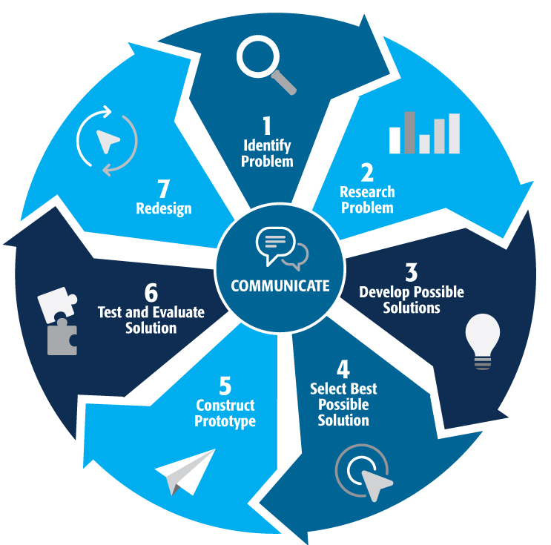
Engineering Design Process
Divide into teams
Review the challenge and criteria & constraints
Brainstorm possible solutions (sketch while you brainstorm!)
Choose best solution and build a prototype
Test then redesign until solution is optimized
Reflect as a team and debrief as a class
Notes:
Material bags for teams to build…

Slide 13
Productive Failure
The engineering design process involves productive failure: test, fail, redesign. Iterate again and again until you have the best possible solution.
It is important to document iterations to keep track of each redesign. Use the engineering notebook to sketch ideas, document iterations and any measurement and/or calculations.
It’s also important to showcase the fact that there can be multiple solutions to the same problem. There’s no one “right” solution.

Slide 14
Vocabulary

Slide 15
Vocabulary
Circuit: A complete path around which electricity can flow
Constraints: Limitations with material, time, size of team, etc.
Criteria: Conditions that the design must satisfy like its overall size, etc.
Engineers: Inventors and problem-solvers of the world. Twenty-five major specialties are recognized in engineering (see infographic).
Engineering Design Process: Process engineers use to solve problems.
Engineering Habits of Mind (EHM): Six unique ways that engineers think.
Iteration: Test & redesign is one iteration. Repeat (multiple iterations).
LED: Light Emitting Diode. A semiconductor device that produces light from electricity.

Slide 16
Vocabulary
Multimeter: Electronic measuring tool that is a combination of several tools in one unit.
Ohm’s Law: The way current flows through a resistance when a different electric potential (voltage) is applied at each end of the resistance.
Prototype: A working model of the solution to be tested.
Resistor: Part of an electrical circuit that resists, or limits, the power of an electrical current in a circuit.
Voltage: Name for the electric force that causes electrons to flow. It's the measure of potential difference between two points in the circuit.
Voltage Divider: An electrical circuit which creates an output voltage which is proportional to an input voltage

Slide 17
Dig Deeper

Slide 18
Dig Deeper into the Topic
Internet Connections
IEEE Global History Network (www.ieeeghn.org)
ITEA Standards for Technological Literacy: Content for the Study of Technology (www.iteaconnect.org/)
National Council of Teachers of Mathematics Principles and Standards for School Mathematics (www.nctm.org/standards)
National Science Education Standards (www.nsta.org/publications/nses.aspx)

Slide 19
Dig Deeper into the Topic
Recommended Reading
Ohm's Law, Electrical Math and Voltage Drop Calculations by Tom Henry. (ISBN: 978-0945495260)
Teach Yourself Electricity and Electronics, Fourth Edition (Paperback) by Stan Gibilisco. (ISBN: 978-0071459334)
Electrical Engineering 101: Everything You Should Have Learned in School but Probably Didn't by Darren Ashby. (ISBN: 978-1856175067)
Writing Activity
Research the life and work of Georg Ohm and write a page on how his discoveries have impacted modern electronics.

Slide 20
Engineering Fields

Slide 21
What is Engineering?
Learn about engineering and how engineers are creative problem solvers and innovators who work to make the world a better place.
(Video 3:43)
Source: TeachEngineering YouTube Channel - http://www.youtube.com/watch?v=H9VDkvgGmVo

Slide 22
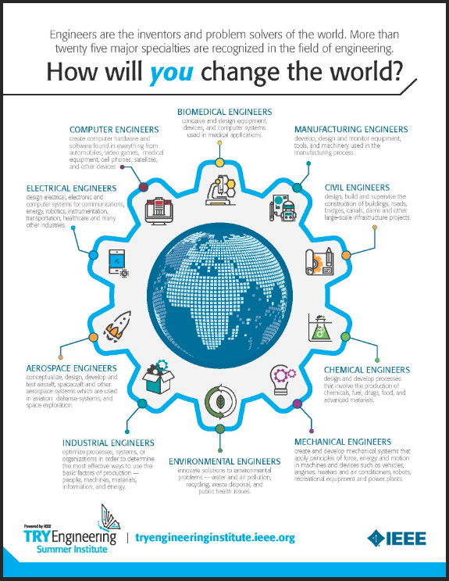
Related Engineering Fields
There are several types of engineering fields that are involved with voltage dividers. Here are just some of the related engineering fields.
Electrical Engineering
Download the Engineering Fields Infographic How will YOU change the world?

Slide 23
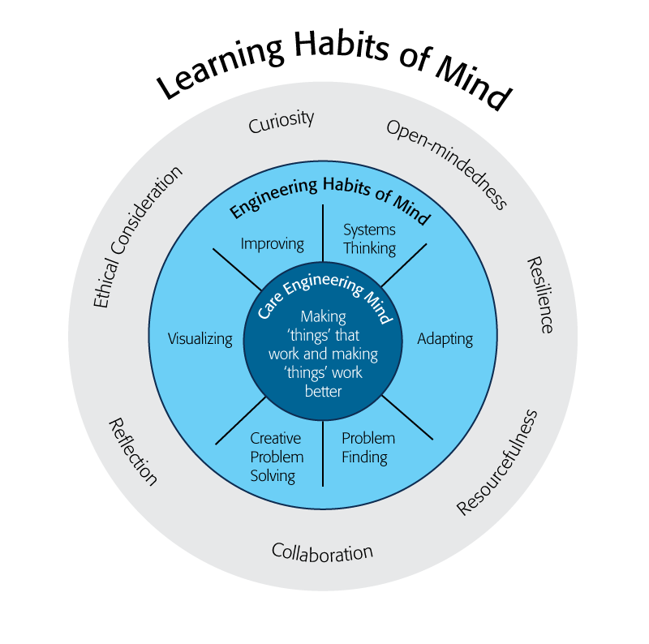
Engineering Habits of Mind
Engineering Habits of Mind (EHM) is about how engineers think everyday. The Core Engineering Mind is about making things that work and making them work better.
Source: https://online-journals.org/index.php/i-jep/article/view/5366)
Notes:
Consider if your lesson address these EHM and how much emphasis it place on each of the EHM. Emphasize the EHM by using the EHM langage when you can.Systems thinking: Seeing whole systems and parts and how they connect.
Problem-finding: identifying and defining a problem.
Visualising: manipulating materials and sketching. Mental rehearsal of practical design solutions
Improving: Persistently trying to make things better by experimenting, designing, sketching, and prototyping
Creative problem-solving: generating ideas and solutions with others with many iterations.
Adapting: Testing, analysing, reflecting, & rethinking
Source: B. Lucas and J. Hanson, Thinking Like an Engineer: Using Engineering Habits of Mind and Signature Pedagogies to Redesign Engineering Education. (International Journal of Engineering Pedagogy, Vol 6, No. 2 (2016): https://online-journals.org/index.php/i-jep/article/view/5366)
More resources on Habits of Mind can be found here: https://www.stem.org.uk/resources/community/collection/424831/engineering-habits-mind-primary
Bill Lucas and Janet Hanson from The Center for Real World Learning at the University of Winchester, UK wrote the paper, Thinking Like an Engineer: Using Engineering Habits of Mind and Signature Pedagogies to Redesign Engineering Education. In the paper, they “ identified the six most distinctive learning dispositions, or engineering “habits of mind” [EHoM] that engineers frequently deploy.”
Maybe add in Checklist here???

Slide 24
Engineering Habits of Mind Checklist
Systems thinking
Problem-finding
Visualising
Improving
Creative problem-solving
Adapting
Notes:
Systems thinking: seeing whole systems and parts and how they connect
Problem-finding: identifying and defining a problem
Visualising: manipulating materials and sketching
Improving: persistently trying to make things better by experimenting
Creative problem-solving: generating ideas with many iterations
Adapting: testing, analysing, reflecting & rethinking
More resources on Habits of Mind can be found here: https://www.stem.org.uk/resources/community/collection/424831/engineering-habits-mind-primary
Bill Lucas and Janet Hanson from The Center for Real World Learning at the University of Winchester, UK wrote the paper, Thinking Like an Engineer: Using Engineering Habits of Mind and Signature Pedagogies to Redesign Engineering Education. In the paper, they “ identified the six most distinctive learning dispositions, or engineering “habits of mind” [EHoM] that engineers frequently deploy.”

Slide 25
Learning Habits of Mind Checklist
Open-mindedness
Resilience
Resourcefulness
Collaboration
Reflection
Ethical Consideration
Curiosity
Notes:
More resources on Habits of Mind can be found here: https://www.stem.org.uk/resources/community/collection/424831/engineering-habits-mind-primary
Bill Lucas and Janet Hanson from The Center for Real World Learning at the University of Winchester, UK wrote the paper, Thinking Like an Engineer: Using Engineering Habits of Mind and Signature Pedagogies to Redesign Engineering Education. In the paper, they “ identified the six most distinctive learning dispositions, or engineering “habits of mind” [EHoM] that engineers frequently deploy.”

Slide 26
Greatest Engineering Achievements of the 20th Century
Source: http://www.greatachievements.org/

Slide 27
Learn more about how engineers make the world a better place

Slide 28
For more engineering lesson plans and resources like games, engineering careers, and STEM opportunities visit IEEE’s TryEngineering.org

