Slide 1
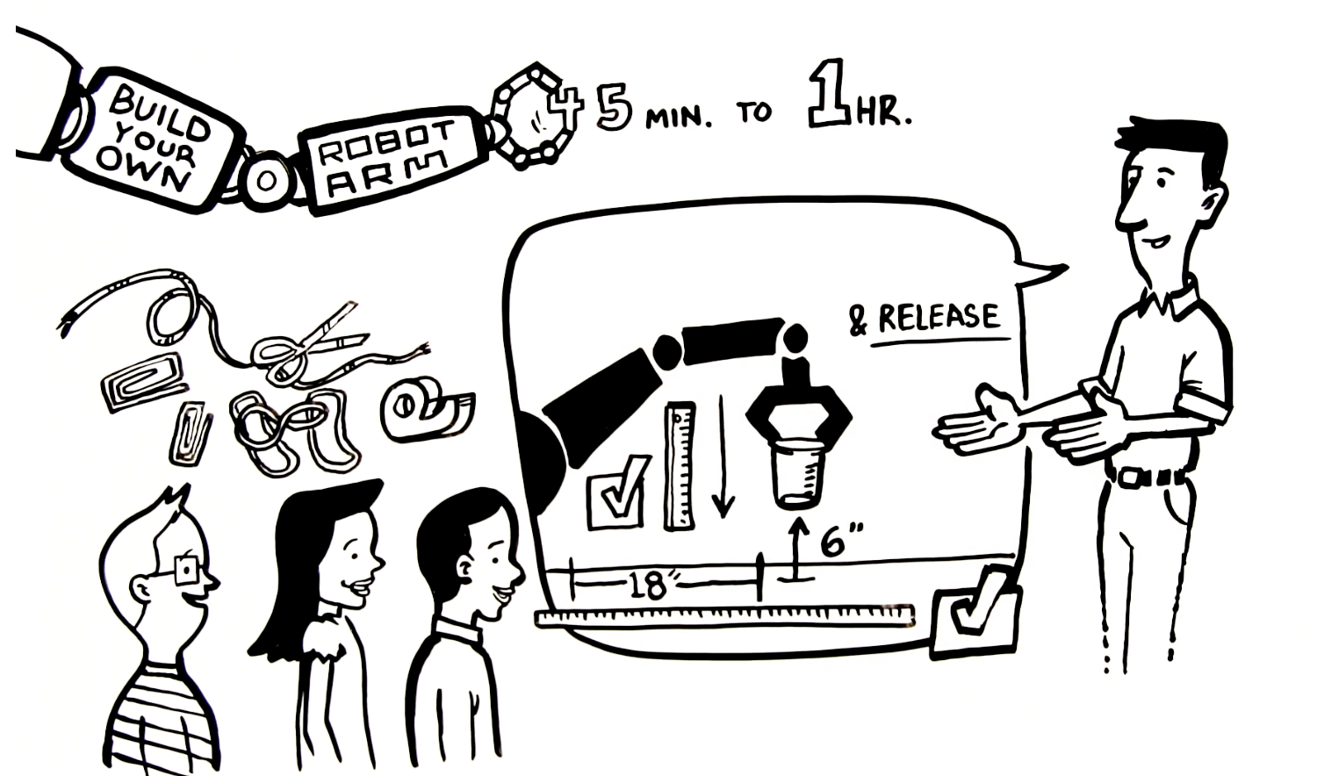
Lesson Plan:
Build Your Own Robot Arm

Slide 2
Real-World Application

Slide 3
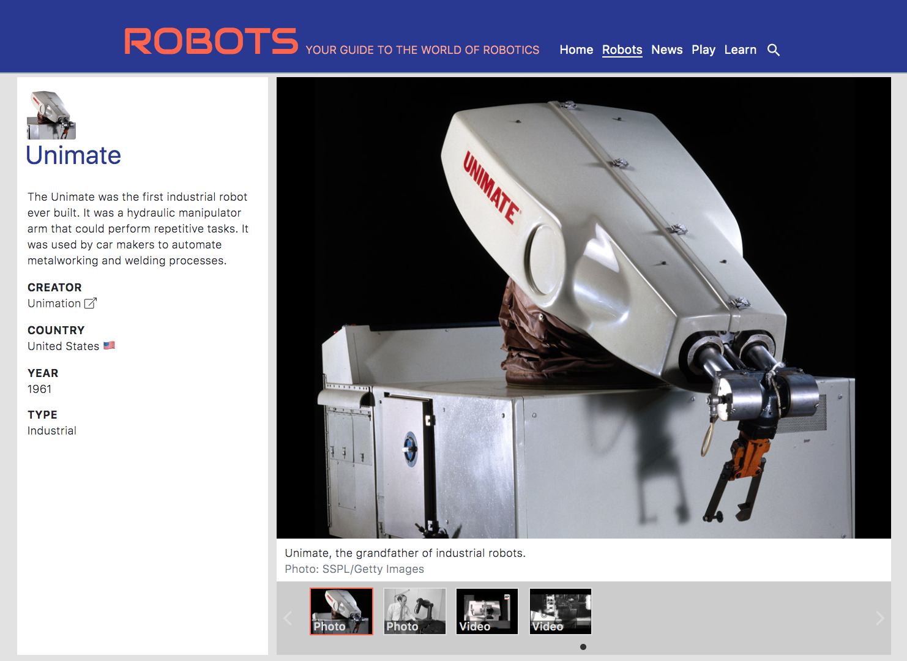
Industrial Robots
Robots that work in a manufacturing setting are known as “industrial robots.”
Industrial robots perform tasks such as sorting, welding, painting, product assembly, packaging, labeling, and quality inspection.
Visit IEEE’s Robots website and check out some videos of Unimate the first industrial robot ever built.

Slide 4
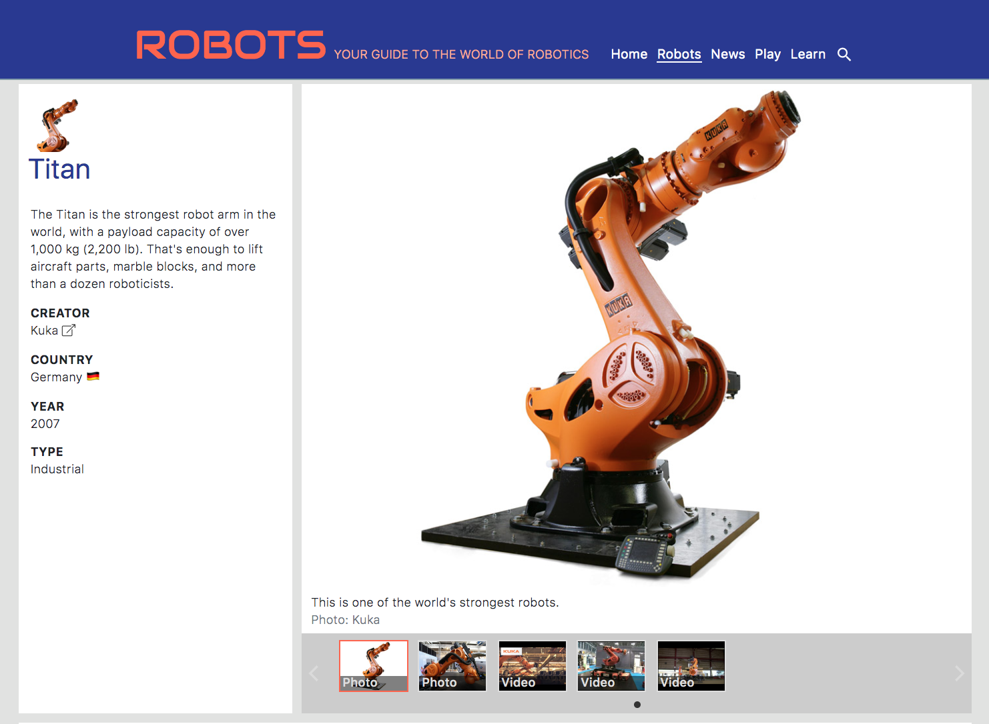
Titan: Strongest Robot Arm in the World
Visit IEEE’s Robots website and check out some videos of Titan the world’s strongest robot arm in action
Notes:
https://robots.ieee.org/

Slide 5
The Design Challenge

Slide 6
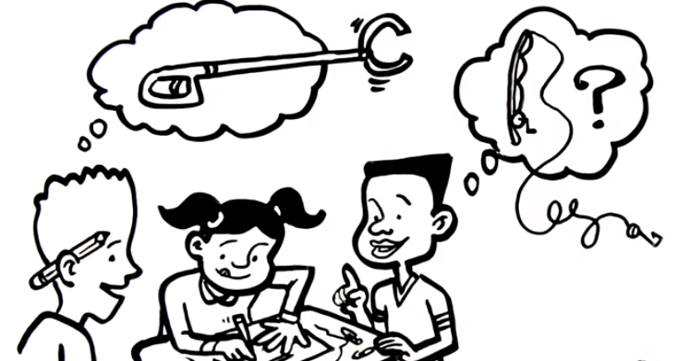
The Design Challenge
You are a team of engineers all working together, using the engineering design process, to design a robot arm that meets the challenge’s criteria and constraints.

Slide 7
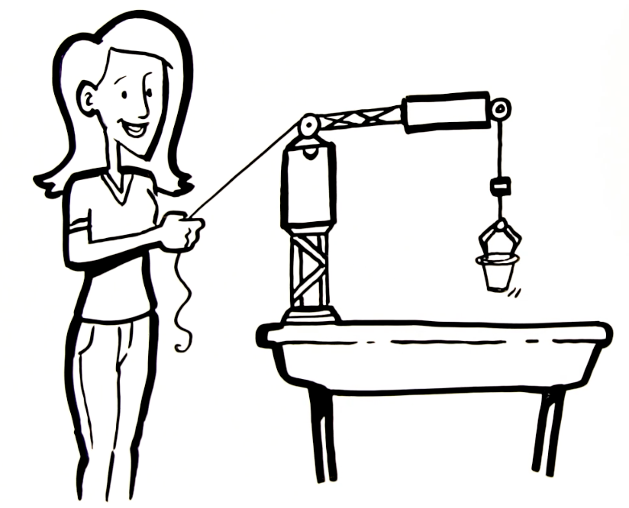
Defining the Challenge: Criteria & Constraints
Criteria:
Arm length: minimum of 18”
Pick up an empty Styrofoam cup 18” away
Lift the cup to a height of at least 6”
Constraints:
Use only the materials provided
Design a solution in the time provided

Slide 8
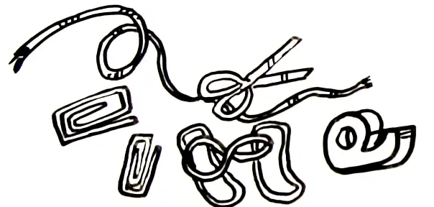
Materials
Required for each team
Cardboard strips
Cup (for testing) - may want to test multiple types of cups - plastic, styrofoam or paper or just test one.
Optional (Table of Possibilities)
Binder clips
Paper clips
Brass fasteners
Rubber bands
Clothespins
Popsicle sticks
Wire
Fishing Line
String
Tape
Paper
Short pencils

Slide 9
Dig Deeper

Slide 10
Vocabulary
Engineers: Inventors and problem-solvers of the world. Twenty-five major specialties are recognized in engineering (see infographic).
Engineering Habits of Mind (EHM): Six unique ways that engineers think.
Engineering Design Process: Process engineers use to solve problems.
Criteria: Conditions that the design must satisfy like its overall size, etc.
Constraints: Limitations with material, time, size of team, etc.
Prototype: A working model of the solution to be tested.
continued on next page

Slide 11
Vocabulary
Iteration: Test & redesign is one iteration. Repeat (multiple iterations).
Industrial Robot: Performs tasks such as sorting, welding, painting, product assembly, packaging, labeling, and quality inspection.
Unimate: First industrial robot ever built.
Titan: The strongest robot arm in the world, with a payload capacity of over 1,000 kg (2,200 lb).

Slide 12
Engineering Design Process

Slide 13
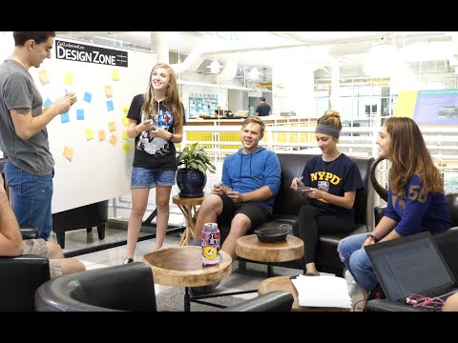
The Engineering Design Process
Learn about the engineering design process (EDP). The process engineers use to solve problems.
Source: TeachEngineering YouTube Channel
‹#›

Slide 14
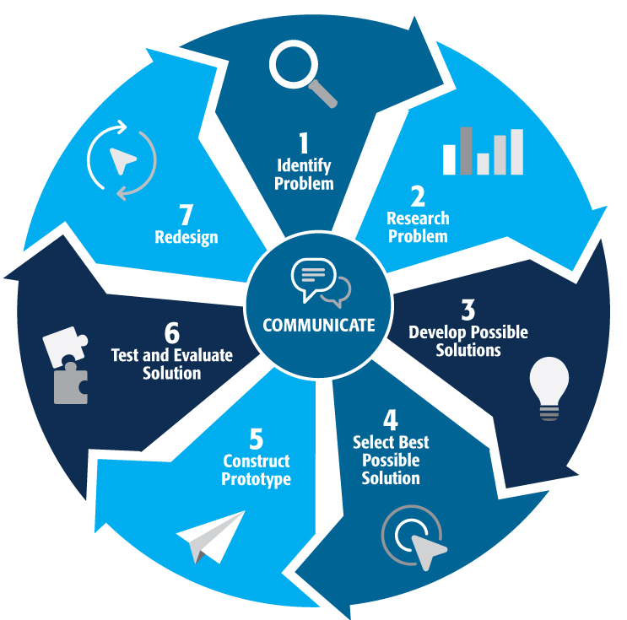
Engineering Design Process
Divide into teams of two (or up to 4 max)
Review the challenge and criteria & constraints
Brainstorm possible solutions (sketch while you brainstorm!)
Choose best solution and build a prototype
Test then redesign until solution is optimized
Reflect as a team and debrief as a class
Notes:
Material bags for teams to build…

Slide 15
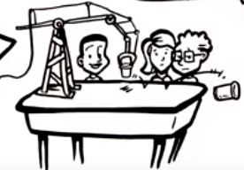
Productive Failure
The engineering design process involves productive failure: test, fail, redesign. Iterate again and again until you have the best possible solution.
It is important to document iterations to keep track of each redesign. Use the engineering notebook to sketch ideas, document iterations and any measurement and/or calculations.
It’s also important to showcase the fact that there can be multiple solutions to the same problem. There’s no one “right” solution.

Slide 16
Consider...
Before you get started brainstorming...consider the following...
How can you control the movement of the arm from a distance?
How might you use the fishing line?
Consider the strength of the grip on the different types of cups.
Look at a trash grabber as one possible example.

Slide 17
Engineering Fields

Slide 18
What is Engineering?
Learn about engineering and how engineers are creative problem solvers and innovators who work to make the world a better place.
Source: TeachEngineering YouTube Channel

Slide 19
Related Engineering Fields
There are many different types of engineering fields that involve designing robot arms. Here are just some of the related engineering fields.
Mechanical Engineering
Manufacturing Engineering
Industrial Engineering
Electrical Engineering
Download the Engineering Fields Infographic How will YOU change the world?

Slide 20
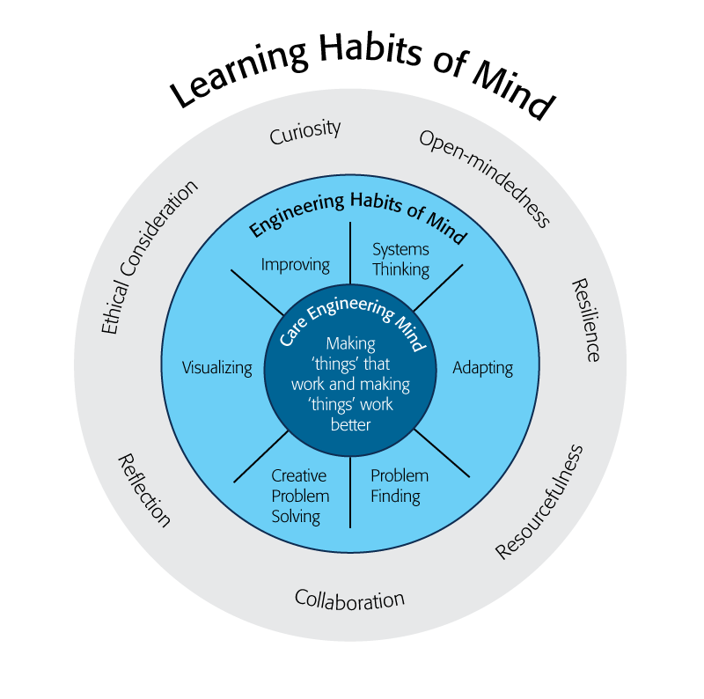
Engineering Habits of Mind (EHM)
EHM is about how engineers think everyday. The core of the engineering mind is about making things that work and making them work better.
Systems thinking: Seeing whole systems and parts and how they connect.
Problem-finding: identifying and defining a problem.
Visualising: manipulating materials and sketching. Mental rehearsal of practical design solutions
Source: B. Lucas and J. Hanson, Thinking Like an Engineer: Using Engineering Habits of Mind and Signature Pedagogies to Redesign Engineering Education. (International Journal of Engineering Pedagogy, Vol 6, No. 2 (2016): https://online-journals.org/index.php/i-jep/article/view/5366)
Notes:
More resources on Habits of Mind can be found here: https://www.stem.org.uk/resources/community/collection/424831/engineering-habits-mind-primary
Bill Lucas and Janet Hanson from The Center for Real World Learning at the University of Winchester, UK wrote the paper, Thinking Like an Engineer: Using Engineering Habits of Mind and Signature Pedagogies to Redesign Engineering Education. In the paper, they “ identified the six most distinctive learning dispositions, or engineering “habits of mind” [EHoM] that engineers frequently deploy.”

Slide 21
Engineering Habits of Mind (EHM)
Improving: Persistently trying to make things better by experimenting, designing, sketching, and prototyping
Creative problem-solving: generating ideas and solutions with others with many iterations.
Adapting: Testing, analysing, reflecting, & rethinking
Source: B. Lucas and J. Hanson, Thinking Like an Engineer: Using Engineering Habits of Mind and Signature Pedagogies to Redesign Engineering Education. (International Journal of Engineering Pedagogy, Vol 6, No. 2 (2016): https://online-journals.org/index.php/i-jep/article/view/5366)
Notes:
More resources on Habits of Mind can be found here: https://www.stem.org.uk/resources/community/collection/424831/engineering-habits-mind-primary
Bill Lucas and Janet Hanson from The Center for Real World Learning at the University of Winchester, UK wrote the paper, Thinking Like an Engineer: Using Engineering Habits of Mind and Signature Pedagogies to Redesign Engineering Education. In the paper, they “ identified the six most distinctive learning dispositions, or engineering “habits of mind” [EHoM] that engineers frequently deploy.”

Slide 22
Greatest Engineering Achievements of 20th Century
Electrification
Automobile
Airplane
Water Supply and Distribution
Electronics
Radio and Television
Agricultural Mechanization
Computers
Telephone
Air Conditioning and Refrigeration
Highways
Spacecraft
Internet
Imaging
Household Appliances
Health Technologies
Petroleum/Petrochemical Technologies
Laser and Fiber Optics
Nuclear Technologies
High-performance Material
Source: http://www.greatachievements.org/

Slide 23
Do you know any Engineers?
How many engineers do you know? Your teammates? Your class?
What do they do? What engineering degrees do they have?
What items in your classroom and your school did engineers help design?
Check out the NAE Grand Challenges for Engineering to help you learn more about how engineers make the world a better place:
NAE Grand Challenge for Engineering

Slide 24
Reflect & Debrief

Slide 25
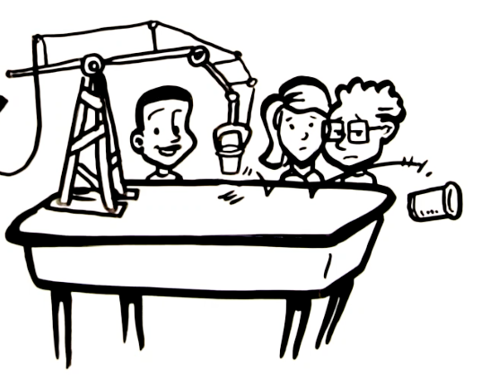
Reflection
Which material was most critical to your robot arm design?
How did working as a team help in the design process?
What did you learn from the designs developed by other teams
How can you redesign it next time to make it even better?

Slide 26
For more engineering lesson plans and resources like games, engineering careers, and STEM opportunities visit IEEE’s TryEngineering.org

