Slide 1
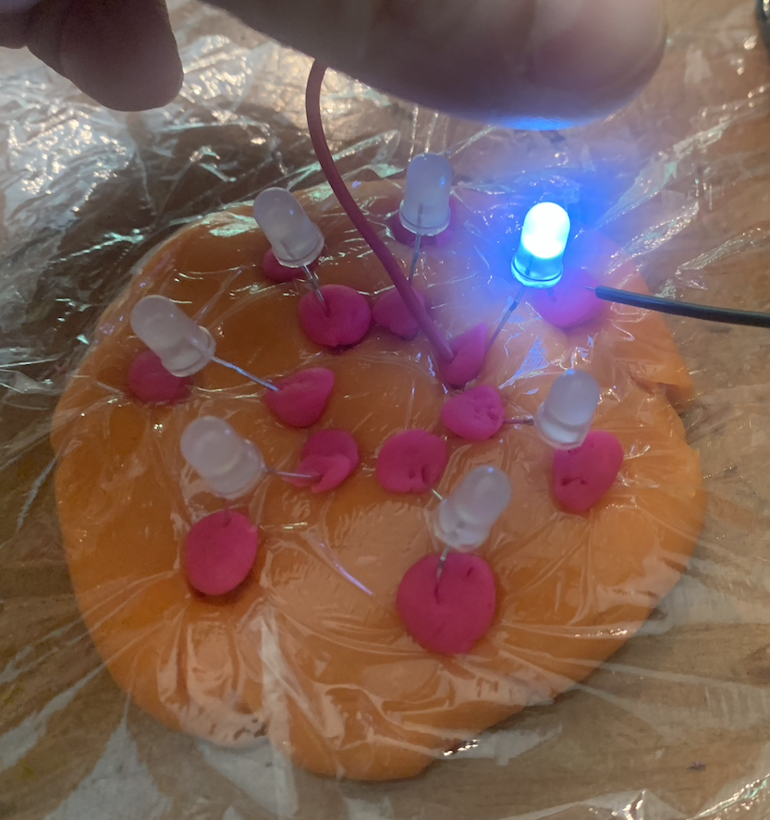
Making of a Chip

Slide 2
Semiconductor?
What image comes to mind when you hear the word

Slide 3
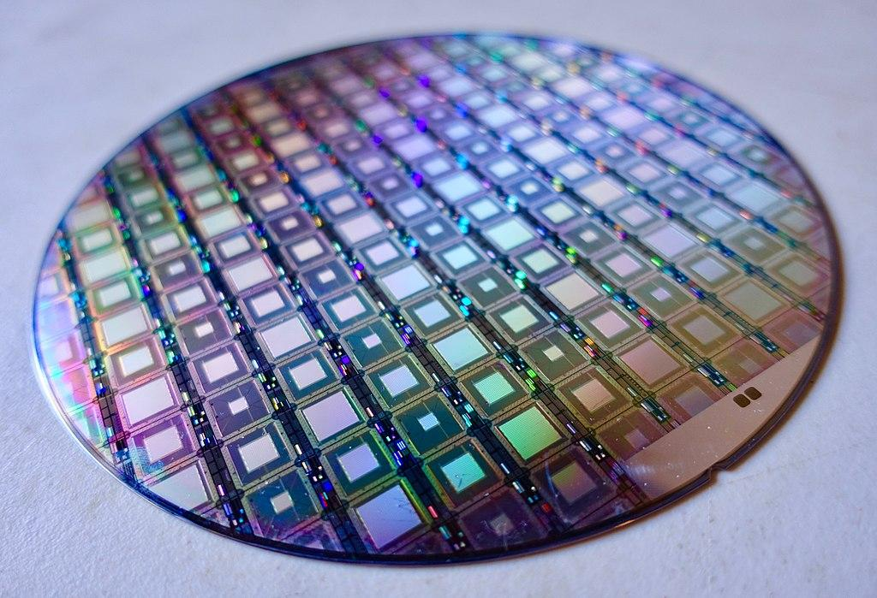
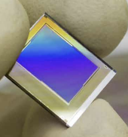
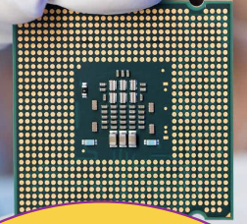
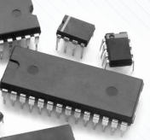
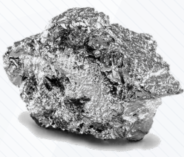
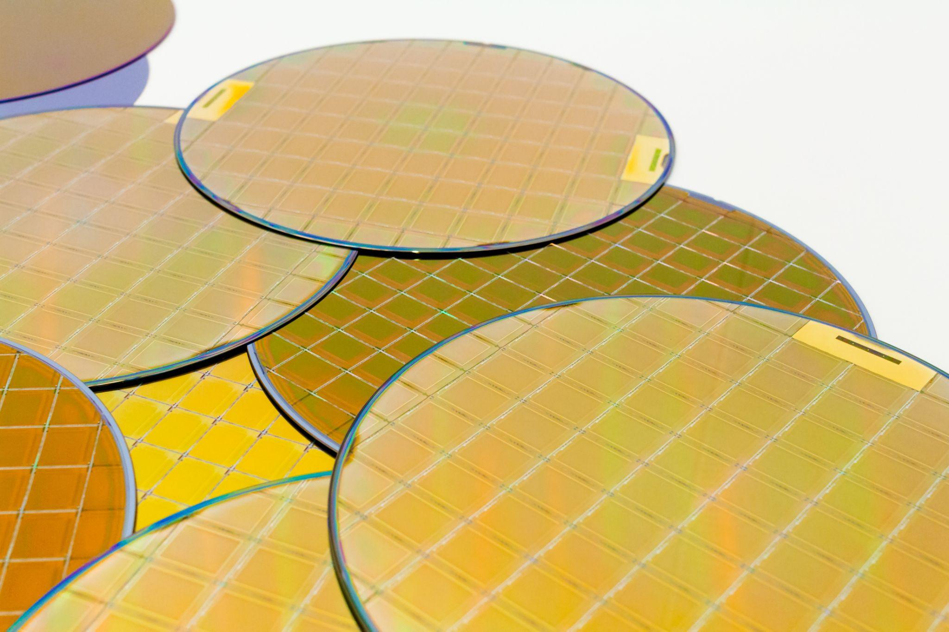
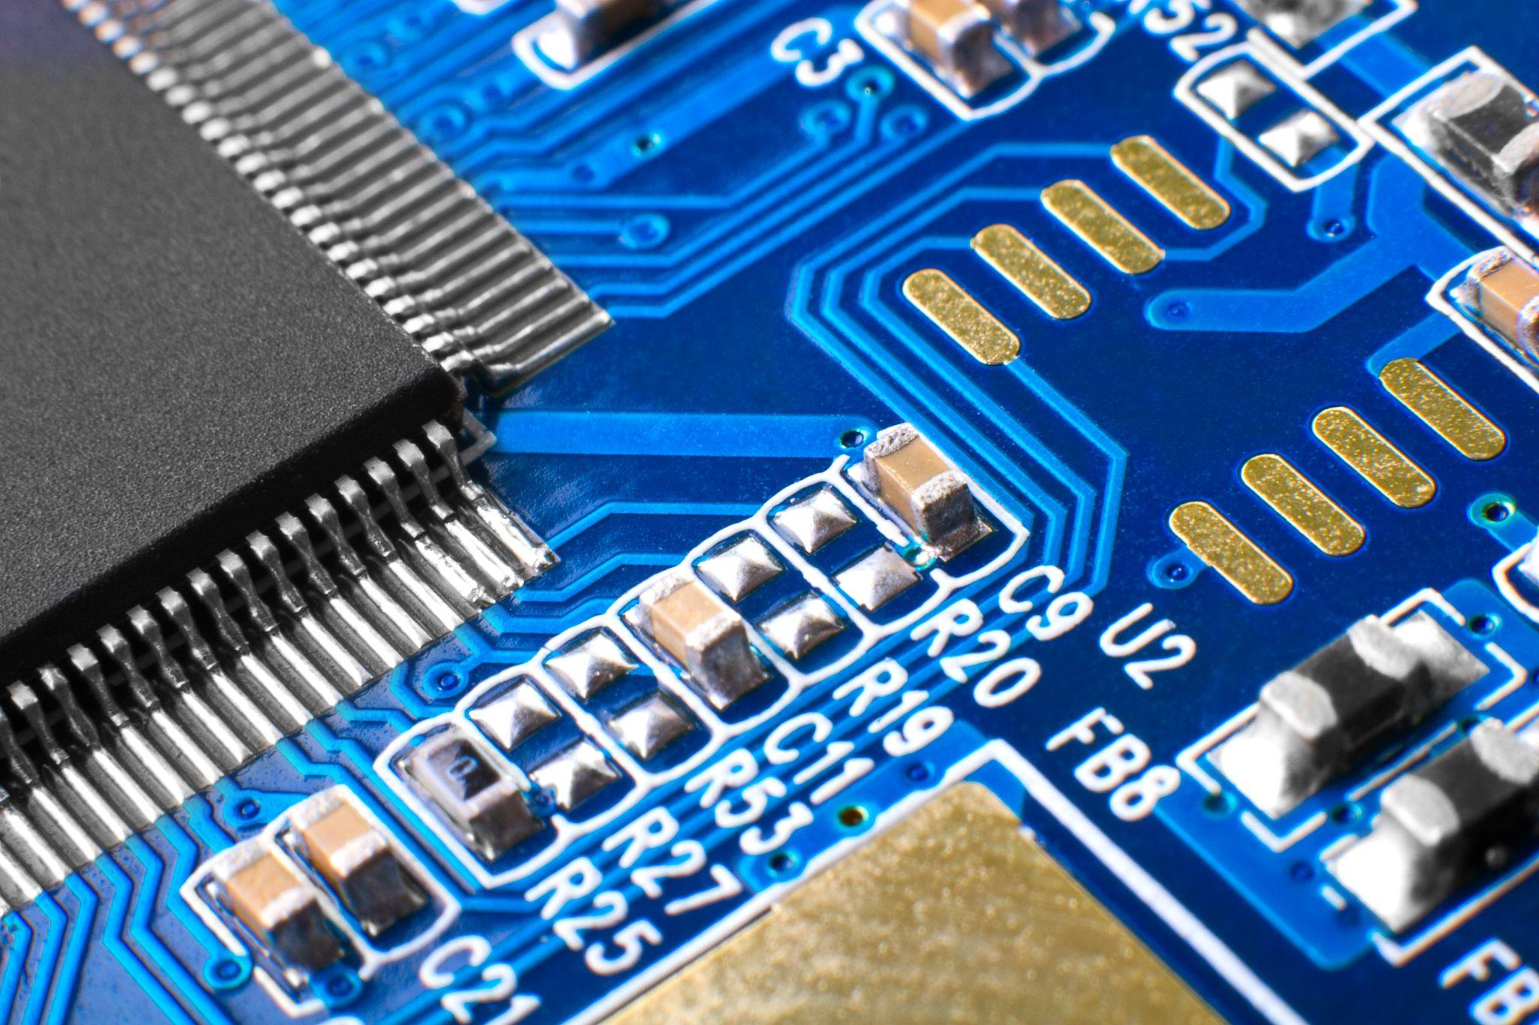
Semiconductor: What image comes to mind?

Slide 4
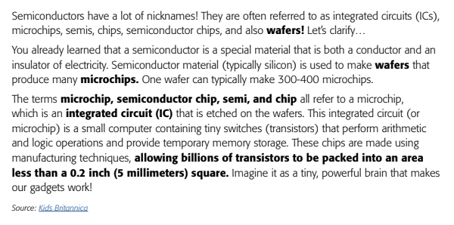
Industry Lingo
Semiconductor nicknames:
Integrated Circuits (ICs)
Microchips
Semiconductor Chips
Semi
Chips
Wafers

Slide 5
The Design Challenge
Notes:
Before we introduce the design challenge, let’s watch a video to learn more about what

Slide 6
The Design Challenge
Design and create the “mask” needed for the creation of a microchip and then use the mask in creating a model of a microchip. Embark on three challenges that lead to the microchip model.
Criteria & Constraints
Watch videos
Create a circuit with Play-Doh
Use only the materials provided
Notes:
Watch video 1

Slide 7
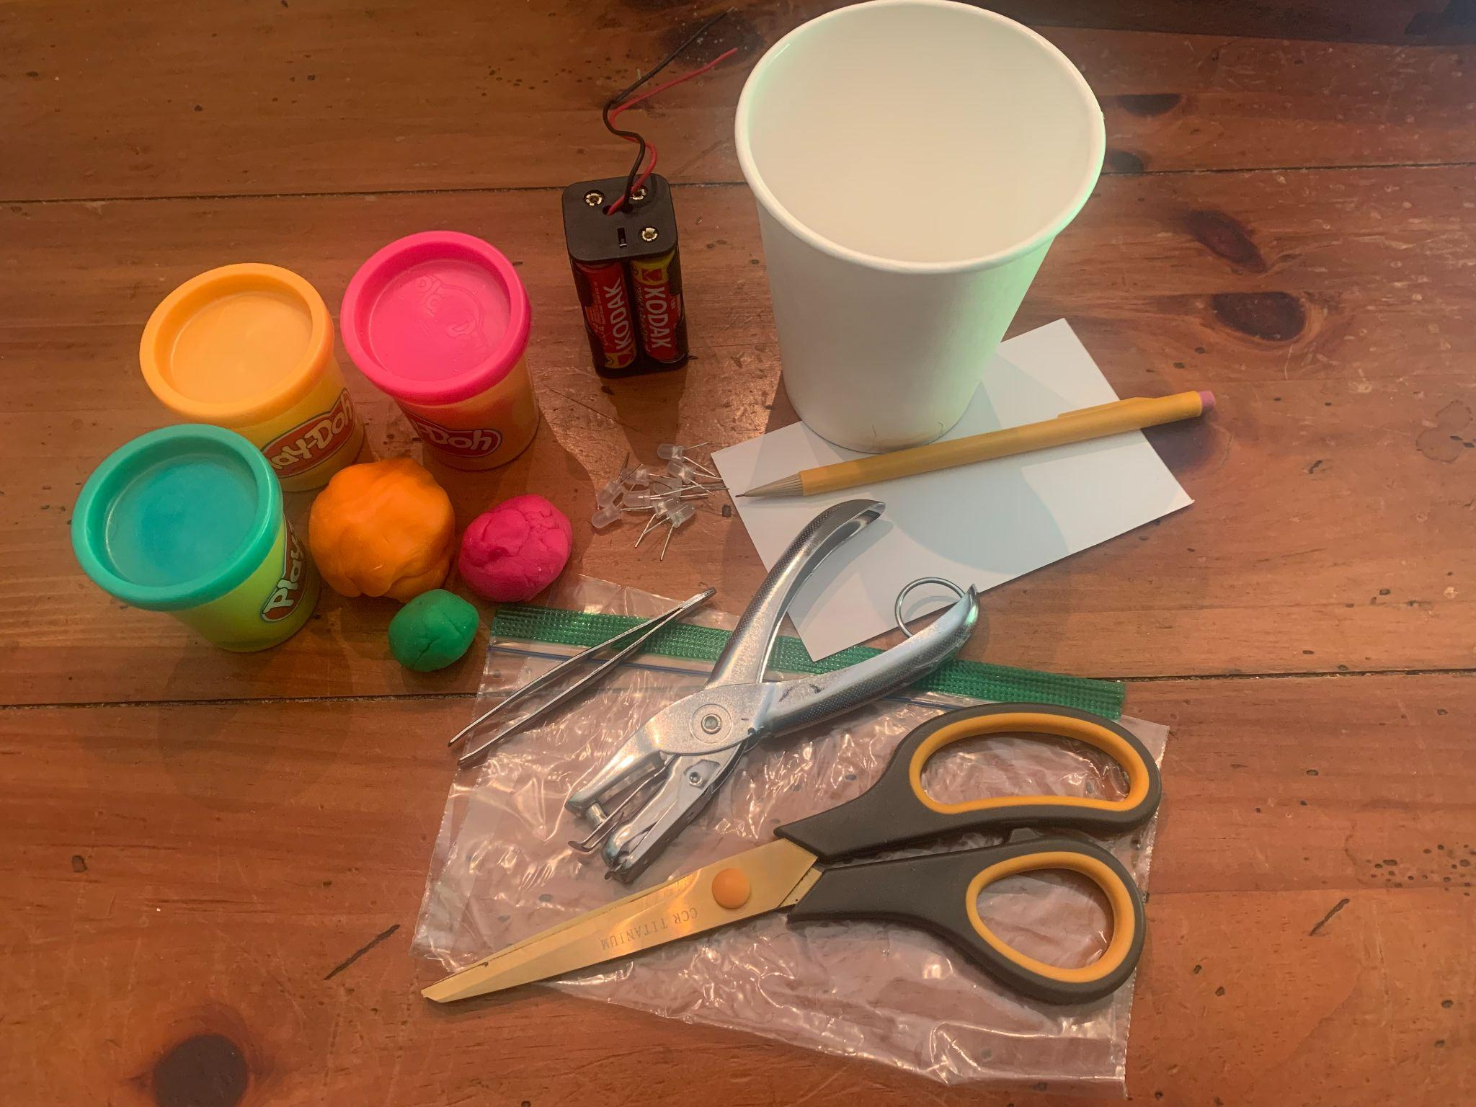
Materials (Per Team)
Index Card (cut 3” in diameter - bottom of a cup)
Sandwich Bag (thin & cut two circles 4”-5” diameter)
Playdoh (5-6 small cans total)
Clay (2-3 pieces)
2-6 White LEDs (20mm- fun larger size)
6-10 White LEDs (5mm) - with legs trimmed shorter
6V battery holder with wires (for 4 AA batteries)
4 AA Batteries
Tools: Scissors, Hole Punch, Tweezers (optional)
Student worksheets
Videos & Ebook

Slide 8
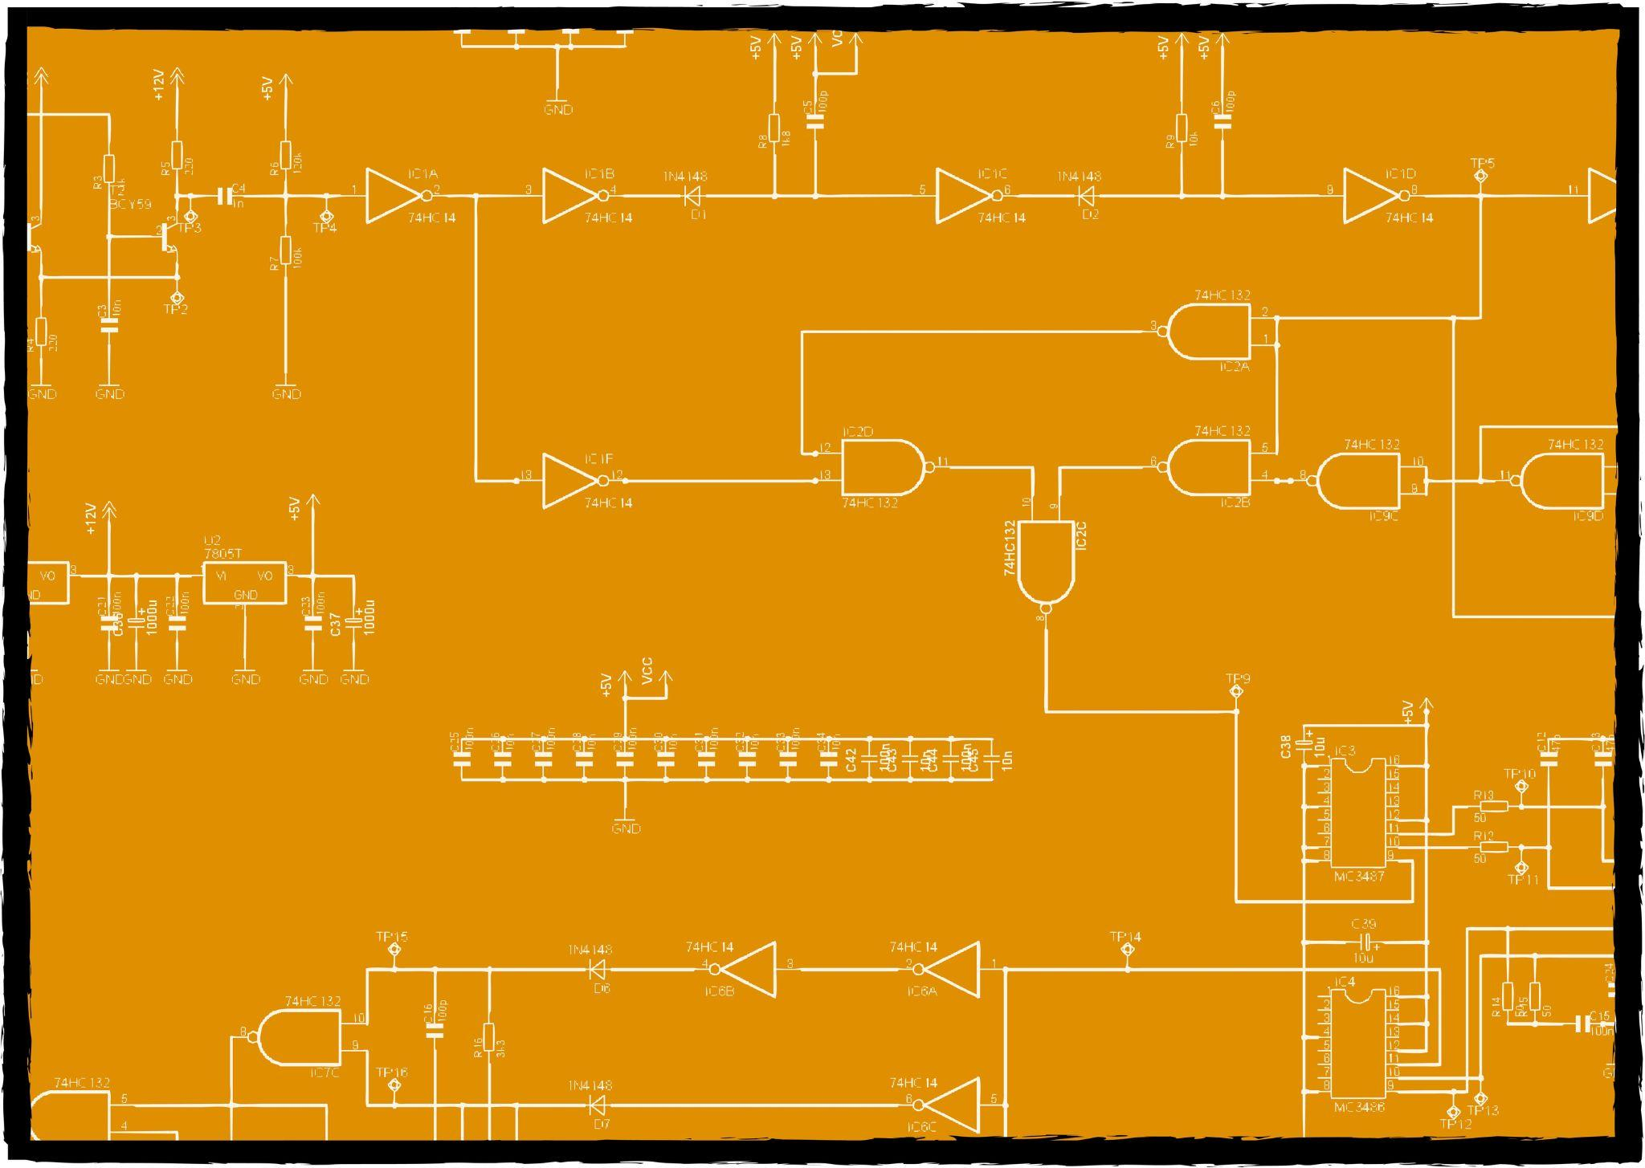
Integrated Circuit (IC) Designer Challenges
You are an Integrated Circuit (IC) Designer. An IC Designer is like a city planner, but instead of designing roads and buildings, you create super-small electronic parts that go inside gadgets like phones and computers.
Their job is to figure out how to arrange tiny resistors, transistors, and capacitors on a chip so they work together. They use computer programs to create a map of where each part should go, ensuring that there are circuits connecting all the parts for electricity to flow. Without ICs, our electronic gadgets wouldn’t work!

Slide 9
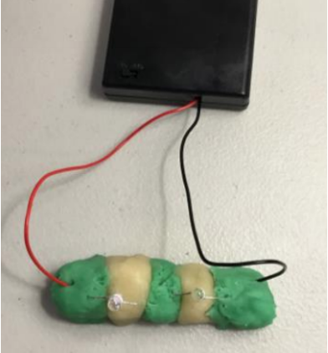
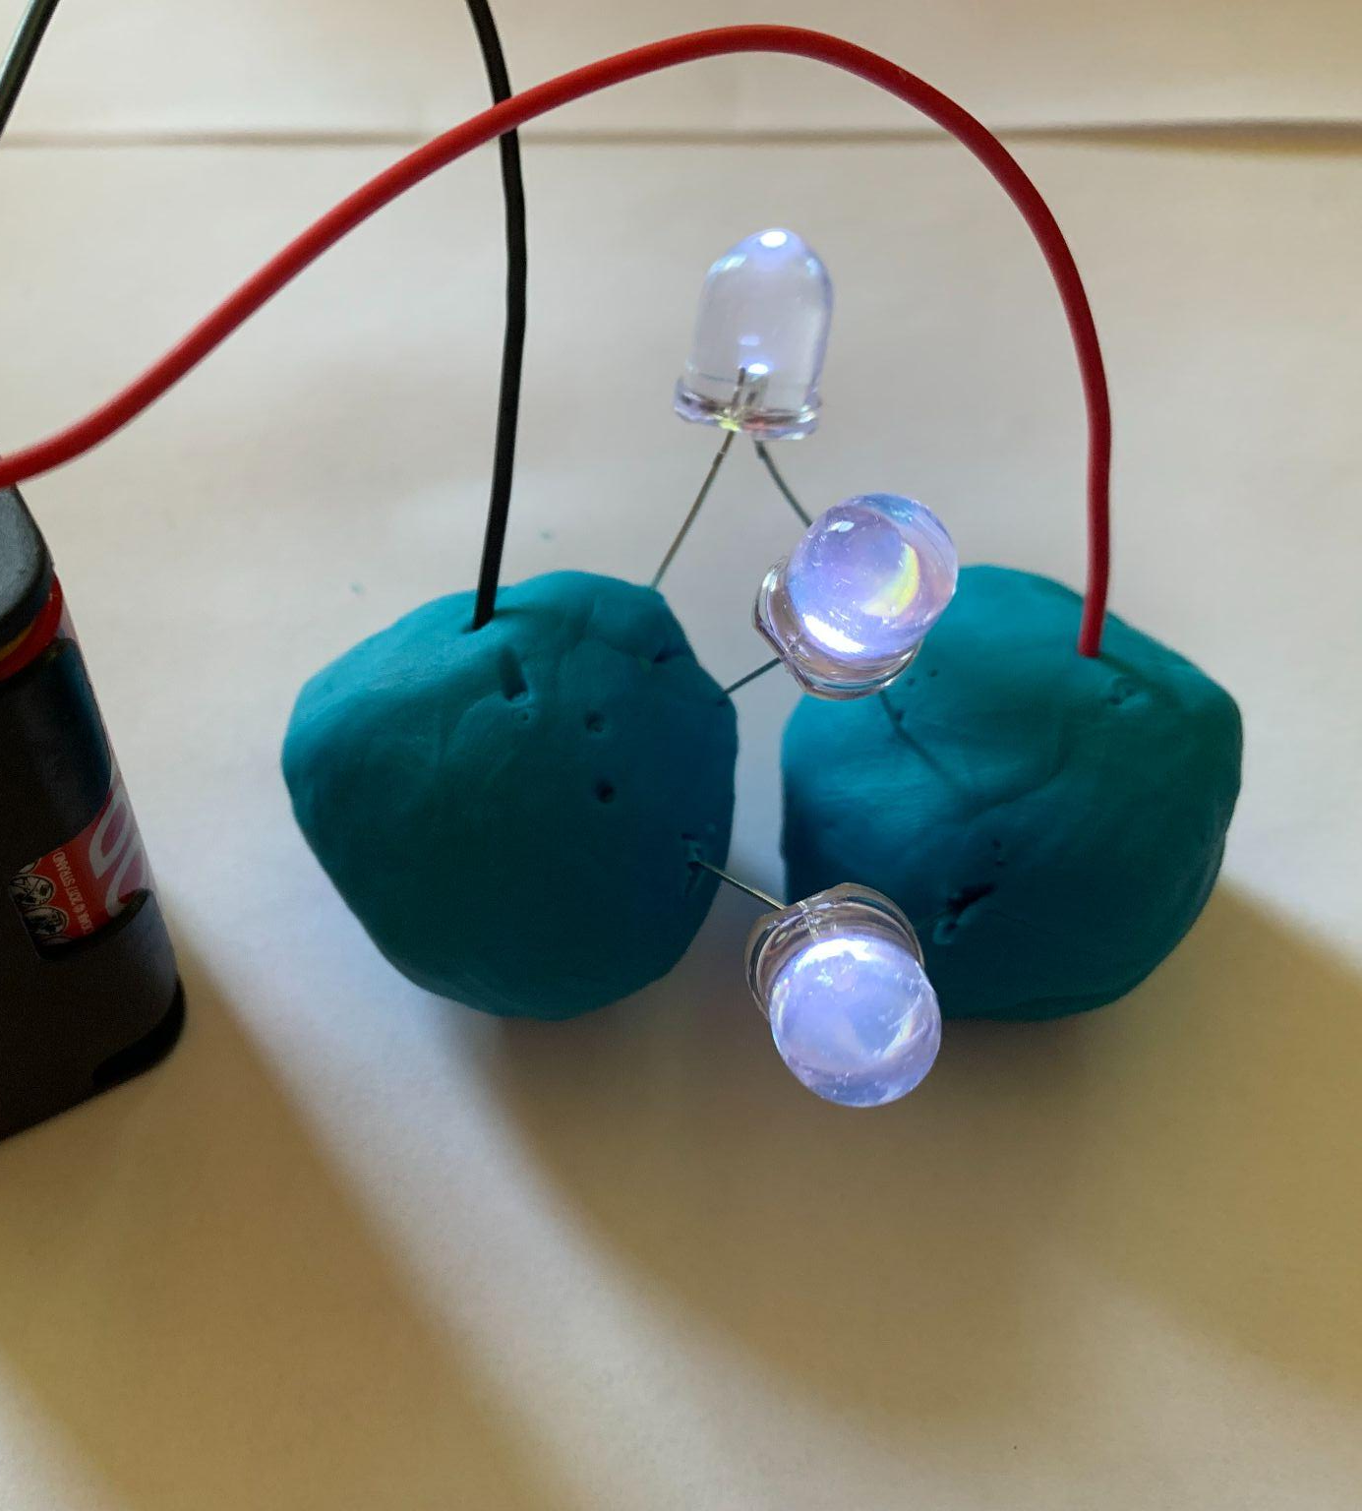
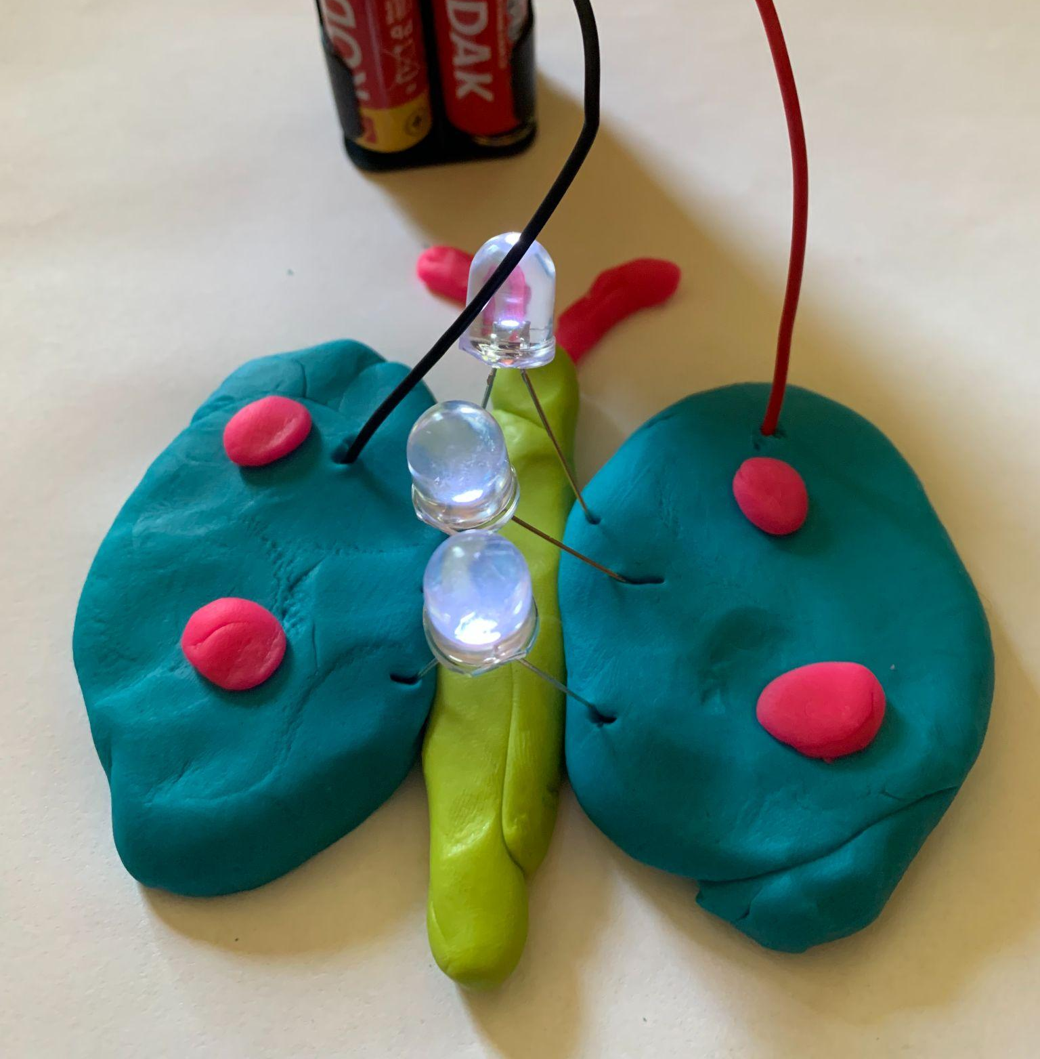
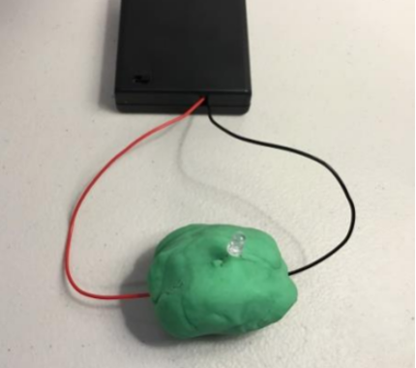
Challenge 1: Electric Dough
Series
In order to prepare you for the design task you need to learn about insulators and conductors by creating a circuit with Play-Doh.
Play-Doh is the conductor and clay is the insulator. Play with making fun circuits. Remember not to short circuit, keep the clay between the LED legs in each design.
Parallel
Short

Slide 10
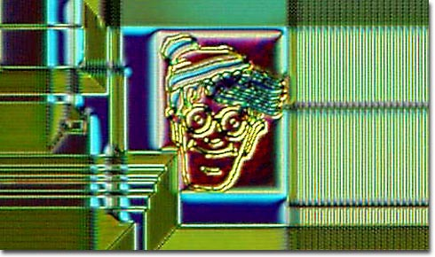
Chip Art (Prep for Next Challenge)
Chip art, also known as silicon art, semiconductor art, silicon wafer art or chip graffiti refers to microscopic hidden doodles (designs, images, or messages) incorporated onto microchips during the manufacturing process. Engineers leave their creative mark on their tiny electronics canvases!
One famous example was a hidden image of Waldo from the popular children’s book series, “Where’s Waldo?” that was found on the surface of a Texas Instruments silicon wafer in the late 1980s.

Slide 11
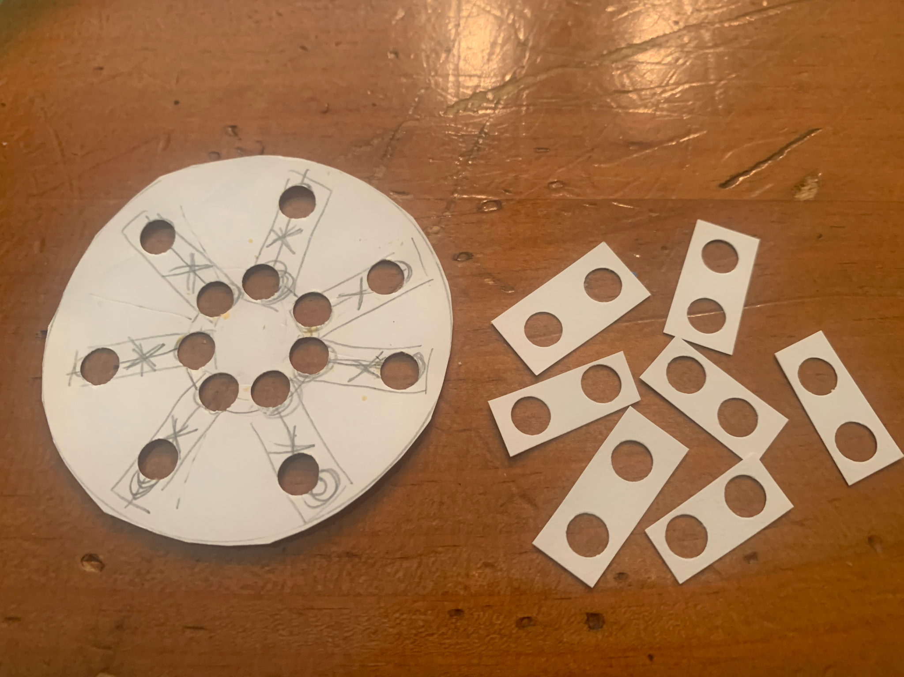
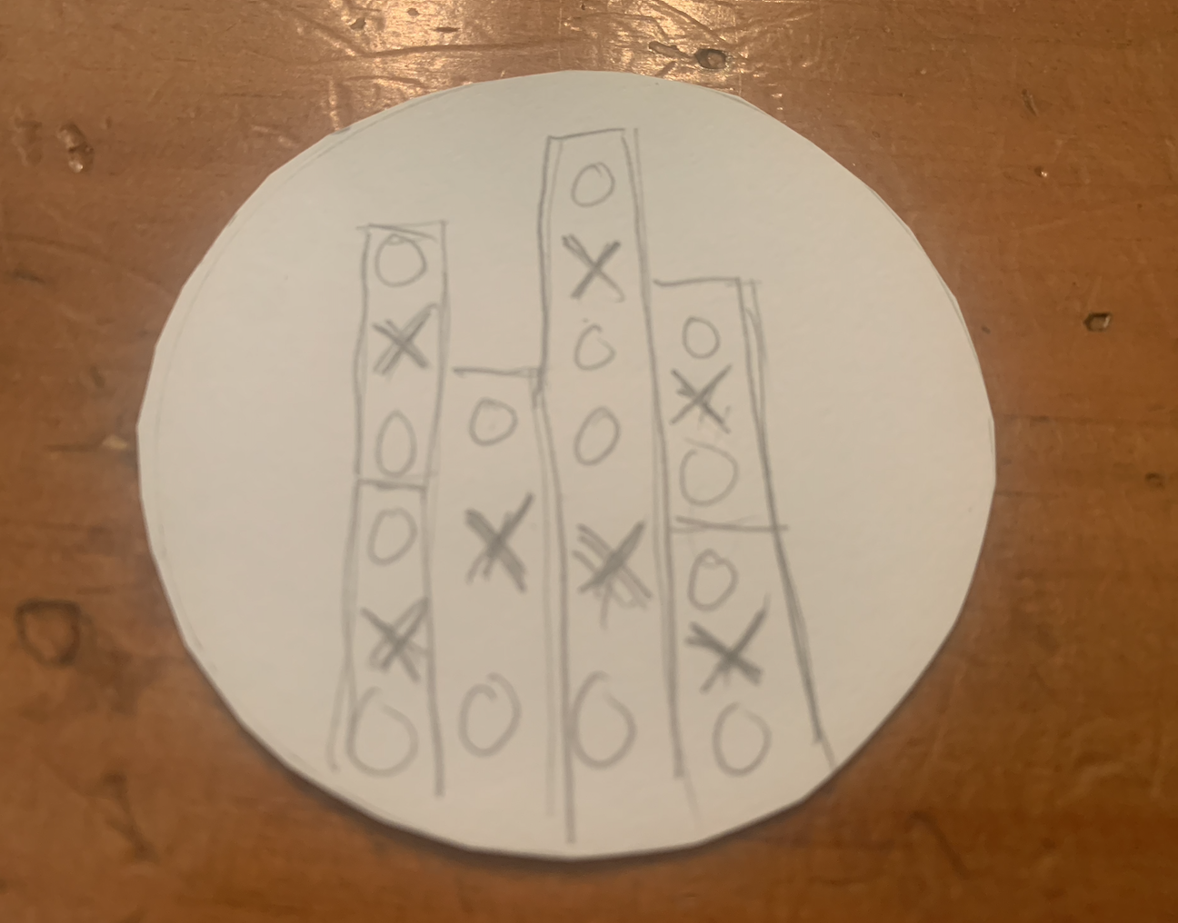
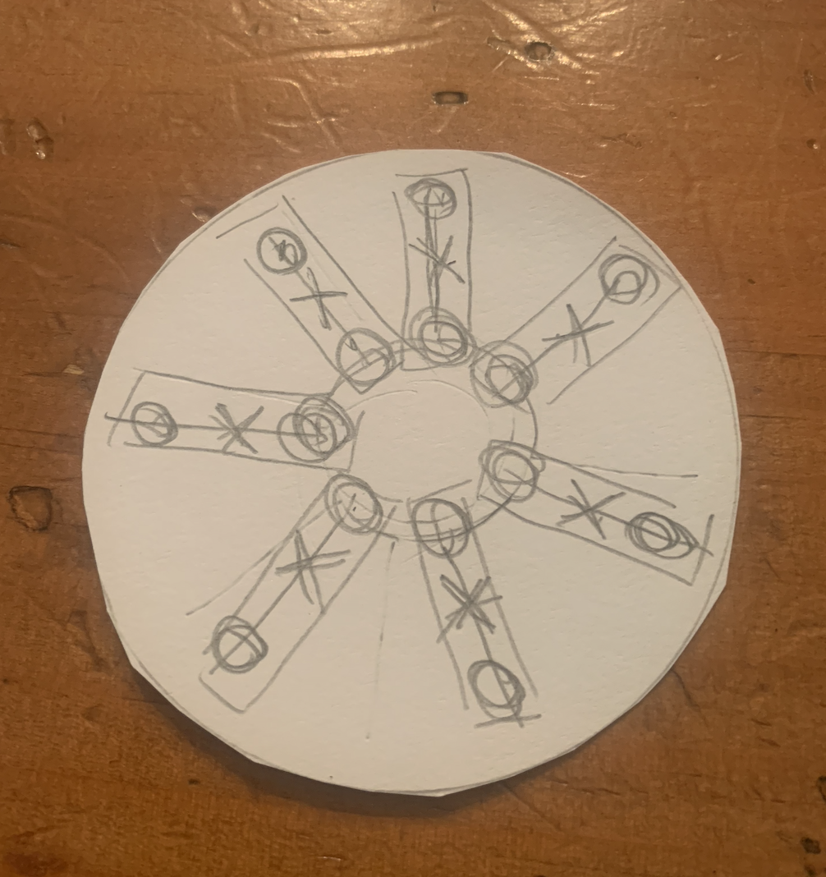
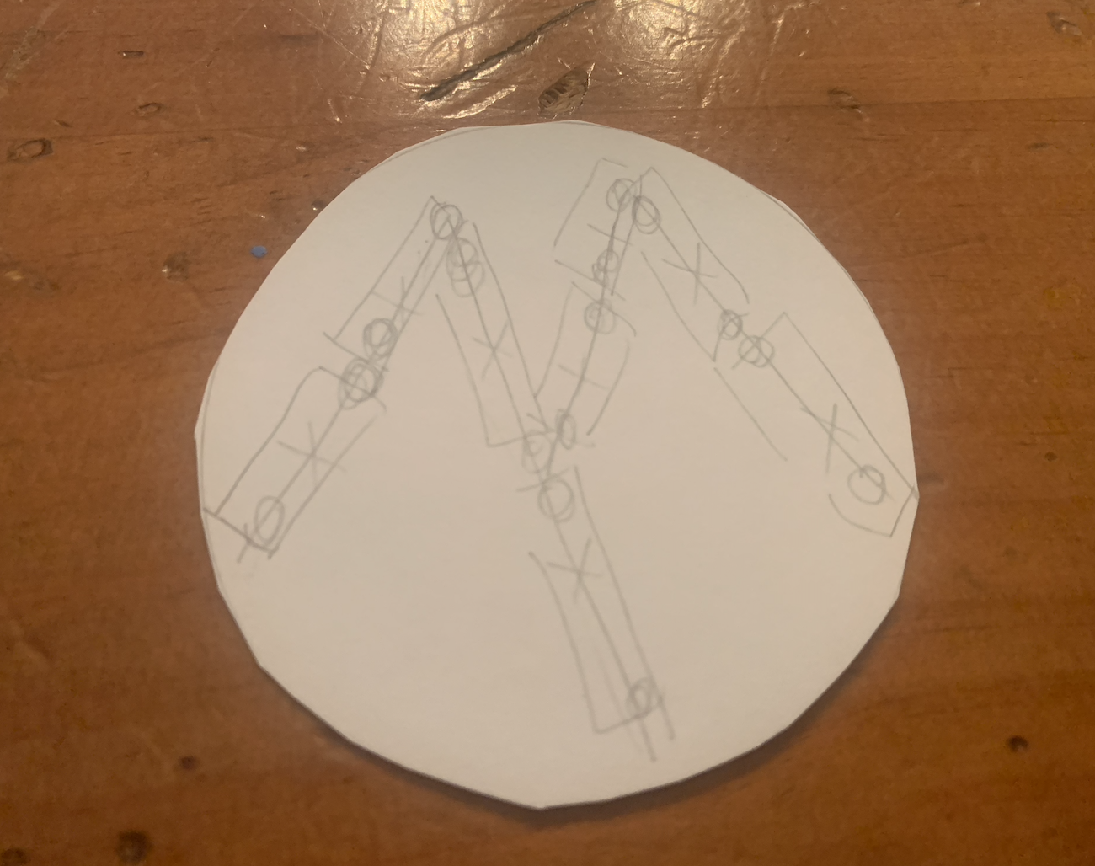
Challenge 2: Making a Mask
Create the “Mask” which is a stencil of the circuit design. As the Integrated Circuit (IC) Designer, you need to create what is called a “Mask”. The circuit design is turned into a mask (or stencil). In honor of “Chip Art” we will turn our chip layout into art. Two constraints:
Must have a minimum of 6 “chips” (A single chip is two hole punches for the LED legs- see image of the six chips to the right)
Must have a recognisable image (see image is the “sun”). Consider these other samples (mountain and city skyline) or letters and numbers as well.

Slide 12
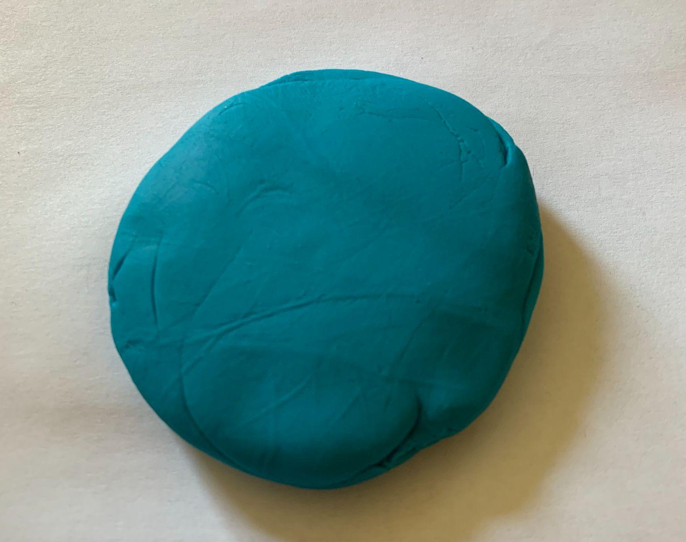
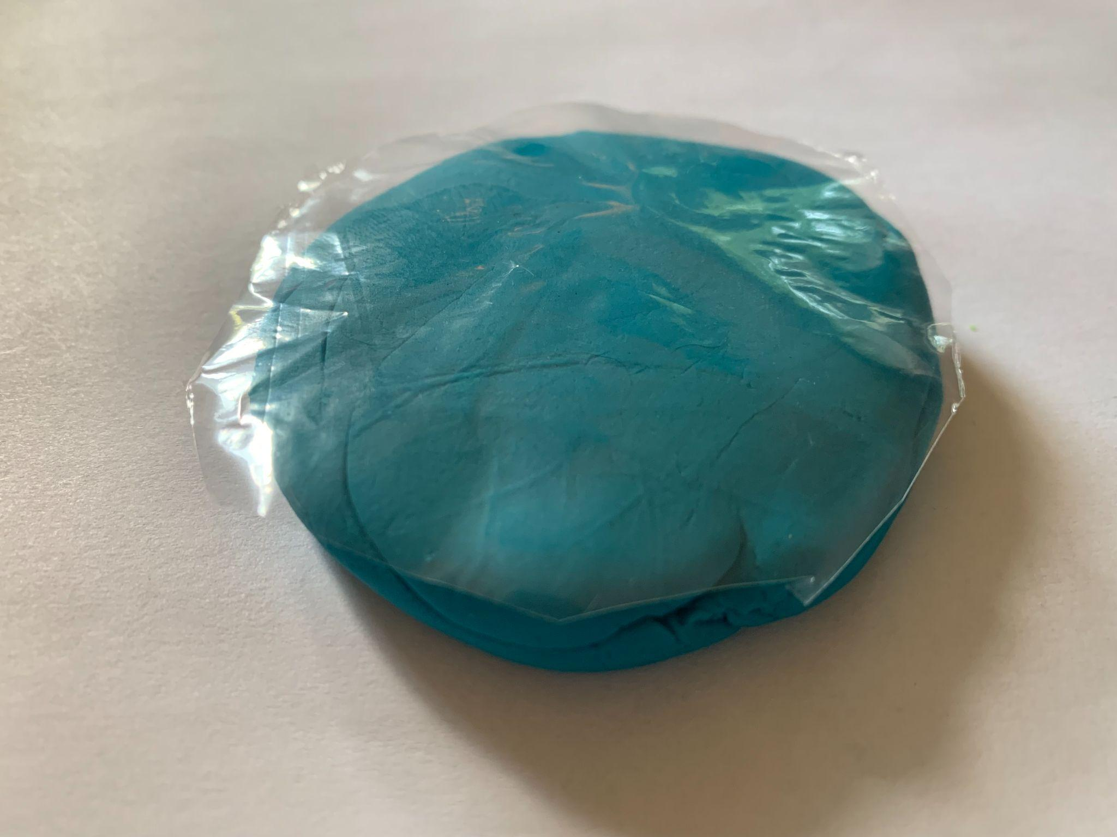
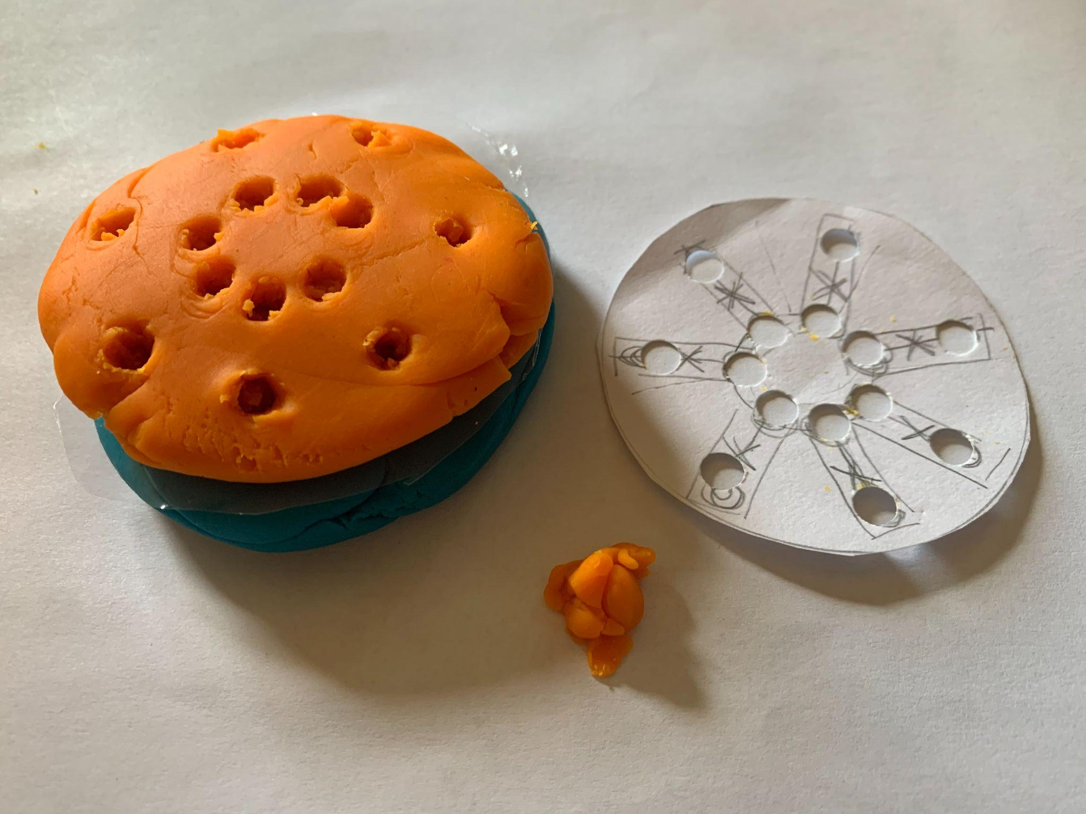
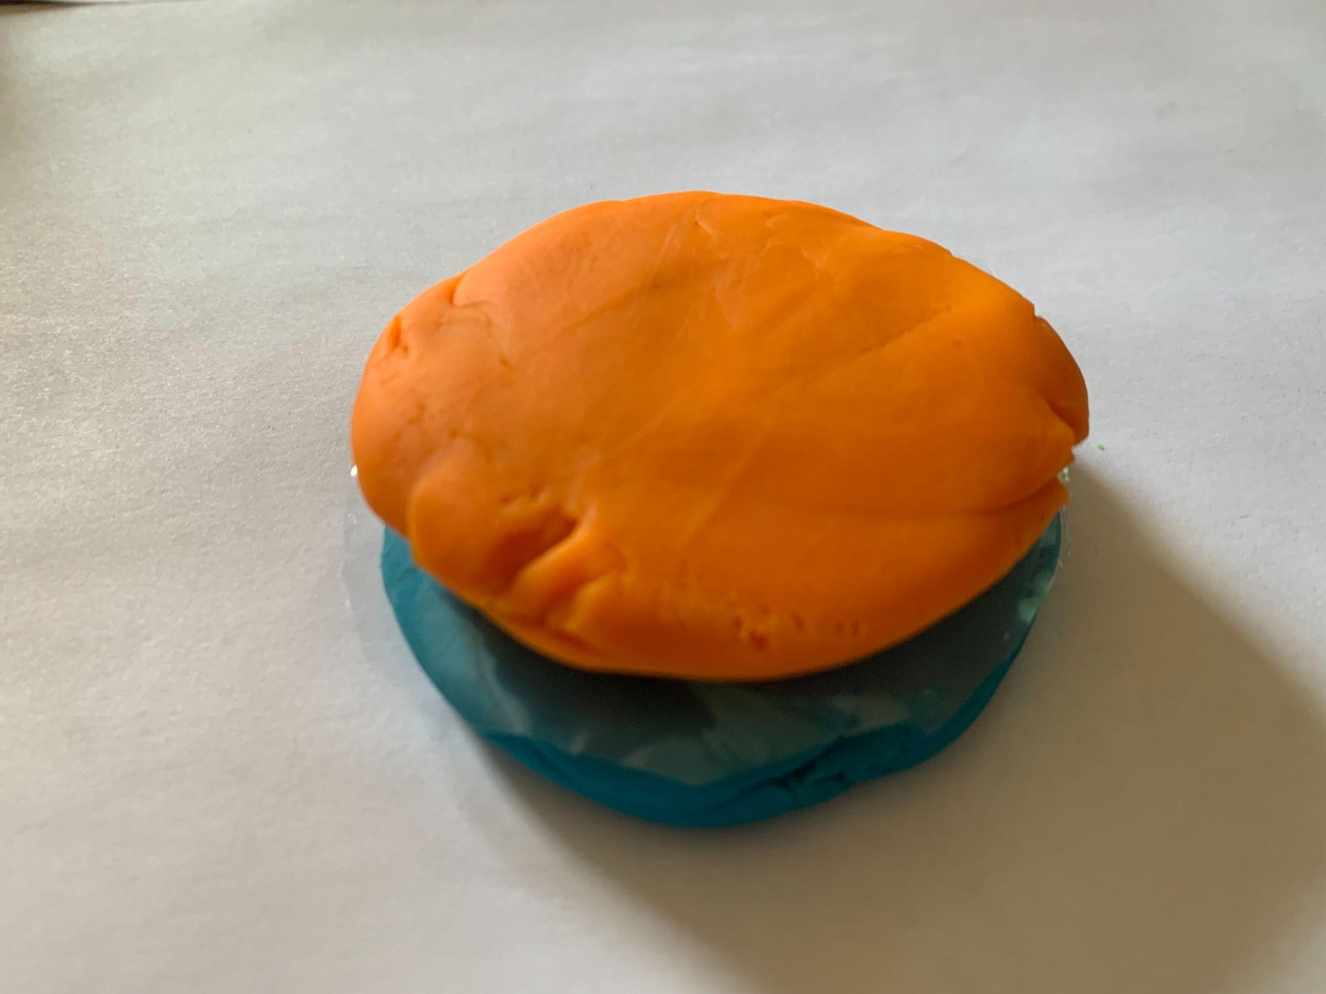
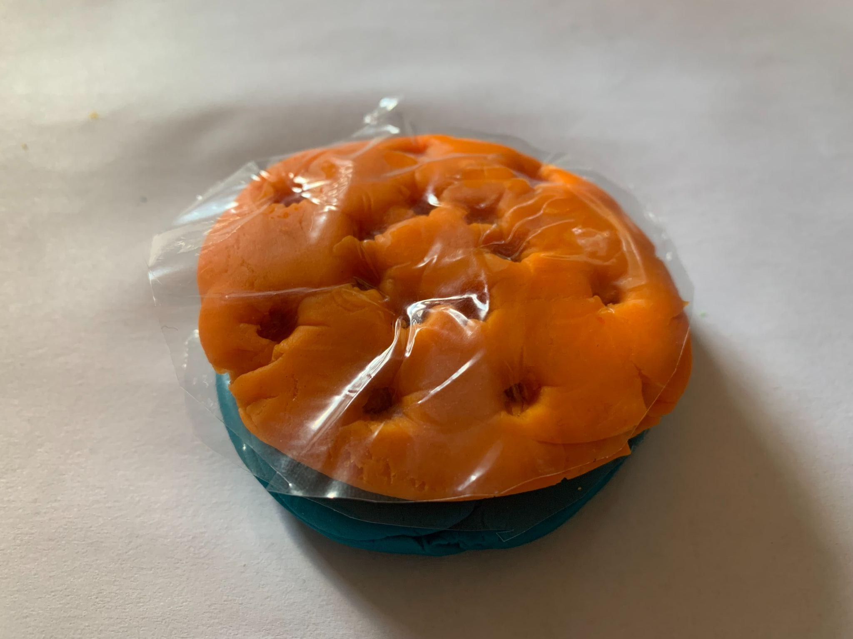
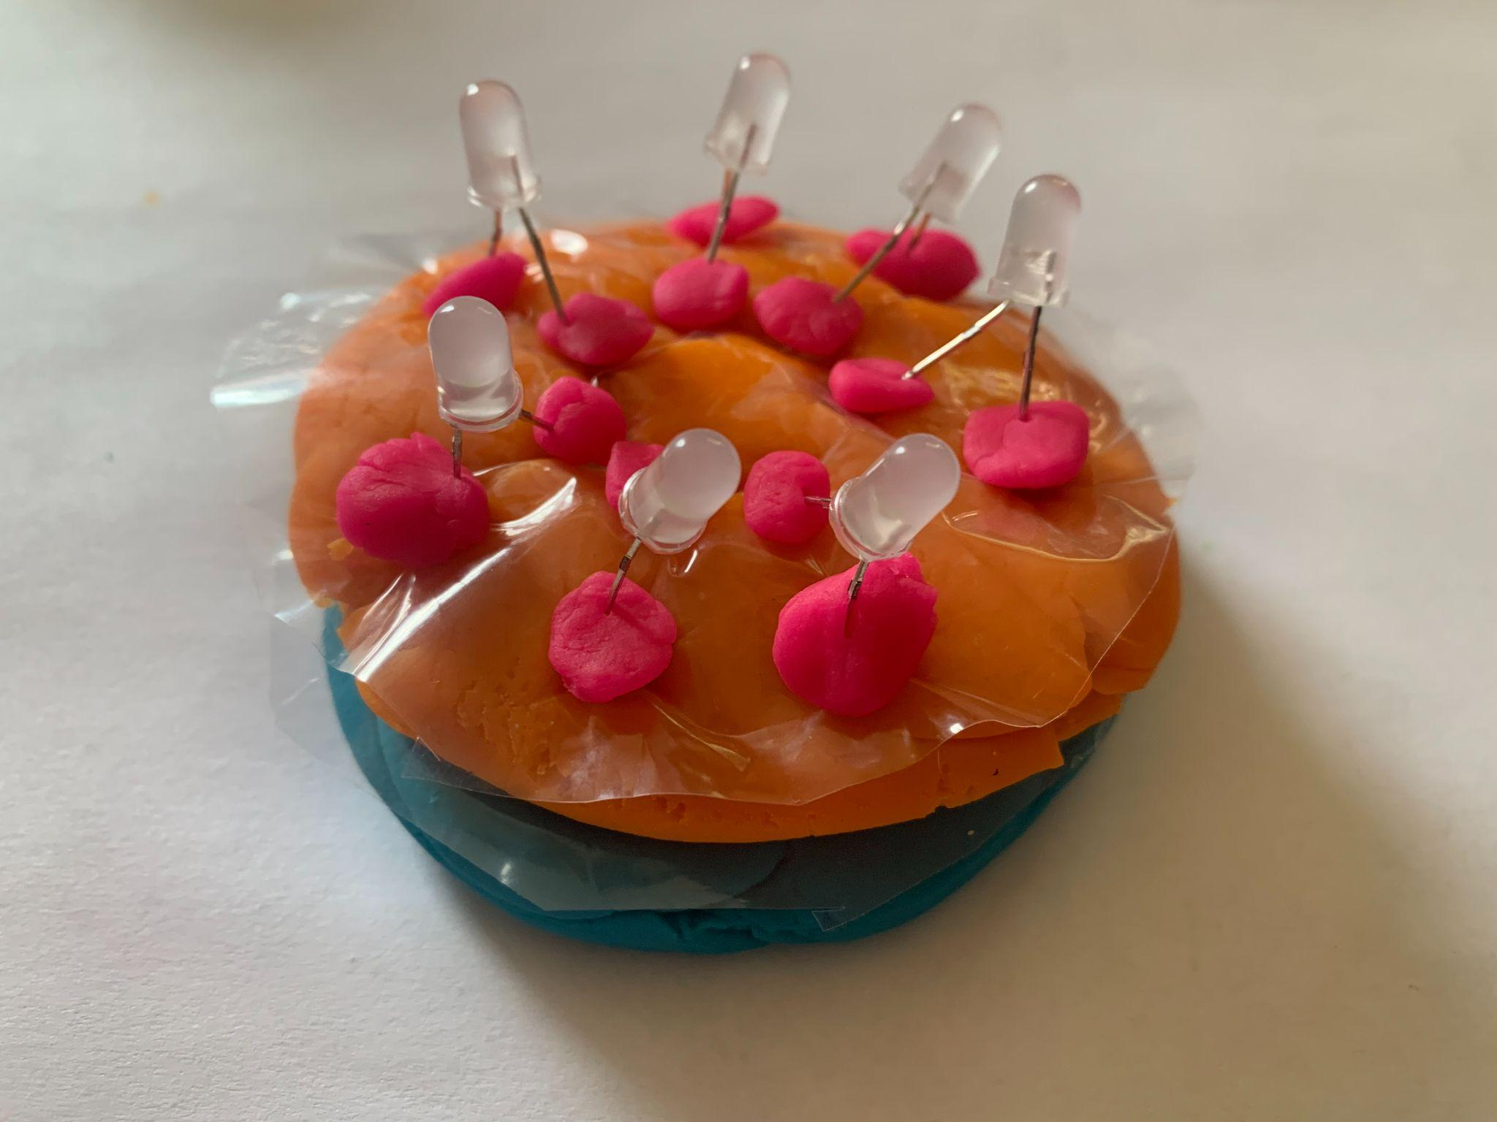
Challenge 3: Making a Microchip
Take on the role of semiconductor engineers working in a foundry or “Fab” (short for Fabrication Facilities) where you make microchips in a clean lab. Explore how a chip is made by making your own model with PlayDoh!
While we don’t have a clean room here, we can learn what happens in ‘fab’ by using a few fun materials like PlayDoh - with some real semiconductors mixed in - to stand in for our silicon, masks and tools in the real fab.
Notes:
Watch video 2 and 3

Slide 13
What’s Next
What as the yield for you chip?
How do you keep your microchip safe?
How do the chips work together?
How do you know it all works?
Notes:
Yield. How many chips can you get out of your wafer? Typically a wafer with approximately a 12 inch diameter can yield 300-400 chips, depending on the amount of space between them.
Packaging: Microchips need to be kept safe, just as you would protect a delicate sculpture with bubble wrap. This protection is provided by electronic packaging, which acts like this bubble wrap, safeguarding the chip from damage and ensuring it stays connected to the device’s main board, known as the printed circuit board (PCB).
Assembly of chips into a gadget: Electronic assembly is akin to crafting an intricate puzzle. Each chip, once encased in its protective packaging, must find its precise place within the gadget, much like each puzzle piece fits into a specific spot. In factories, skilled workers or advanced robots position the chips accurately. After placement, these chips must communicate, achieved through delicate wires or soldering, akin to the puzzle pieces interlocking firmly.
Testing: The final stage is rigorous testing, ensuring the gadget functions seamlessly, similar to the satisfying snap of the last puzzle piece fitting perfectly into place.

Slide 14
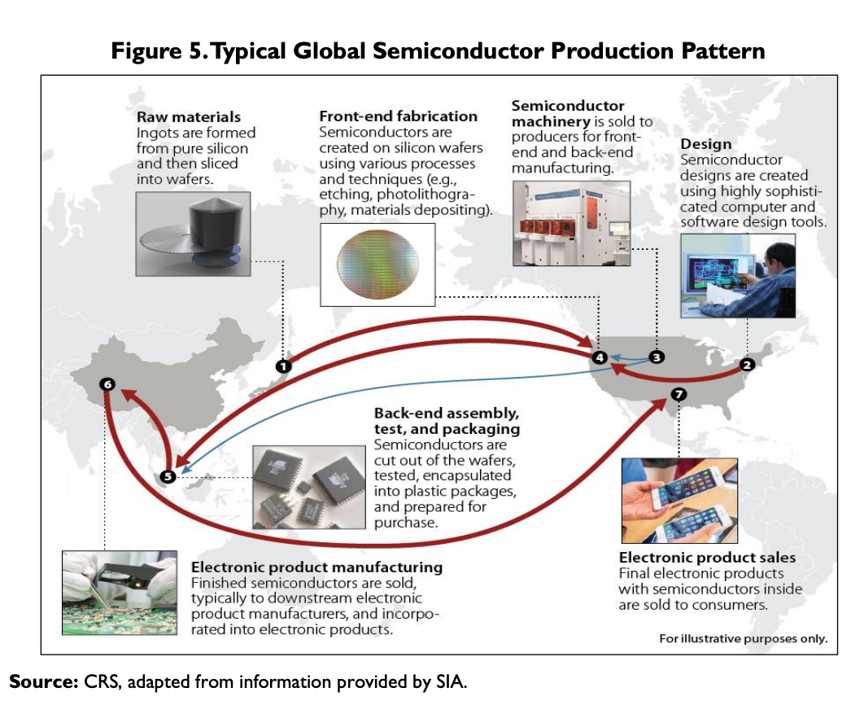
Supply Chain
Supply chains are like intricate webs connecting factories, warehouses, trucks, ships, and stores. They ensure that products—whether it’s the latest smartphone, a trendy fashion item, or a beloved toy—reach us efficiently. But what happens when this delicate balance is disrupted? Let’s explore some common causes…

Slide 15
Supply Chain Disruptions
Natural Disasters
Transportation Delays
Global Demand Surges
Labor Shortages
Geopolitical Tensions
Supplier Woes
Just-in-Time Inventory
In the end, supply chains are complex systems, akin to a well-choreographed dance amidst chaos. Each disruption sends ripples that touch our lives. As you unbox a new gadget or toy, think of the intricate journey it took to reach you. It’s a testament to the steadfast dedication of those who maintain the flow of goods, despite the challenges of nature and circumstance.

Slide 16
Science Fiction Saga
As a class let's write a short story about a particular supply chain disruption and how it impacted the world. We will be crafting the story as a collective effort.
Each team picks out 3 words. They must use one word in their sentence and they get 3 turns.
Read Sample Story

Slide 17
Tips and Tricks

Slide 18
Failure is part of the process
If your chip has LEDs that work, don’t worry, we expect that. Engineers fail and they try again and again. So troubleshoot and then redesign until you get your best solution. Failure is part of the process! Have fun!
Ready, Set, Let’s Engineer!

Slide 19
Helpful Hints
Polarity: Both the LED and coin cell battery have a Positive and Negative end. Notice the positive leg of the LED must connect with the positive side of the coin cell battery and same for the negative side.
Shorting a circuit: Be mindful to not to short your circuit during our electric dough challenge.
Etching: Make sure you make the hole fairly deep
Deposition, Vias, Doping: In regard to deposition, you will need the sandwich bag circle to be larger in diameter than our wafer. Pushing the blanket down into the etched out holes can be hard. Start on one side, pushing down with the top of the LED and then flattening, Slowly working your your way across your chip. Adding the vias into the holes requires some dexterity - we suggest using the tweezers to place small clumps of clay in the holes (patting down and adding more as needed)
Adding the LEDs to the wafer: Make sure you cut the legs of the LEDs (keep one longer and one shorter). The low depth of the Vias will make it necessary to have LEDs shorter so they do not tip over.

Slide 20
Reflect & Debrief

Slide 21
Reflection
How does the Play-Doh microchip model you made of a you made compare to an actual microchip? Did making the model help you better understand the making of a microchip?
What steps in the microchip making process do you still feel you don’t understand as well as you would like?
What challenges did you run into in creating your model What other tools or materials might have helped you?

Slide 22
Engineering Design Process

Slide 23
The Engineering Design Process
Learn about the engineering design process (EDP). The process engineers use to solve problems. (Video 1:47)
Source: TeachEngineering YouTube Channel http://www.youtube.com/watch?v=b0ISWaNoz-c

Slide 24
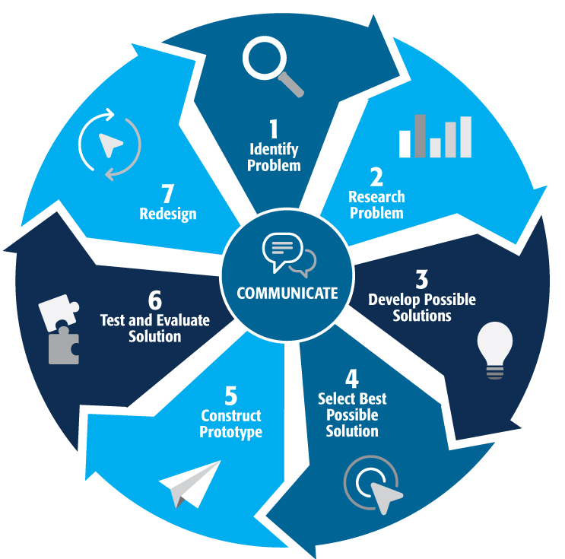
Engineering Design Process
Divide into teams of two (or up to 4 max)
Review the challenge and criteria & constraints
Brainstorm possible solutions (sketch while you brainstorm!)
Choose best solution and build a prototype
Test then redesign until solution is optimized
Reflect as a team and debrief as a class
Notes:
Material bags for teams to build…

Slide 25
Productive Failure
The engineering design process involves productive failure: test, fail, redesign. Iterate again and again until you have the best possible solution.
It is important to document iterations to keep track of each redesign. Use the engineering notebook to sketch ideas, document iterations and any measurement and/or calculations.
It’s also important to showcase the fact that there can be multiple solutions to the same problem. There’s no one “right” solution.

Slide 26
Vocabulary

Slide 27
Vocabulary
Conductor- Material that allows electricity to pass through it, like a metal (copper, gold and silver for example).
Insulator- Material that doesn't allow electricity to pass through it, like rubber, glass and plastic for example.
Semiconductor- is a special material that is both conductor and insulator of electricity! Sometimes it conducts, sometimes it doesn’t. Silicon and gallium are examples of semiconductor materials.
Ingot- Silicon is mined and then made into an ingot. Silicon is melted, tiny amounts of other elements are added to make it a particular type of silicon. A rod is dipped into the molten silicon and when it is pulled out the silicon cools and solidifies making the shiny cylindrical stick of silicon. The ingot is then sliced into thin “wafers”
Wafer- is a thin slice of semiconductor material used to make microchips that is cut from an Ingot.
Microchip (also known as: semiconductor chip, semi, and chip)- is an integrated circuit (IC) that is etched on the wafers.

Slide 28
Vocabulary
Integrated circuit (or microchip) - is a small computer containing tiny switches that perform arithmetic and logic operations and provide temporary memory storage.
Printed circuit board (PCB). A PCB is a special board that connects all the electronic parts in your gadgets without using messy wires. It’s like a map of a city: the streets are like thin metal lines on the board called traces, and the houses are like the parts that do different jobs, like making sounds or showing pictures. And just like the chip - its made of many layers!
Transistor- is a tiny switch that perform arithmetic and logic operations and provide temporary memory storage
Nanoscale- Nanoscale is incredibly small – a billion times smaller than what we can see with our eyes. (For example, chips are made on a nanoscale). There are billions of transistors on a microchip.
Moore’s Law-is like a growth spurt for computers! Gordon Moore, the co-founder of Fairchild Semiconductor and Intel, predicted, in 1975, that the number of transistors (tiny switches) on a microchip would double about every two years.
Foundry or “Fab” (short for Fabrication Facilities) - is where you make microchips.
Clean Lab- in a clean lab, everything is ultra-clean. Even a speck of dust can mess up the chips! That speck of dust can interfere with the conductive network on a chip. It’s a high-tech space where cleanliness is king!

Slide 29
Vocabulary
Manufacturing Process of Making a Microchip:
Clean & Polish- The wafer is cleaned and polished.
Photoresist Coating- After preparing the wafer, its surface is coated with a photoresist, a light-sensitive material as part of the “photolithography” process.
Photo Mask- The circuit design is turned into a mask (or stencil). To make the mask, the circuit design is drawn (or stamped) on the mask material and then and then cut out leaving the mask or stencil of the “negative of the circuit.” Light then transfers the circuit (imprinted) onto the wafer,exposing the parts that should be removed in the next step. We call this step of making the mask ‘tapeout’ since masks used to be made with tape.
Etching- Etching is the process of removing unwanted material to create the features of the chip by using chemicals that eat away the wafer's exposed areas, leaving behind the desired pattern. It also removes the underlying layers of silicon and other materials in the pattern of the circuit design.
Deposition- involves adding a blanket of conducting or non-conducting materials depending on the desired properties of the final product.

Slide 30
Vocabulary
Doping- is the process of changing the properties of silicon in the wafer to create different components of the chip. This is done by introducing impurities into the silicon, which changes its conductivity. The type and amount of impurities determine whether the silicon becomes n-type, which has an excess of electrons, or p-type, which has a shortage of electrons. These are made with big machines called ion implanters, and where n and p meet (a PN junction), makes the basis of a transistor!
Vias- Vias are little wires that let us go from one layer to another - like an elevator for the circuit, we go from one layer to another 'via' the via!
Quality Control- Quality Control Engineers test the chips to ensure they will actually work. This technology can be delicate and even damage not visible to the human eye can hinder its function. Therefore, clean rooms are essential to keep out any impurities and maximize the number of chips a wafer creates.

Slide 31
Vocabulary
Chip Art- Chip art, also known as silicon art, semiconductor art, silicon wafer art or chip graffiti refers to microscopic hidden doodles (designs, images, or messages) incorporated onto microchips during the manufacturing process.
Supply Chain- is an intricate wes connecting factories, warehouses, trucks, ships, and stores. They ensure that products reach us efficiently.
Short Circuit- When wires that are not supposed to come in contact with each other touch (overlap in someway)
Parallel Circuit- Allows multiple paths for electricity (current) to flow through
Series Circuit- Allows one path for electricity (current) to flow through
Resistance- In electrical circuits, resistance is like a “crowd” that makes it tougher for electric charges (like tiny electrons) to move around. Insulators have resistance and the more insulating a material, the more resistance it has.

Slide 32
Background Knowledge

Slide 33
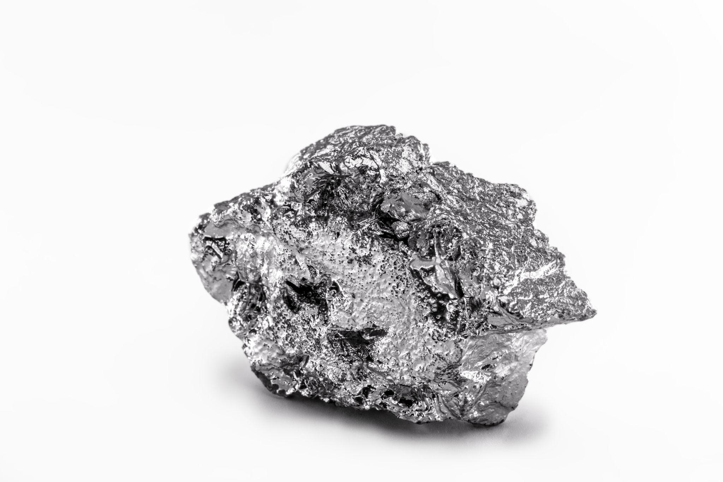
What is a Semiconductor?
First let’s answer, What is a conductor? It is a material that is good at conducting electricity, like metal. There are also insulators - materials that can’t conduct electricity, like rubber. It is a material like a metal (like copper), that is good at conducting electricity and it is also a insulator (can’t conduct, like rubber). A semiconductor is a unique material that can be made to do both! Sometimes it conducts, sometimes it doesn’t. It can be used in things like computers and phones to make tiny switches called transistors.
Silicon is the most common semiconductor. It’s like the superhero of electronics! By adding different atoms to silicon, we can change its behavior. We create two types of semiconductors: n-type (which has extra electrons) and p-type (which has “holes” where electrons can move around). Other semiconductor materials are being used as well like germanium or compounds such as gallium arsenide. They are just right for creating electronic magic!

Slide 34
Why are Semiconductors Important?
They’re the building blocks of modern electronics! Think of transistors (tiny switches) that control everything in your computer, phone, and other gadgets. Without semiconductors, we wouldn’t have these amazing devices. So, remember: Semiconductors are like the “Goldilocks” of materials—they’re not too conductive, not too insulating, but just right for powering our tech!
Semiconductors are in almost everything now: computers, smartphones, cars, household appliances, gaming systems, and medical equipment. As a result, semiconductors are incredibly important for today’s economy, as they drive innovation and productivity in many industries.

Slide 35
Supply Chain
Supply chains are like intricate webs connecting factories, warehouses, trucks, ships, and stores. They ensure that products—whether it’s the latest smartphone, a trendy fashion item, or a beloved toy—reach us efficiently. But what happens when this delicate balance is disrupted? Let’s explore some common causes…

Slide 36
Supply Chain Disruptions
Natural Disasters
Transportation Delays
Global Demand Surges
Labor Shortages
Geopolitical Tensions
Supplier Woes
Just-in-Time Inventory
In the end, supply chains are complex systems, akin to a well-choreographed dance amidst chaos. Each disruption sends ripples that touch our lives. As you unbox a new gadget or toy, think of the intricate journey it took to reach you. It’s a testament to the steadfast dedication of those who maintain the flow of goods, despite the challenges of nature and circumstance.

Slide 37
Dig Deeper

Slide 38
Dig Deeper (Extension Activities)
Semiconductor Missions - See full mission descriptions
Welcome! Join us on this grand mission (made up of several smaller missions) as we learn more about the world of semiconductors. There are five missions to explore. They will challenge you to dig deeper into understanding semiconductors, semiconductor technology, supply chain and its impact on our world.
Mission (1) -- Materials Mission: Superhero of Electronics
Insulator & Conductor PhET Simulation
Semiconductors Types PhET Simulation
Mission (2) -- Design Mission: Art Infusion
Integrated Circuit Designer Certification -“Squishy Circuit”
Create the “Mask”

Slide 39
Dig Deeper (Extension Activities)
Mission (3) -- Nanoscale Mission: Morse’s Law
Graphing Moore’s Law
Predicting the Future
Mission (4) -- History Mission: Transistor Revolution
Debate on significance of transistor
Mission (5) -- Supply Chain Mission: Science Fiction Saga
Supply chain disruption team story
Word Collecting & Story Process: Upon the completion of each mission, teams collect interesting words needed for the final mission!

Slide 40
Engineering Fields

Slide 41
What is Engineering?
Learn about engineering and how engineers are creative problem solvers and innovators who work to make the world a better place.
(Video 3:43)
Source: TeachEngineering YouTube Channel - http://www.youtube.com/watch?v=H9VDkvgGmVo

Slide 42
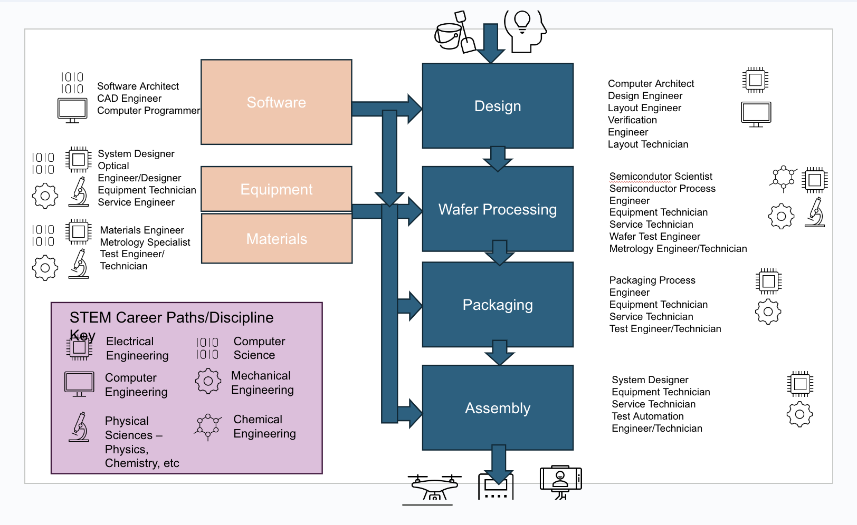
Careers in the Semiconductor Industry
There are so many diverse careers in the semiconductor industry! Review the graphic of semiconductor careers and engineering disciplines. Many engineers have the skills and knowledge to perform multiple functions.
Electrical Engineering
Computer Engineering
Computer Science
Mechanical Engineering
Chemical Engineering

Slide 43
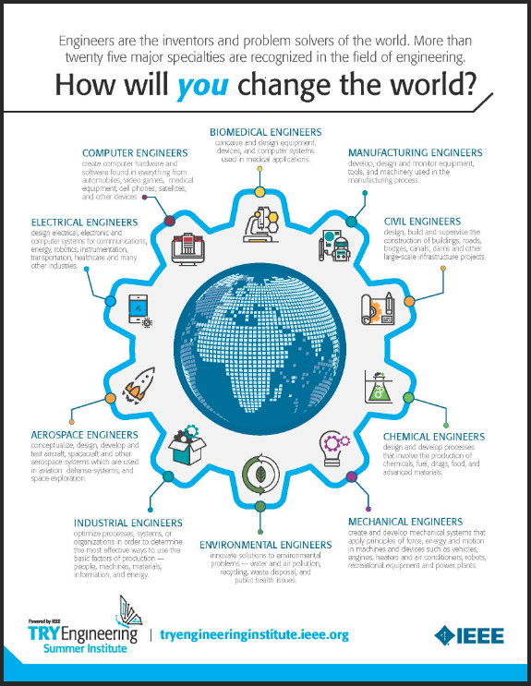
How will you change the world?
Download the Engineering Fields Infographic. How will YOU change the world? Engineers are the inventors and problem solvers of the world! More than twenty five major specialties are recognized in the field of engineering. Engineers make the world a better place!

Slide 44
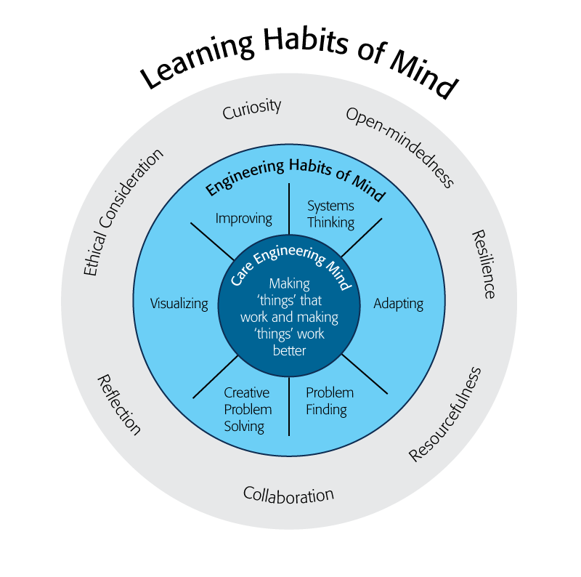
Engineering Habits of Mind
Engineering Habits of Mind (EHM) is about how engineers think everyday. The Core Engineering Mind is about making things that work and making them work better.
Source: https://online-journals.org/index.php/i-jep/article/view/5366)
Notes:
Consider if your lesson address these EHM and how much emphasis it place on each of the EHM. Emphasize the EHM by using the EHM langage when you can.Systems thinking: Seeing whole systems and parts and how they connect.
Problem-finding: identifying and defining a problem.
Visualising: manipulating materials and sketching. Mental rehearsal of practical design solutions
Improving: Persistently trying to make things better by experimenting, designing, sketching, and prototyping
Creative problem-solving: generating ideas and solutions with others with many iterations.
Adapting: Testing, analysing, reflecting, & rethinking
Source: B. Lucas and J. Hanson, Thinking Like an Engineer: Using Engineering Habits of Mind and Signature Pedagogies to Redesign Engineering Education. (International Journal of Engineering Pedagogy, Vol 6, No. 2 (2016): https://online-journals.org/index.php/i-jep/article/view/5366)
More resources on Habits of Mind can be found here: https://www.stem.org.uk/resources/community/collection/424831/engineering-habits-mind-primary
Bill Lucas and Janet Hanson from The Center for Real World Learning at the University of Winchester, UK wrote the paper, Thinking Like an Engineer: Using Engineering Habits of Mind and Signature Pedagogies to Redesign Engineering Education. In the paper, they “ identified the six most distinctive learning dispositions, or engineering “habits of mind” [EHoM] that engineers frequently deploy.”
Maybe add in Checklist here???

Slide 45
Engineering Habits of Mind Checklist
Systems thinking
Problem-finding
Visualising
Improving
Creative problem-solving
Adapting
Notes:
Systems thinking: seeing whole systems and parts and how they connect
Problem-finding: identifying and defining a problem
Visualising: manipulating materials and sketching
Improving: persistently trying to make things better by experimenting
Creative problem-solving: generating ideas with many iterations
Adapting: testing, analysing, reflecting & rethinking
More resources on Habits of Mind can be found here: https://www.stem.org.uk/resources/community/collection/424831/engineering-habits-mind-primary
Bill Lucas and Janet Hanson from The Center for Real World Learning at the University of Winchester, UK wrote the paper, Thinking Like an Engineer: Using Engineering Habits of Mind and Signature Pedagogies to Redesign Engineering Education. In the paper, they “ identified the six most distinctive learning dispositions, or engineering “habits of mind” [EHoM] that engineers frequently deploy.”

Slide 46
Learning Habits of Mind Checklist
Open-mindedness
Resilience
Resourcefulness
Collaboration
Reflection
Ethical Consideration
Curiosity
Notes:
More resources on Habits of Mind can be found here: https://www.stem.org.uk/resources/community/collection/424831/engineering-habits-mind-primary
Bill Lucas and Janet Hanson from The Center for Real World Learning at the University of Winchester, UK wrote the paper, Thinking Like an Engineer: Using Engineering Habits of Mind and Signature Pedagogies to Redesign Engineering Education. In the paper, they “ identified the six most distinctive learning dispositions, or engineering “habits of mind” [EHoM] that engineers frequently deploy.”

Slide 47
Greatest Engineering Achievements of the 20th Century
Source: http://www.greatachievements.org/

Slide 48
Learn more about how engineers make the world a better place

Slide 49
For more engineering lesson plans and resources like games, engineering careers, and STEM opportunities visit IEEE’s TryEngineering.org

