Slide 1
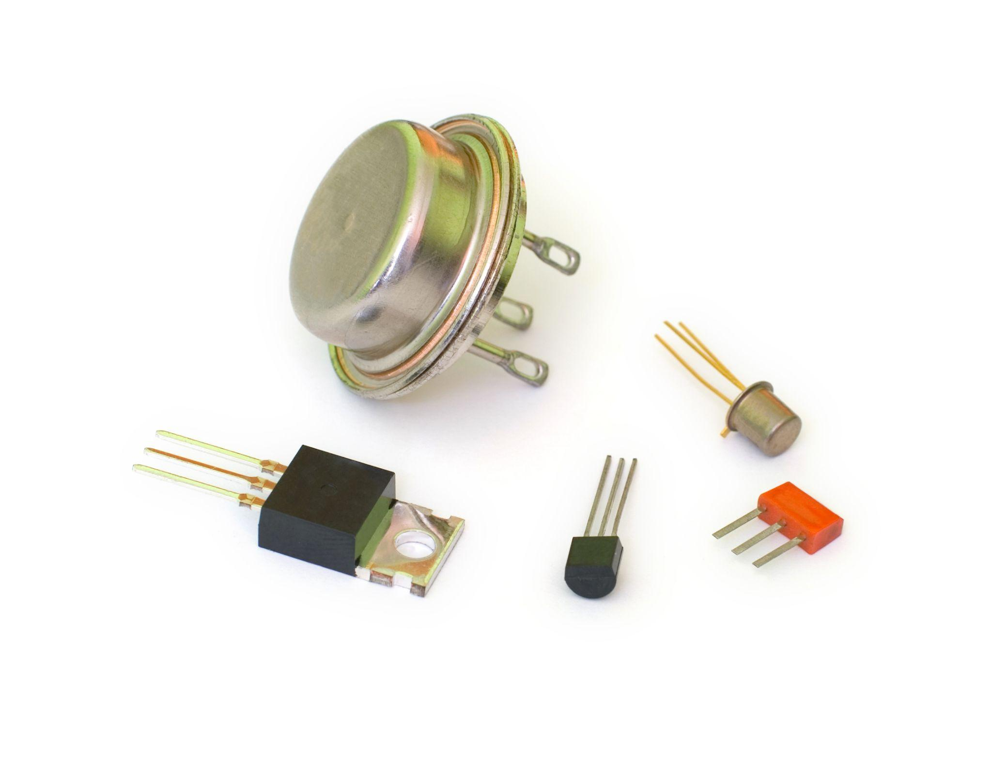
Keysight Lesson Transistor Power: Night Light Challenge

Slide 2
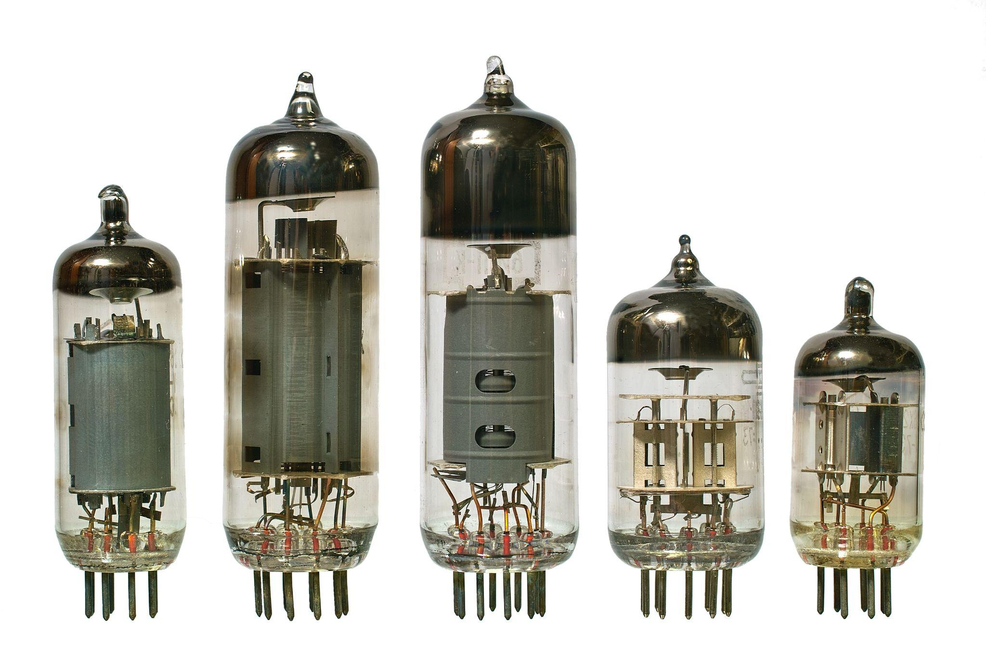
What are these and how are they connected?

Slide 3
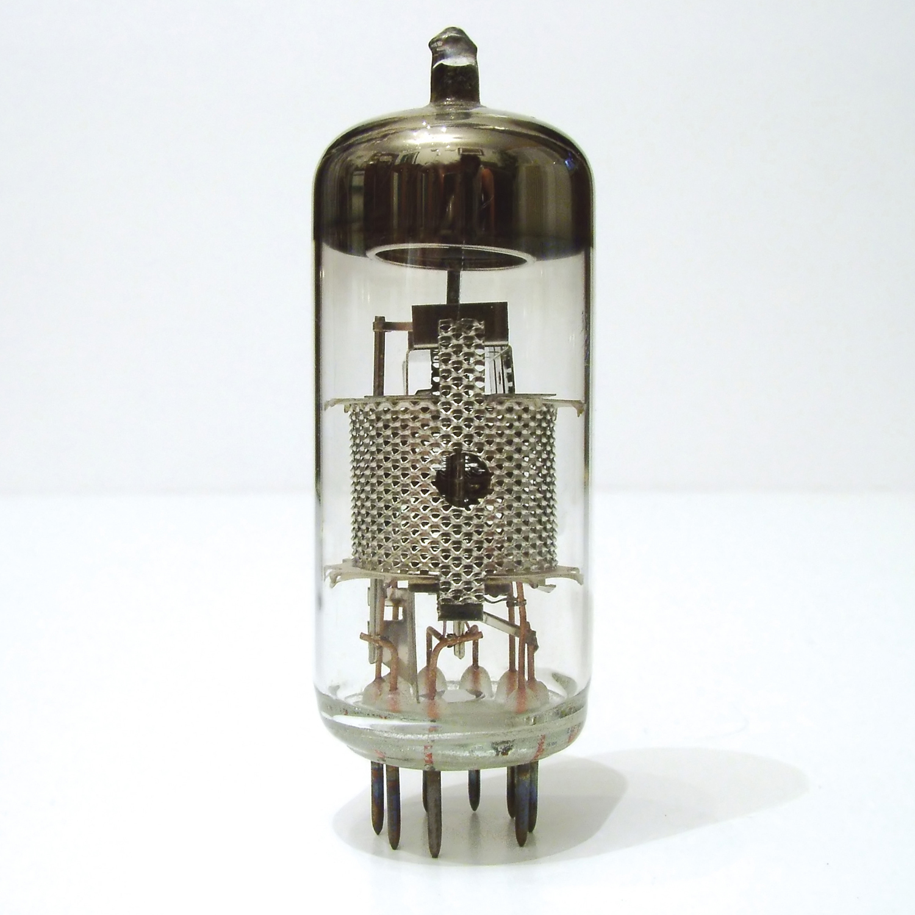
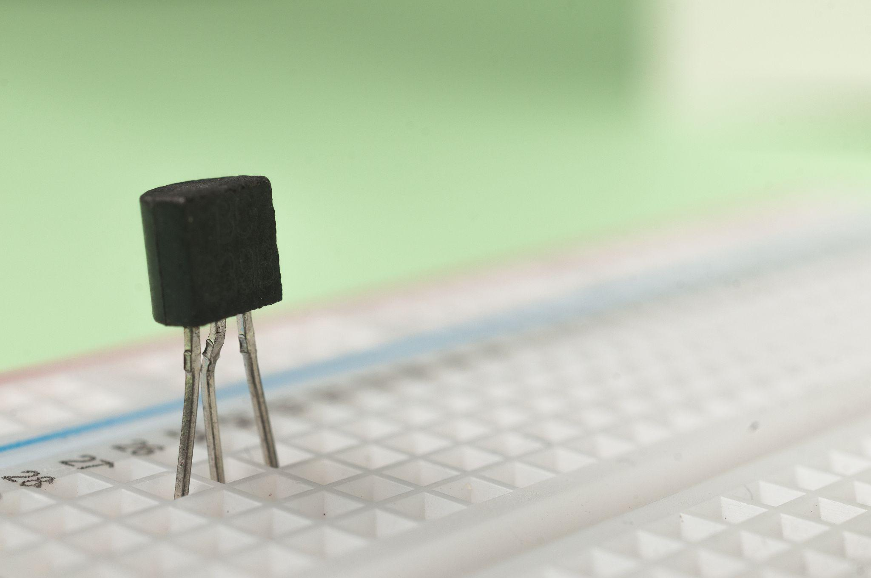
Vacuum Tube to Transistor
In 1947, scientists at Bell Labs invented the transistor, a tiny electronic component made from semiconductors.
Transistors replaced bulky vacuum tubes (used in radios and telephones) and revolutionized electronics. They’re the building blocks of modern devices like computers, phones, and televisions.

Slide 4
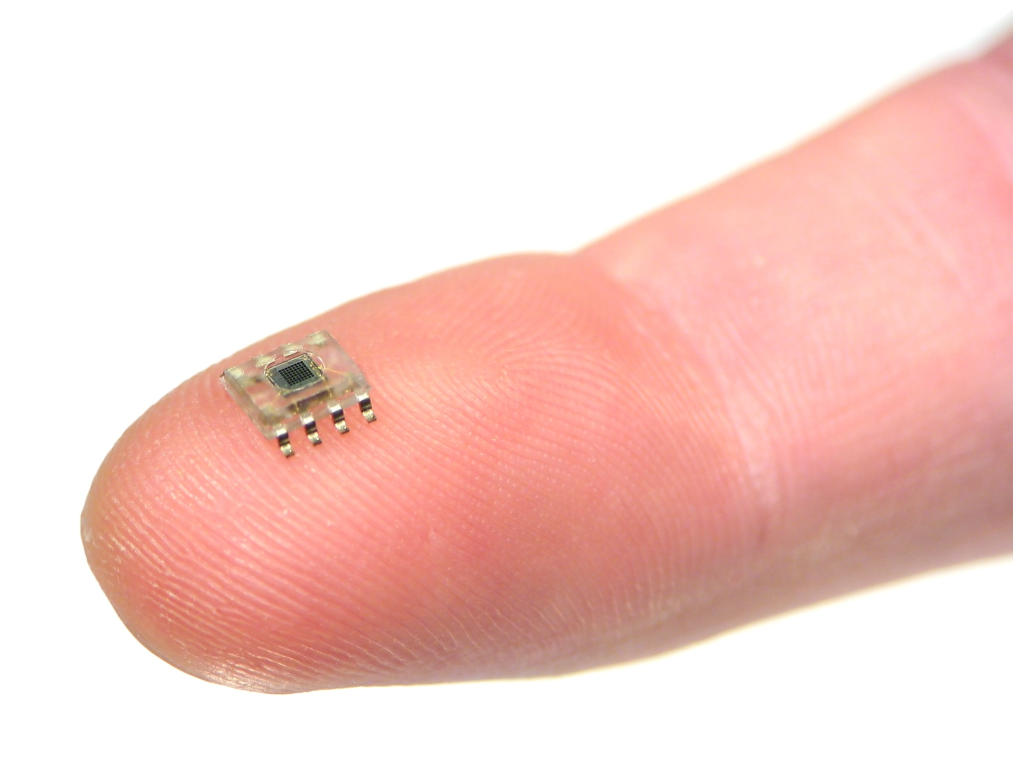
Transistor to Microchip
In the early 1960s, the invention of the integrated circuit (commonly known as a microchip) extended the capabilities of the single transistor. To compile an integrated circuit, many transistors are manufactured at once and permanently connected within a single silicon chip.
In the past 50 years, the number of transistors on a chip has grown to more than one-million on a single chip. These chips are on a nanoscale.
Even smaller than this! Nanoscale is incredibly small – a billion times smaller than what we can see with our eyes!

Slide 5
Essential Question: Why the Transistor?

Slide 6
Why the Transistor?
How has the transistor changed our world?
Has is changed our world for good?
Where do we use transistors today?
What is the future of the transistors?

Slide 7
The Design Challenge

Slide 8
The Design Challenge
Design and construct a functioning night light. When the light goes out in your room your night light goes on. Students design both the circuit and the housing.
Criteria & Constraints
Use simulation tool (Tinkercad Circuit) to iterate on circuit design
Transistor & photoresistor must be included in the circuit
Housing for the night light must include only the material provided
Notes:
DESIGN CHALLENGE:
Design and construct a functioning night light. When the light goes out in your room your night light goes on. Students design both the circuit and the housing.
Criteria & Constraints
Use simulation tool (Tinkercad Circuit) to iterate on circuit design
Transistor & photoresistor must be included in the circuit
Housing for the night light must include only the material provided

Slide 9
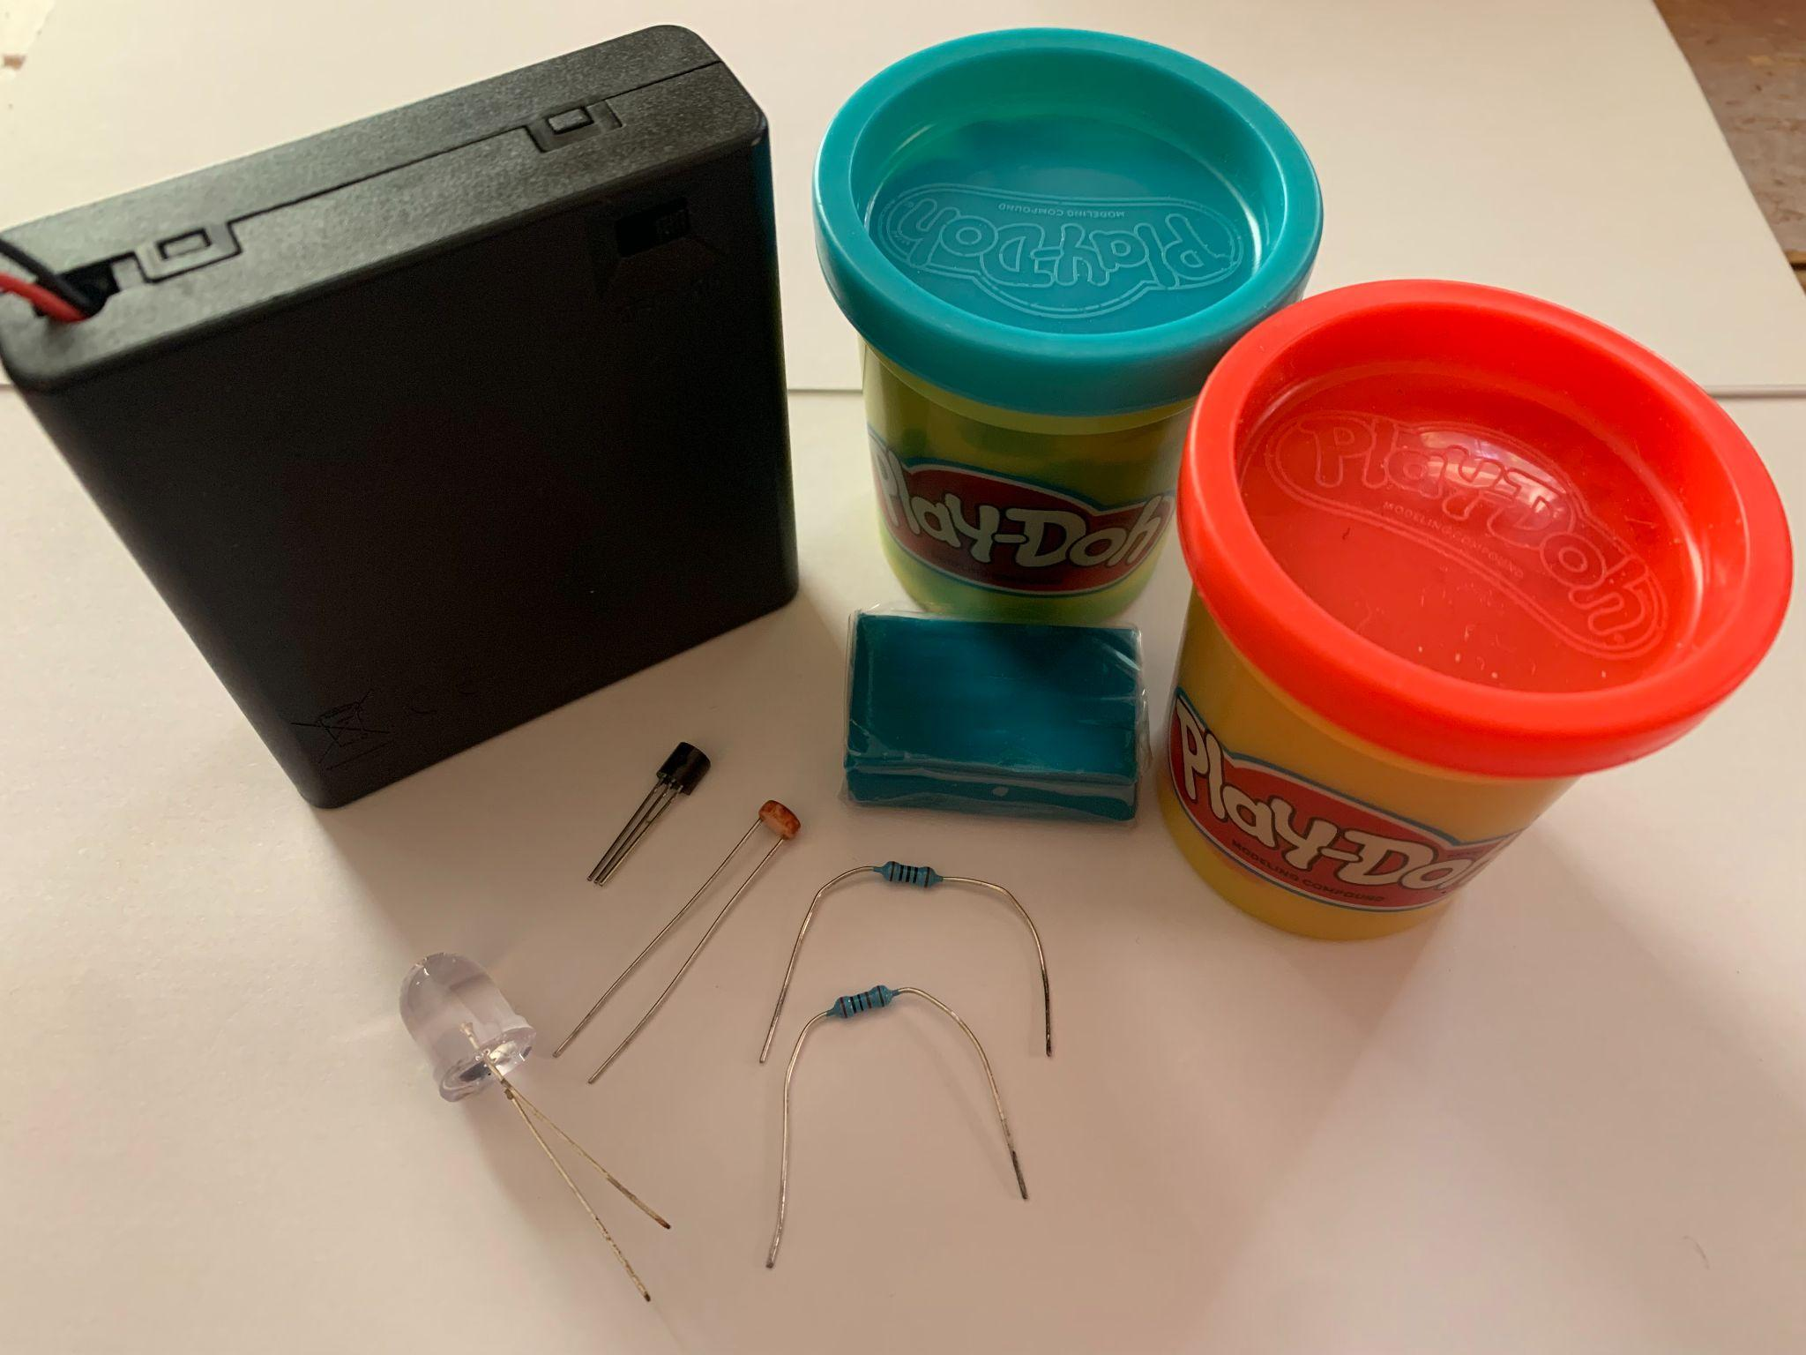
Materials
Tinkercad Circuits & Computers
LEDs (10 mm or 5 mm) - any colors
Photoresistor
Transistor (NPN)- We used PN2222
Resistors: 2K Ohm resistor and 100 Ohm resistor (you can play with others as well)
AA Batteries (4 per team) & Holder
PlayDough (conductive material) & Clay (non-conductive)- optional
Table of Possibilities: Creative items are for creating the night light. (pipe cleaners, cups, cardboard, cardstock colored paper, googly eyes, feathers, binder clips, paper clips, tape/glue, scissors, markers, etc). Also play with:
Paper circuit material (copper tape, 3V coin cell batteries & holders)

Slide 10

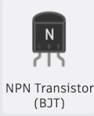
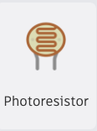
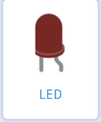
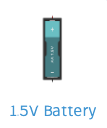
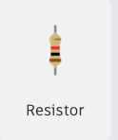
Tinkercad Circuit
Pull up all the needed parts for the night light & discuss each(see vocabulary list).
In teams of two (1) Play (2) Test out how to assemble the parts to create a circuit that has the LED light up when it is dark (a night light).
Come back to the larger group ready to share what you did and if you were successful.
X4
X2

Slide 11
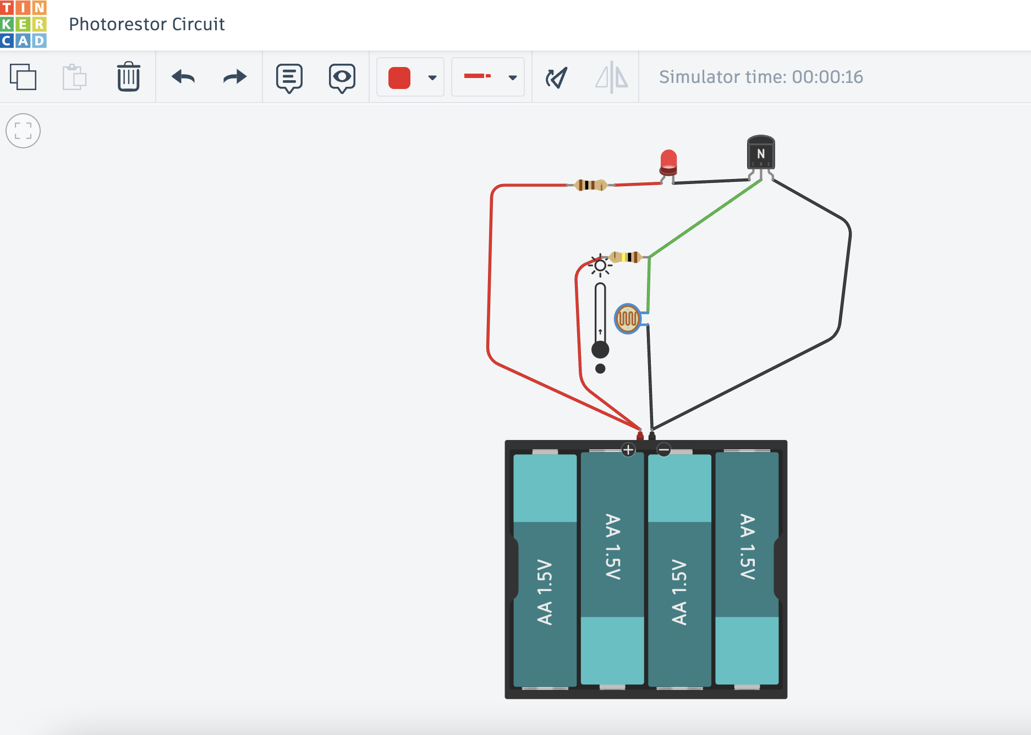
Demo the Creation of the Night Light
Do you need two resistors?
What would more power or less power do?
What would happen if you did not have the transistor?

Slide 12
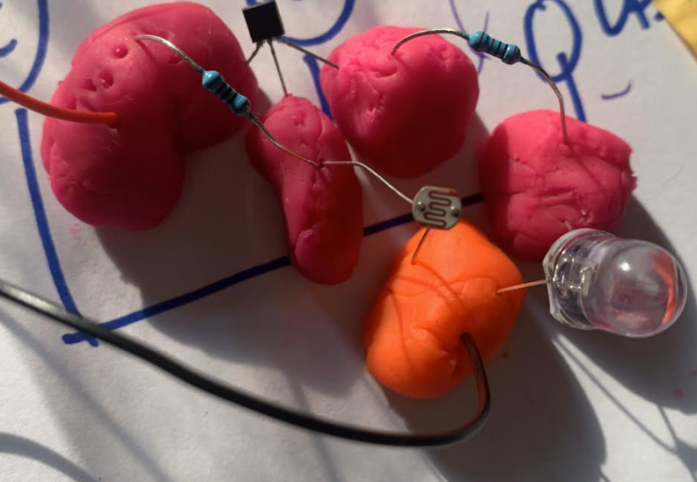
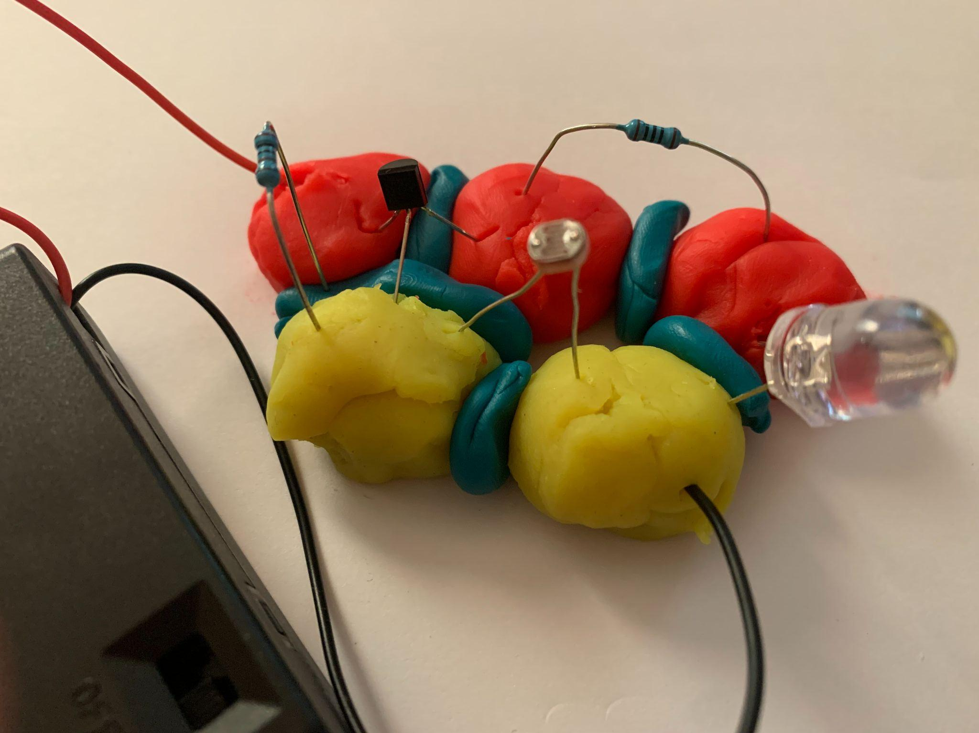
Night Light with Playdough
Replicate the Tinkercad circuit using the required material for the playdough circuit. Iterate to get the night light to work
Test: cover the photoresistor with your hand or place it in a dark area. The LED should light up when it’s dark.

Slide 13
Helpful Hints
Consider Polarity of the LED (long leg is positive)
Consider using clay to avoid shots in your playdough circuit
Typically the flat face of the transistor is the front with the Emitter (left) and Collector (right). It will depend on the transistor you have so check the datasheet to make sure or just flip it if it isn’t working.

Slide 14
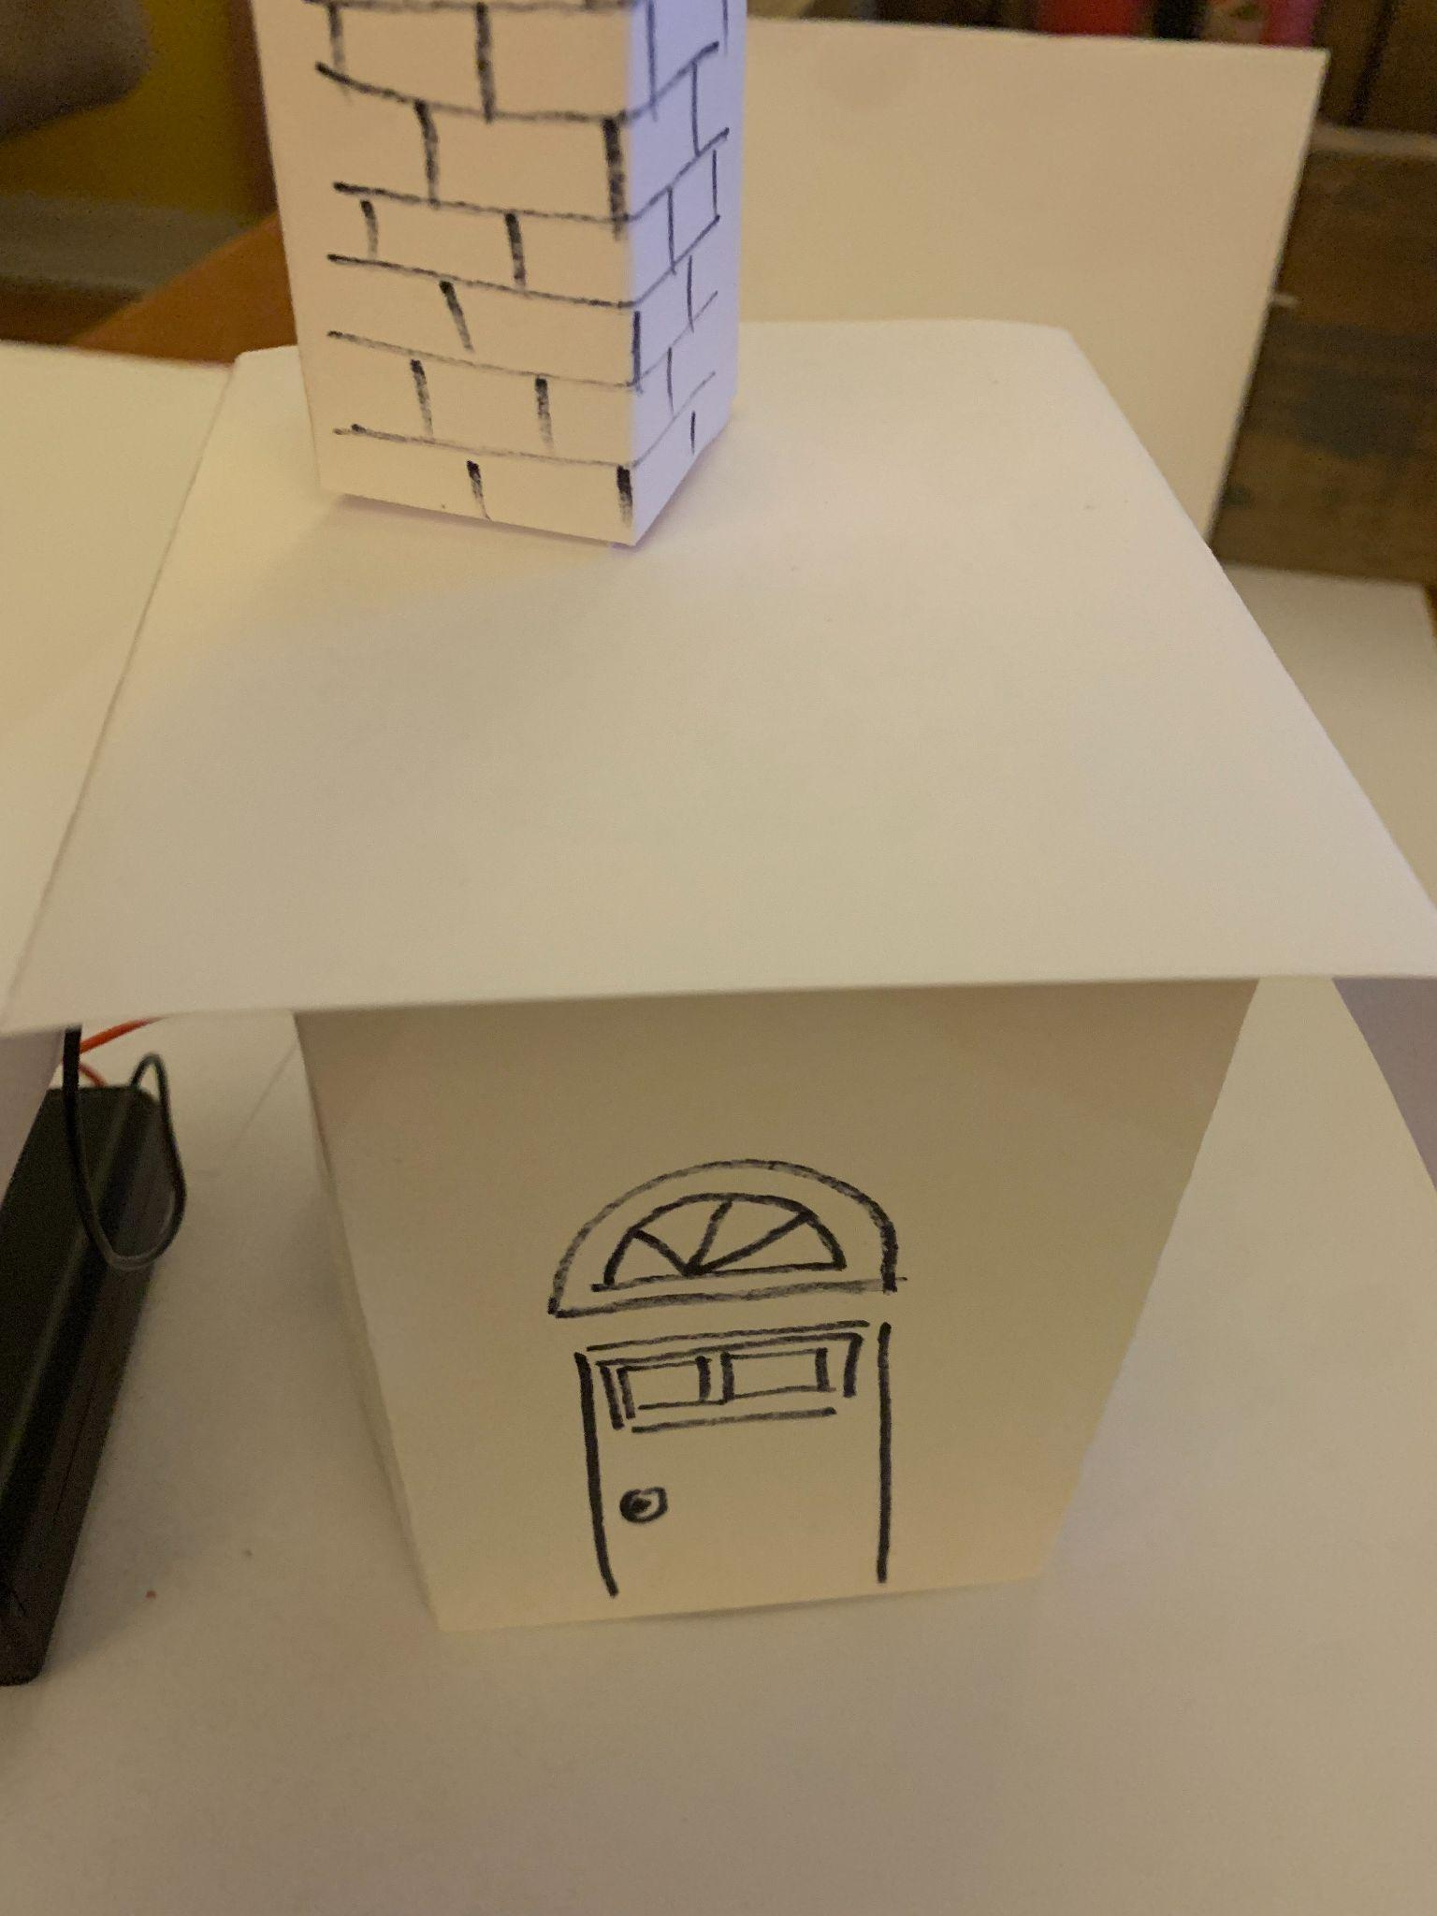
Night Light Housing Design
Design a housing (cover) for the night light circuit.
See sample (actually a house design out of index cards and marker)
Consider turning the playdough circuit into a paper circuit with copper tape.

Slide 15
Failure is part of the process
If your circuit does not work, don’t worry, we expect that. Engineers fail and they try again and again. So troubleshoot and then redesign until you get your best solution. Failure is part of the process! Have fun!
Ready, Set, Let’s Engineer!

Slide 16
Reflect & Debrief

Slide 17
Reflection
How does the Tinkercad model you made compare to the playdough night light created?
What challenges did you run into in creating night light? What other tools or materials might have helped you?
What did you like best and least about your housing?

Slide 18
Engineering Design Process

Slide 19
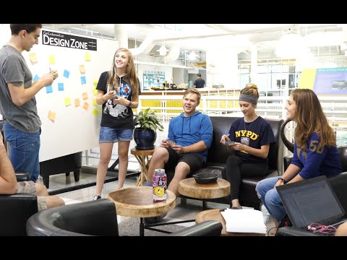
The Engineering Design Process
Learn about the engineering design process (EDP). The process engineers use to solve problems. (Video 1:47)
Source: TeachEngineering YouTube Channel http://www.youtube.com/watch?v=b0ISWaNoz-c

Slide 20
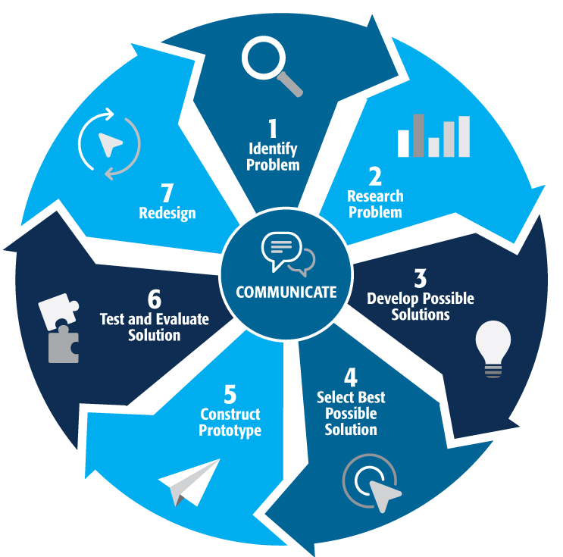
Engineering Design Process
Divide into teams of two (or up to 4 max)
Review the challenge and criteria & constraints
Brainstorm possible solutions (sketch while you brainstorm!)
Choose best solution and build a prototype
Test then redesign until solution is optimized
Reflect as a team and debrief as a class
Notes:
Material bags for teams to build…

Slide 21
Productive Failure
The engineering design process involves productive failure: test, fail, redesign. Iterate again and again until you have the best possible solution.
It is important to document iterations to keep track of each redesign. Use the engineering notebook to sketch ideas, document iterations and any measurement and/or calculations.
It’s also important to showcase the fact that there can be multiple solutions to the same problem. There’s no one “right” solution.

Slide 22
Vocabulary

Slide 23
Vocabulary
Transistor: is a switch that can turn things on and off, but with a twist. It can control and amplify electricity. It is made of 3 parts: Base (door that controls the electricity flow), Collector (door electricity comes in through) and Emitter (door electricity goes out)
Photoresistor: is a special kind of electronic part that can “see” light, like a magic eye. It can tell when it’s light or dark. When it’s bright, the magic eye opens wide and lets a lot of electricity flow through. When it’s dark, the magic eye closes and only lets a little bit of electricity flow.
P-type Transistor: (PNP) have positive energy (holes where electrons can move around).
N-type Transistor: (NPN) have negative energy (extra electrons)
Amplify: make a small sound (small signal) into a big sound (big signal). So, if you whisper into it an amplifier, it can make your whisper loud enough for everyone to hear.
Automate: machines/computers do a task instead of people.

Slide 24
Vocabulary
Conditional Switches: are like a special box that does different things based on the switch you flip. If you flip the red switch, it plays music. If you flip the blue switch, it shows a movie. If you flip the green switch, it tells a joke. The box uses a “conditional switch” to decide what to do based on the button you press.
Resistance: is like a roadblock for electricity. In an electrical circuit, resistance makes it harder for the electric current to flow smoothly. This can happen in things like wires or special parts called resistors.
Semiconductor: is a special material that a transistor is made of that is both conductor and insulator of electricity. Sometimes it conducts, sometimes doesn’t.
Silicon: is an example of semiconductor material.

Slide 25
Vocabulary
Microchip: (also known as: semiconductor chip, semi, and chip) – is an integrated circuit (IC) that is etched on the wafers.
Nanoscale: is incredibly small – a billion times smaller than what we can see with our eyes. (For example, chips are made on a nanoscale). There are billions of transistors on a microchip.
Moore’s Law: is like a growth spurt for computers! Gordon Moore, the co-founder of Fairchild Semiconductor and Intel, predicted, in 1975, that the number of transistors (tiny switches) on a microchip would double about every two years.

Slide 26
Background Knowledge

Slide 27
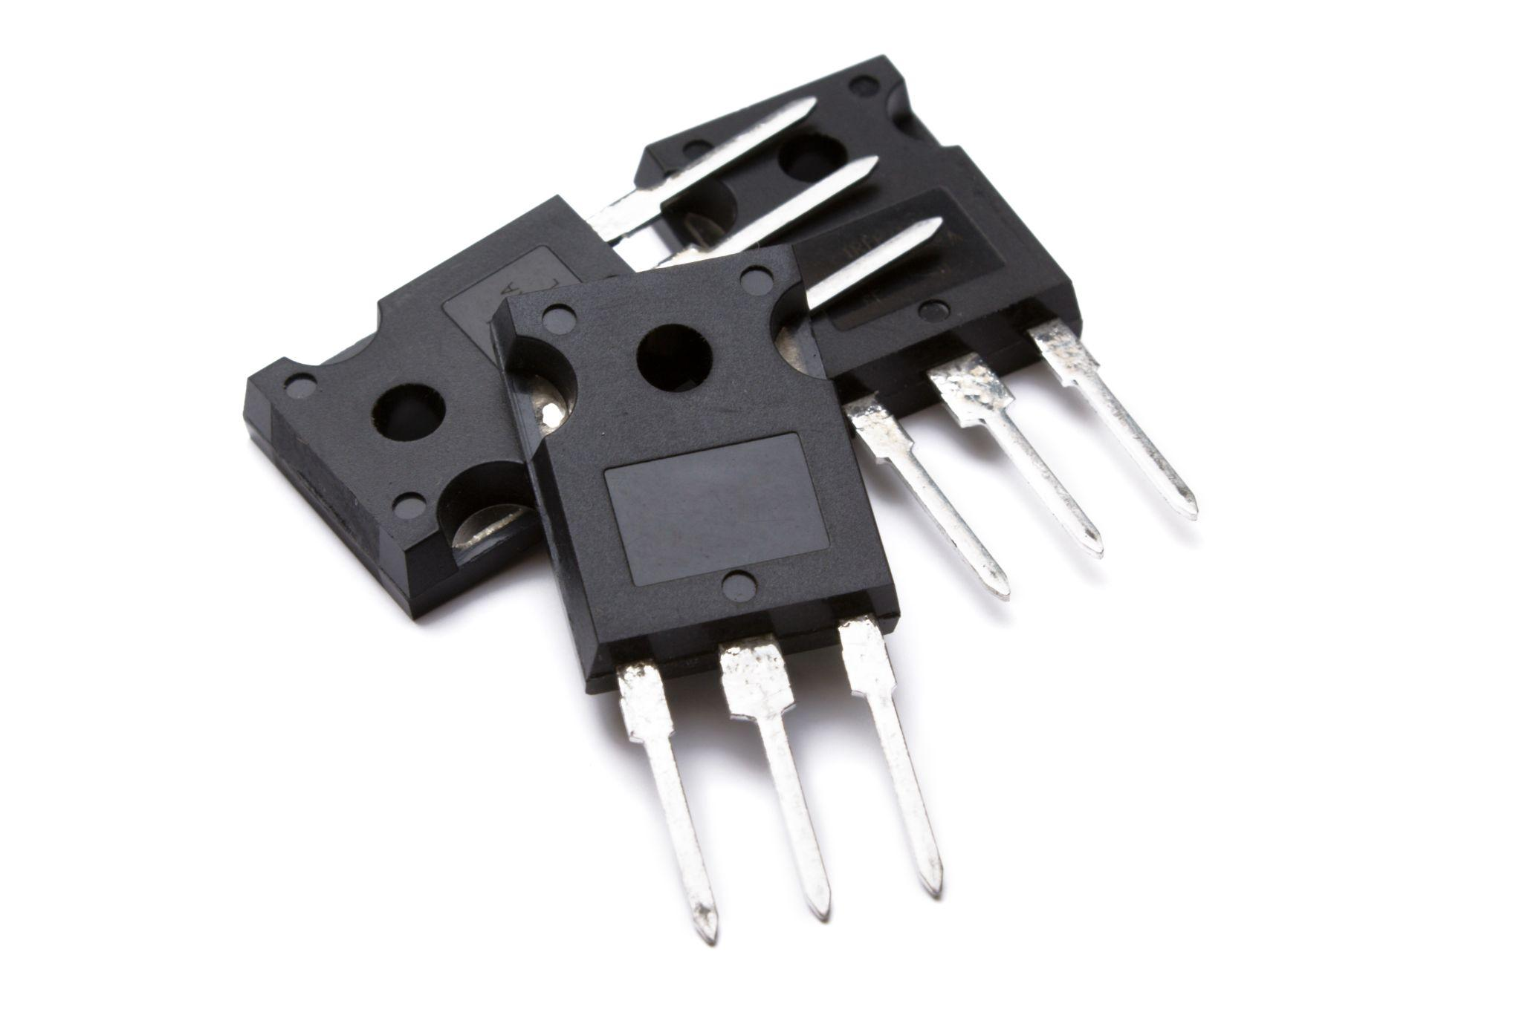
So What is a Transistor?
Transistors are the superhero of electronic parts! They are made of semiconductor material that can either act as a conductor or an insulator giving it its superpower.
Imagine a transistor as a magic switch that can turn things on and off, but with a twist. A transistor helps control and amplify electricity, making it super important in all the gadgets we use, like phones, computers, and even toys.

Slide 28

Transistors: Teeny Tech that Changes the World
Learn more by watching this video on Vimeo: Transistors: Teeny Tech that Changed the World by Abby Kent (Project for Science and Natural History Filmmaking from Montana State University)

Slide 29
Why Use a Transistor?
(1) Automate Things: Imagine you want to turn something on and off really fast, like blinking lights on a toy. A transistor can do this quickly and many times without getting tired.
(2) Conditional Switches: Think of a transistor like a smart switch. It can turn things on or off based on certain conditions, like turning on a night light when it gets dark.
So, transistors help make things work automatically and smartly!

Slide 30
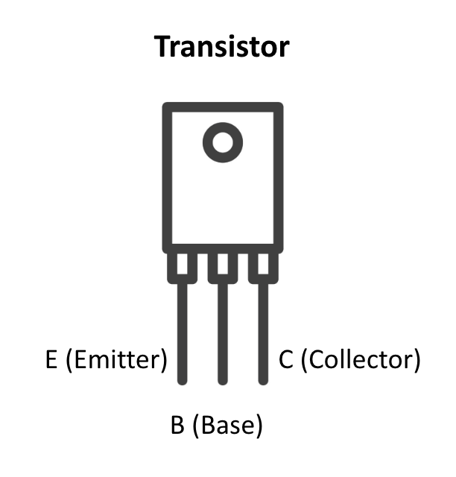
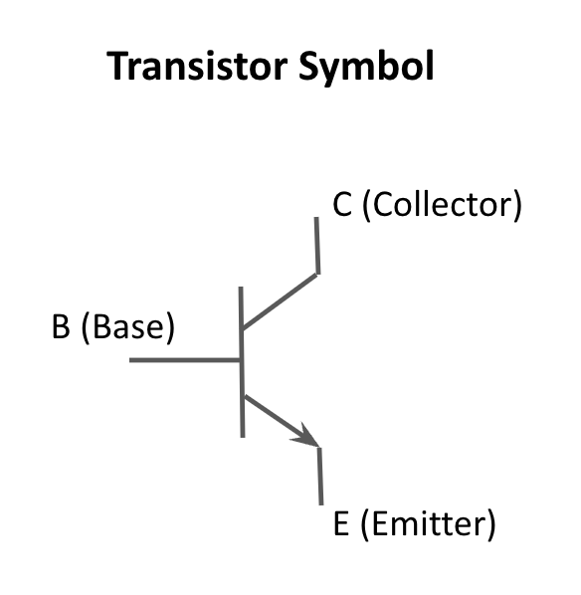
Parts of a Transistor
A transistor has three parts: the Base (B), Collector (C), and Emitter (E). Think of them as different doors:

Slide 31
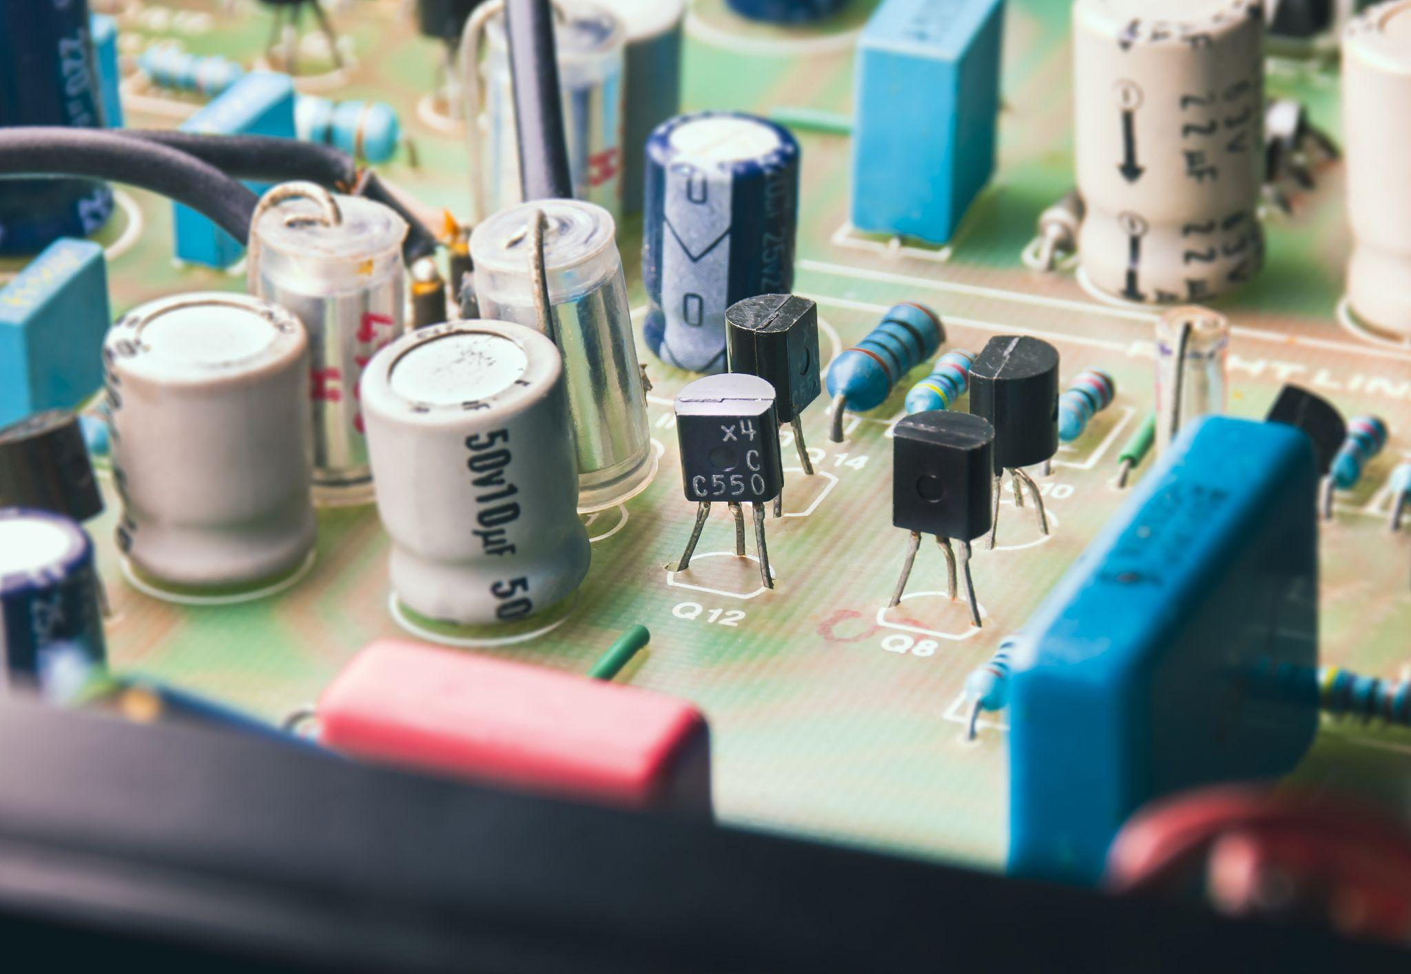
Parts of a Transistor
Collector (C): The Collector is the door where electricity comes in. It’s not the amplifier itself, but it’s part of the path that helps amplify the signal.
Emitter (E): The Emitter is the door where the electricity goes out. It’s not the switch, but it works with the Base to control the flow of electricity.
Base (B): The Base is the magic door”that controls everything. When you give it a small push (a tiny electric signal), it can open the other two doors (Collector and Emitter) allowing a bigger flow of electricity to pass from the Collector to the Emitter. Together, they make the transistor turn things on and off and make small signals bigger or amplify them.

Slide 32
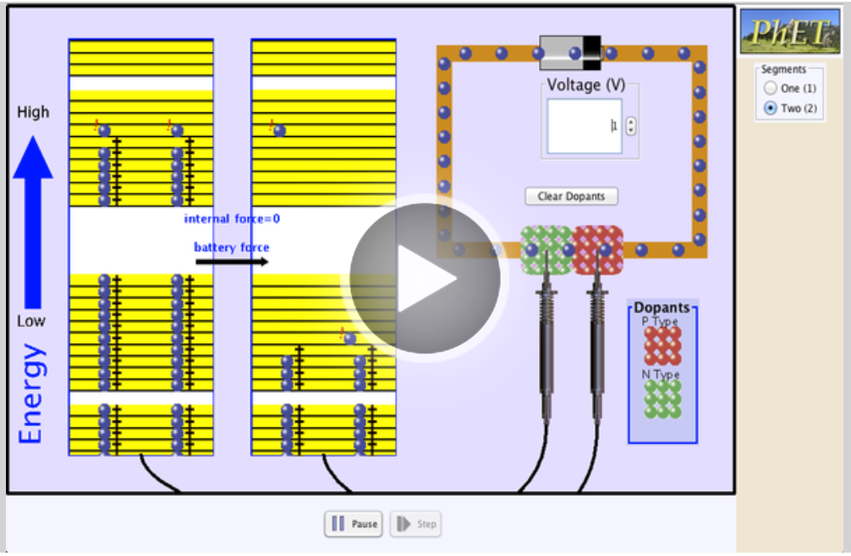
P-Type and N-Type Transistors
There are many different types of transistors. For example, there are N-type (NPN) and P-type transistors (PNP). The main difference is that N-type transistors have negative energy (extra electrons) and P-type transistors have positive energy (holes where electrons can move around).
To dive deeper into how the electrons can move in a semiconductor (like our transistor), play the PhET Semiconductor Simulation. Silicon is the most common semiconductor. By adding different atoms to silicon, we can change its behavior.

Slide 33
Dig Deeper

Slide 34
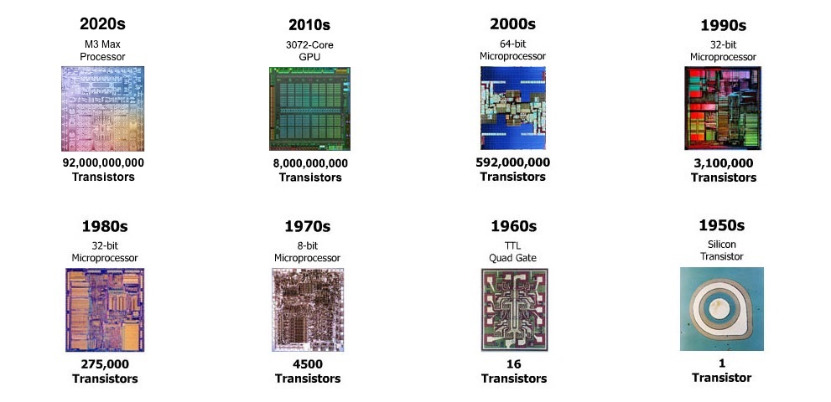
Moore’s Law

Slide 35
Moore’s Law
Gordon Moore, the co-founder of Fairchild Semiconductor and Intel, predicted, in 1975, that the number of transistors on a microchip would double about every two years (Moore’s Law).. That means the chips get smaller and smaller. Imagine it’s like your room getting twice as big every two years. This growth helps make computers faster and more powerful. Amazingly, Moore's Law has shown to be true for the last 50 years. (Image Source: https://www.computerhistory.org/siliconengine/)
How much smaller can a transistor be? How many might fit on the tip of an eraser in 10 years? Is there a limit to how small a transistor can be? Will Moore’s Law last forever?

Slide 36
Dig Deeper (Extension Activities)
Dive deeper Into Semiconductors. Visit the TryEngineering Semiconductor page (with three videos and ebook) and also he Making of a MIcrochip lesson.
More Resources
How a Transistor Works EASY! - Electronics Basics 22 (Updated) by Simple Electronics (Video)
How To Use Transistors In YOUR Projects! || Transistors Explained || Transistors As A Switch by Simple Electronics (Video)
NPN vs PNP Transistors: Symbol & Working Principle by JAKElectronics (Webpage)

Slide 37
Engineering Fields

Slide 38

What is Engineering?
Learn about engineering and how engineers are creative problem solvers and innovators who work to make the world a better place.
(Video 3:43)
Source: TeachEngineering YouTube Channel - http://www.youtube.com/watch?v=H9VDkvgGmVo

Slide 39
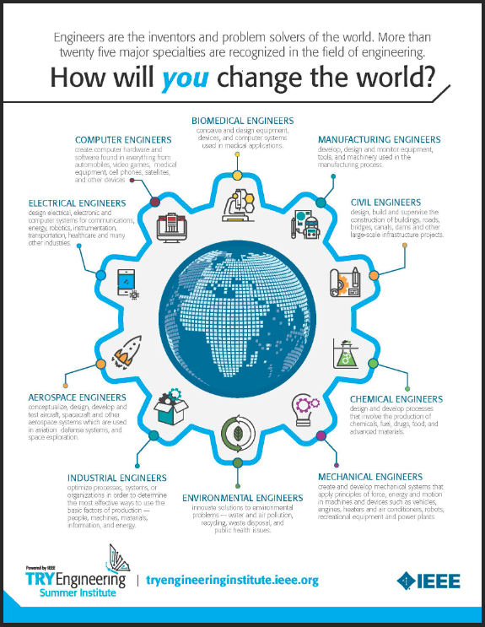
Related Engineering Fields
There are several types of engineering fields that are involved circuits. Here are just some of the related engineering fields.
Computer Engineering
Software Engineering
Power and Nuclear Engineering
Download the Engineering Fields Infographic How will YOU change the world? Engineers are the inventors and problem solvers of the world! More than twenty five major specialties are recognized in the field of engineering. Engineers make the world a better place!

Slide 40
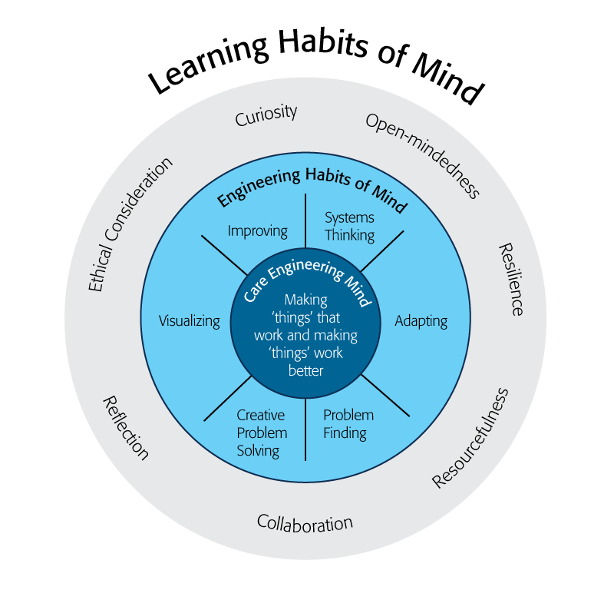
Engineering Habits of Mind
Engineering Habits of Mind (EHM) is about how engineers think everyday. The Core Engineering Mind is about making things that work and making them work better.
Source: https://online-journals.org/index.php/i-jep/article/view/5366)
Notes:
Consider if your lesson address these EHM and how much emphasis it place on each of the EHM. Emphasize the EHM by using the EHM langage when you can.Systems thinking: Seeing whole systems and parts and how they connect.
Problem-finding: identifying and defining a problem.
Visualising: manipulating materials and sketching. Mental rehearsal of practical design solutions
Improving: Persistently trying to make things better by experimenting, designing, sketching, and prototyping
Creative problem-solving: generating ideas and solutions with others with many iterations.
Adapting: Testing, analysing, reflecting, & rethinking
Source: B. Lucas and J. Hanson, Thinking Like an Engineer: Using Engineering Habits of Mind and Signature Pedagogies to Redesign Engineering Education. (International Journal of Engineering Pedagogy, Vol 6, No. 2 (2016): https://online-journals.org/index.php/i-jep/article/view/5366)
More resources on Habits of Mind can be found here: https://www.stem.org.uk/resources/community/collection/424831/engineering-habits-mind-primary
Bill Lucas and Janet Hanson from The Center for Real World Learning at the University of Winchester, UK wrote the paper, Thinking Like an Engineer: Using Engineering Habits of Mind and Signature Pedagogies to Redesign Engineering Education. In the paper, they “ identified the six most distinctive learning dispositions, or engineering “habits of mind” [EHoM] that engineers frequently deploy.”
Maybe add in Checklist here???

Slide 41
Engineering Habits of Mind Checklist
Systems thinking
Problem-finding
Visualising
Improving
Creative problem-solving
Adapting
Notes:
Systems thinking: seeing whole systems and parts and how they connect
Problem-finding: identifying and defining a problem
Visualising: manipulating materials and sketching
Improving: persistently trying to make things better by experimenting
Creative problem-solving: generating ideas with many iterations
Adapting: testing, analysing, reflecting & rethinking
More resources on Habits of Mind can be found here: https://www.stem.org.uk/resources/community/collection/424831/engineering-habits-mind-primary
Bill Lucas and Janet Hanson from The Center for Real World Learning at the University of Winchester, UK wrote the paper, Thinking Like an Engineer: Using Engineering Habits of Mind and Signature Pedagogies to Redesign Engineering Education. In the paper, they “ identified the six most distinctive learning dispositions, or engineering “habits of mind” [EHoM] that engineers frequently deploy.”

Slide 42
Learning Habits of Mind Checklist
Open-mindedness
Resilience
Resourcefulness
Collaboration
Reflection
Ethical Consideration
Curiosity
Notes:
More resources on Habits of Mind can be found here: https://www.stem.org.uk/resources/community/collection/424831/engineering-habits-mind-primary
Bill Lucas and Janet Hanson from The Center for Real World Learning at the University of Winchester, UK wrote the paper, Thinking Like an Engineer: Using Engineering Habits of Mind and Signature Pedagogies to Redesign Engineering Education. In the paper, they “ identified the six most distinctive learning dispositions, or engineering “habits of mind” [EHoM] that engineers frequently deploy.”

Slide 43
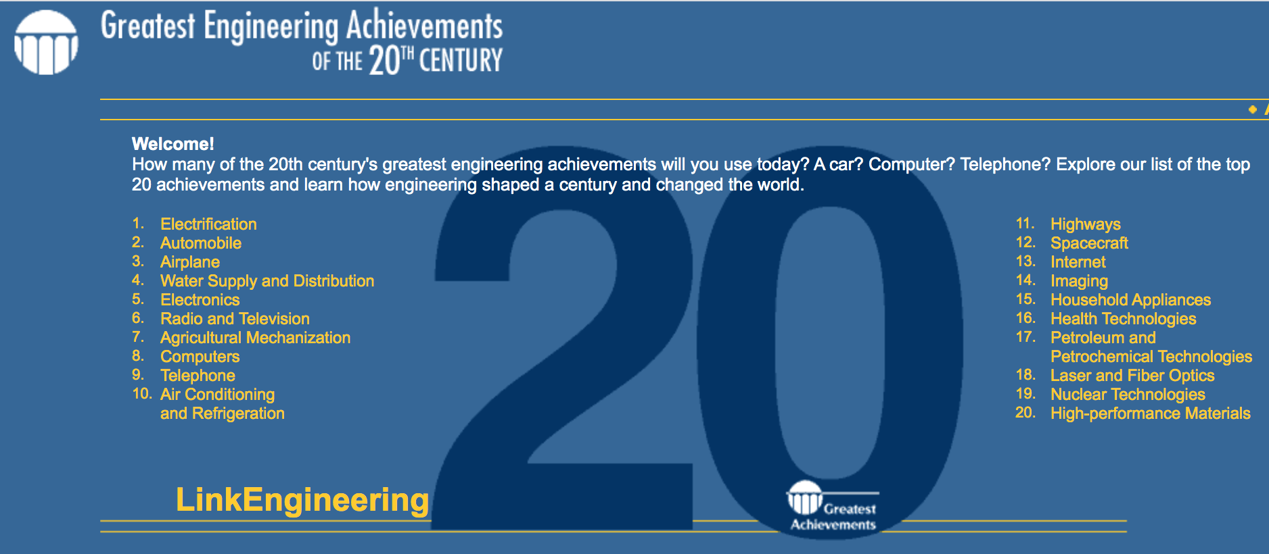
Greatest Engineering Achievements of the 20th Century
Source: http://www.greatachievements.org/

Slide 44

Learn more about how engineers make the world a better place

Slide 45

For more engineering lesson plans and resources like games, engineering careers, and STEM opportunities visit IEEE’s TryEngineering.org

