Slide 1
Lesson Plan:
Engineered Music

Slide 2
The Design Challenge

Slide 3
The Design Challenge
You are a team of engineers who have been given the challenge of building a new musical instrument that can repeat a pattern of three different sounds , three times. The new instrument must be "tunable" and must also be unique from other instruments.

Slide 4
Defining the Challenge: Criteria & Constraints
Criteria
Repeat a pattern of three different sounds, three times
Must be “tunable”
Must be unique from other instruments
Constraints
Use only the materials provided
Teams may trade unlimited materials

Slide 5
Material
Materials – Required (Table of Possibilities)
String
Paperclips
Paper
Cardboard
Cardboard tubes (paper towel or toilet paper rolls)
Rubber bands
Wire or pipe cleaners

Slide 6
Material
Materials – Required (Table of Possibilities)
Aluminum foil
Plastic wrap
Empty juice boxes
Wooden dowels
Non-toxic glue

Slide 7
Testing Materials and Process
Testing Material
Instrument designs
Testing Process
Teams test their instrument designs by playing a pattern of three different sounds, three times. Team members may take turns demonstrating the instrument. If the team has designed an instrument that requires the instrument be put in or near their mouth, one team member should be selected to play in the instrument. Students should document how unique their design is.

Slide 8
Consider...
Before you get started building, consider how different instruments work and how you might “tune” them to make sounds.

Slide 9
Reflect & Debrief

Slide 10
Reflection
Did you succeed in creating an instrument that could repeat a pattern of three different sounds three times? If not, why did it fail?
Did you need to request additional materials while building your instrument?
Did you negotiate any material trades with other teams? How did that process work for you?
Do you think that engineers have to adapt their original plans during the manufacturing process of instruments or other products? Why might they?

Slide 11
Reflection
If you had to do it all over again, how would your planned design change? Why?
What designs or methods did you see other teams try that you thought worked well?
Do you think you would have been able to complete this project easier if you were working alone? Explain…
How do you think the engineering designs for musical instruments have changed over time? What impact has the development of new materials had on the engineering plans for musical instruments?

Slide 12
Reflection
What impact has the development of electronics had on the engineering plans for musical instruments?
What engineering considerations are needed in musical instrument design to accommodate physically challenged musicians?

Slide 13
Engineering Design Process

Slide 14
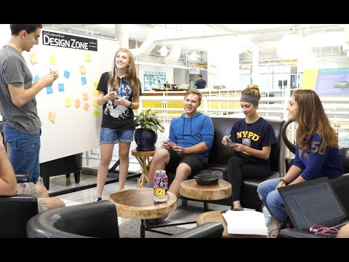
The Engineering Design Process
Learn about the engineering design process (EDP). The process engineers use to solve problems. (Video 1:47)
Source: TeachEngineering YouTube Channel http://www.youtube.com/watch?v=b0ISWaNoz-c

Slide 15
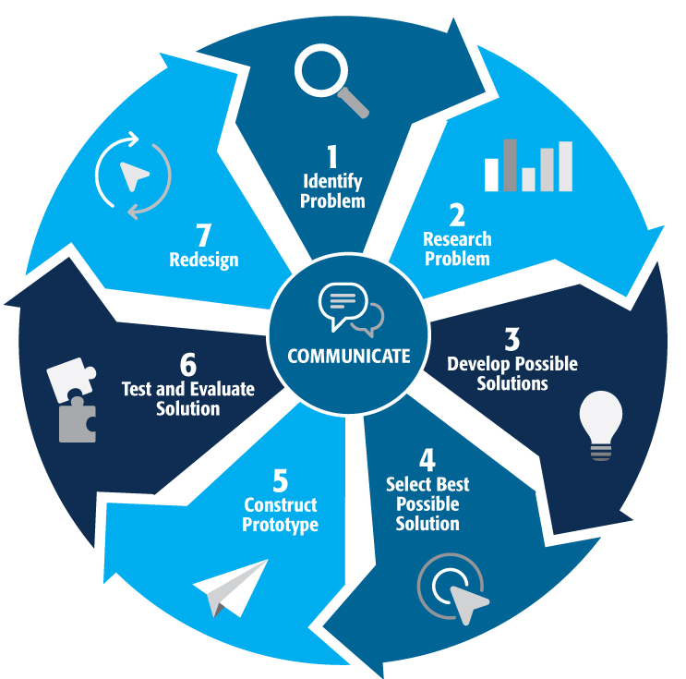
Engineering Design Process
Divide into teams
Review the challenge and criteria & constraints
Brainstorm possible solutions (sketch while you brainstorm!)
Choose best solution and build a prototype
Test then redesign until solution is optimized
Reflect as a team and debrief as a class
Notes:
Material bags for teams to build…

Slide 16
Productive Failure
The engineering design process involves productive failure: test, fail, redesign. Iterate again and again until you have the best possible solution.
It is important to document iterations to keep track of each redesign. Use the engineering notebook to sketch ideas, document iterations and any measurement and/or calculations.
It’s also important to showcase the fact that there can be multiple solutions to the same problem. There’s no one “right” solution.

Slide 17
Vocabulary

Slide 18
Vocabulary
Constraints: Limitations with material, time, size of team, etc.
Criteria: Conditions that the design must satisfy like its overall size, etc.
Engineers: Inventors and problem-solvers of the world. Twenty-five major specialties are recognized in engineering (see infographic).
Engineering Design Process: Process engineers use to solve problems.
Engineering Habits of Mind (EHM): Six unique ways that engineers think.
Key: When the notes of a song are centered around a certain note or class of notes that sound "right" when played.
Iteration: Test & redesign is one iteration. Repeat (multiple iterations).

Slide 19
Vocabulary
Note: A small bit of sound, similar to a syllable in speaking a language
Pitch: Highness or lowness of sound
Prototype: A working model of the solution to be tested.
Tunable: Able to correct musical pitch or key.

Slide 20
Dig Deeper

Slide 21
Dig Deeper into the Topic
Internet Connections
Musical Instruments of the World (www.asza.com/ihm.shtml)
Museum of Musical Instruments (www.themomi.org)
How Recorders Work (www.flute-a-bec.com/acoustiquegb.html)
Recommended Reading
The Physics of Musical Instruments (ISBN: 0387983740)
Music, Physics and Engineering (ISBN: 0486217698)
Teaching Kids Recorder (ISBN: 0595367437)

Slide 22
Dig Deeper into the Topic
Writing Activity
Pick a country or culture at a point three hundred years ago and write an essay or a paragraph about the challenges they might face finding materials to make a specific musical instrument (trombone, piano, guitar - for example).

Slide 23
Engineering Fields

Slide 24
What is Engineering?
Learn about engineering and how engineers are creative problem solvers and innovators who work to make the world a better place.
(Video 3:43)
Source: TeachEngineering YouTube Channel - http://www.youtube.com/watch?v=H9VDkvgGmVo

Slide 25
Related Engineering Fields
There are several types of engineering fields that are involved with the design of musical instruments. Here are just some of the related engineering fields.
Mechanical Engineering
Electrical Engineering
Download the Engineering Fields Infographic How will YOU change the world?

Slide 26
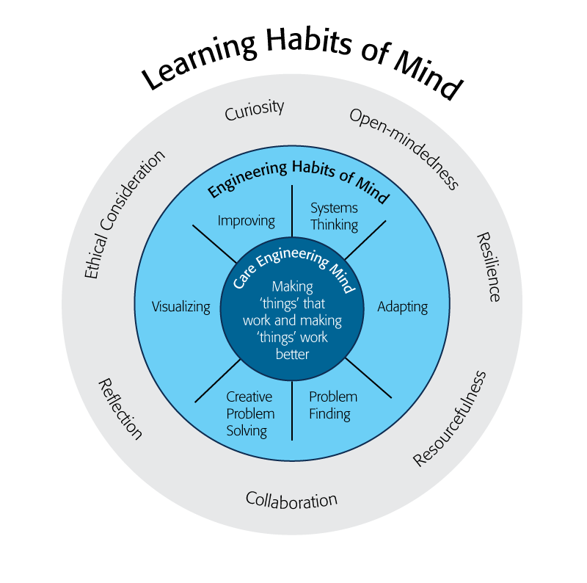
Engineering Habits of Mind
Engineering Habits of Mind (EHM) is about how engineers think everyday. The Core Engineering Mind is about making things that work and making them work better.
Source: https://online-journals.org/index.php/i-jep/article/view/5366)
Notes:
Consider if your lesson address these EHM and how much emphasis it place on each of the EHM. Emphasize the EHM by using the EHM langage when you can.Systems thinking: Seeing whole systems and parts and how they connect.
Problem-finding: identifying and defining a problem.
Visualising: manipulating materials and sketching. Mental rehearsal of practical design solutions
Improving: Persistently trying to make things better by experimenting, designing, sketching, and prototyping
Creative problem-solving: generating ideas and solutions with others with many iterations.
Adapting: Testing, analysing, reflecting, & rethinking
Source: B. Lucas and J. Hanson, Thinking Like an Engineer: Using Engineering Habits of Mind and Signature Pedagogies to Redesign Engineering Education. (International Journal of Engineering Pedagogy, Vol 6, No. 2 (2016): https://online-journals.org/index.php/i-jep/article/view/5366)
More resources on Habits of Mind can be found here: https://www.stem.org.uk/resources/community/collection/424831/engineering-habits-mind-primary
Bill Lucas and Janet Hanson from The Center for Real World Learning at the University of Winchester, UK wrote the paper, Thinking Like an Engineer: Using Engineering Habits of Mind and Signature Pedagogies to Redesign Engineering Education. In the paper, they “ identified the six most distinctive learning dispositions, or engineering “habits of mind” [EHoM] that engineers frequently deploy.”
Maybe add in Checklist here???

Slide 27
Engineering Habits of Mind Checklist
Systems thinking
Problem-finding
Visualising
Improving
Creative problem-solving
Adapting
Notes:
Systems thinking: seeing whole systems and parts and how they connect
Problem-finding: identifying and defining a problem
Visualising: manipulating materials and sketching
Improving: persistently trying to make things better by experimenting
Creative problem-solving: generating ideas with many iterations
Adapting: testing, analysing, reflecting & rethinking
More resources on Habits of Mind can be found here: https://www.stem.org.uk/resources/community/collection/424831/engineering-habits-mind-primary
Bill Lucas and Janet Hanson from The Center for Real World Learning at the University of Winchester, UK wrote the paper, Thinking Like an Engineer: Using Engineering Habits of Mind and Signature Pedagogies to Redesign Engineering Education. In the paper, they “ identified the six most distinctive learning dispositions, or engineering “habits of mind” [EHoM] that engineers frequently deploy.”

Slide 28
Learning Habits of Mind Checklist
Open-mindedness
Resilience
Resourcefulness
Collaboration
Reflection
Ethical Consideration
Curiosity
Notes:
More resources on Habits of Mind can be found here: https://www.stem.org.uk/resources/community/collection/424831/engineering-habits-mind-primary
Bill Lucas and Janet Hanson from The Center for Real World Learning at the University of Winchester, UK wrote the paper, Thinking Like an Engineer: Using Engineering Habits of Mind and Signature Pedagogies to Redesign Engineering Education. In the paper, they “ identified the six most distinctive learning dispositions, or engineering “habits of mind” [EHoM] that engineers frequently deploy.”

Slide 29
Greatest Engineering Achievements of the 20th Century
Source: http://www.greatachievements.org/

Slide 30
Learn more about how engineers make the world a better place

Slide 31
For more engineering lesson plans and resources like games, engineering careers, and STEM opportunities visit IEEE’s TryEngineering.org

