Slide 1
Lesson Plan:
Downhill Skier

Slide 2
The Design Challenge

Slide 3
The Design Challenge
You are a team of engineers working together to design and build a downhill skier out of everyday materials. Your goal is to have your skier reach the bottom of the ski ramp in the fastest time.

Slide 4
Defining the Challenge: Criteria & Constraints
Criteria
Not allowed to push the skier down the ski ramp
Constraints
Use only the materials provided.

Slide 5
Material
Required for Build – per team
Video*: https://www.youtube.com/watch?v=BAV3DEfB7cM
4 Craft sticks
4 Plastic/Paper straws
2 Sheets Plastic wrap (8x12 inches)
4 Pipe cleaners
Scotch tape
2 Sheets Aluminum foil (8x12 inches)
*Video Source: NBC News Learn YouTube Channel

Slide 6
Testing Material Process
Testing Material
2 Ski Ramps (smooth wood or plastic boards about 5 x 40 inches)
Stopwatch or timer
Testing Process
Test the skiers by launching them down the ski ramp and timing how long they can get from the top to the bottom. Mark the start and finish points with tape.

Slide 7
Consider...
Before you get started building, consider showing the NBC News Learn’s Downhill Science of Alpine Skiing Video https://www.youtube.com/watch?v=BAV3DEfB7cM so students can learn about the forces that impact skiing and then lead a discussion about what the students learned from the video.

Slide 8
Reflect & Debrief

Slide 9
Reflection
What worked best about your design?
What could you have improved?
What did you learn from other team’s designs?
How did you work as a team?

Slide 10
Engineering Design Process

Slide 11
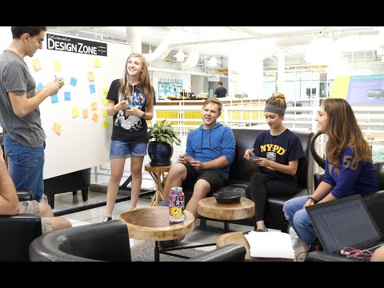
The Engineering Design Process
Learn about the engineering design process (EDP). The process engineers use to solve problems. (Video 1:47)
Source: TeachEngineering YouTube Channel http://www.youtube.com/watch?v=b0ISWaNoz-c

Slide 12
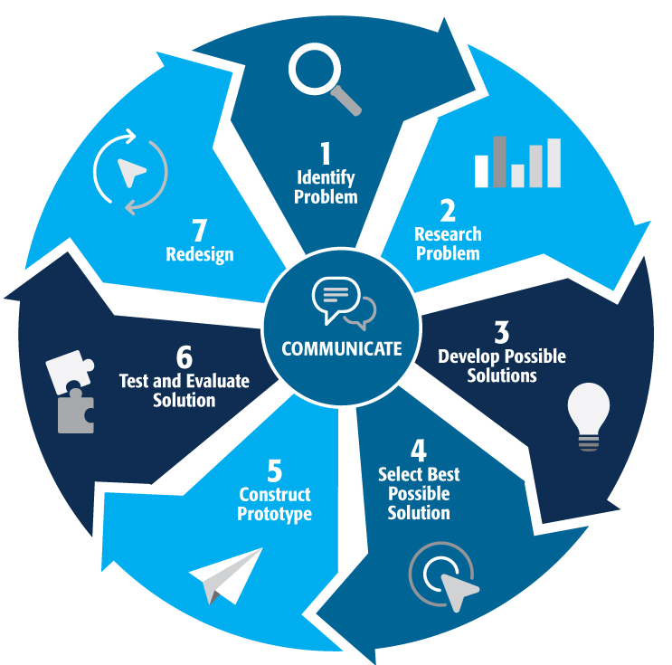
Engineering Design Process
Divide into teams
Review the challenge and criteria & constraints
Brainstorm possible solutions (sketch while you brainstorm!)
Choose best solution and build a prototype
Test then redesign until solution is optimized
Reflect as a team and debrief as a class
Notes:
Material bags for teams to build…

Slide 13
Productive Failure
The engineering design process involves productive failure: test, fail, redesign. Iterate again and again until you have the best possible solution.
It is important to document iterations to keep track of each redesign. Use the engineering notebook to sketch ideas, document iterations and any measurement and/or calculations.
It’s also important to showcase the fact that there can be multiple solutions to the same problem. There’s no one “right” solution.

Slide 14
Vocabulary

Slide 15
Vocabulary
Acceleration: Increasing the rate or speed of something
Criteria: Conditions that the design must satisfy like its overall size, etc.
Engineers: Inventors and problem-solvers of the world. Twenty-five major specialties are recognized in engineering (see infographic).
Engineering Design Process: Process engineers use to solve problems.
Engineering Habits of Mind (EHM): Six unique ways that engineers think.
Force: A push or pull acting on an object
Friction: Resistance of one object when moving against another

Slide 16
Vocabulary
Gravity: The force that pulls an object toward the center of the earth
Iteration: Test & redesign is one iteration. Repeat (multiple iterations).
Prototype: A working model of the solution to be tested.
Wind Resistance: A force an object will need to overcome to move through the air

Slide 17
Dig Deeper

Slide 18
Dig Deeper into the Topic
Internet Connections
NBC News Downhill Science: Alpine Skiing (http://nbclearn.com/portal/site/learn/cuecard/47275)
Recommended Reading
Downhill Skiing by Cynthia Amoroso (ISBN-13: 978-1567664560)
Writing Activity Students can write a paragraph about the safety equipment skiers use.

Slide 19
Engineering Fields

Slide 20
What is Engineering?
Learn about engineering and how engineers are creative problem solvers and innovators who work to make the world a better place.
(Video 3:43)
Source: TeachEngineering YouTube Channel - http://www.youtube.com/watch?v=H9VDkvgGmVo

Slide 21
Related Engineering Fields
There are several types of engineering fields that are involved with the engineering and design of ski ramps. Here are just some of the related engineering fields.
Civil engineering
Mechanical Engineering
Electrical Engineering
Download the Engineering Fields Infographic How will YOU change the world?

Slide 22
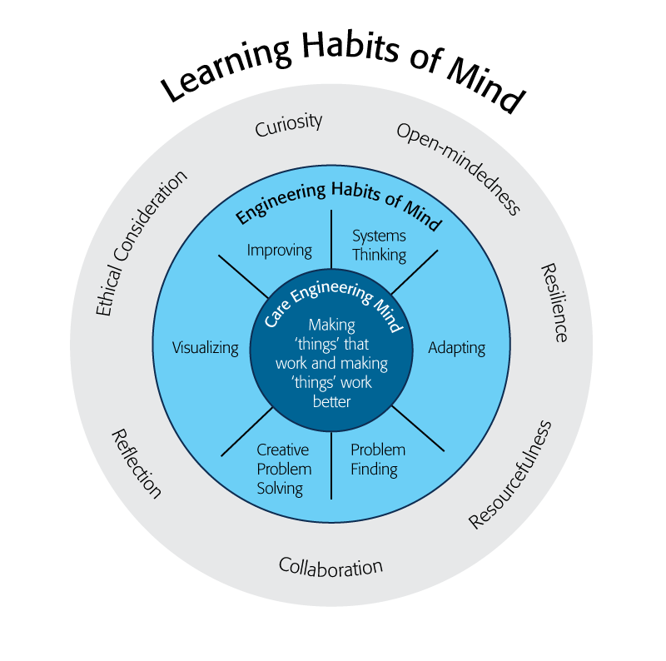
Engineering Habits of Mind
Engineering Habits of Mind (EHM) is about how engineers think everyday. The Core Engineering Mind is about making things that work and making them work better.
Source: https://online-journals.org/index.php/i-jep/article/view/5366)
Notes:
Consider if your lesson address these EHM and how much emphasis it place on each of the EHM. Emphasize the EHM by using the EHM langage when you can.Systems thinking: Seeing whole systems and parts and how they connect.
Problem-finding: identifying and defining a problem.
Visualising: manipulating materials and sketching. Mental rehearsal of practical design solutions
Improving: Persistently trying to make things better by experimenting, designing, sketching, and prototyping
Creative problem-solving: generating ideas and solutions with others with many iterations.
Adapting: Testing, analysing, reflecting, & rethinking
Source: B. Lucas and J. Hanson, Thinking Like an Engineer: Using Engineering Habits of Mind and Signature Pedagogies to Redesign Engineering Education. (International Journal of Engineering Pedagogy, Vol 6, No. 2 (2016): https://online-journals.org/index.php/i-jep/article/view/5366)
More resources on Habits of Mind can be found here: https://www.stem.org.uk/resources/community/collection/424831/engineering-habits-mind-primary
Bill Lucas and Janet Hanson from The Center for Real World Learning at the University of Winchester, UK wrote the paper, Thinking Like an Engineer: Using Engineering Habits of Mind and Signature Pedagogies to Redesign Engineering Education. In the paper, they “ identified the six most distinctive learning dispositions, or engineering “habits of mind” [EHoM] that engineers frequently deploy.”
Maybe add in Checklist here???

Slide 23
Engineering Habits of Mind Checklist
Systems thinking
Problem-finding
Visualising
Improving
Creative problem-solving
Adapting
Notes:
Systems thinking: seeing whole systems and parts and how they connect
Problem-finding: identifying and defining a problem
Visualising: manipulating materials and sketching
Improving: persistently trying to make things better by experimenting
Creative problem-solving: generating ideas with many iterations
Adapting: testing, analysing, reflecting & rethinking
More resources on Habits of Mind can be found here: https://www.stem.org.uk/resources/community/collection/424831/engineering-habits-mind-primary
Bill Lucas and Janet Hanson from The Center for Real World Learning at the University of Winchester, UK wrote the paper, Thinking Like an Engineer: Using Engineering Habits of Mind and Signature Pedagogies to Redesign Engineering Education. In the paper, they “ identified the six most distinctive learning dispositions, or engineering “habits of mind” [EHoM] that engineers frequently deploy.”

Slide 24
Learning Habits of Mind Checklist
Open-mindedness
Resilience
Resourcefulness
Collaboration
Reflection
Ethical Consideration
Curiosity
Notes:
More resources on Habits of Mind can be found here: https://www.stem.org.uk/resources/community/collection/424831/engineering-habits-mind-primary
Bill Lucas and Janet Hanson from The Center for Real World Learning at the University of Winchester, UK wrote the paper, Thinking Like an Engineer: Using Engineering Habits of Mind and Signature Pedagogies to Redesign Engineering Education. In the paper, they “ identified the six most distinctive learning dispositions, or engineering “habits of mind” [EHoM] that engineers frequently deploy.”

Slide 25
Greatest Engineering Achievements of the 20th Century
Source: http://www.greatachievements.org/

Slide 26
Learn more about how engineers make the world a better place

Slide 27
For more engineering lesson plans and resources like games, engineering careers, and STEM opportunities visit IEEE’s TryEngineering.org

