Slide 1
Lesson Plan:
Designing Drones

Slide 2
The Design Challenge

Slide 3
The Design Challenge
You are a team of engineers given the challenge of creating a rotor out of simple materials that falls as slowly as possible. You may use any materials provided to you and will first work as a team to review a sample template and develop your own design for a rotor.

Slide 4
Defining the Challenge: Criteria & Constraints
Criteria
Design rotor to drop the slowest from a height of 10 feet
Constraints
Use only the materials provided.
Teams may trade unlimited materials.

Slide 5
Material
Required for Build – per team
Sample templates (included in the Student Worksheet)
Paperclips
Paper
Index Card Paper
Construction Paper
Cardboard in a range of thicknesses
Foam sheets

Slide 6
Material
Optional Kit
If budgets allow, and as an extension idea, there are several kits to allow teams of students to build and even program a drone. The costs for these kits are continuing to drop at the basic level. At the moment you can get a basic but good drone kit for between $30-50. When using drone kits, be sure to arrange for a large open space where no people could possibly be in the way of the flying drone. A large school field is recommended and be sure to get approval from school administration.
Sky Viper s1750 Stunt 2017 Edition Drone ($50)
Syma X11 R/C Quadcopter ($30)
Holy Stone HS170 Predator Mini RC Helicopter Drone ($40)

Slide 7
Testing Material Process
Testing Material
Chair or step stool
Measuring tape
Testing Process
Test the rotors by standing on a chair or step stool and dropping each rotor from a height of ten feet. Teams should record the amount of time it takes for their rotor design to reach the floor. Each team may test their rotor three times and the slowest flight of the three should be used when comparing results to other teams.

Slide 8
Consider...
Before you get started building, consider how a helicopter flies. Discuss how wing shape and length, center of gravity, and the overall weight might impact flight.
Investigate the many different ways helicopters are used around the world. Read the NASA resource on helicopters at: www.nasa.gov/audience/forstudents/5-8/features/nasa-knows/what-is-a-helicopter-58.html.

Slide 9
Reflect & Debrief

Slide 10
Reflection
What aspect(s) of the design led to the success of the rotor that flew for the longest time?
Describe one part of your design that you think worked the best.
If you had a chance to do this project again, what would your team have chosen to do differently?
If you could have selected some building materials which were not made available to you, what would you have selected? Why?
Do you think this project worked better because you were part of a team, or do you think you could have done a better job working alone?

Slide 11
Engineering Design Process

Slide 12
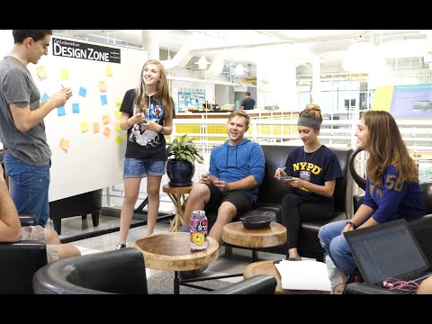
The Engineering Design Process
Learn about the engineering design process (EDP). The process engineers use to solve problems. (Video 1:47)
Source: TeachEngineering YouTube Channel http://www.youtube.com/watch?v=b0ISWaNoz-c

Slide 13
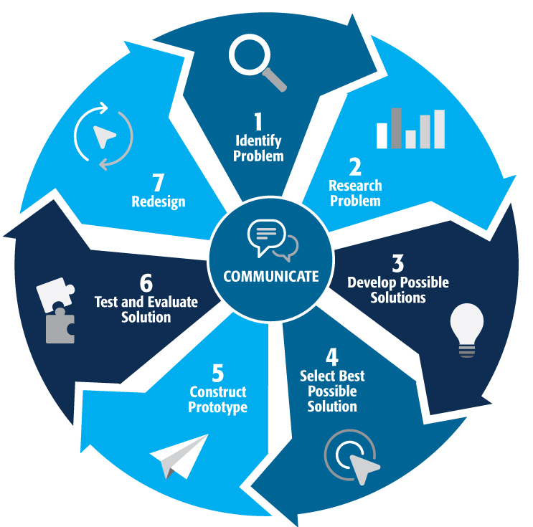
Engineering Design Process
Divide into teams
Review the challenge and criteria & constraints
Brainstorm possible solutions (sketch while you brainstorm!)
Choose best solution and build a prototype
Test then redesign until solution is optimized
Reflect as a team and debrief as a class
Notes:
Material bags for teams to build…

Slide 14
Productive Failure
The engineering design process involves productive failure: test, fail, redesign. Iterate again and again until you have the best possible solution.
It is important to document iterations to keep track of each redesign. Use the engineering notebook to sketch ideas, document iterations and any measurement and/or calculations.
It’s also important to showcase the fact that there can be multiple solutions to the same problem. There’s no one “right” solution.

Slide 15
Vocabulary

Slide 16
Vocabulary
Aerodynamic: The qualities of an object that affect how easily it is able to move through the air.
Criteria: Conditions that the design must satisfy like its overall size, etc.
Drag: A force that acts opposite to the relative motion of any object moving with respect to surrounding air (or water).
Engineers: Inventors and problem-solvers of the world. Twenty-five major specialties are recognized in engineering (see infographic).
Engineering Design Process: Process engineers use to solve problems.
Engineering Habits of Mind (EHM): Six unique ways that engineers think.

Slide 17
Vocabulary
Lift: An aerodynamic force that helps to counteract weight. The heavier an object is, the harder it is for lift to work against it and achieve flight.
Iteration: Test & redesign is one iteration. Repeat (multiple iterations).
Prototype: A working model of the solution to be tested.
Thrust: The forward motion (velocity) or thrust of an aircraft through the air along with the shape of the aircraft and its parts.
Weight: Everything has weight, which is a result of gravitational forces. The materials selected for a glider design will have a weight that will need to be offset by “lift” in order to fly.

Slide 18
Dig Deeper

Slide 19
Dig Deeper into the Topic
Internet Connections
NASA What is a Helicopter (www.nasa.gov/audience/forstudents/5-8/features/nasaknows/what-is-a-helicopter-58.html)
NASA Updrafts and Downdrafts (www.grc.nasa.gov/www/k12/airplane/move4.html) FAA Unmanned Aircraft Systems (www.faa.gov/uas)
Recommended Reading
“How Do Helicopters Work?” by Jennifer Boothroyd (ISBN: 978-1467707848)
“How Does a Helicopter Work?” by Sarah Eason (ISBN: 978-1433934650)

Slide 20
Dig Deeper into the Topic
“Flight” by Philip Wilkinson (ISBN: 978-0195219968)
“Drones: An Illustrated Guide to the Unmanned Aircraft that are Filling Our Skies” by Martin J. Dougherty (ISBN: 978-1782742555)
Writing Activity
Write an essay or a paragraph describing a situation where a helicopter or drone would be a more efficient flight vehicle than a plane. Or, write an essay about how drones are used in agriculture or by real estate salespeople.

Slide 21
Engineering Fields

Slide 22
What is Engineering?
Learn about engineering and how engineers are creative problem solvers and innovators who work to make the world a better place.
(Video 3:43)
Source: TeachEngineering YouTube Channel - http://www.youtube.com/watch?v=H9VDkvgGmVo

Slide 23
Related Engineering Fields
There are several types of engineering fields that are involved with the engineering and design of flying vehicles like drones. Here are just some of the related engineering fields.
Aerospace Engineering
Mechanical Engineering
Electrical Engineering
Download the Engineering Fields Infographic How will YOU change the world?

Slide 24
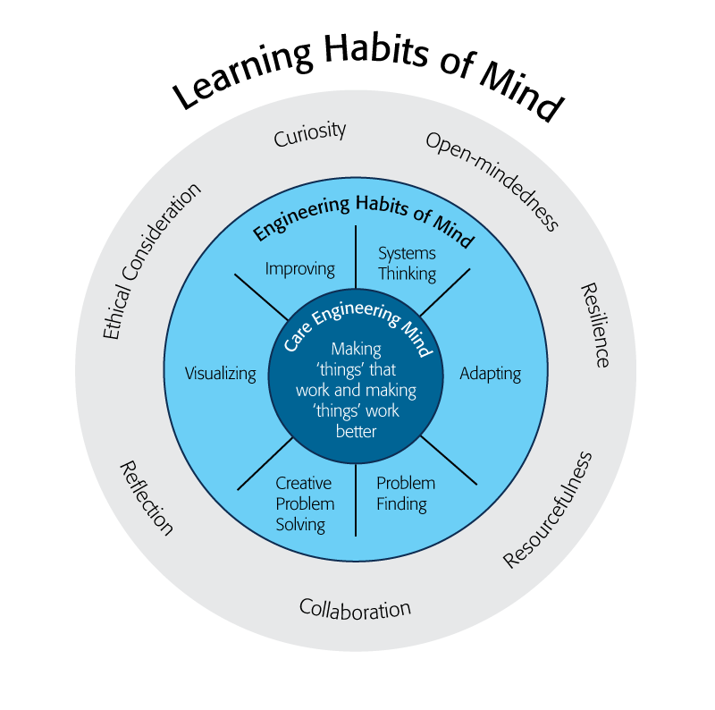
Engineering Habits of Mind
Engineering Habits of Mind (EHM) is about how engineers think everyday. The Core Engineering Mind is about making things that work and making them work better.
Source: https://online-journals.org/index.php/i-jep/article/view/5366)
Notes:
Consider if your lesson address these EHM and how much emphasis it place on each of the EHM. Emphasize the EHM by using the EHM langage when you can.Systems thinking: Seeing whole systems and parts and how they connect.
Problem-finding: identifying and defining a problem.
Visualising: manipulating materials and sketching. Mental rehearsal of practical design solutions
Improving: Persistently trying to make things better by experimenting, designing, sketching, and prototyping
Creative problem-solving: generating ideas and solutions with others with many iterations.
Adapting: Testing, analysing, reflecting, & rethinking
Source: B. Lucas and J. Hanson, Thinking Like an Engineer: Using Engineering Habits of Mind and Signature Pedagogies to Redesign Engineering Education. (International Journal of Engineering Pedagogy, Vol 6, No. 2 (2016): https://online-journals.org/index.php/i-jep/article/view/5366)
More resources on Habits of Mind can be found here: https://www.stem.org.uk/resources/community/collection/424831/engineering-habits-mind-primary
Bill Lucas and Janet Hanson from The Center for Real World Learning at the University of Winchester, UK wrote the paper, Thinking Like an Engineer: Using Engineering Habits of Mind and Signature Pedagogies to Redesign Engineering Education. In the paper, they “ identified the six most distinctive learning dispositions, or engineering “habits of mind” [EHoM] that engineers frequently deploy.”
Maybe add in Checklist here???

Slide 25
Engineering Habits of Mind Checklist
Systems thinking
Problem-finding
Visualising
Improving
Creative problem-solving
Adapting
Notes:
Systems thinking: seeing whole systems and parts and how they connect
Problem-finding: identifying and defining a problem
Visualising: manipulating materials and sketching
Improving: persistently trying to make things better by experimenting
Creative problem-solving: generating ideas with many iterations
Adapting: testing, analysing, reflecting & rethinking
More resources on Habits of Mind can be found here: https://www.stem.org.uk/resources/community/collection/424831/engineering-habits-mind-primary
Bill Lucas and Janet Hanson from The Center for Real World Learning at the University of Winchester, UK wrote the paper, Thinking Like an Engineer: Using Engineering Habits of Mind and Signature Pedagogies to Redesign Engineering Education. In the paper, they “ identified the six most distinctive learning dispositions, or engineering “habits of mind” [EHoM] that engineers frequently deploy.”

Slide 26
Learning Habits of Mind Checklist
Open-mindedness
Resilience
Resourcefulness
Collaboration
Reflection
Ethical Consideration
Curiosity
Notes:
More resources on Habits of Mind can be found here: https://www.stem.org.uk/resources/community/collection/424831/engineering-habits-mind-primary
Bill Lucas and Janet Hanson from The Center for Real World Learning at the University of Winchester, UK wrote the paper, Thinking Like an Engineer: Using Engineering Habits of Mind and Signature Pedagogies to Redesign Engineering Education. In the paper, they “ identified the six most distinctive learning dispositions, or engineering “habits of mind” [EHoM] that engineers frequently deploy.”

Slide 27
Greatest Engineering Achievements of the 20th Century
Source: http://www.greatachievements.org/

Slide 28
Learn more about how engineers make the world a better place

Slide 29
For more engineering lesson plans and resources like games, engineering careers, and STEM opportunities visit IEEE’s TryEngineering.org

