Slide 1

Lesson Plan:
Desert Island Survival

Slide 2
The Design Challenge

Slide 3
The Design Challenge
You are a team of engineers all working together to design and build a hut that can withstand a windstorm. The hut must be no bigger than 36 square inches and at least 5 inches high. It must have a working door.

Slide 4
Defining the Challenge: Criteria & Constraints
Criteria
The hut cannot be bigger than 36 square inches
The hut must be at least 5 inches high
The hut has to have a working door
The hut must withstand a windstorm for 10 seconds
Use the tape sparingly
Constraints
The hut cannot be taped to the table or stool during construction or testing
Use only the materials provided

Slide 5
Material
Required for Build – per team
4 Index cards
2 Pieces of construction paper 8x10
4 Pieces of newspaper
10 Craft sticks
Graph paper (36 sq inches)
Ruler
10 Pieces of masking tape (3 inches long)
4 Straws

Slide 6
Testing Material Process
Testing Material
Hair Dryer or Small Fan
Testing Process
Demonstrate the speed for the students. Place the hut design on a table or stool. The hair dryer or small fan should be held 12 inches away from the hut design. Point the hair dryer or small fan on full speed toward the hut design for 10 seconds. If the hut does not blow off the table or stool and stays in place for 10 seconds, they have succeeded.

Slide 7
Consider...
Before you get started building, present the rubric (see Student worksheet) to the group. Discuss the rubric with the students – so they know exactly what is required. Discuss what factors are needed for success. Some students will realize that the weight of the hut is an important factor.

Slide 8
Reflect & Debrief

Slide 9
Reflection
What would you change if you could change your design?
What did you learn from the other team’s designs?
How did you work together as a group?

Slide 10
Engineering Design Process

Slide 11
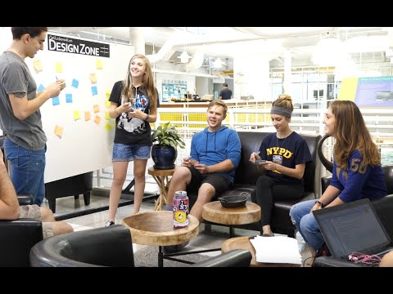
The Engineering Design Process
Learn about the engineering design process (EDP). The process engineers use to solve problems.
(Video 1:47)
Source: TeachEngineering YouTube Channel http://www.youtube.com/watch?v=b0ISWaNoz-c

Slide 12
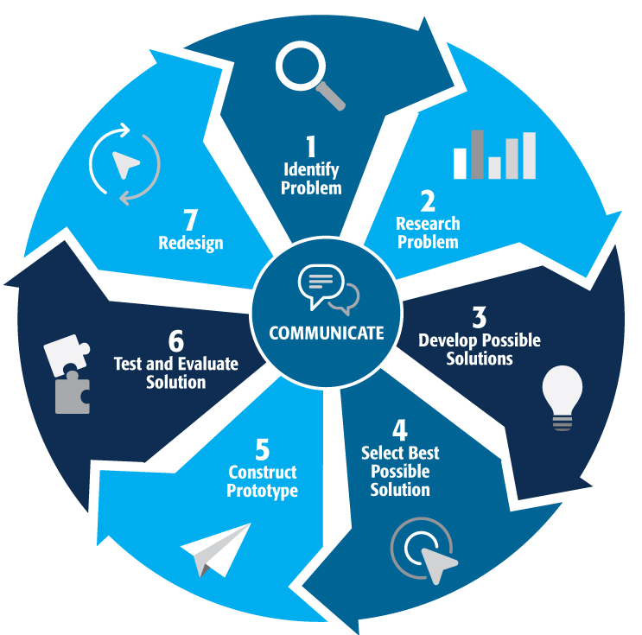
Engineering Design Process
Divide into teams
Review the challenge and criteria
& constraints
Brainstorm possible solutions (sketch
while you brainstorm!)
Choose best solution and build a prototype
Test then redesign until solution is
optimized
Reflect as a team and debrief as a class
Notes:
Material bags for teams to build…

Slide 13
Productive Failure
The engineering design process involves productive failure: test, fail, redesign. Iterate again and again until you have the best possible solution.
It is important to document iterations to keep track of each redesign. Use the engineering notebook to sketch ideas, document iterations and any measurement and/or calculations.
It’s also important to showcase the fact that there can be multiple solutions to the same problem. There’s no one “right” solution.

Slide 14
Vocabulary

Slide 15
Vocabulary
Criteria: Conditions that the design must satisfy like its overall size, etc.
Engineers: Inventors and problem-solvers of the world. Twenty-five major specialties are recognized in engineering (see infographic).
Engineering Design Process: Process engineers use to solve problems.
Engineering Habits of Mind (EHM): Six unique ways that engineers think.
Iteration: Test & redesign is one iteration. Repeat (multiple iterations).
Prototype: A working model of the solution to be tested.
Rubric: A scoring guide used to evaluate performance, a product, or a project.

Slide 16
Engineering Fields

Slide 17

What is Engineering?
Learn about engineering and how engineers are creative problem solvers and innovators who work to make the world a better place.
(Video 3:43)
Source: TeachEngineering YouTube Channel - http://www.youtube.com/watch?v=H9VDkvgGmVo

Slide 18
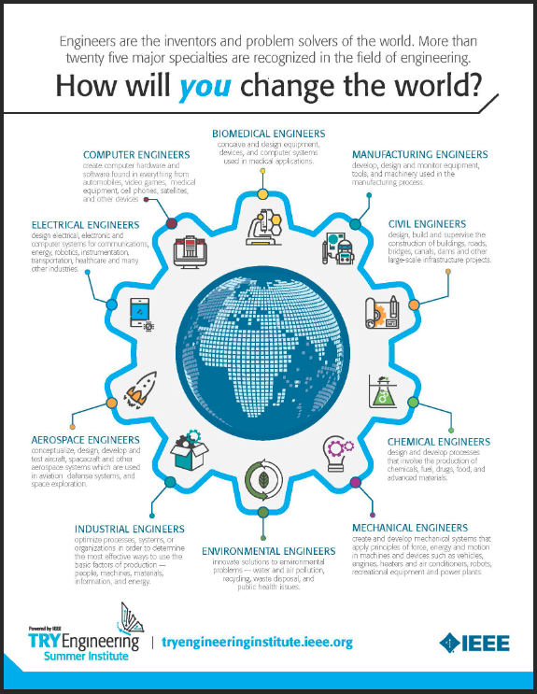
Related Engineering Fields
There are several types of engineering fields that are involved with the engineering and design of structures. Here are just some of the related engineering fields.
  Civil Engineering
  Mechanical Engineering
  Electrical Engineering
  Environmental Engineering
Download the Engineering Fields Infographic How will YOU change the world?

Slide 19
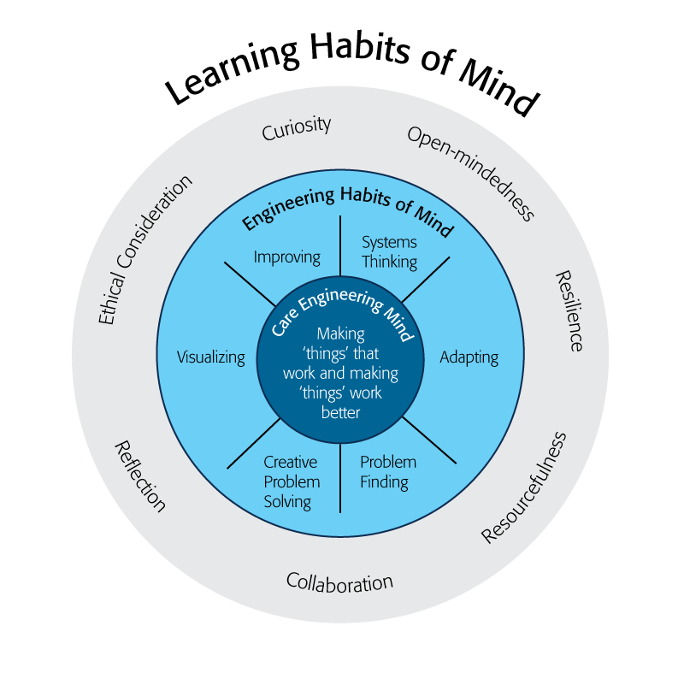
Engineering Habits of Mind
Engineering Habits of Mind (EHM) is about how engineers think everyday. The Core Engineering Mind is about making things that work and making them work better.
Source: https://online-journals.org/index.php/i-jep/article/view/5366)
Notes:
Consider if your lesson address these EHM and how much emphasis it place on each of the EHM. Emphasize the EHM by using the EHM langage when you can.Systems thinking: Seeing whole systems and parts and how they connect.
Problem-finding: identifying and defining a problem.
Visualising: manipulating materials and sketching.
Mental rehearsal of practical design solutions
Improving: Persistently trying to make things
better by experimenting, designing, sketching,
and prototyping
Creative problem-solving: generating ideas
and solutions with others with many iterations.
Adapting: Testing, analysing, reflecting,
& rethinking
Source: B. Lucas and J. Hanson, Thinking Like an Engineer: Using Engineering Habits of Mind and Signature Pedagogies to Redesign Engineering Education. (International Journal of Engineering Pedagogy, Vol 6, No. 2 (2016):
https://online-journals.org/index.php/i-jep/article/view/5366)
More resources on Habits of Mind can be found here: https://www.stem.org.uk/resources/community/collection/424831/engineering-habits-mind-primary
Bill Lucas and Janet Hanson from The Center for Real World Learning at the University of Winchester, UK wrote the paper, Thinking Like an Engineer: Using Engineering Habits of Mind and Signature Pedagogies to Redesign Engineering Education. In the paper, they “ identified the six most distinctive learning dispositions, or engineering “habits of mind” [EHoM] that engineers frequently deploy.”
Maybe add in Checklist here???

Slide 20
Engineering Habits of Mind Checklist
Systems thinking
Problem-finding
Visualising
Improving
Creative problem-solving
Adapting
Notes:
Systems thinking: seeing whole systems and parts and how they connect
Problem-finding: identifying and defining a problem
Visualising: manipulating materials and sketching
Improving: persistently trying to make things better by experimenting
Creative problem-solving: generating ideas with many iterations
Adapting: testing, analysing, reflecting & rethinking
More resources on Habits of Mind can be found here: https://www.stem.org.uk/resources/community/collection/424831/engineering-habits-mind-primary
Bill Lucas and Janet Hanson from The Center for Real World Learning at the University of Winchester, UK wrote the paper, Thinking Like an Engineer: Using Engineering Habits of Mind and Signature Pedagogies to Redesign Engineering Education. In the paper, they “ identified the six most distinctive learning dispositions, or engineering “habits of mind” [EHoM] that engineers frequently deploy.”

Slide 21
Learning Habits of Mind Checklist
Open-mindedness
Resilience
Resourcefulness
Collaboration
Reflection
Ethical Consideration
Curiosity
Notes:
More resources on Habits of Mind can be found here: https://www.stem.org.uk/resources/community/collection/424831/engineering-habits-mind-primary
Bill Lucas and Janet Hanson from The Center for Real World Learning at the University of Winchester, UK wrote the paper, Thinking Like an Engineer: Using Engineering Habits of Mind and Signature Pedagogies to Redesign Engineering Education. In the paper, they “ identified the six most distinctive learning dispositions, or engineering “habits of mind” [EHoM] that engineers frequently deploy.”

Slide 22
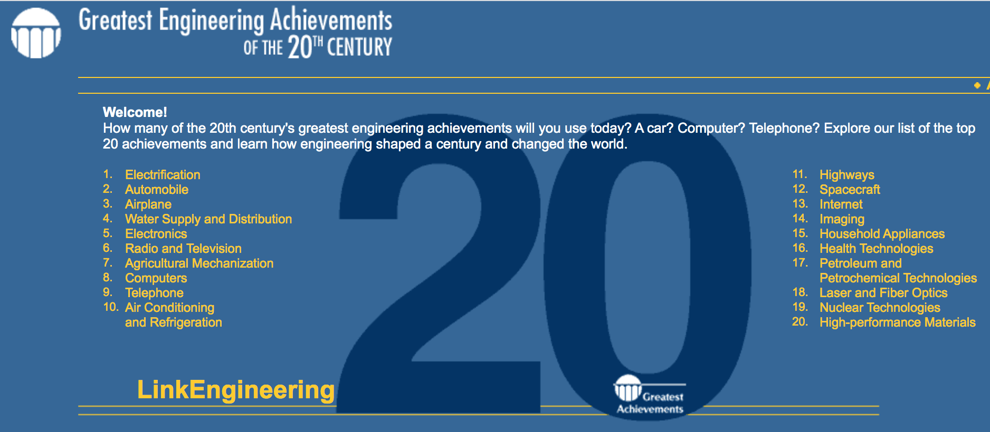
Greatest Engineering Achievements of the 20th Century
Source: http://www.greatachievements.org/

Slide 23

Learn more about how engineers make the world a better place

Slide 24

For more engineering lesson plans and
resources like games, engineering careers,
and STEM opportunities visit IEEE’s TryEngineering.org

