Slide 1
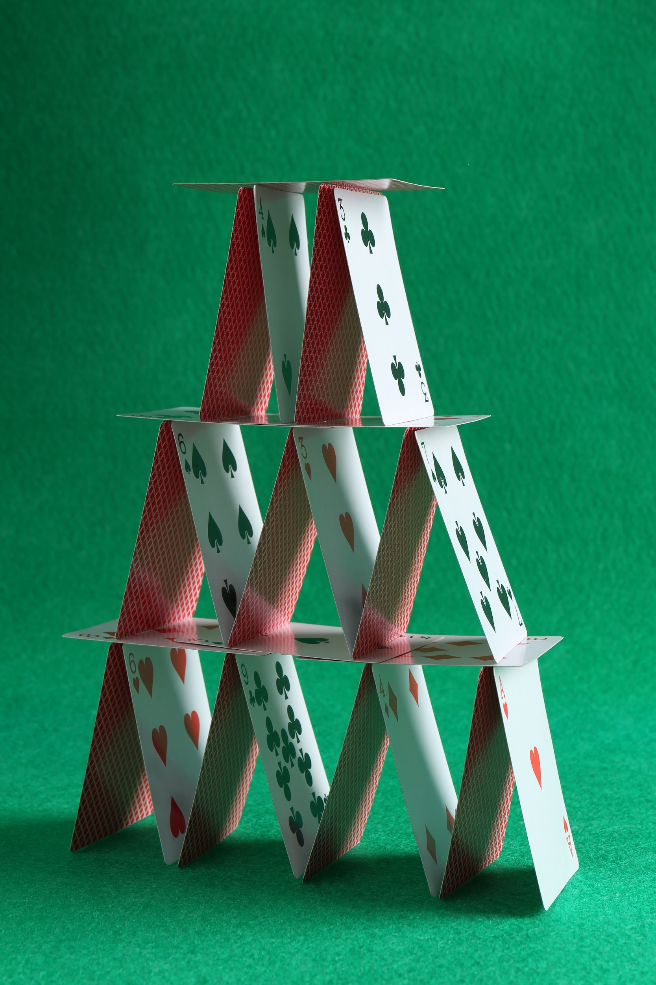
Critical Load
Early Childhood Adaptation

Slide 2
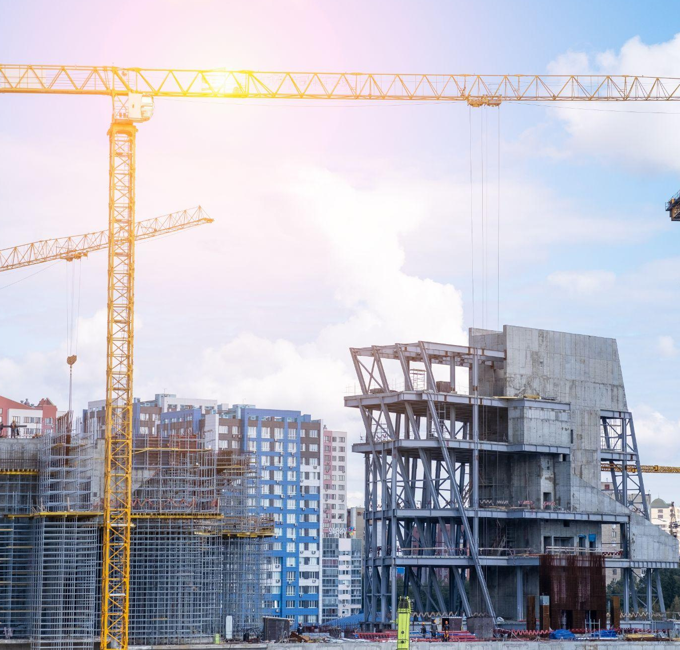
Part 1: Let’s Learn About Strong Structures

Slide 3
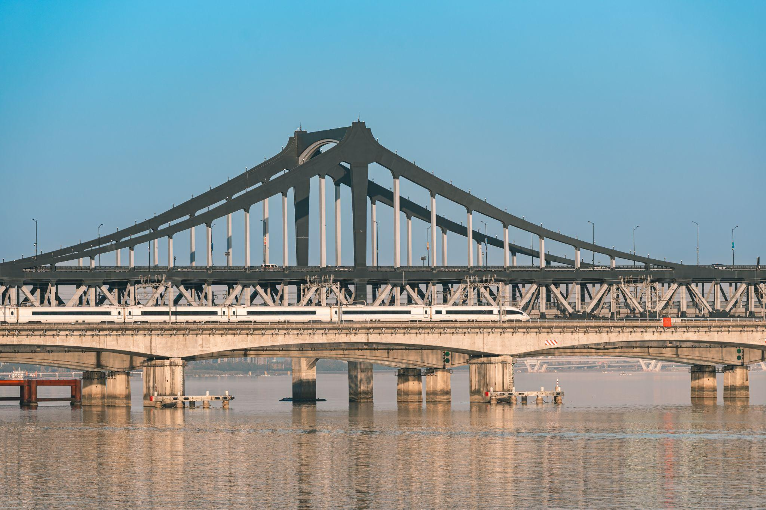
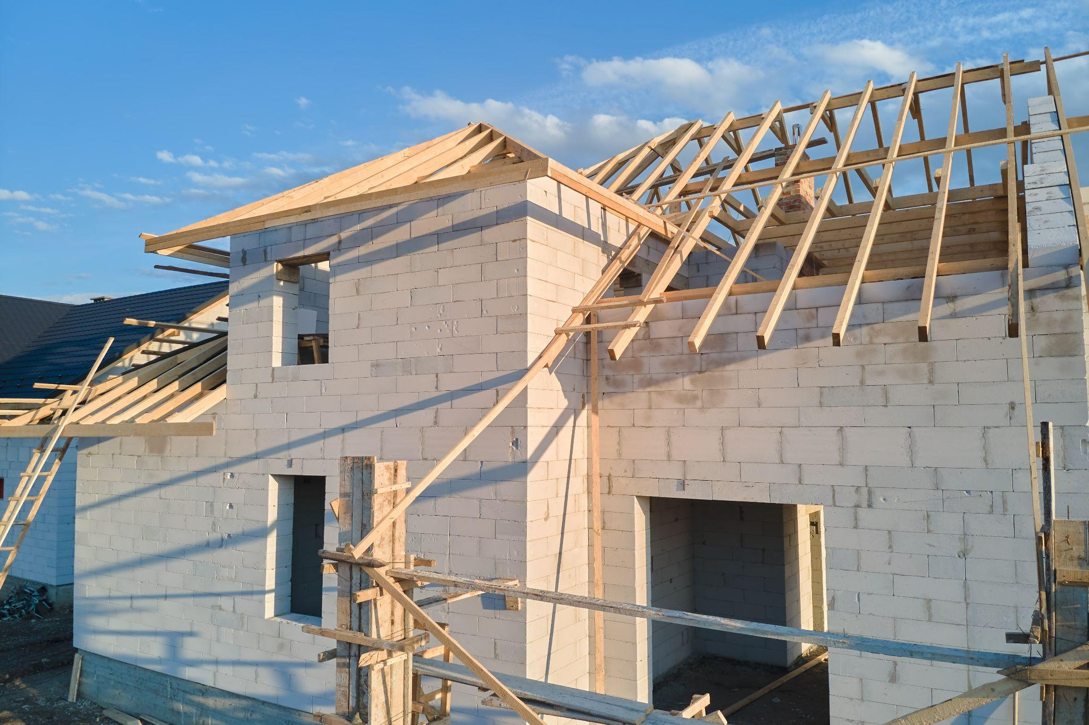
Let’s Make an Observation!
What do you notice?
What shapes do you see?
Are these structures strong? Why?
How do these structures hold weight?

Slide 4
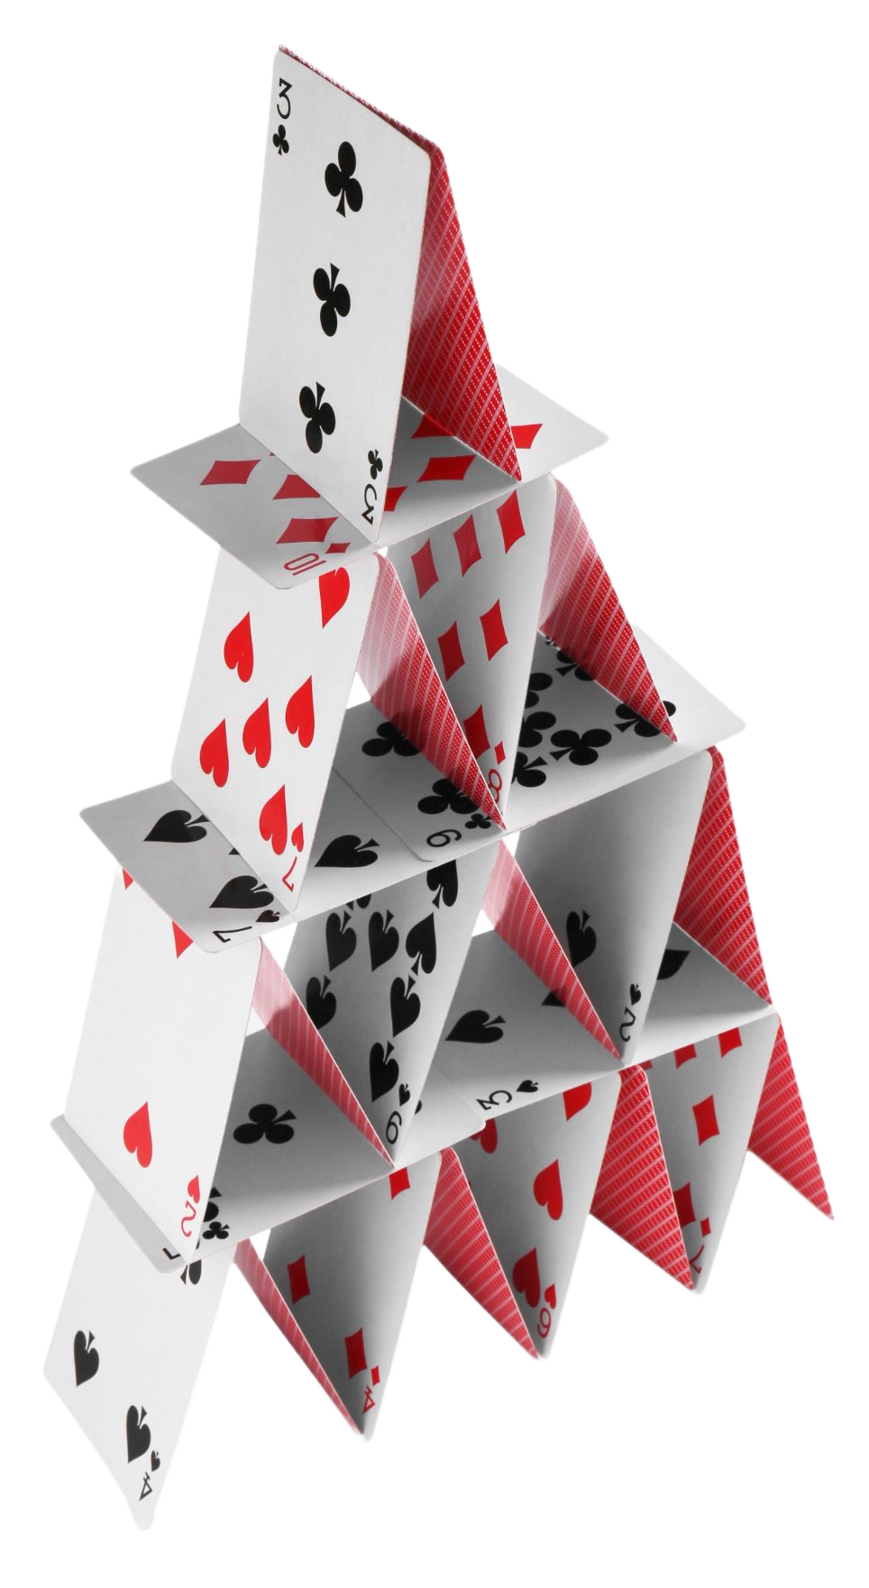
Engineering Design Challenge
Can we build a structure that holds a lot of weight without falling down?
Our challenge is to make a tower using index cards and tape that can hold as much weight as possible without collapsing.
To build our towers, we must become engineers. Engineers ask questions and observe before they build.

Slide 5
What Do We Know?
K W L
Let’s create a KWL Chart.
A KWL Chart is a graphic organizer used to organize knowledge about a topic.
Know: What I already know
Want: What I want to learn
Learned: What I learned
We will start by brainstorming everything we already know about strong structures!

Slide 6
What Do We Want to Know?
Engineers ask questions to understand a problem. Let’s think like engineers!
What do we want to know about strong structures?
What are things we need to know to make sure our structures can hold weight without falling over?
K W L

Slide 7
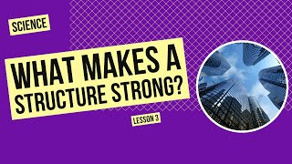
Watch & Discuss

Slide 8
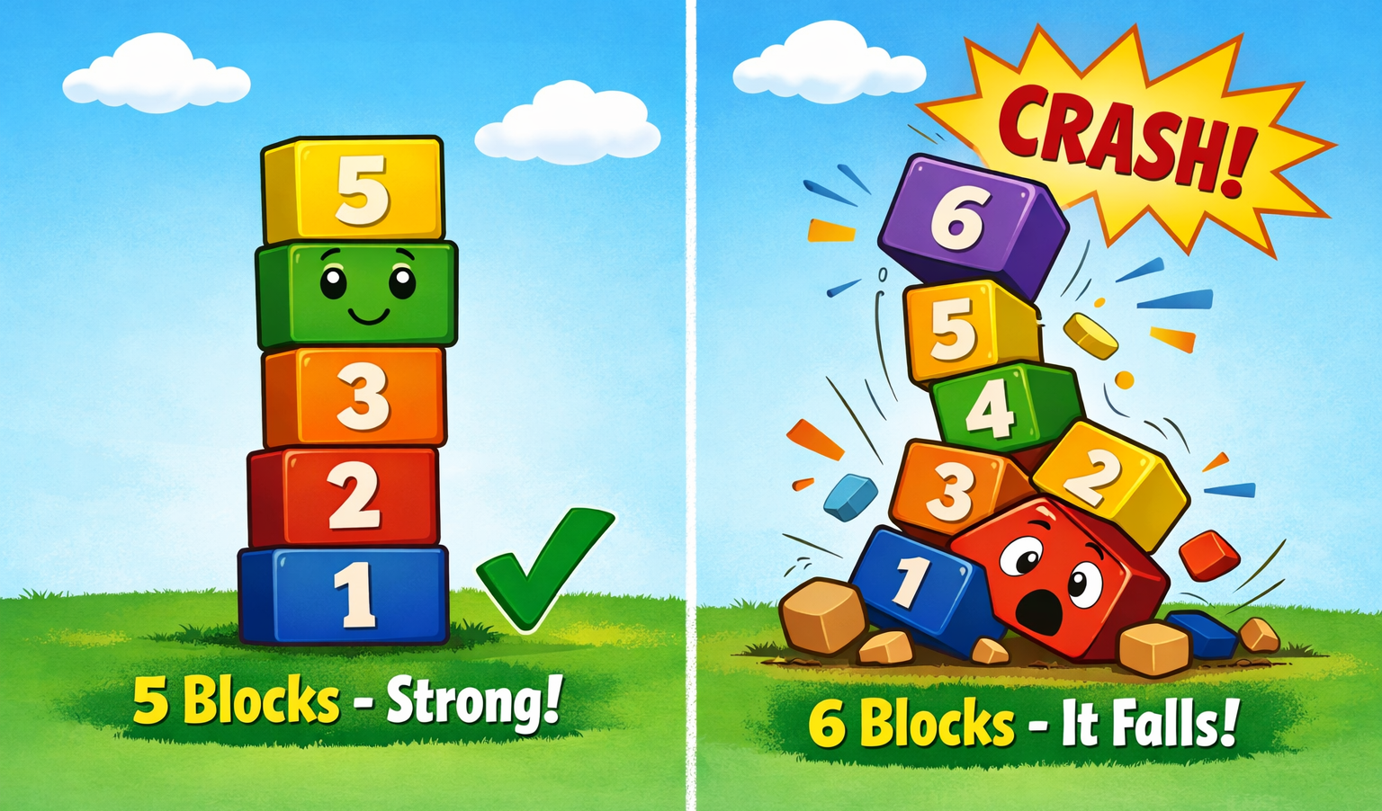
What is Critical Load?
A structure is strong if it can hold a lot of weight without breaking or falling.
The weight is called the load.
The critical load is the most amount of weight it can hold before it breaks.
The block tower can hold 5 blocks without falling down. When we add one more block, the tower falls!
The critical load of the block tower is 5 blocks.

Slide 9
What Did We Learn?
Engineers learn by watching and asking questions.
What did you learn about strong structures?
Were all your questions answered?
Do you still have questions?
K W L

Slide 10
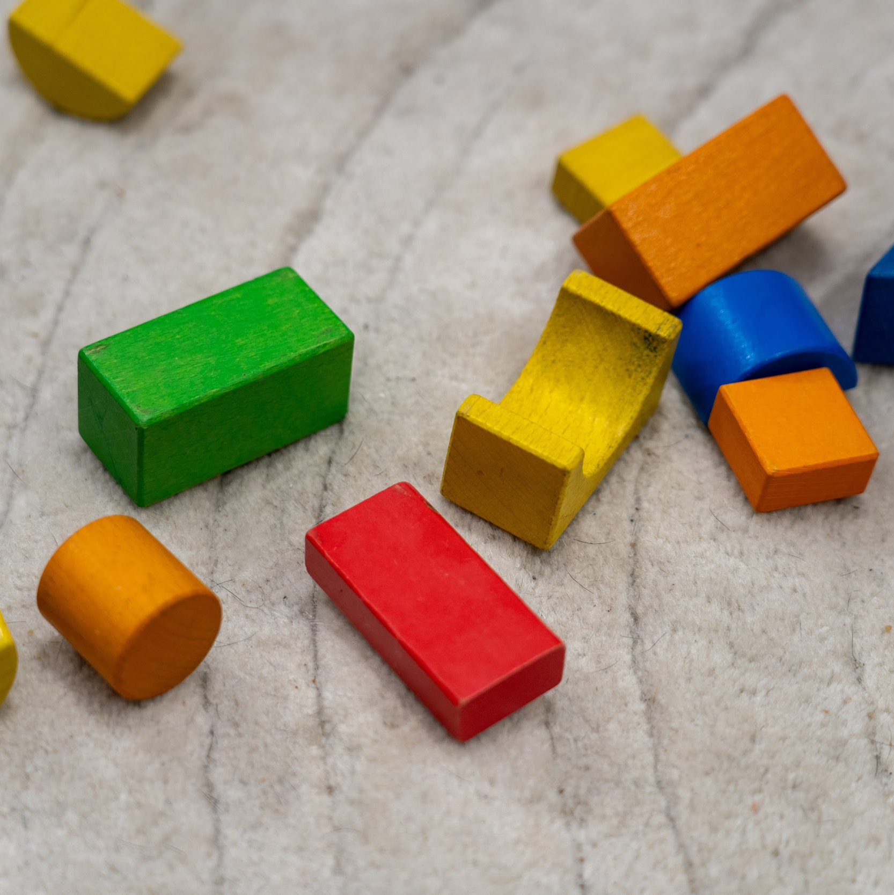
Part 2: Strong Shapes - How Structures Support Weight

Slide 11
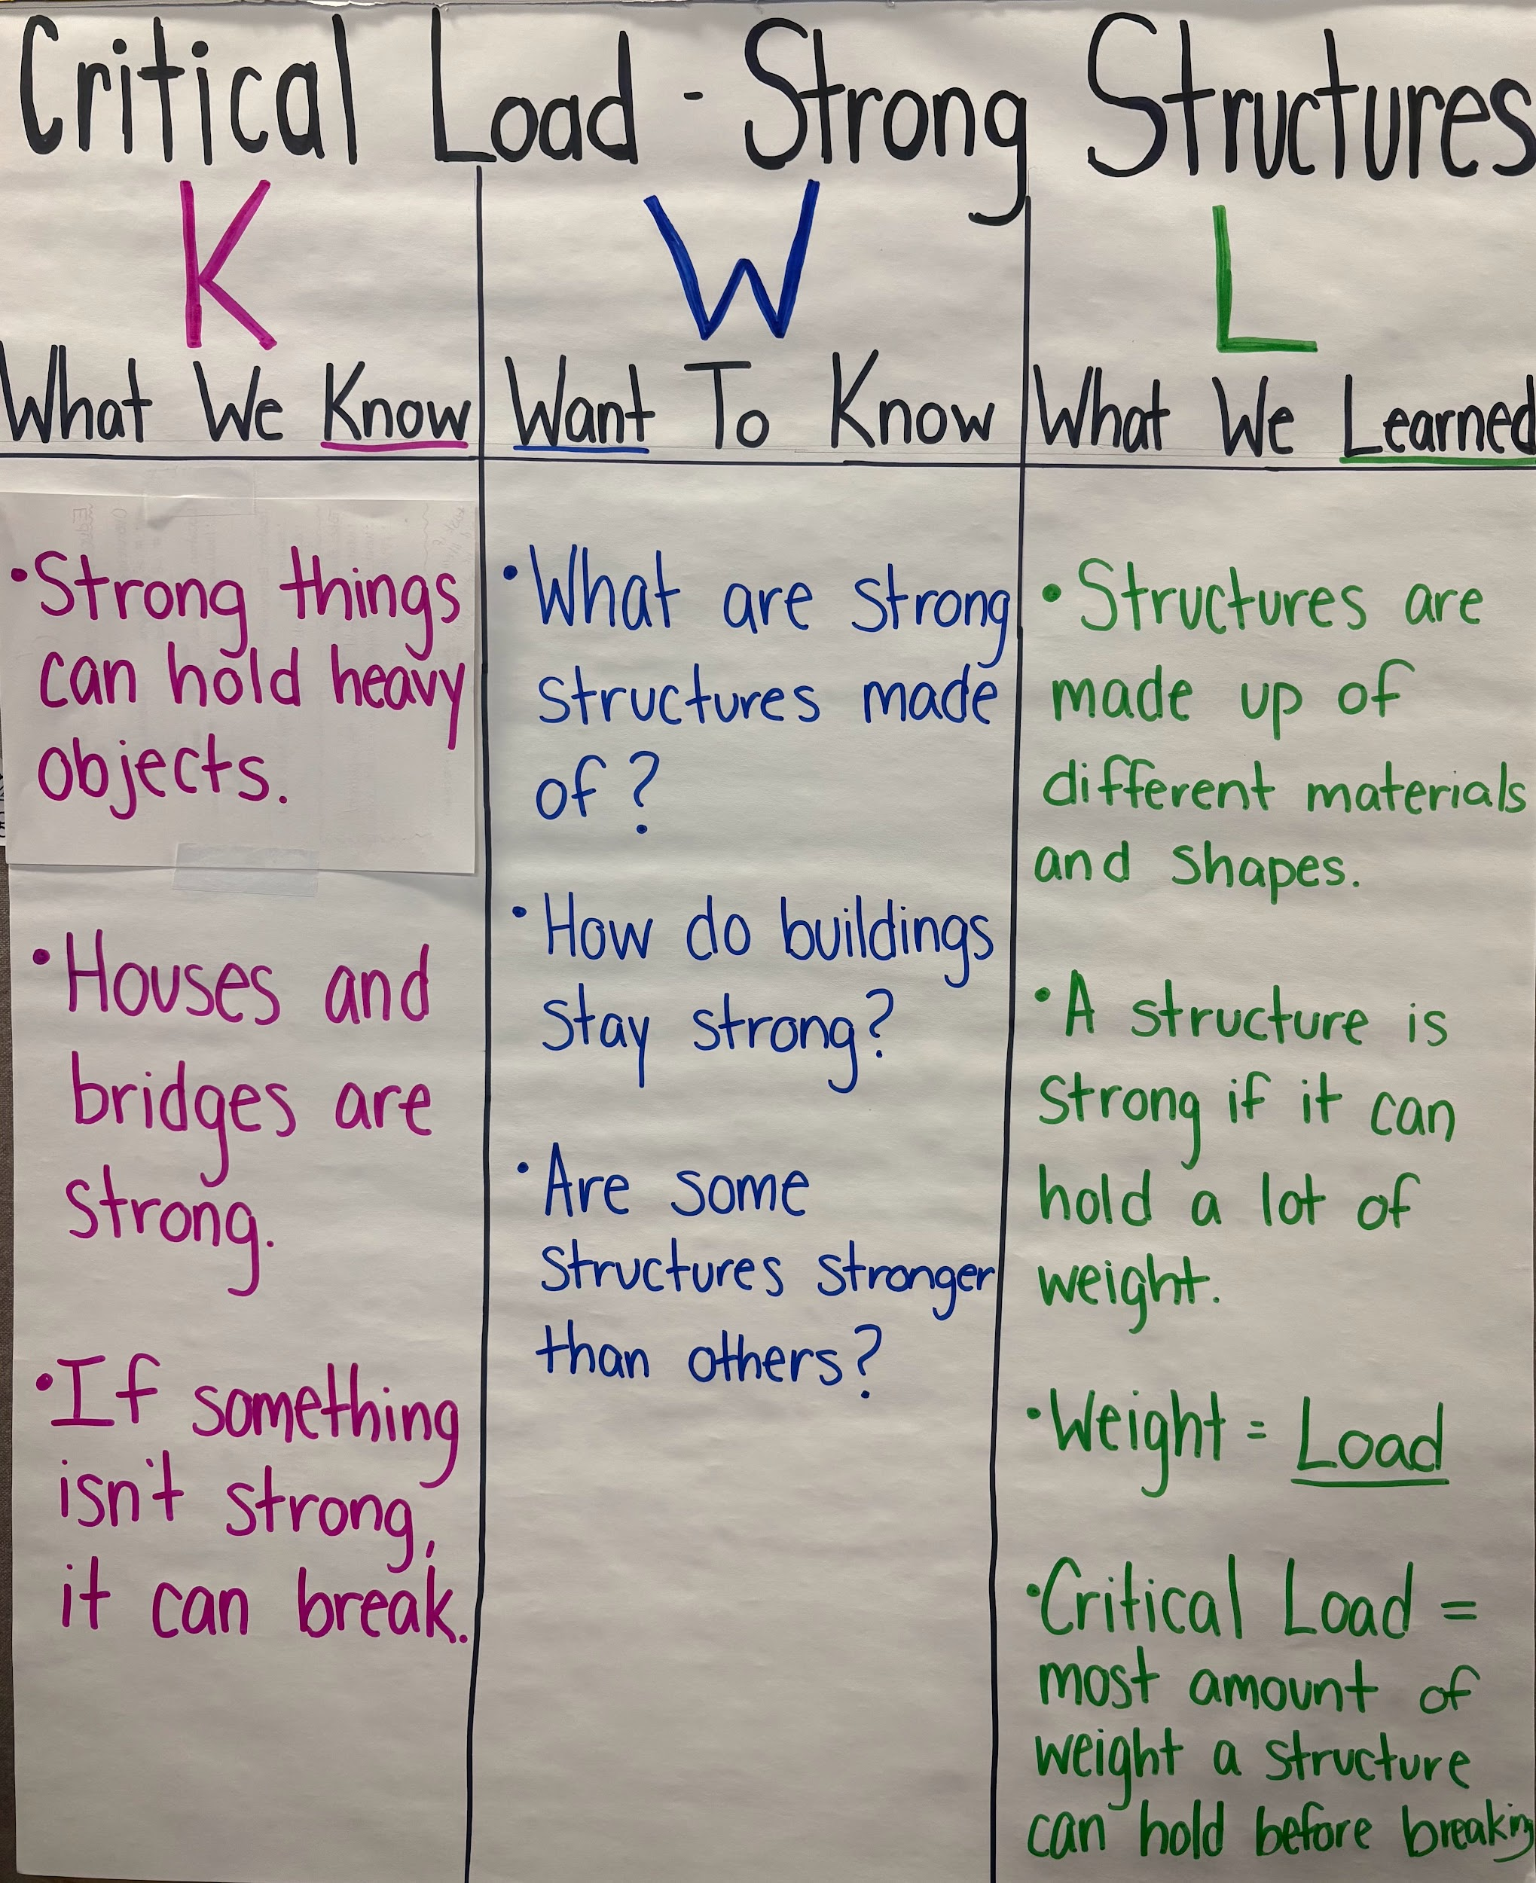
Review KWL Chart
What do you remember about strong structures?
What is critical load?
What makes structures strong?

Slide 12
Engineering Design Challenge
Can we build a structure that holds a lot of weight without falling down?
Our challenge is to make a tower using index cards and tape that can hold as much weight as possible without collapsing.
To build our towers, we must become engineers and explore our materials!

Slide 13
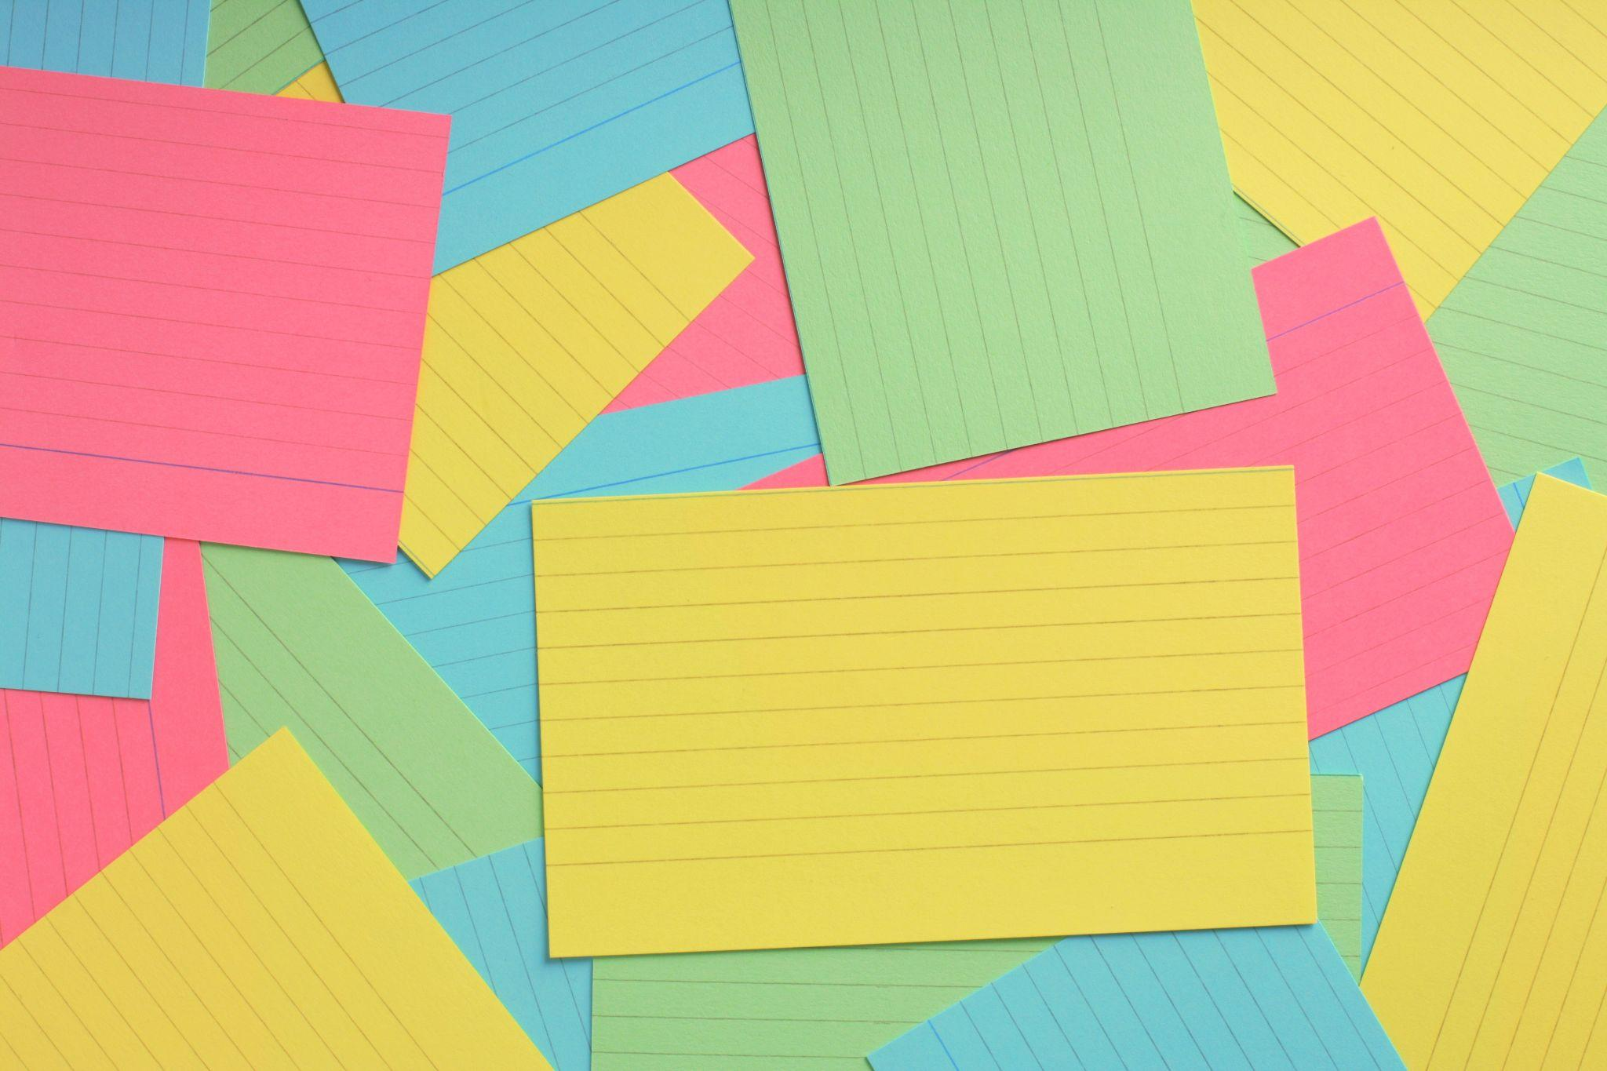
Material Exploration
Is an index card strong enough to hold your classroom weights?

Slide 14
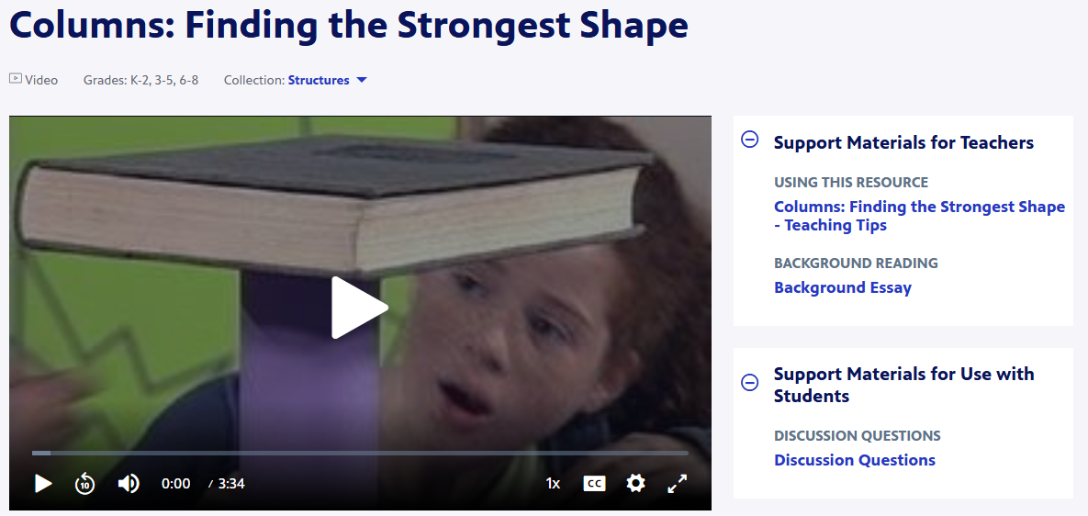
How Do Shapes Affect Structures?
Notes:
Visit https://www.pbslearningmedia.org/resource/phy03.sci.phys.mfe.zcolumnsi/columns-finding-the-strongest-shape/ or click on the image to watch the video.

Slide 15
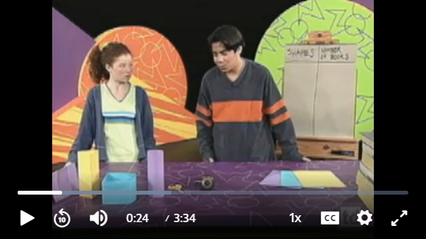
Making Predictions
Pause the video a 0:24.
What do you think will happen?
Tent -
Triangle -
Box -
Cylinder -

Slide 16

Testing Shape Structures
Create a tent, a triangle, a box, and a cylinder.
Test each shape’s strength by gently placing a book on top.
Did the results match your predictions?
Which shape had the highest critical load - the tent, triangle, box, or cylinder?

Slide 17
Reflection
Do you think we could use the same shapes with index cards?
Why is it helpful to test ideas instead of only thinking about them?
How might you design your structure so that it is strong enough to hold our classroom weights (coins, marbles, Legos, etc)?
How can shapes increase a structure’s critical load?

Slide 18
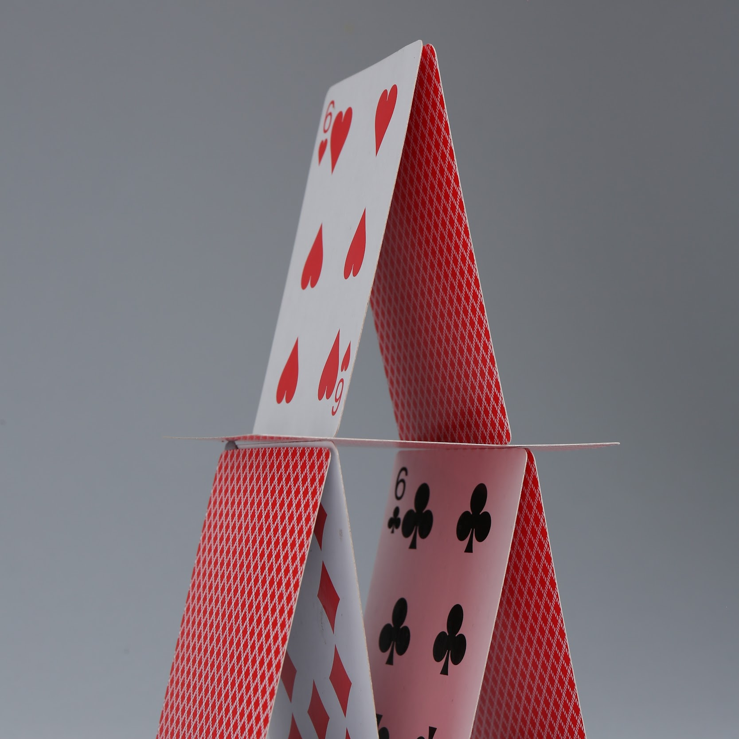
Part 3: Design, Build, & Test A Strong Structure

Slide 19
Engineering Design Challenge
Can we build a structure that holds a lot of weight without falling down?
Criteria:
The tower must stand up on its own
The tower must hold weight (blocks, books, coins, marbles, Legos, sand, etc)
Constraints:
Use only the materials provided
Do not cut or tear the cards

Slide 20

Brainstorming Solutions
What shapes will help your structure hold more weight?
Which part of your structure needs to hold the most weight?
How will you make the top large enough to hold something?
Draw your structure!

Slide 21
Build Your Solution
Working with your partner or team, use the materials provided to build ONE strong structure.
Criteria:
The tower must stand up on its own
The tower must hold weight (blocks, books, or other classroom weights)
Constraints:
Use only the materials provided
Do not cut or tear the cards

Slide 22
Test Your Solution
What do you think the “critical load” of your structure is?
Let’s find out!
Place your structure on a flat surface.
Your teacher will carefully place weight on your structure until it meets the critical load.
What was the critical load of your structure?

Slide 23
Reflection
What was your structure’s critical load?
How close were you to your prediction?
What aspects of your design do you think helped its ability to hold more weight?
  What shapes did you use?
How would you improve your structure to make it stronger?

Slide 24
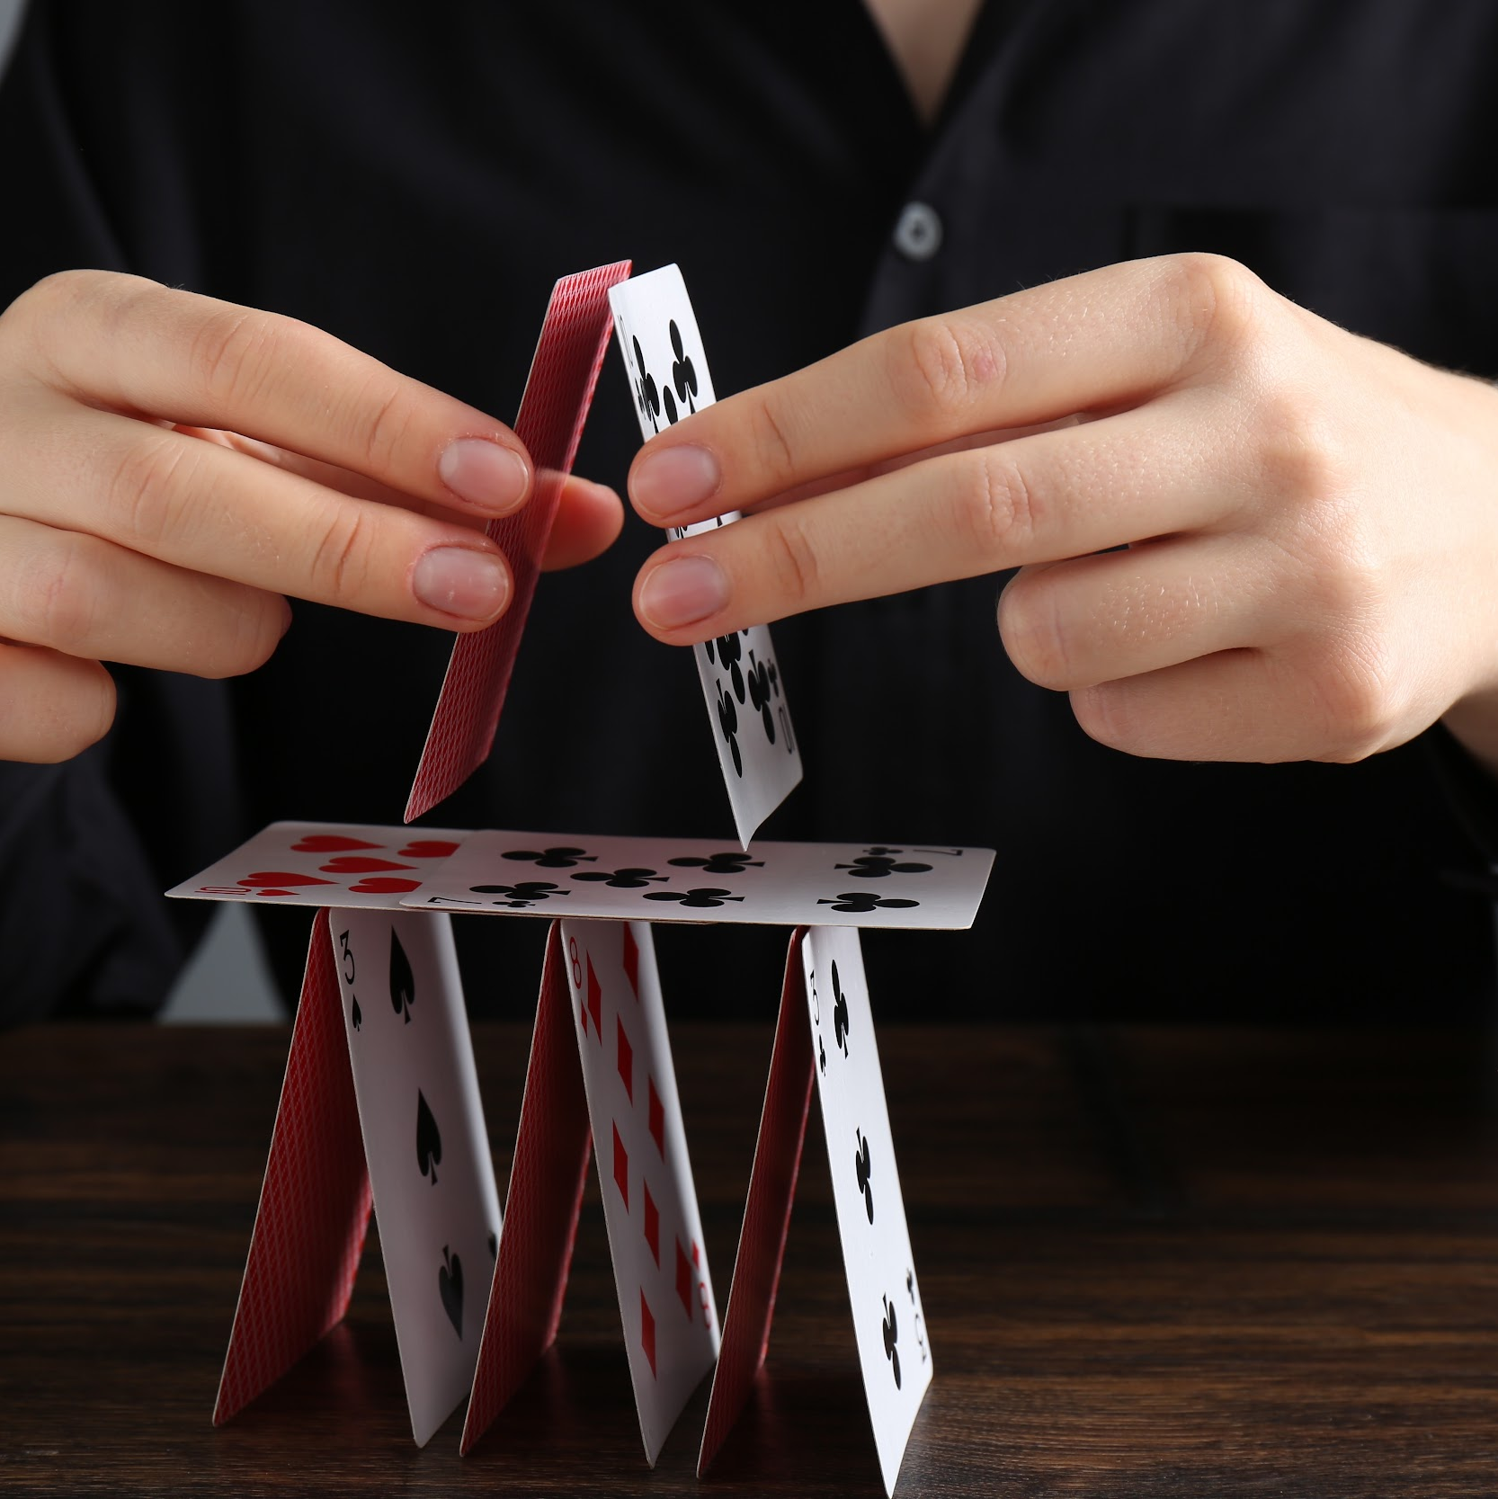
Part 4: Redesign & Share

Slide 25
Engineering Design Challenge
Can we build a structure that holds a lot of weight without falling down?
Criteria:
The tower must stand up on its own
The tower must hold weight (blocks, books, or other classroom weights)
Constraints:
Use only the materials provided
Do not cut or tear the cards

Slide 26

Redesign: Make it Better!
Engineers always look at what they made and think about how to make it better. Think about your first structure:
What was the critical load?
What shapes did you use?
How can you make your structure stronger?
Draw your new design!

Slide 27
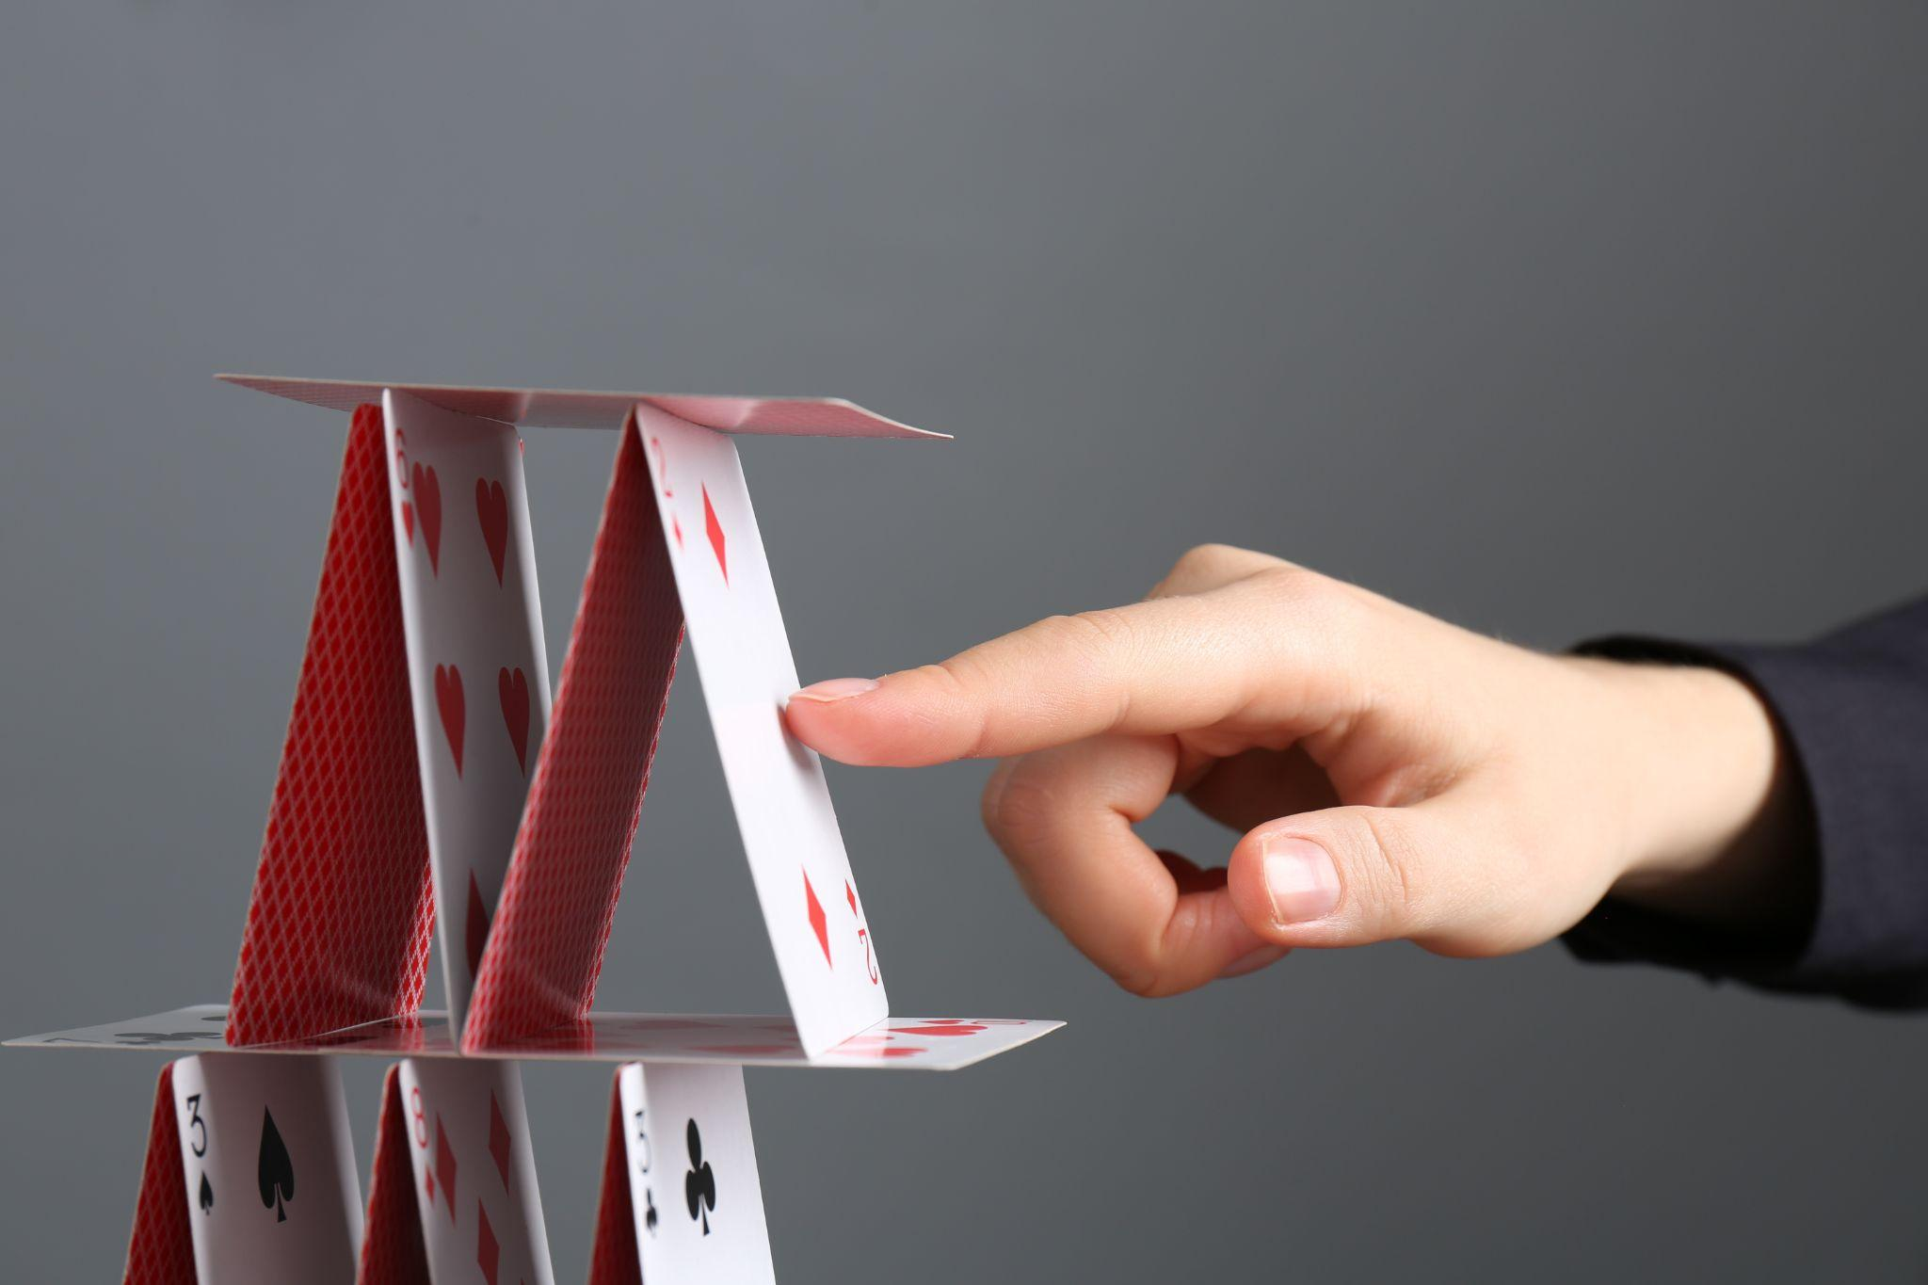
Build Your Redesigned Structure
Work with your partner or team to redesign your structure.
What did you change about your structure?
Will the changes increase your structures critical load?

Slide 28
Test Your Redesigned Structure
What do you think the “critical load” of your structure is?
Let’s find out!
Place your structure on a flat surface.
Your teacher will carefully place weight on your structure until it meets the critical load.
What was the critical load of your structure? Was it better than your first design?

Slide 29
Share Your Results
Share with the class!
What was the critical load of your first structure?
What was the critical load of your second structure?
Which was better? Why?
What shapes did you use in each?
Why is it important to know the critical load?

Slide 30

Reflection
What was the hardest part of building today?
What did you learn from watching other teams test their structures?
How did you help your teammates?
What would you change if you could build again?
Why do real buildings need to hold a lot of weight?
Where do you see strong shapes—like triangles or cylinders—in real buildings?

