Slide 1
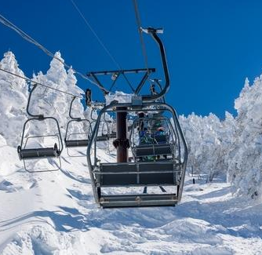
Chair Lift Challenge
Early-Childhood Adaptation

Slide 2
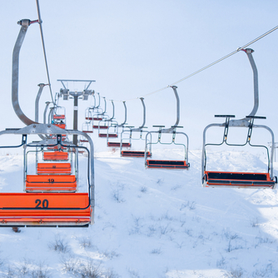
Part 1: Let’s Learn About Chair Lifts!

Slide 3
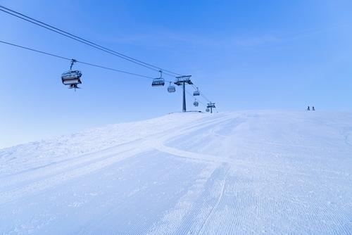
Let’s Make An Observation!
What do you notice?
Where was this picture taken?
Who uses this transportation system?

Slide 4
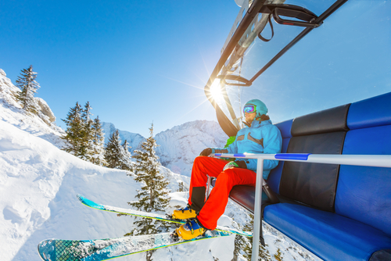
Personal Connections
Who has ridden in a chair lift at a ski mountain? What was it like?
Did you feel like you were flying? Were you up high?
What did the chair look like? Did it have a bar to keep you safe?
For friends who haven't been on a chair lift - have you been on a swing? A chair lift is kind of like a swing that moves you up a mountain!

Slide 5
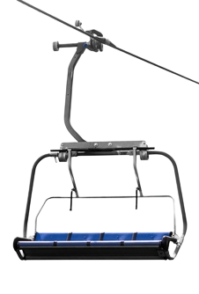
Engineering Design Challenge
Can we make a chair lift that sends a ball up a mountain?
Our goal is to make a tiny chair that can hold a ping pong ball and travel up and down a mountain without dropping the ball!
To build our chair lifts, we must become engineers! Engineers ask questions and observe before they build.

Slide 6
What Do We Know?
K W L
Let’s create a KWL Chart.
A KWL Chart is a graphic organizer used to organize knowledge about a topic.
Know: What I already know
Want: What I want to learn
Learned: What I learned
We will start by brainstorming everything we already know about chair lifts!

Slide 7
What Do We Want to Know?
Engineers ask questions to understand a problem. Let’s think like engineers!
What do we want to know about chair lifts?
What are things we need to know to make sure our chair lifts can travel up and down the mountain without dropping the ball?
K W L

Slide 8

Chair Lift in Action!

Slide 9
Chair Lift in Action!
What did you see? What were the chairs attached to?
Did the chairs move by themselves or was something pulling them?
Were people safe in the chairs?
For those who have ridden chair lifts, did it look like the ones you’ve been on?

Slide 10
What Did We Learn?
Engineers learn by watching and asking questions.
What did you learn about chair lifts?
Were all your questions answered?
Do you still have questions?
Tomorrow, we will act as engineers by designing and building our chairs!
K W L

Slide 11
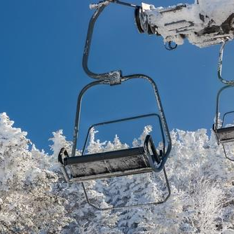
Part 2: Design and Build Your Chair

Slide 12
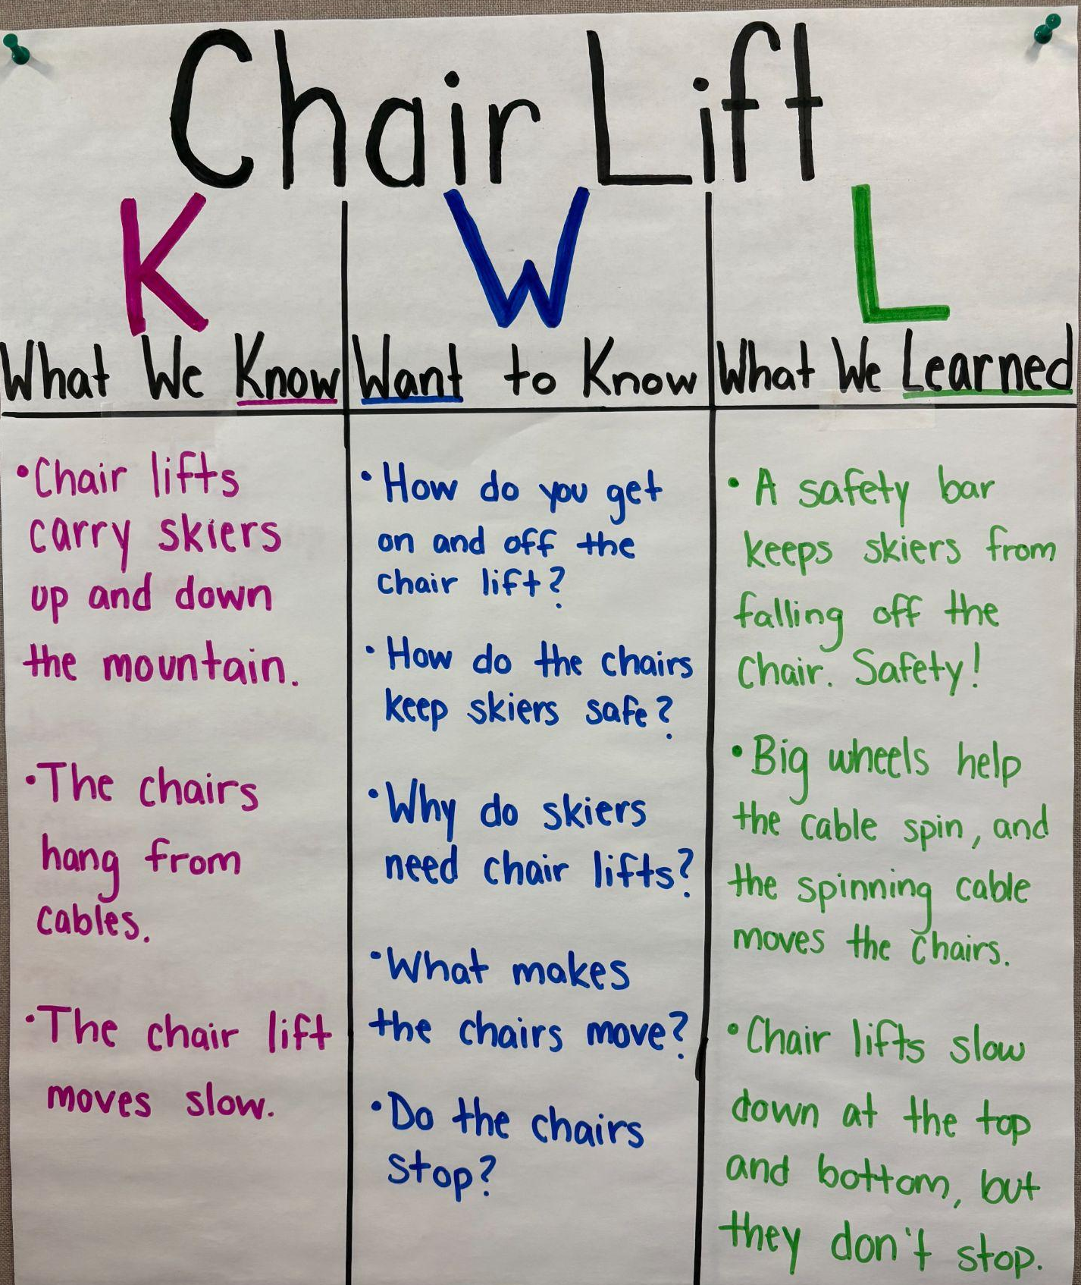
Review KWL Chart
Yesterday, we learned how chair lifts work and keep skiers safe.
What do you remember about chair lifts?
What helps them go up the mountain?
How do they keep people safe?
Today, we’re going to build a chair for our ping pong balls to travel up the mountain.

Slide 13
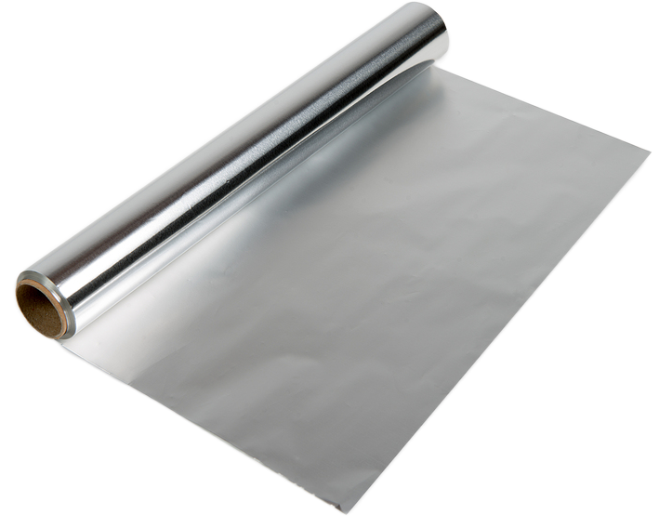
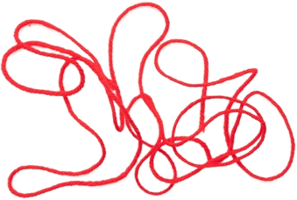
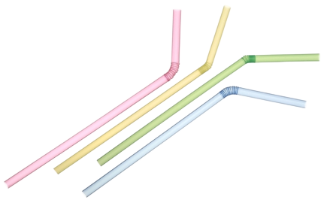
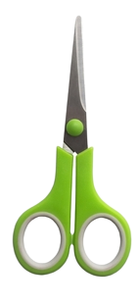
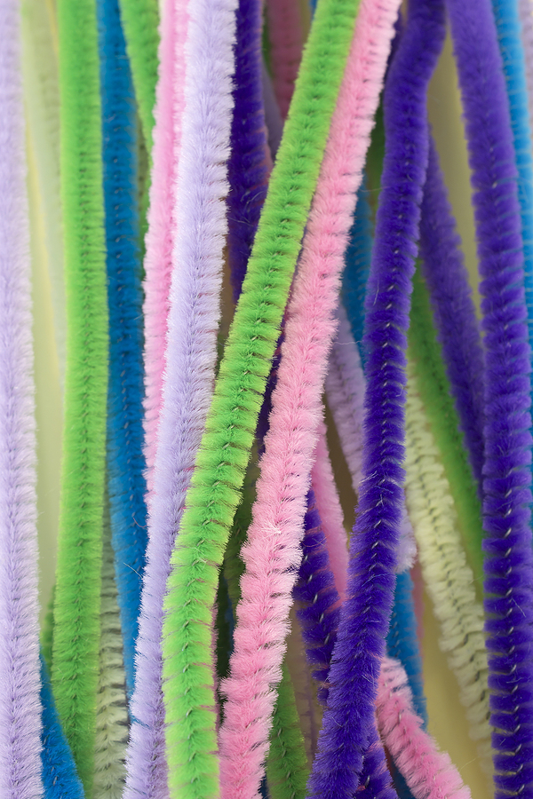
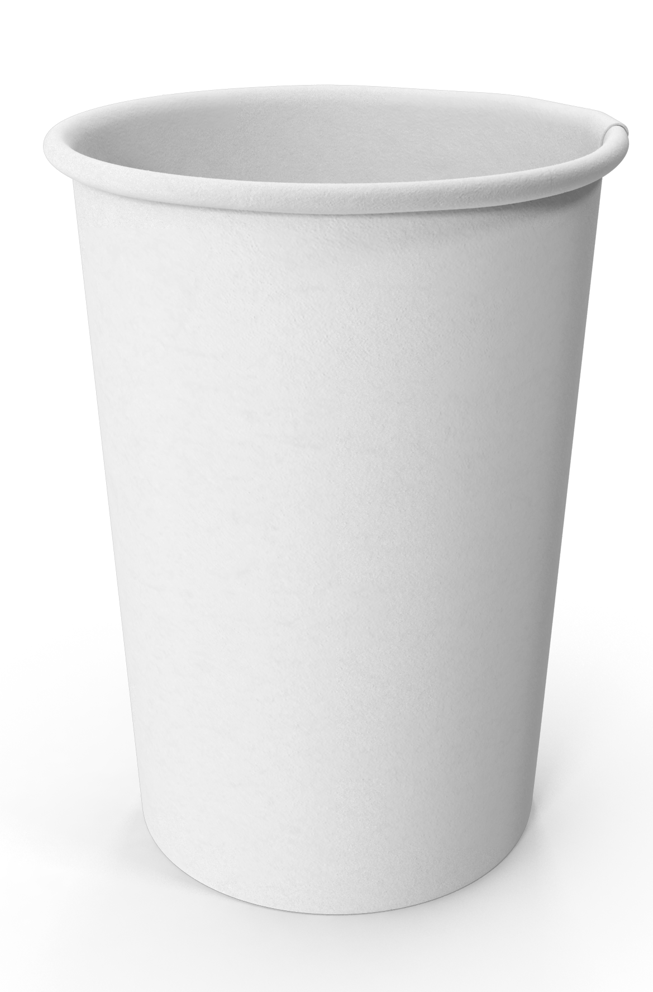

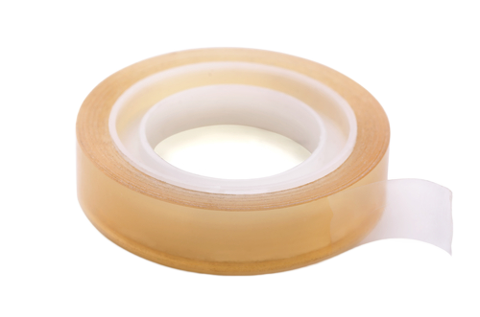
Material Exploration
Let’s explore our materials!
Which ones are strong? Which are bendy?
Which ones could make good sides for a chair?
Which ones could we use to hang the chair?

Slide 14
Engineering Design Challenge
Can we make a chair lift that sends a ball up a mountain?
Criteria:
The chair must hold a ping pong ball.
The ball must stay in the chair from bottom to top.
The chair must be light enough to hang, move, and slide up and down the mountain on the cable.
Constraints:
Use only the materials provided.
No pushing the chair – it must slide/roll on the cable.

Slide 15
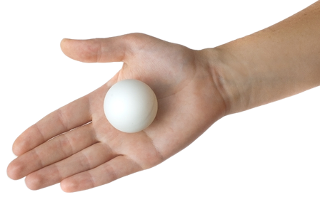
Brainstorming Solutions
Let’s think about what makes a good chair for our ball.
What does a chair look like?
If you’ve ridden a chair lift, what kept you from sliding out?
What shape would work best?
Where should we attach the string?
Draw your chair design!
Ping Pong Ball Test
Use your hands to cup the ball in different ways.
What hand shape keeps the ball the safest?

Slide 16
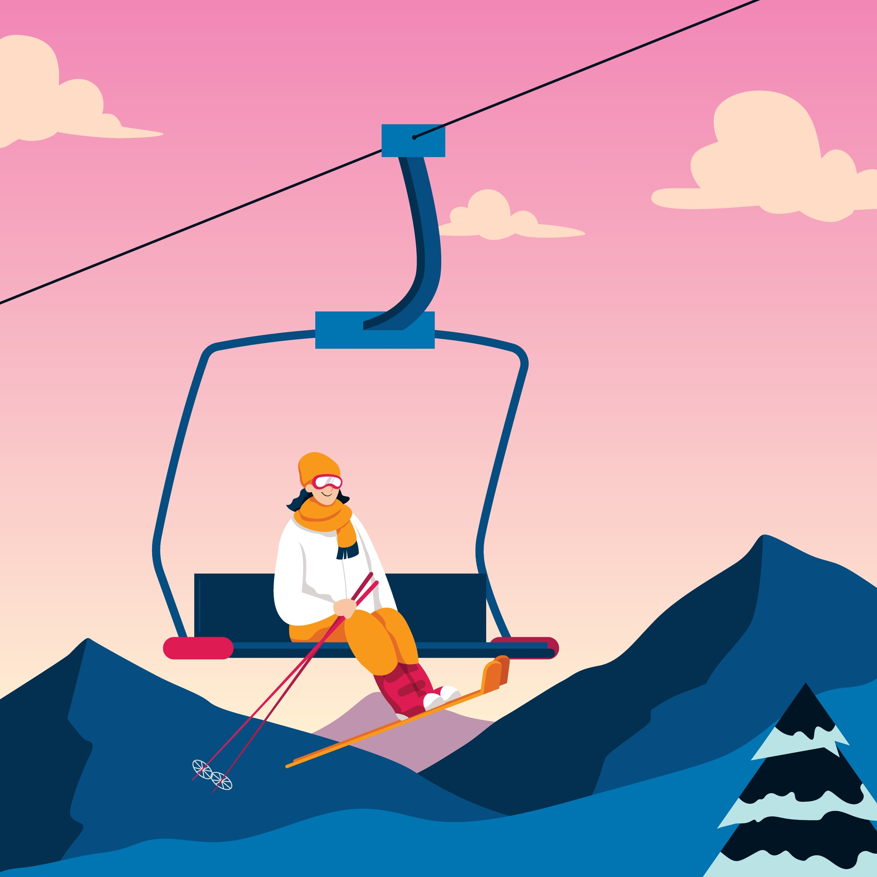
Build Your Solution
Working with a partner or in small groups, use the materials provided to build ONE chair.
Criteria:
The chair must hold the ping pong ball.
The ball cannot fall out when the chair is moved.
The chair must be light enough to hang and move.
Constraints:
Use only the materials provided.

Slide 17
Test Your Solution
Test 1
The Shake Test
Test 2
The Tilt Test
Test 3
The Swing Test
Hold the chair by the strings.
Gently shake it side to side.
Does the ball roll out or stay in?
Tilt the chair forward and backward.
Does the ball roll out or stay in?
Hold the chair by the strings.
Gently swing it back and forth?
Does the ball roll out or stay in?

Slide 18
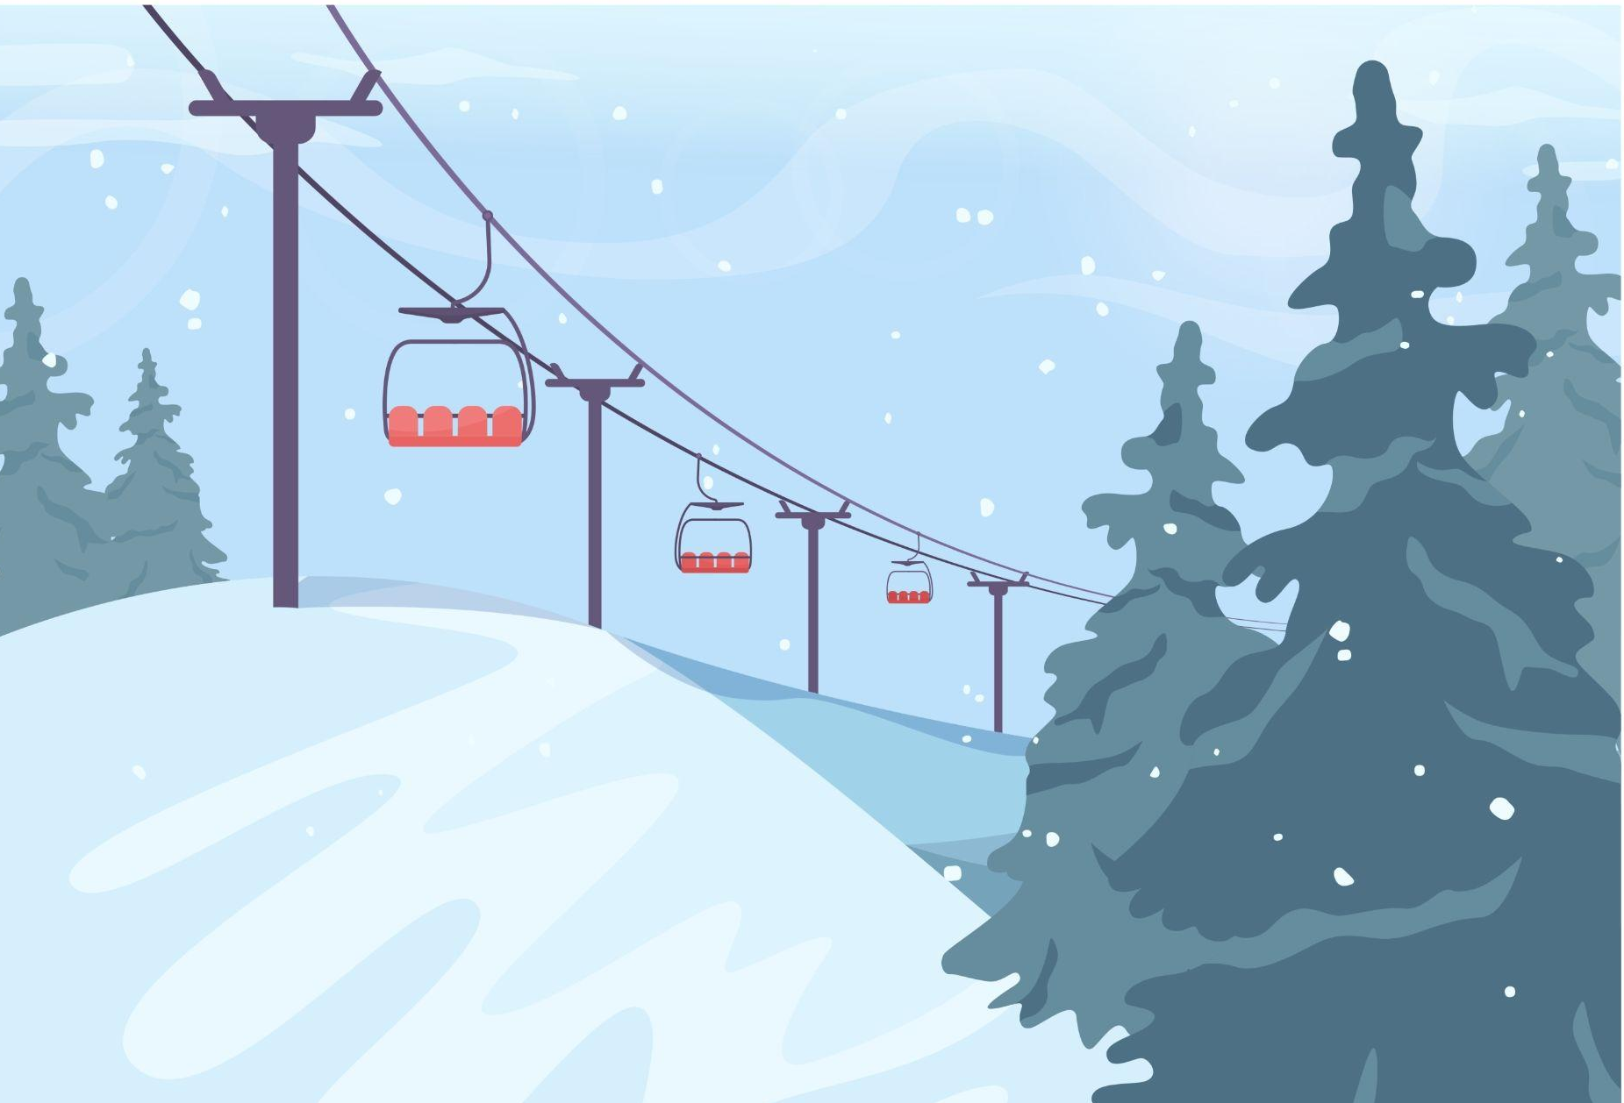
Reflection
Did your ball stay in the chair?
What worked well about your design?
If you could change one thing, what would it be?

Slide 19
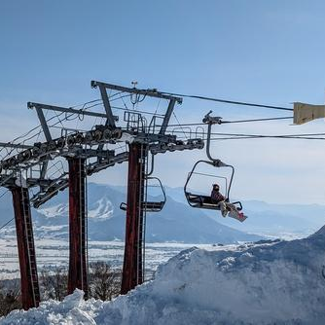
Part 3: Design & Build the Lift Attachment

Slide 20
Engineering Design Challenge
Can we make a chair lift that sends a ball up a mountain?
Criteria:
The chair must hold a ping pong ball.
The ball must stay in the chair from bottom to top.
The chair must be light enough to hang, move, and slide up and down the mountain on the cable.
Constraints:
Use only the materials provided.
No pushing the chair – it must slide/roll on the cable.

Slide 21
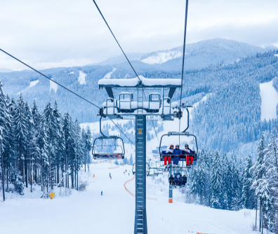
Cable Demonstration
Your chairs need to hang from the cable and slide along it.
How can you attach your chair to the cable so it can slide?
Which material could you slide along the string?

Slide 22
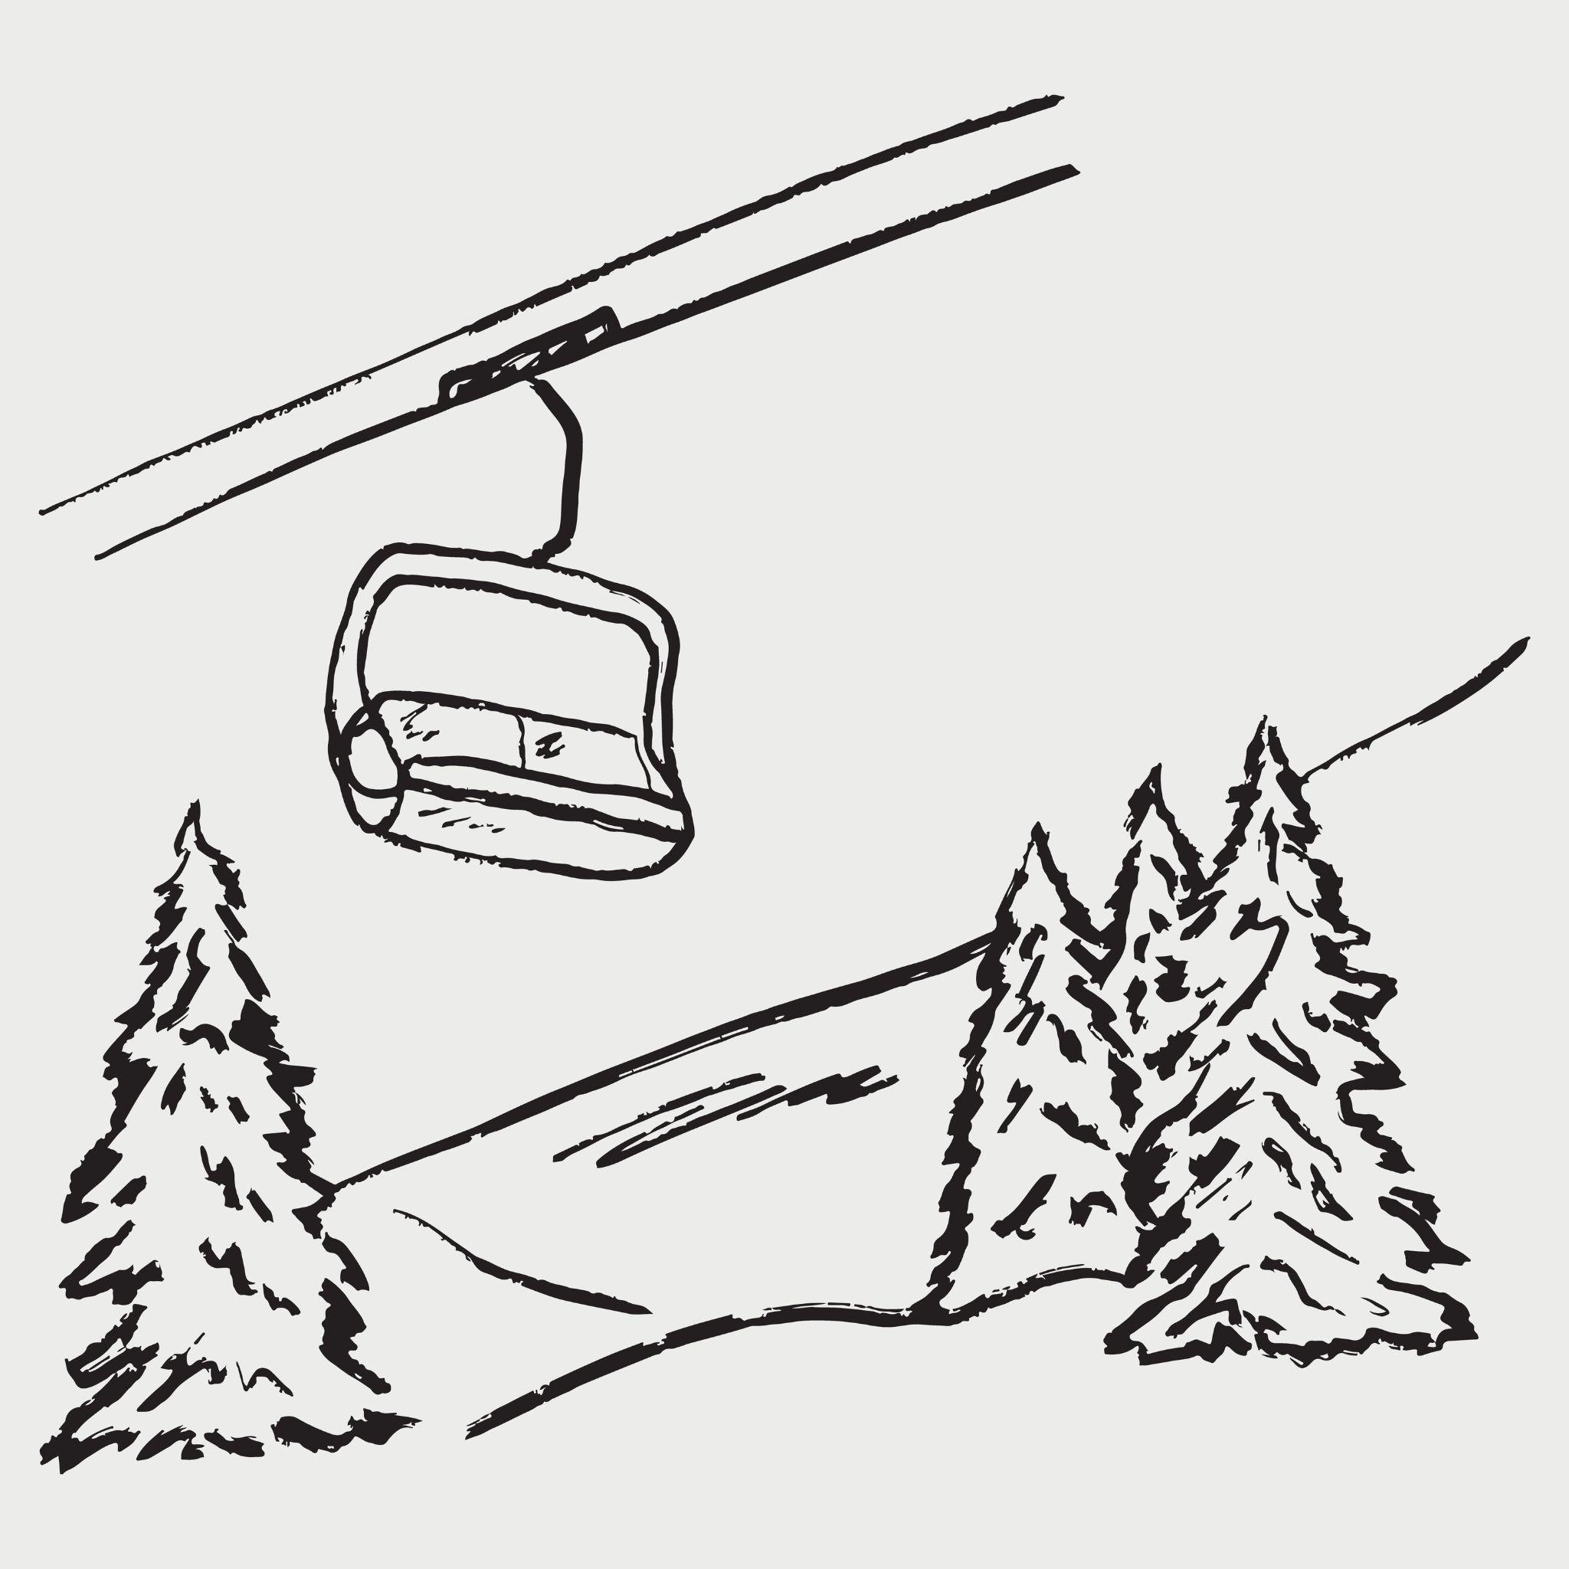
Brainstorming Solutions
Experiment with different materials on string!
What can you put on the string that will slide easily?
How will you attach the sliding part to your chair?
Will your chair hang straight, or will it tip?
How can you ensure the ball doesn’t fall out when the chair moves?
Draw your lift design!

Slide 23
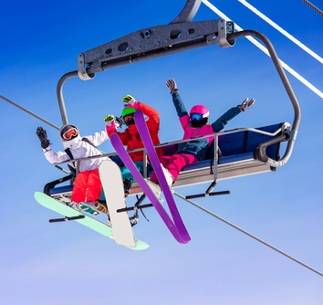
Build Your Solution
Working with your partner or team, use the materials provided to build ONE lift attachment by:
Choosing which material will slide on the cable
Attaching it to the string cable
Attaching your chair to the sliding piece

Slide 24
Test Your Solution
Test 1
Movement Test
Test 2
Ball Safety Test
Test 3
Downhill Test
Place the chair at the bottom.
Gently pull or push it along the cable.
Does it move smoothly up the mountain?
Put the ping pong ball in the chair
Move the chair up the cable slowly.
Does the ball stay in the entire ride?
Put the ping pong ball in the chair
Move the chair down the cable.
Does it move smoothly and keep the ball safe?

Slide 25
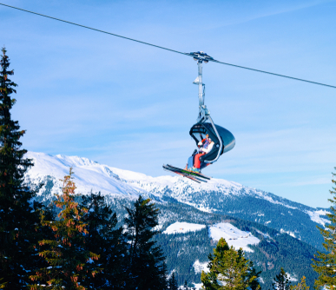
Reflection
Did your chair lift work? Did the ball make it to the top?
What was hard about making the lift?
How is you chair like a real chair lift?
What would you change about your chair or lift?

Slide 26
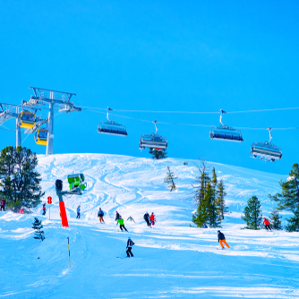
Part 4: Redesign & Share

Slide 27
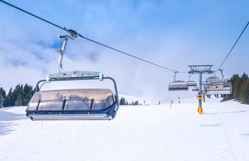
Revisit Your Chair Lifts
Engineers always look at what they made and think about how to make it better. Let’s look at our chair lifts and discuss:
Did your chair lift work? Did the ball make it to the top?
Can you change or adjust the structure or materials to make it better?

Slide 28
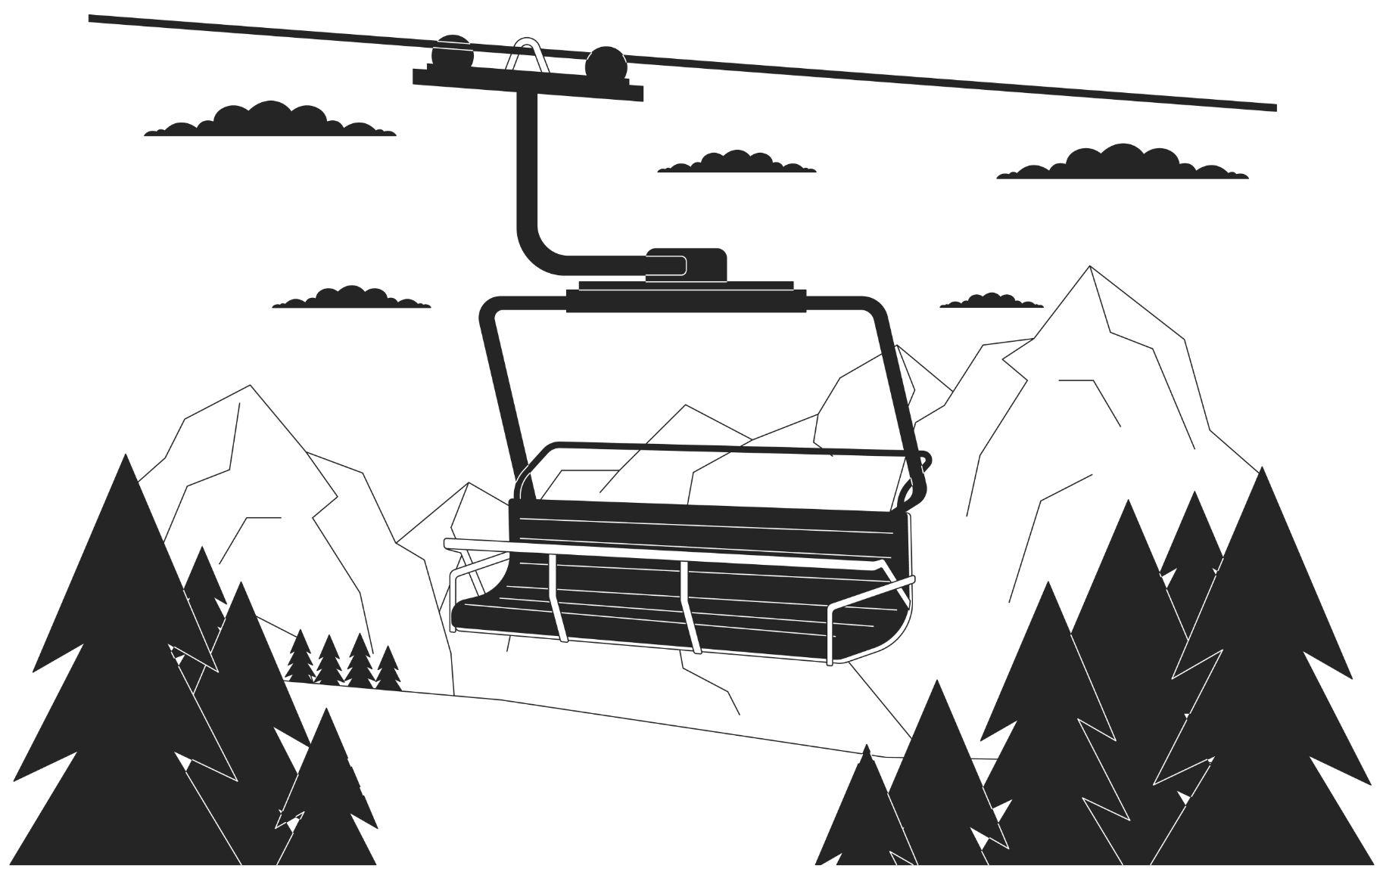
Redesign: Make it Better!
Look closely at your first design
Decide what to change
Draw your new design!

Slide 29
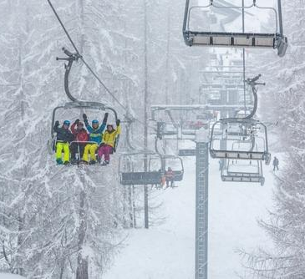
Build & Test Your Redesigned Chair Lift
Work with your partner or team, to redesign your chair lift.
Each team will test their new chair lift.
What did you change to your chair design? Structure? Materials?
Did your change improve your chairs performance?

Slide 30
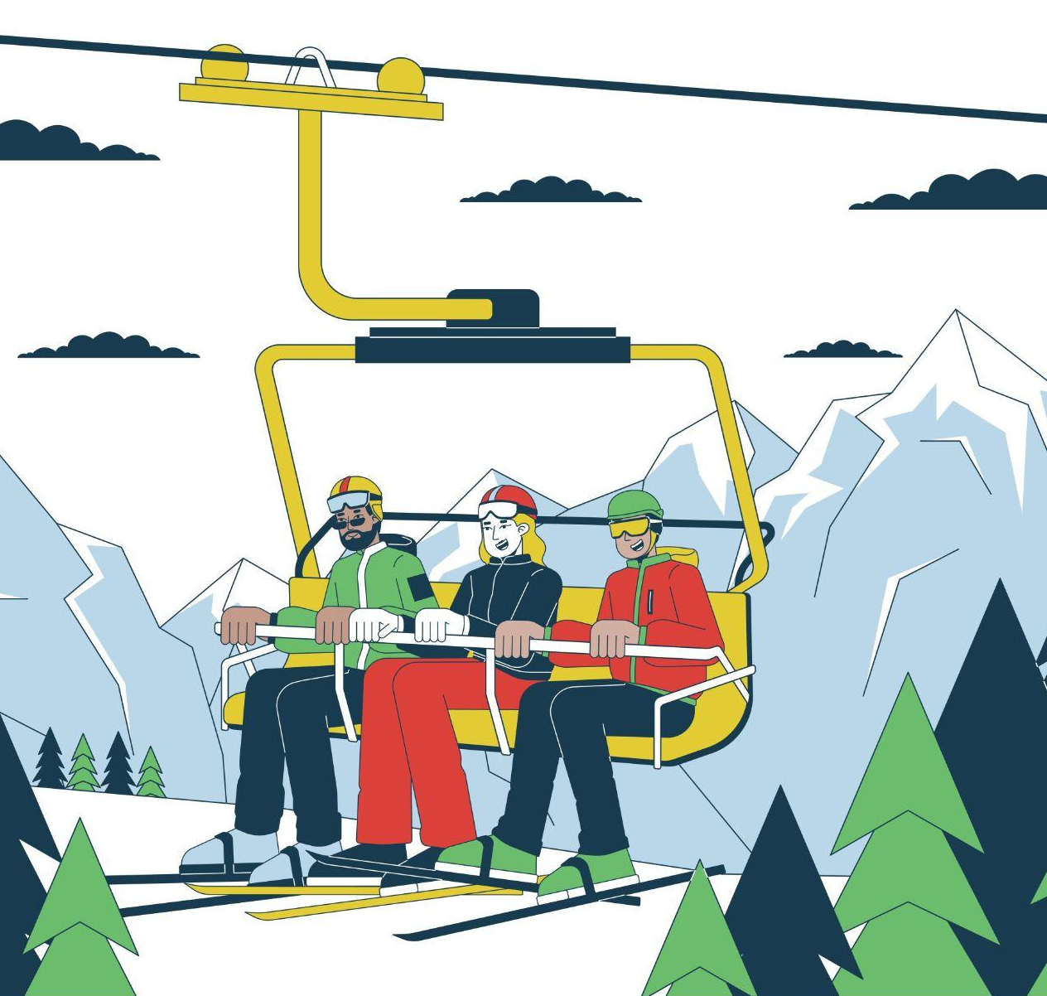
Present Your Chair Lift
Share your chair lift with the class!
Put the ping pong ball on the chair.
Attach the chair to the cable.
Perform a test.
What materials did your team use?
What did you change in the redesign?
What did you learn about being an engineer?

Slide 31
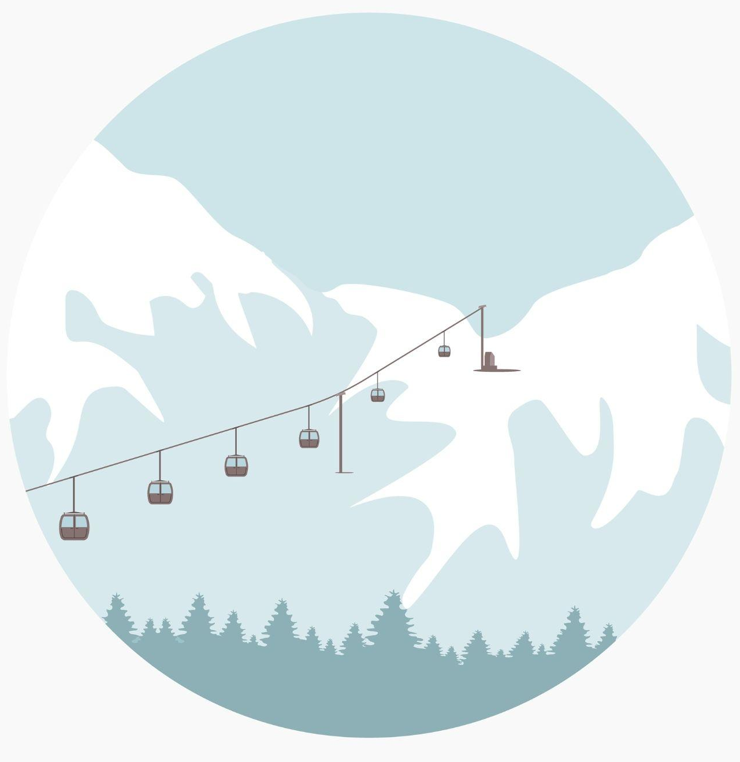
Reflection
What was the hardest part - making the chair or making it move on the cable?
What did you learn from other teams?
How did you help your teammates?
What would you do differently next time?
Who wants to ride a real chair lift now?

Slide 32


For more engineering lesson plans and resources like games, engineering careers, and STEM opportunities visit IEEE’s TryEngineering.org.

