Slide 1
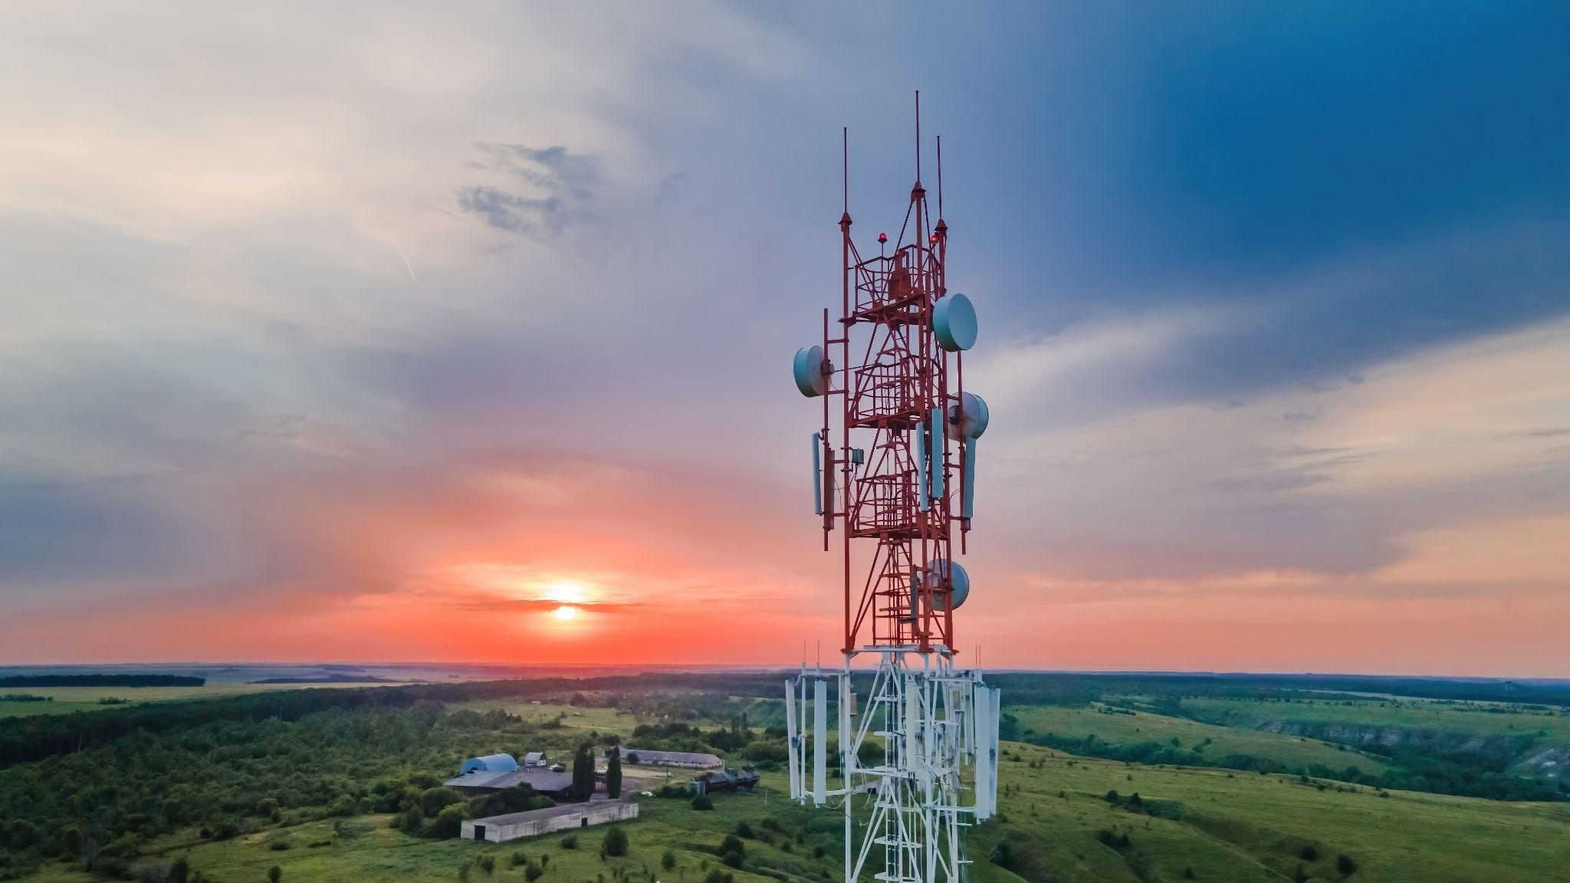
Cell Tower Discovery Challenge

Slide 2
Invisible Obstacle
Raise your hand if you’ve ever gone into a basement, an elevator, or maybe even stood behind a big brick wall, and suddenly your phone has no signal. It’s like your speedy radio waves—which are racing to bring you data at the speed of light—hit an invisible obstacle or a massive traffic jam! Only this traffic jam isn't cars; it's the stuff we use to build our world.
What kind of materials do you think are the biggest, baddest blockers that can stop a signal traveling that fast dead in its tracks? Let’s find out what's playing 'keep-away' with our radio waves!

Slide 3
The Design Challenge

Slide 4
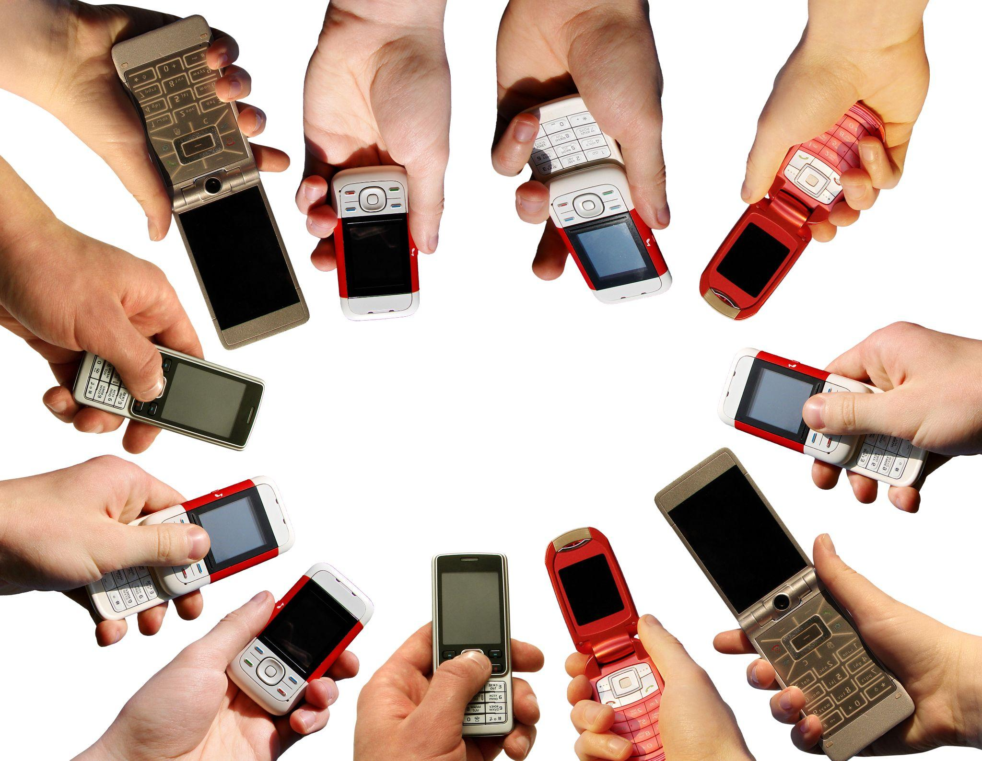
Design Challenge
As a team of telecommunications engineers, your mission is to design a maze that represents a city with a cell network and obstacles, including multiple cell stations. You’ll use lasers to model the data traveling along radio waves and mirrors to redirect that data around the city. Your challenge is to guide the “data” through your maze to reach the cell stations while avoiding the barriers.

Slide 5
Criteria & Constraints
Criteria
The map for your course must have five real attractions from your town marked in their proper locations in relation to each other.
Your course must have a minimum of 2 obstacles (the teacher places into your course)
Your course must have a minimum of 3 towers (determine where to put the towers so that you avoid the barriers)
The laser beam must hit all your cell towers and avoid the two obstacles
Constraints
The size of the maze must be contained within the map
Use no more than 10 mirrors to redirect the beam around the barriers

Slide 6
Materials
Lasers
Mirrors
Desks (teams push together their desks to create a larger maze on top)
Large piece of paper or cardboard to lay on the table/floor.
Map of your town/city
Markers to draw the big attractions around the city (ie. the park, the lake, etc) and mark out where the obstacles will be placed and the cell towers
Objects to create the obstacles (supplies in the class- books, boxes, etc)
Cups (or object of your choice) to represent the cell towers

Slide 7
Failure is Part of the Process
Failure is part of the process! Engineers test, fail, troubleshoot, and redesign until they reach the best solution.
Iterate again and again: test, fail, redesign– each cycle brings you closer to success.
Document your journey: sketch ideas, record iterations, and note measurements or calculations.
Celebrate multiple solutions: there’s no single “right” answer– creativity leads to diverse possibilities.
Ready, Set, Let’s Engineer!

Slide 8
Reflect & Debrief

Slide 9
Reflection: The Design
How did your team decide where to place mirrors and towers, and what did that teach you about how real cell networks handle obstacles?
What challenges did you face while trying to guide the “data” through your city, and how did you adjust your design to solve them?
If you could redesign your city or network, what changes would you make to improve how efficiently the data travels?

Slide 10
Reflection: Real-World
How does the way you guided your laser “data” through the maze compare to how real cell networks move signals around buildings, mountains, or other obstacles in a city?
Where in your everyday life do you rely on cell towers working together, and how did this activity help you understand what’s happening behind the scenes?
If you were a telecommunications engineer designing a real city’s network, what changes from your maze design would you apply to improve signal coverage and reliability

Slide 11
Background Concepts

Slide 12
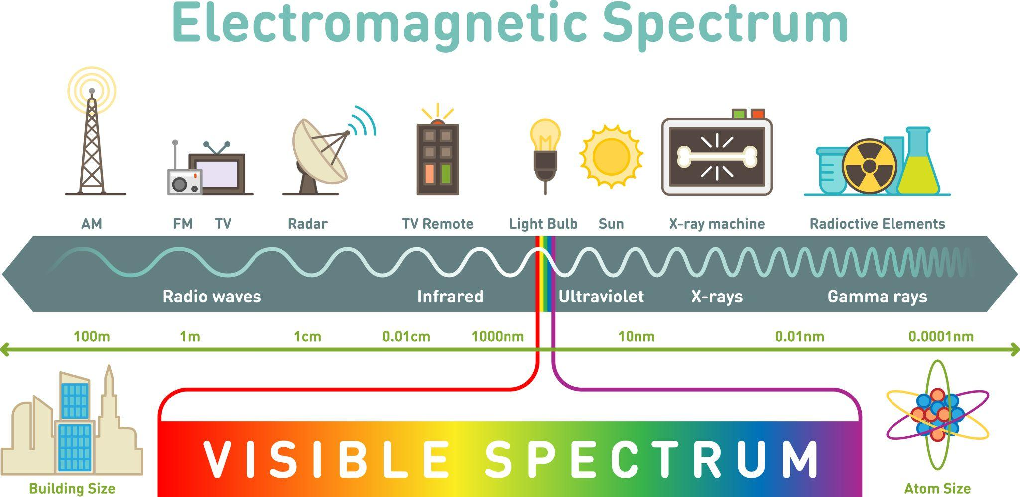
Radio Signals & Data Transmission
Communication is done via radio signals (a form of electromagnetic radiation, like light or Wi-Fi).
Signals send bursts of energy from a transmitter to a receiver.
The received energy pattern is converted into useful communication forms (video, sound, files).
Radio waves follow the limitations of light and travel at the speed of light (300,000 km/s or 670,000 mph).

Slide 13
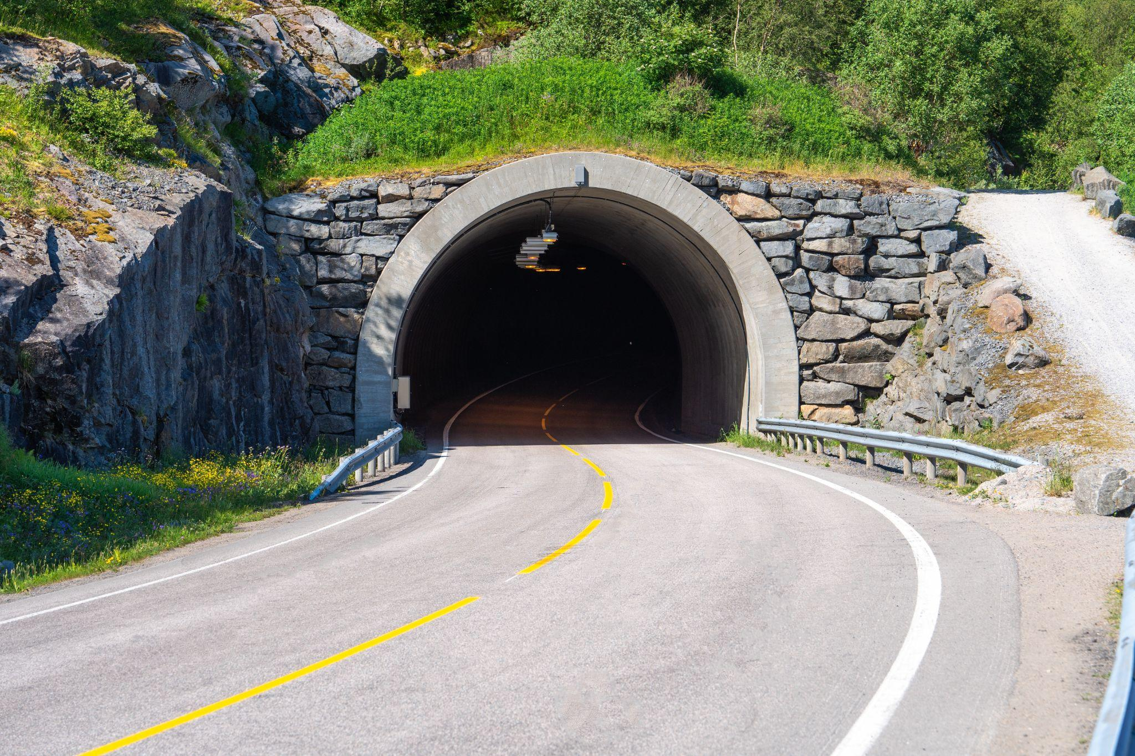
Obstacles to Radio Waves
Signal Blocking and Obstacles
Radio waves travel in straight lines and can be partially or completely blocked by objects (planets, moons, Sun).
Common physical blockages include:
Depths of buildings (elevators, interior stairwells)
Tunnels, mines, or mountain ranges

Slide 14
Materials That Block Signals
Metal
It is a conductor of electricity, and because radio waves are electromagnetic, metal has the ability to absorb them.
Metal blinds, doors, furniture, buildings, and walls can greatly lessen or completely kill the signal.
Concrete
It is one of the thickest building materials, making it hard for the signal to pass through.
Signal blocking is worse when concrete is coupled with metal laths.

Slide 15
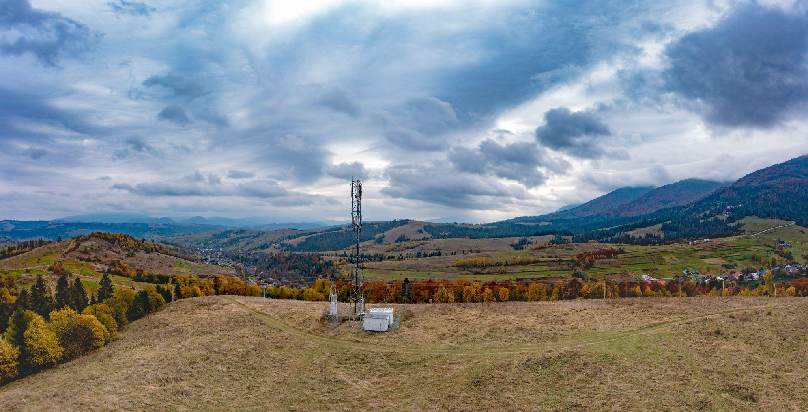
What Determines Cell Tower Range?
The range is not fixed and is affected by many variables:
How high the antenna is over the surrounding landscape
The frequency of the signal in use
The rated power of the transmitter
The directional characteristics of the antenna array on the site
Nearby buildings and vegetation (which absorb and reflect radio energy).
Local geographical or regulatory factors and weather conditions

Slide 16
Dig Deeper

Slide 17
Dig Deeper (Extension Activities)
Vist the Communications Engineering Collection for more resources:
Connected for Good ebook
Invisible Threads: How Communication Engineers Keep Us Connected Video
Communications Engineering: Innovating for Tomorrow’s World Video
What is Communications Engineering? Video
Communication Engineering Collection
Check out the following TryEngineering Tuesday student guides:
TryEngineering Tuesday: 5G
TryEngineering Tuesday: Wifi and IEEE 802.11 Standard
TryEngineering Tuesday: 5G, 6G, and the Metaverse-A Silicon Valley View
TryEngineering Tuesday: Web3 Featuring GoKnown
TryEngineering Tuesday: The Metaverse
TryEngineering Tuesday: Extended Reality and 5G

Slide 18
Vocabulary

Slide 19
Vocabulary
Access Point: a device that creates a wireless local area network, or WLAN, usually in an office or large building.
WiFi: the radio signal sent from a wireless router to a nearby device, which translates the signal into data you can see and use. This signal allows nearby devices such as computers, laptops, tablets, phones, and gaming systems to connect to the internet
Beamforming: a technique that allows a wireless signal to focus its transmission towards a specified device or group of devices rather than allowing the signal to spread equally to any and all devices attached to a network
Millimeter Waves: vary in length from 1 to 10 mm, compared to the radio waves that serve today's smartphones, which measure tens of centimeters in length.
Small Cell: a low-cost radio access point with low radio frequency (RF) power output, footprint and range. It can be deployed indoors or outdoors, and in licensed, shared or unlicensed spectrum.
Full Duplex: the ability for data to be transmitted in both directions between a sender and a receiver in a single carrier at the same time
4G: the 4th generation of broadband wireless technology which follows the third generation (3G) and precedes the fifth generation (5G). This generation of wireless technology allows for speeds of up to 100 megabits per second (Mbps), making it suitable for applications such as streaming high-definition video and audio.
5G: the 5th generation of broadband wireless technology which follows the fourth generation (4G) and precedes the sixth generation (6G). This generation of wireless technology allows for speeds of up to 20 gigabits per second (Gbps), making it suitable for applications such IoT/Smart Technologies and extended realities.

Slide 20
Vocabulary
Cell Network: many cell stations make up a cell network
Cell Station: transreceivers that serve as the primary hub for connectivity of wireless device communication. It connects one device to a network or other devices. Wireless internet uses cell towers to create a WiFi network that your devices connect to.
Waves: disturbance or variation that transfers energy progressively from point to point in a medium. Radio waves and millimeter waves are the foundational types of waves with regards to wireless communications
Wavelength: the distance between identical points (adjacent crests) in the adjacent cycles of a waveform signal propagated in space or along a wire. In wireless systems, this length is usually specified in meters (m), centimeters (cm) or millimeters (mm).
Amplitude: the maximum displacement or distance moved by a point on a vibrating body or wave measured from its equilibrium position.
Electromagnetic Spectrum: the complete range of all types of radiation that has both electric and magnetic fields and travels in waves. The range of waves that includes radio waves, microwaves, infrared waves, visible light, ultraviolet light, X-rays, and gamma rays.
Bandwidth: amount of data capable of being transmitted through an internet connection in a given amount of time; not to be confused with internet speed
Delay: a characteristic that describes the time it takes for data to travel from one endpoint to another in a telecommunications network

Slide 21
Engineering Fields

Slide 22

What is Engineering?
Learn about engineering and how engineers are creative problem solvers and innovators who work to make the world a better place.
(Video 3:43)
Source: TeachEngineering YouTube Channel - http://www.youtube.com/watch?v=H9VDkvgGmVo

Slide 23
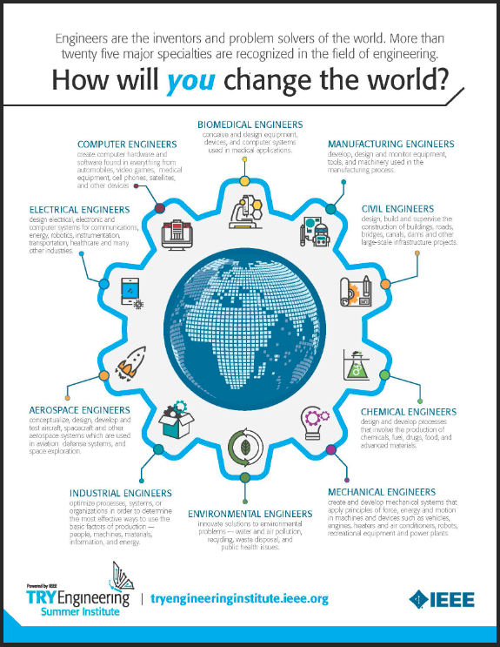
Related Engineering Fields
There are several types of engineering fields that are involved with communication. Here are just some of the related engineering fields.
Electrical Engineering
Computer Information Technology
Computer Information Systems
Explore the Engineering Fields Infographic - How will YOU change the world? Engineers are the inventors and problem solvers of the world! More than twenty five major specialties are recognized in the field of engineering. Engineers make the world a better place!

Slide 24
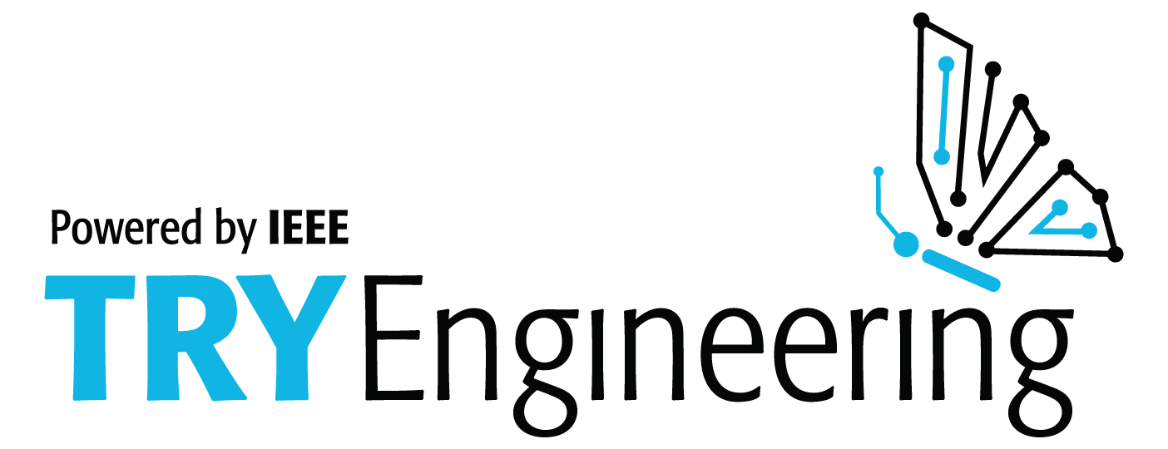
For more engineering lesson plans and resources like games, engineering careers, and STEM opportunities visit IEEE’s TryEngineering.org

