Slide 1

Bright Beats Challenge A MathWorks Lesson

Slide 2
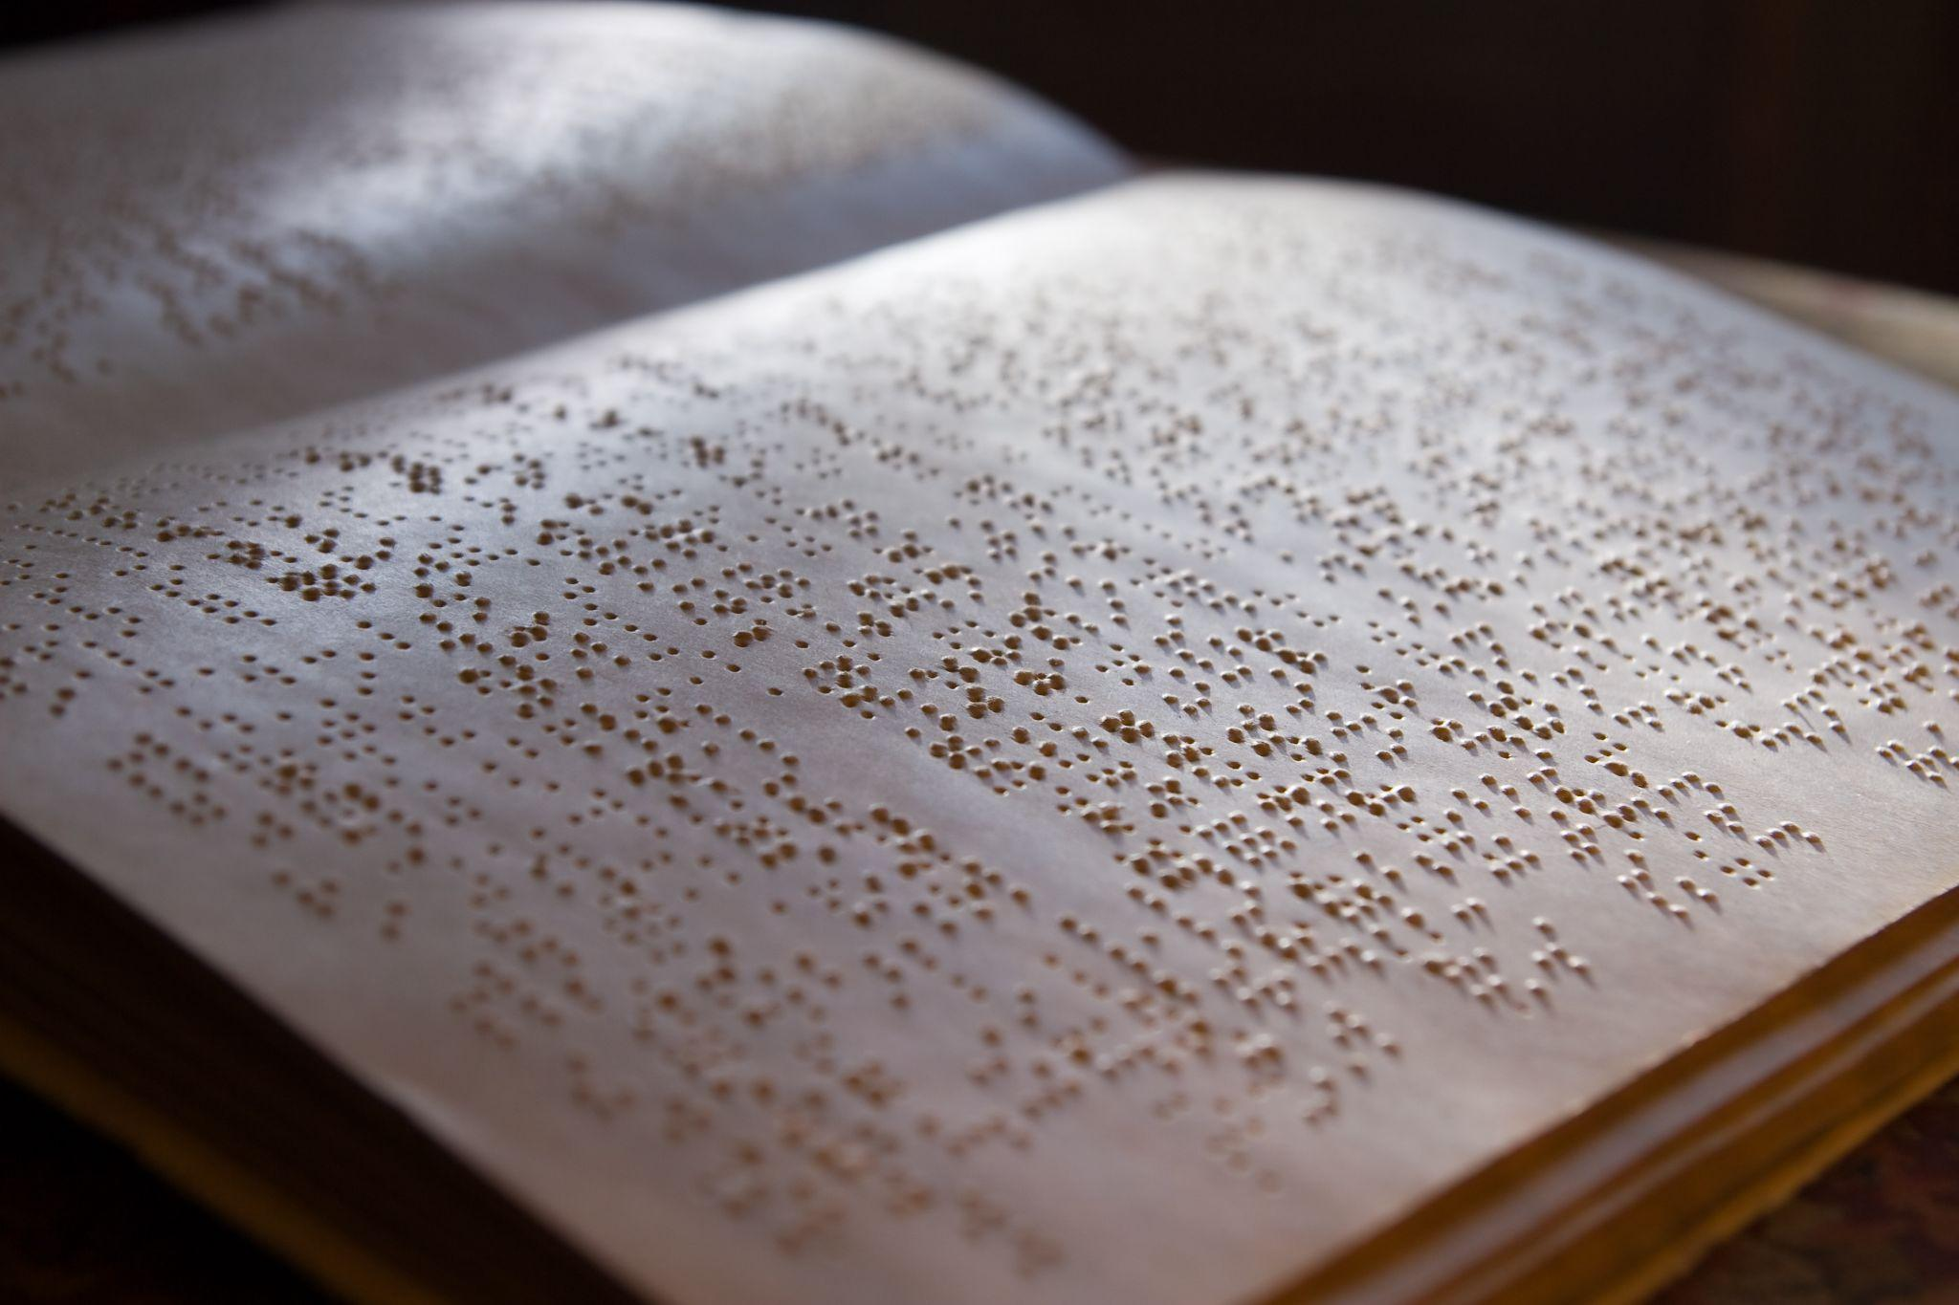
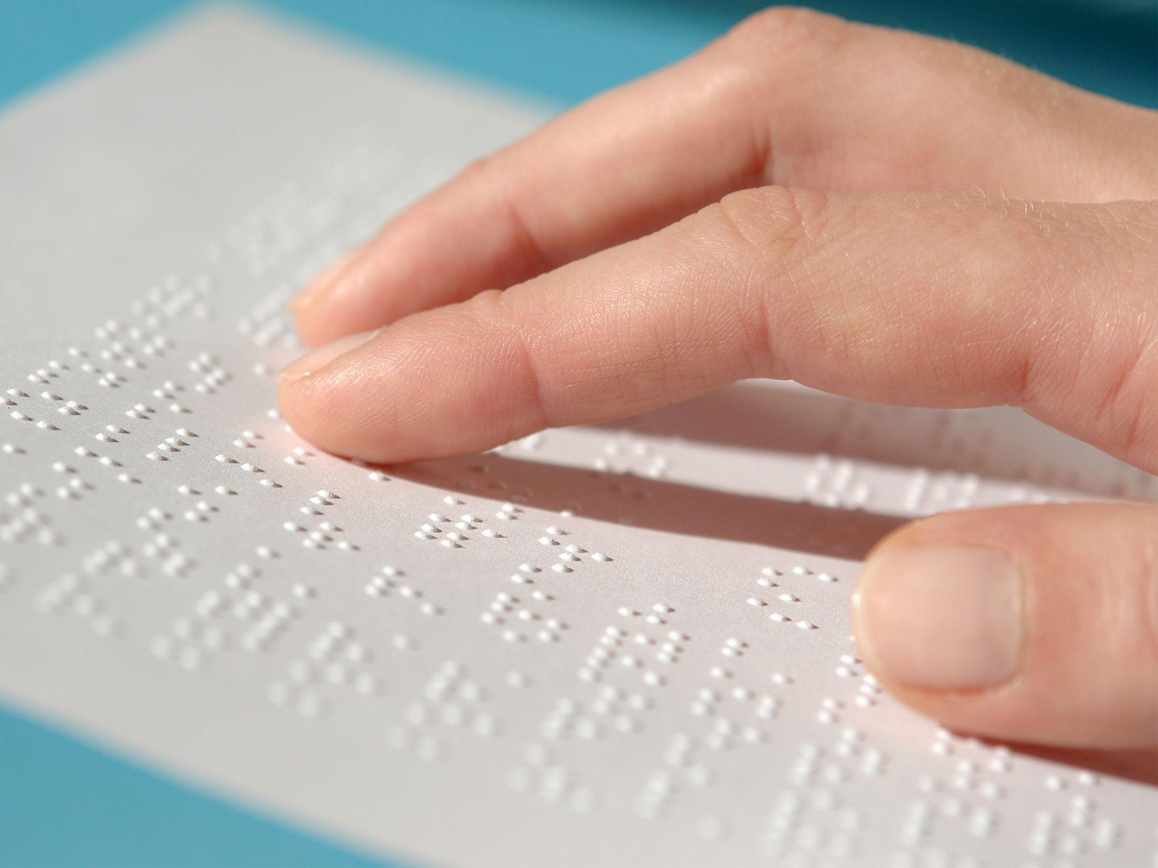
Do you know what this is?

Slide 3

Watch: The Boy Who Invented Braille

Slide 4

Braille to Bright Beats Challenge
Similar to Braille, where visual information is translated into a tactile representation, in the Bright Beats Challenge, we will translate visual information into an audio representation.

Slide 5
The Design Challenge

Slide 6

Bright Beats Challenge
You will create a light-sensitive musical synthesizer using a micro:bit to transform light levels into corresponding musical notes. By translating visual signals into audio signals, this device can allow users to experiences photos in a new and unique way.

Slide 7

MATLAB Simulation
In the accompanying MATLAB activity, you will turn pixels from digital images into piano notes. In the process, you’ll uncover the power of computers and programs like MATLAB for transforming visual and audio signals through signal processing and learn how images are represented by computers. Building from the micro:bit activity, you’ll be able to customize sounds further and translate more complex images into sounds.

Slide 8
Criteria & Constraints
Criteria
Light Detection: Use the micro:bit's light sensor to measure ambient brightness.
Sound Mapping: Program musical notes that correspond to specific light levels.
Constraints:
Must use only onboard micro:bit components (no external sensors or speakers).
The system must operate continuously without manual resets.

Slide 9
Materials
Computer (1 per team of 2 kids)
1 micro:bit v2 (per team)
MATLAB: matlab.mathworks.com
MATLAB Activity Files and Instructor Guide
Printed black and white image
White paper, black marker, and colored markers
Mini flashlight, head lamp, or cell phone light
Cardboard or Cardstock
Tape/Glue
Rubber Bands
Scissors
Other fun decorative items for the device (pipe cleaners, etc)
TryE Signal Processing Video
Wave Wonders Ebook
TryE Signal Pro

Slide 10
Failure is part of the process
If your code does not work, don’t worry, we expect that. Engineers fail and they try again and again. So troubleshoot and then redesign until you get your best solution. Failure is part of the process! Have fun!
Ready, Set, Let’s Engineer!

Slide 11
Prepare Your Image

Slide 12
Prepare Your Image
Draw a bold, high-contrast image (black on white) or use a printed black-and-white image to cut into strips. The strips will be pulled across the micro:bit’s light sensor to trigger different musical tones based on light intensity.
Choose a Black-and-White Image & Print OR Draw Your Image
Cut Strips (vertical or horizontal) & Number them Make sure it’s sized to fit over the micro:bit’s LED grid. Number them so you can “read” the image in the correct order.

Slide 13
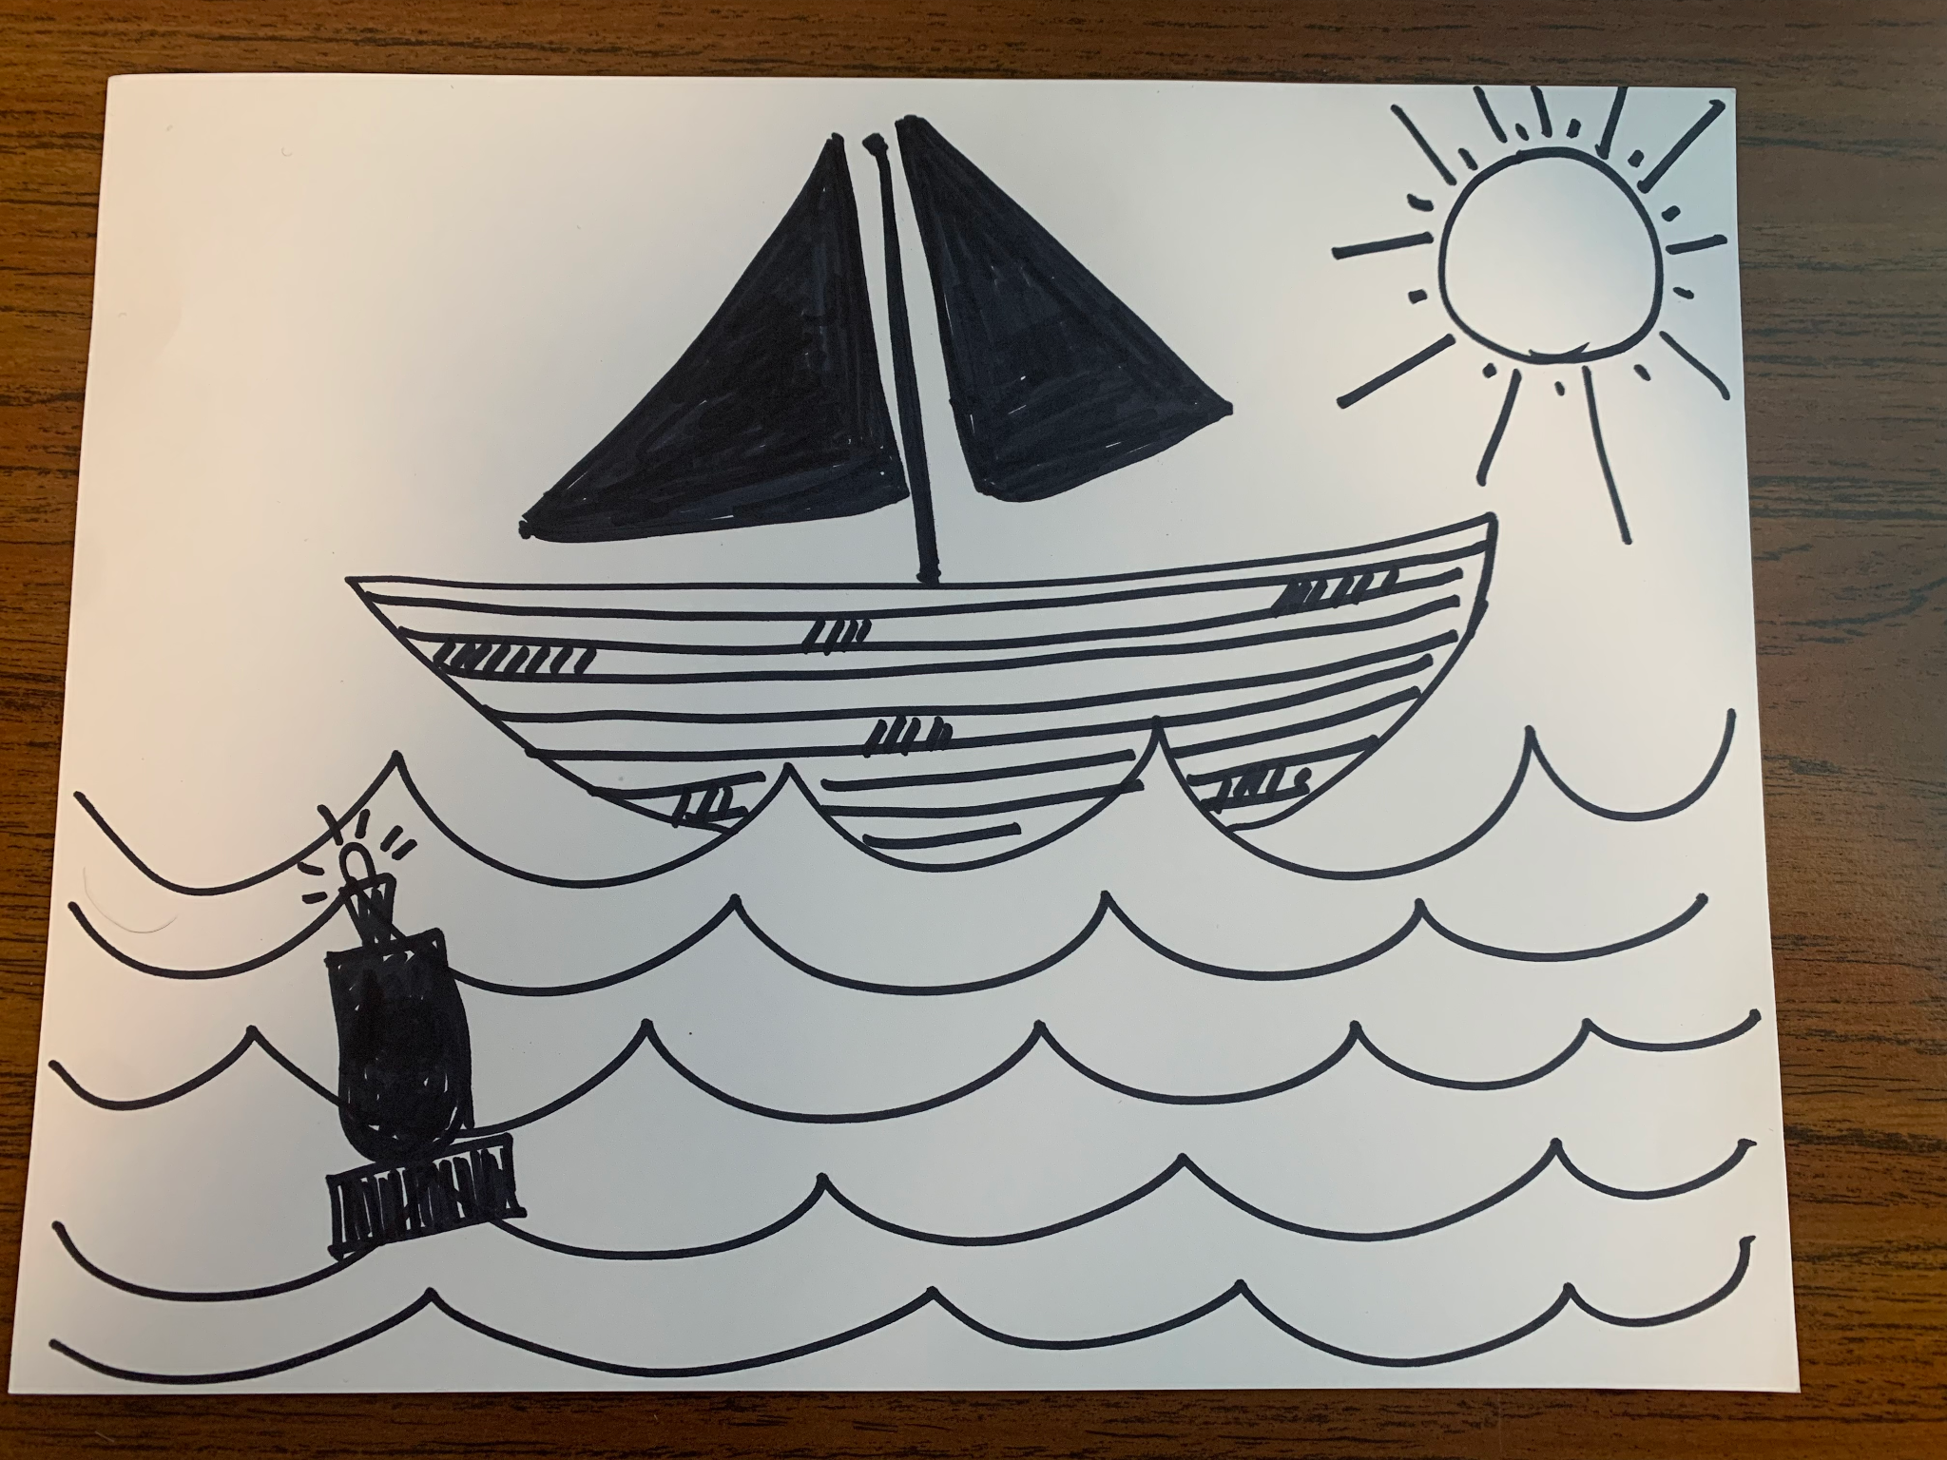
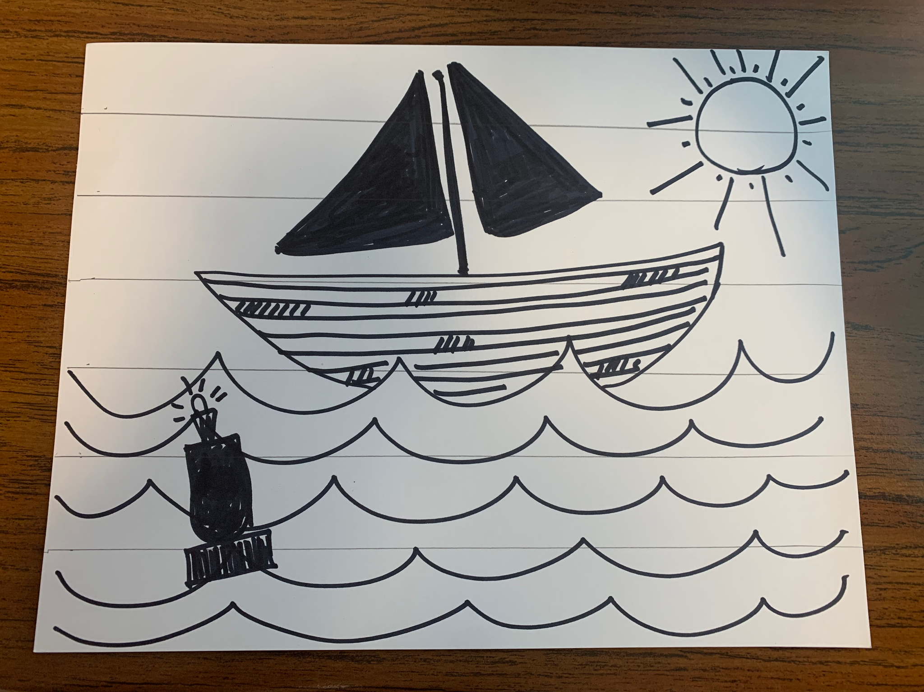
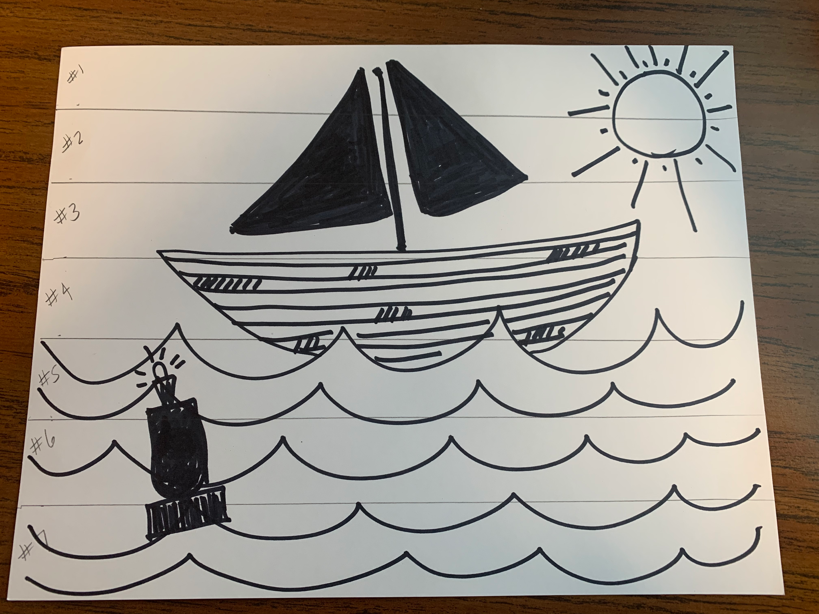
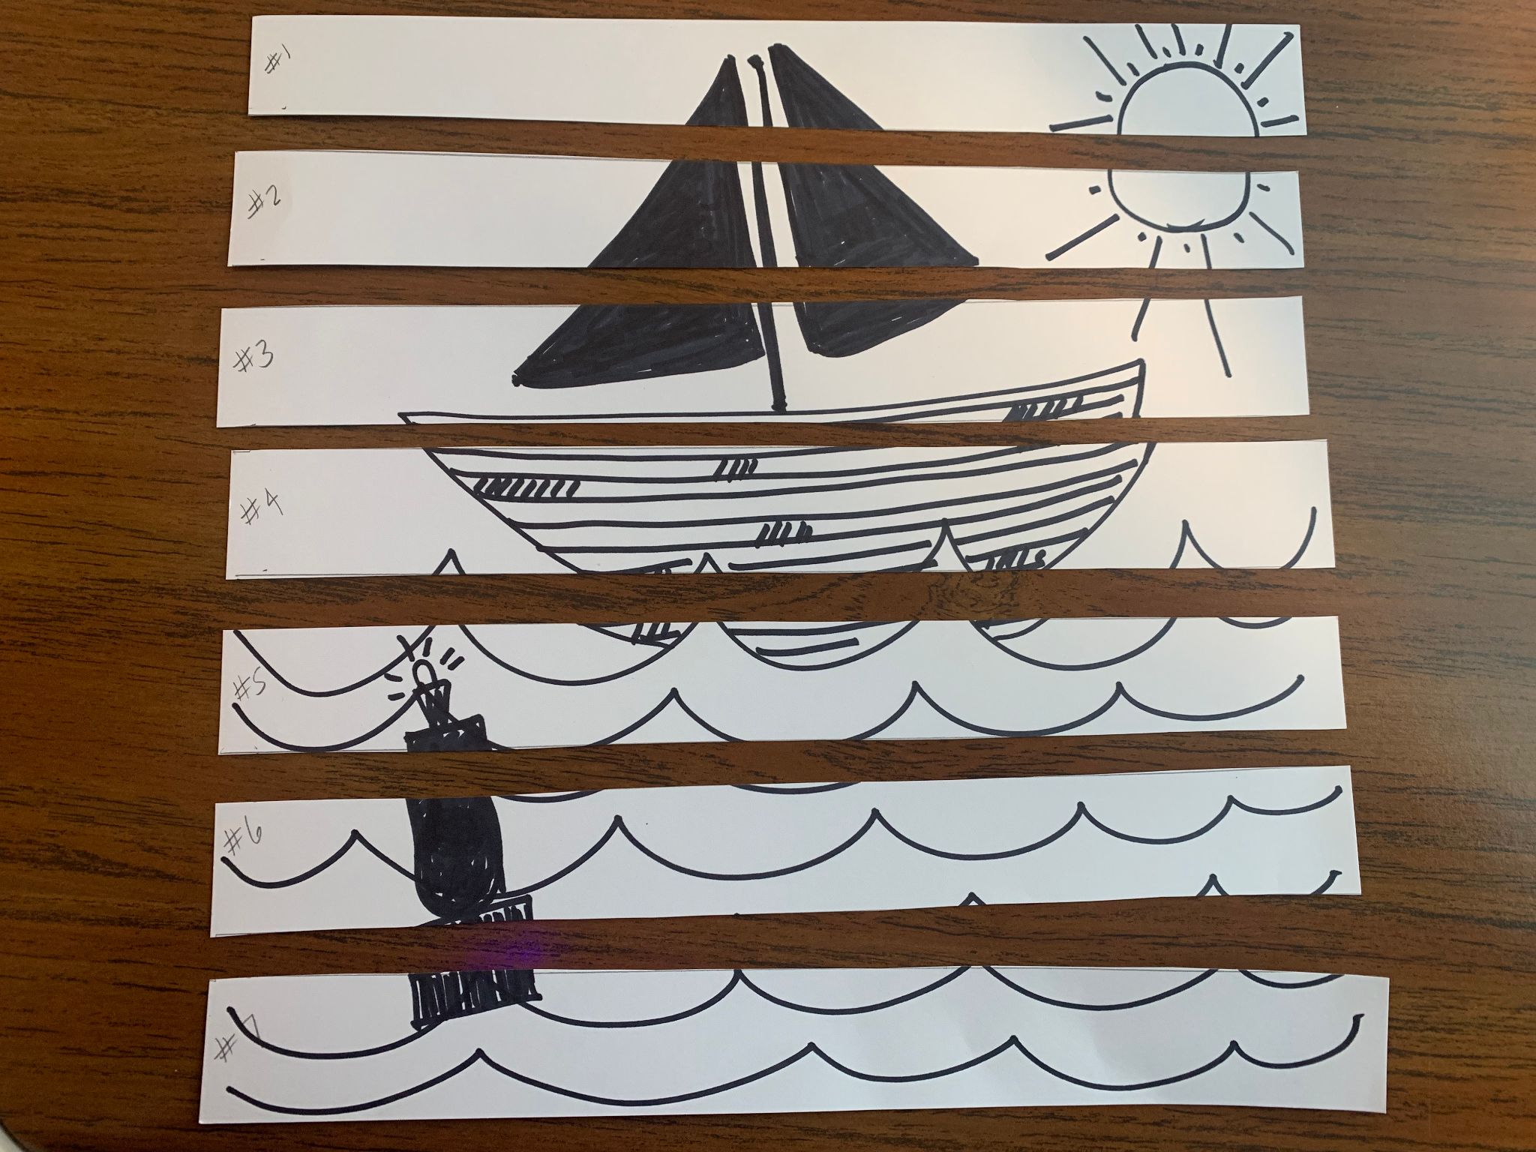

Slide 14
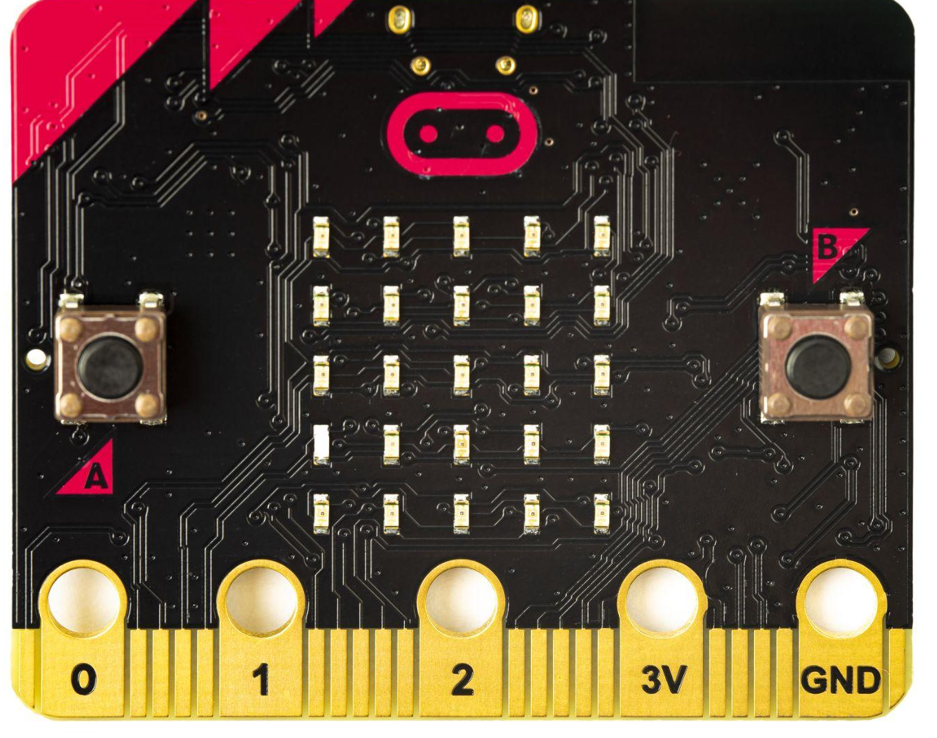
micro:bit

Slide 15
micro:bit Pre-Activity
To prepare you for the design challenge with micro:bit, try this pre-activity in Microsoft MakeCode
Write a program that shows the light level on the screen.
Shine a flashlight on the micro:bit — watch the number go up!
Cover it with your hand — the number goes down!
Open the serial monitor to view the data.
Observe how the light level changes in real time.

Slide 16
Program micro:bit to Solve the Challenge
Program the micro:bit in MakeCode to solve the design challenge:
Initialize Variables
Log Light Level to Serial Monitor
Map Light Level to Sound Frequency
Play the Sound

Slide 17

Need More Support? See Sample Code
Sample Code

Slide 18
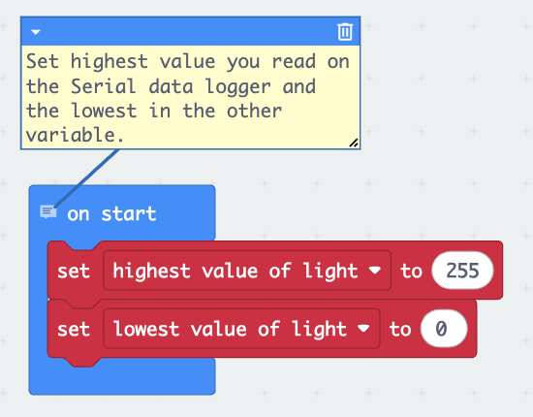
Initialize Variables
Go to the Variables category and:
Create a variable called note
Create a variable called brightness
Create a variable called highest_value_of_light and set it to 255
Create a variable called lowest_value_of_light and set it to 0
Use the “set [variable] to [value]” block to assign initial values.

Slide 19
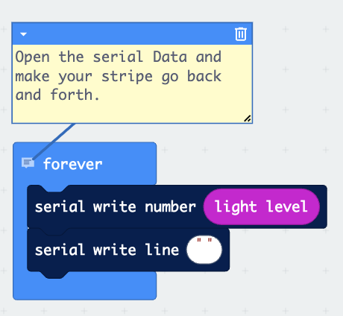
Log Light Level to Serial Monitor
Go to Loops and drag a forever block.
Inside it:
Go to Input and drag light level block
Go to Serial and use write number block to send the light level
Add a serial write line block with an empty string to separate entries
This will continuously log the light level to the serial monitor.

Slide 20
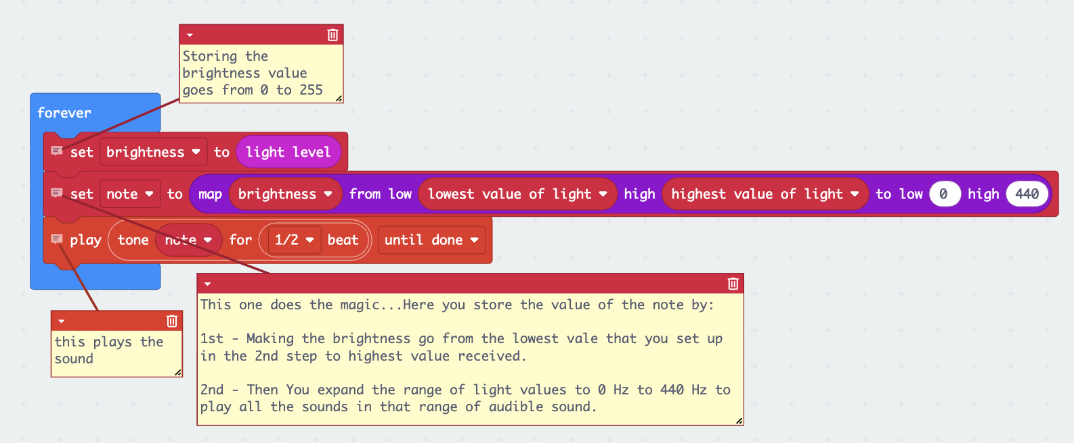
Map Light Level to Sound Frequency
Add another forever block. Inside it:
Set brightness to light level (from Input)
Use the map block from Math to convert brightness to frequency:
Map brightness from lowest_value_of_light to highest_value_of_light
To range 0 to 440
Store result in note

Slide 21
Play Sound
Still inside the second forever block:
Go to Music
Use play tone block
Replace the frequency with note
Set duration to half beat
Make sure both forever loops are running simultaneously
Connect your micro:bit to your computer and open the Serial Monitor to view light levels
Shine light or cover the sensor to hear pitch changes

Slide 22
Build & Test the Light-Sensitive Musical Synthesizer

Slide 23
Build the Housing
Create Box/Stand: Using cardboard (or card stock), create a box or stand that can securely hold your micro:bit flat.
Mount Light: Design a way to mount a mini-flashlight (head lamp or cell phone) directly above the micro:bit, pointing down. This ensures consistent lighting as the strip moves across the sensor.
Create Slit to Pull Strips: Create a slit/opening in the box/stand that allows you to pull the image strips across the micro:bit’s LED grid.
Mount the Micro:bit: Place the micro:bit flat inside your prepared box or on the surface of your stand, ensuring its light sensor or photoresistor faces upwards towards where the image strip will pass.
Add a Light Source: Mount the flashlight directly above the micro:bit, pointing down, to ensure consistent lighting.

Slide 24
Test Device
Pull the Strips Across: Slowly pull your image strip #1 across the micro:bit’s LED grid, observing how the light and dark areas passing over the sensor trigger different musical tones. Continue to pull all the strip in the correct order to “read the image”
Listen to the Sound Changes: The micro:bit will map the light levels to musical notes. Darker areas will produce lower tones, and lighter areas will produce higher tones — creating a unique sound pattern based on your image.
Experiment: Try different images, patterns, or even draw your own with black markers. You can also reverse the strip or change the speed of movement to alter the sound.

Slide 25
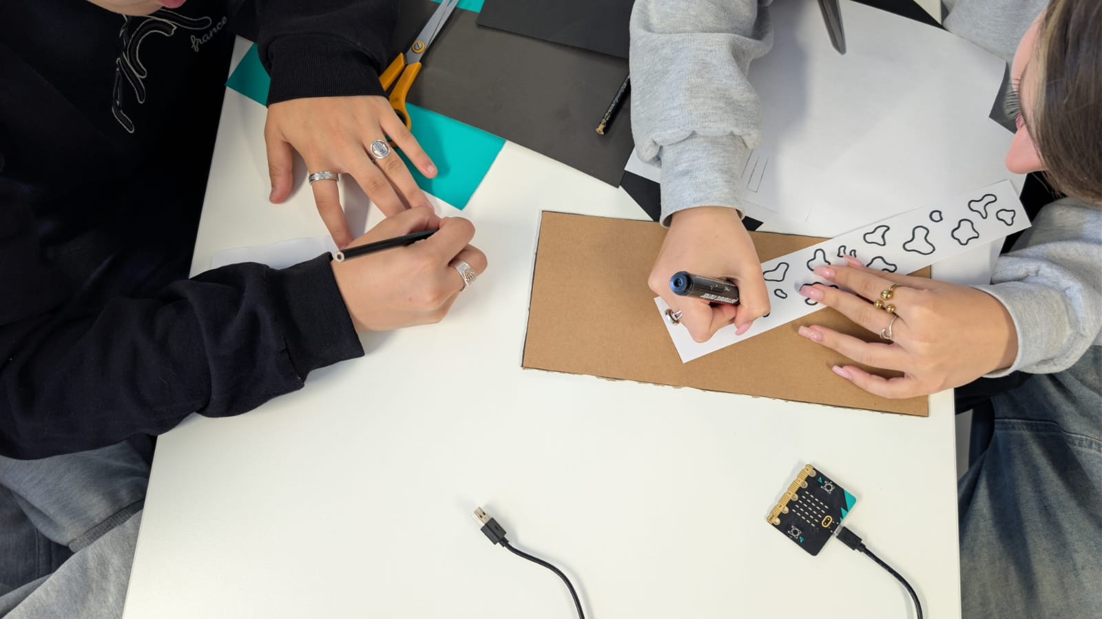
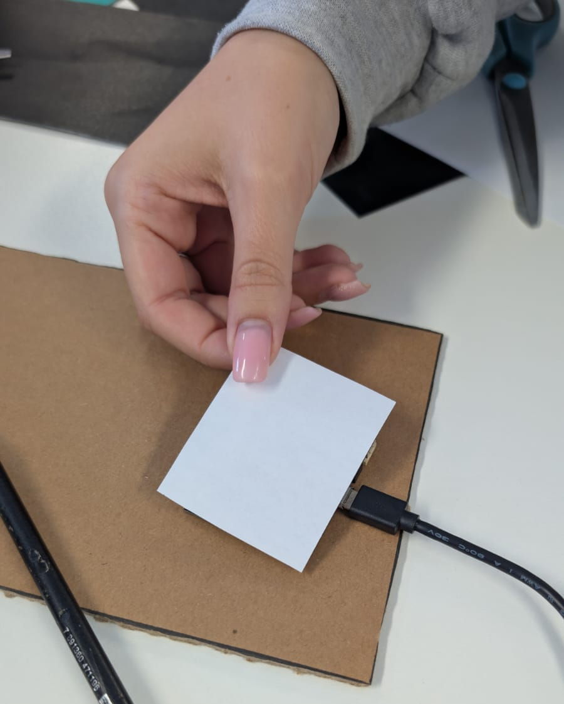
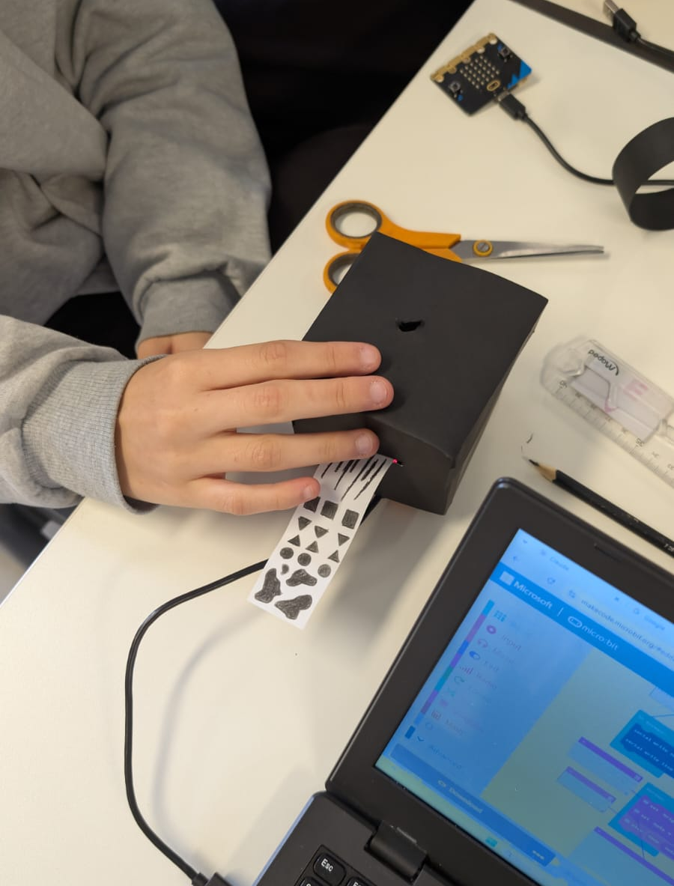
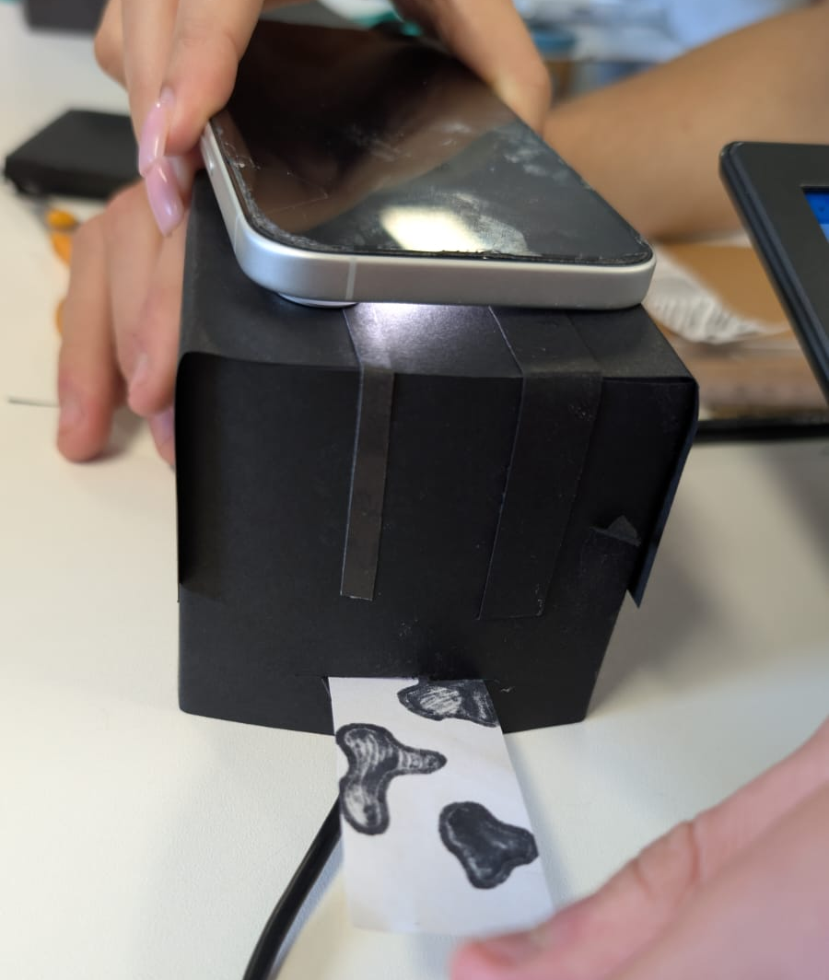
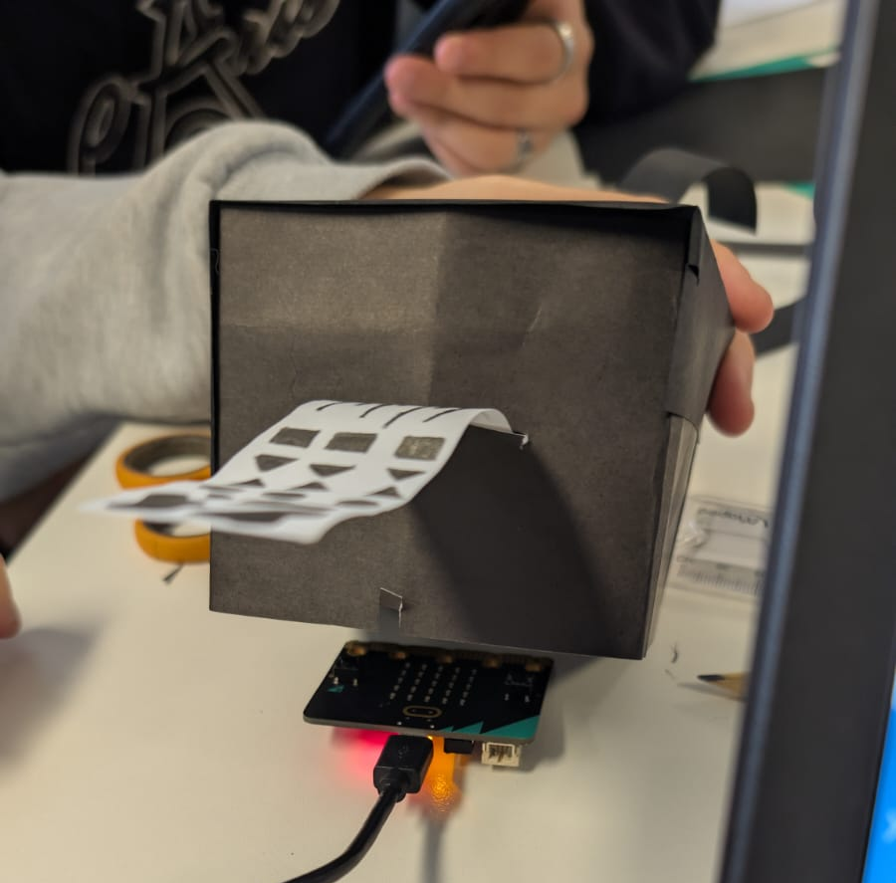

Slide 26
MATLAB Simulation

Slide 27
MATLAB Simulation
In the MATLAB activity, you’ll turn pixels from digital images into sounds. Using the power of MATLAB, you’ll learn how computers and programs like MATLAB represent and transform visual and audio signals through signal processing.
With the micro:bit device, you were limited to simple black and white images. With MATLAB, you’ll be able to translate complex digital images into a wider variety of sounds.
MATLAB Activity Files - click ‘ Open in MATLAB Online’ and follow the step-by-step instructions in ‘BrightBeatsChallenge_Student.mlx’
PDF of Instructor Guide

Slide 28
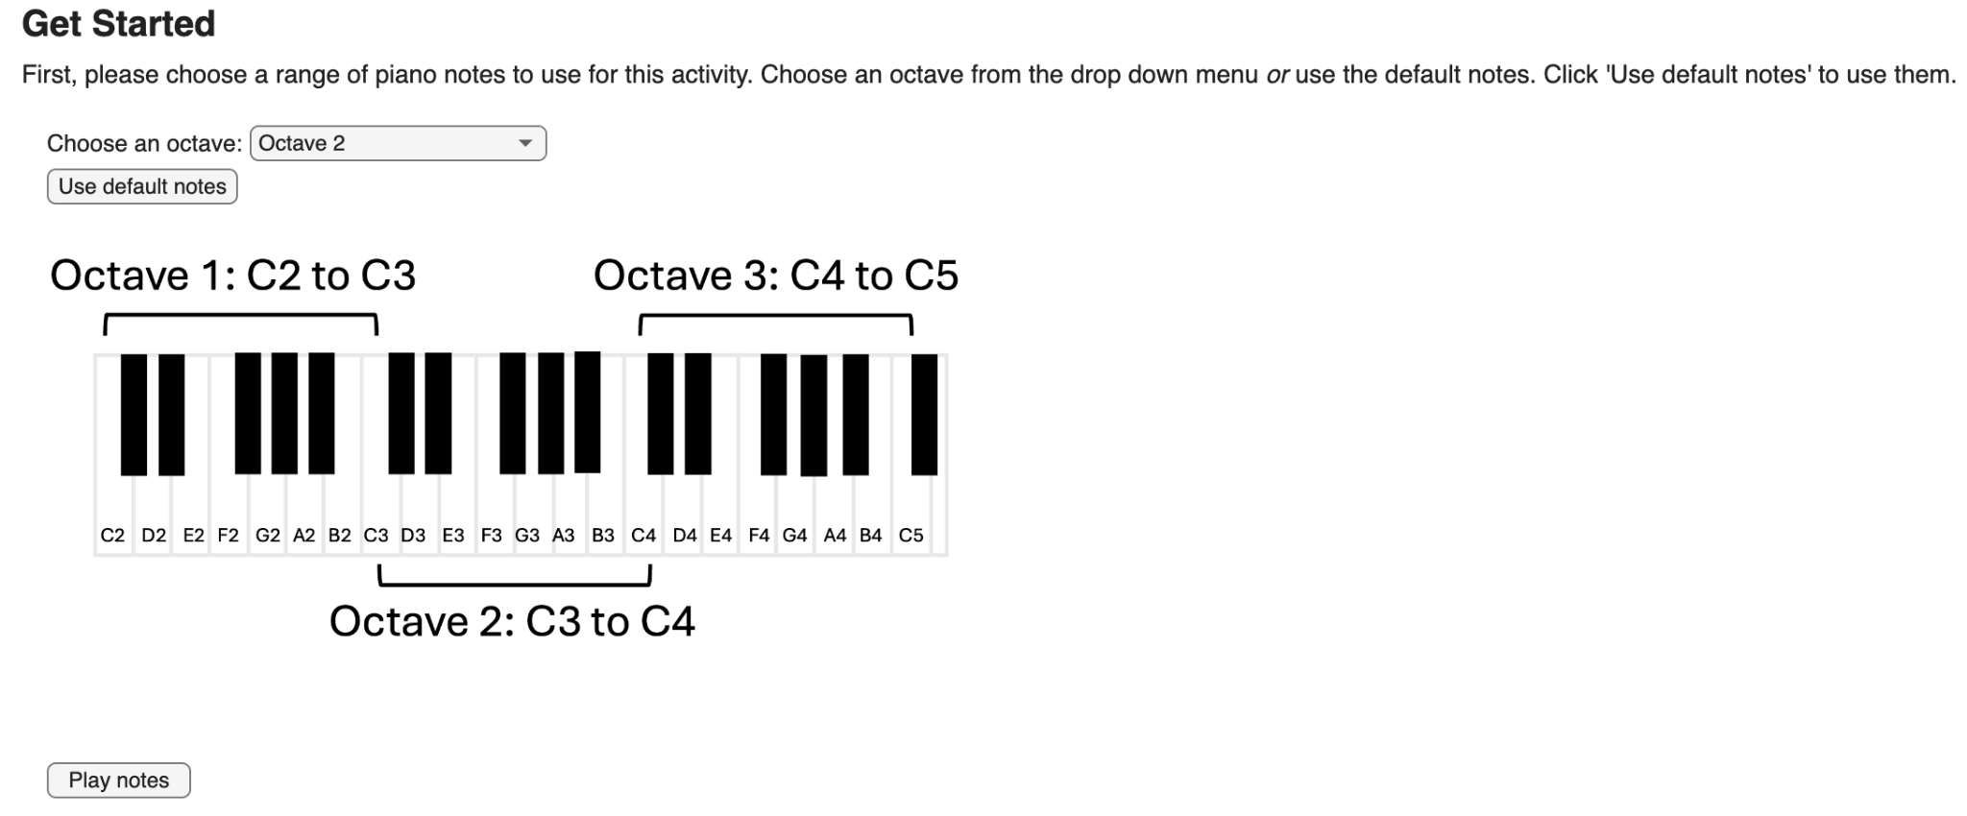

Slide 29
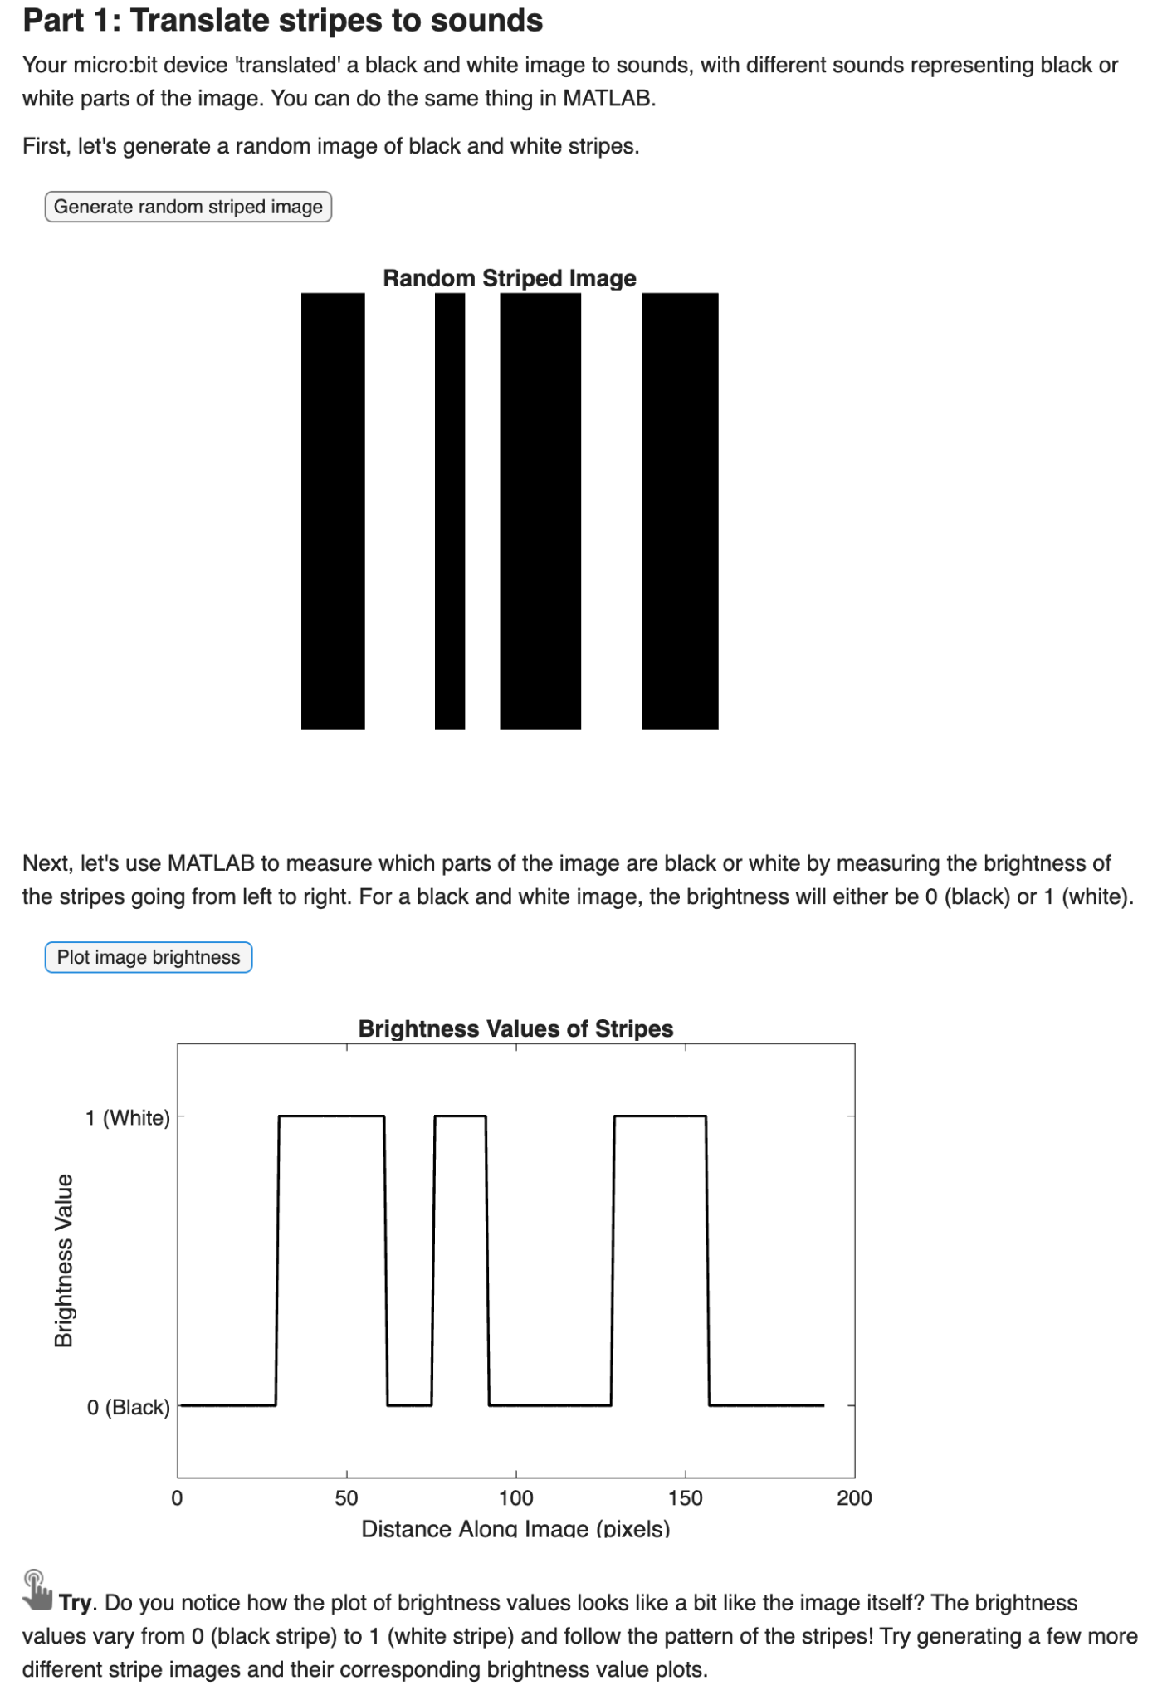
Try: Generate few random striped images, and make note of how the brightness value plots change corresponding to the stripe patterns.

Slide 30
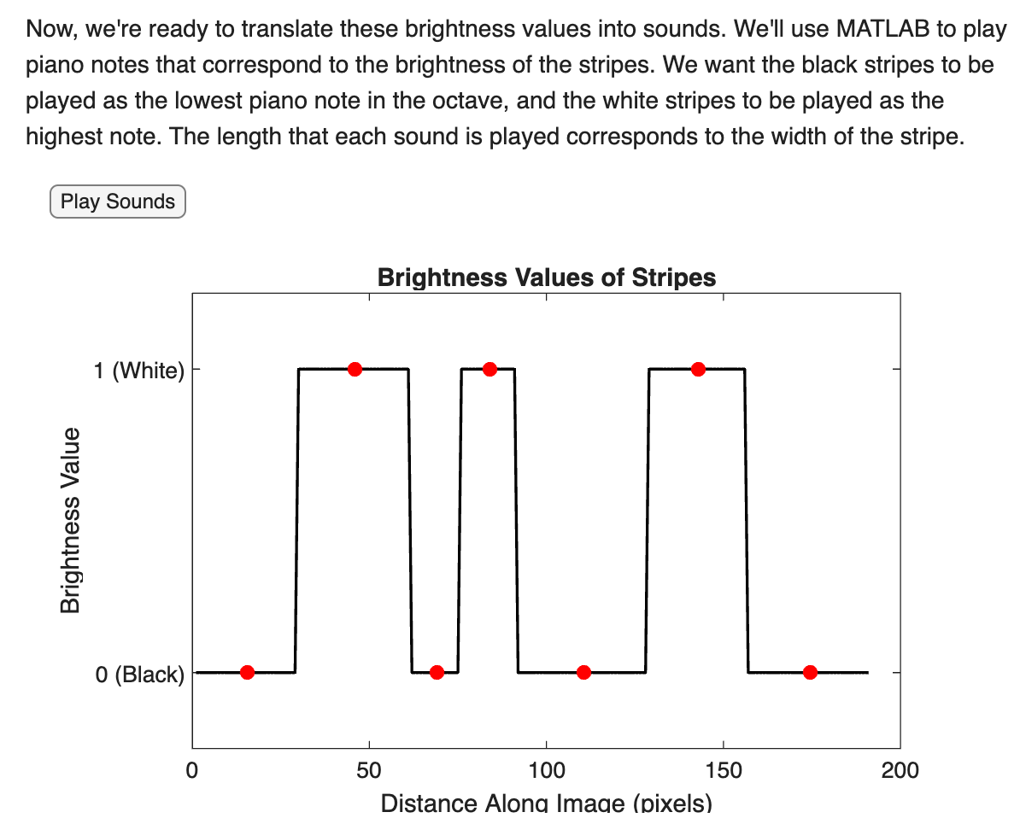
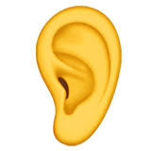
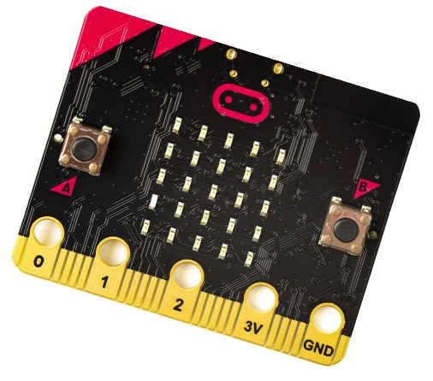
Challenge: Close your eyes and listen to the sounds again. Can you visualize the striped image just by listening to the sounds?
How many stripes are there in total?
How many black stripes are there? How many white?
Can you tell which stripes are wide and which are thin?
Challenge: Grab a blank strip of paper and draw the striped image we generated with MATLAB. Copy it as closely as you can. Pull this image strip across the micro:bit device you built earlier. What are some differences you notice between how the micro:bit translates the stripes into sounds compared to MATLAB? Is one translation more accurate than the other?

Slide 31
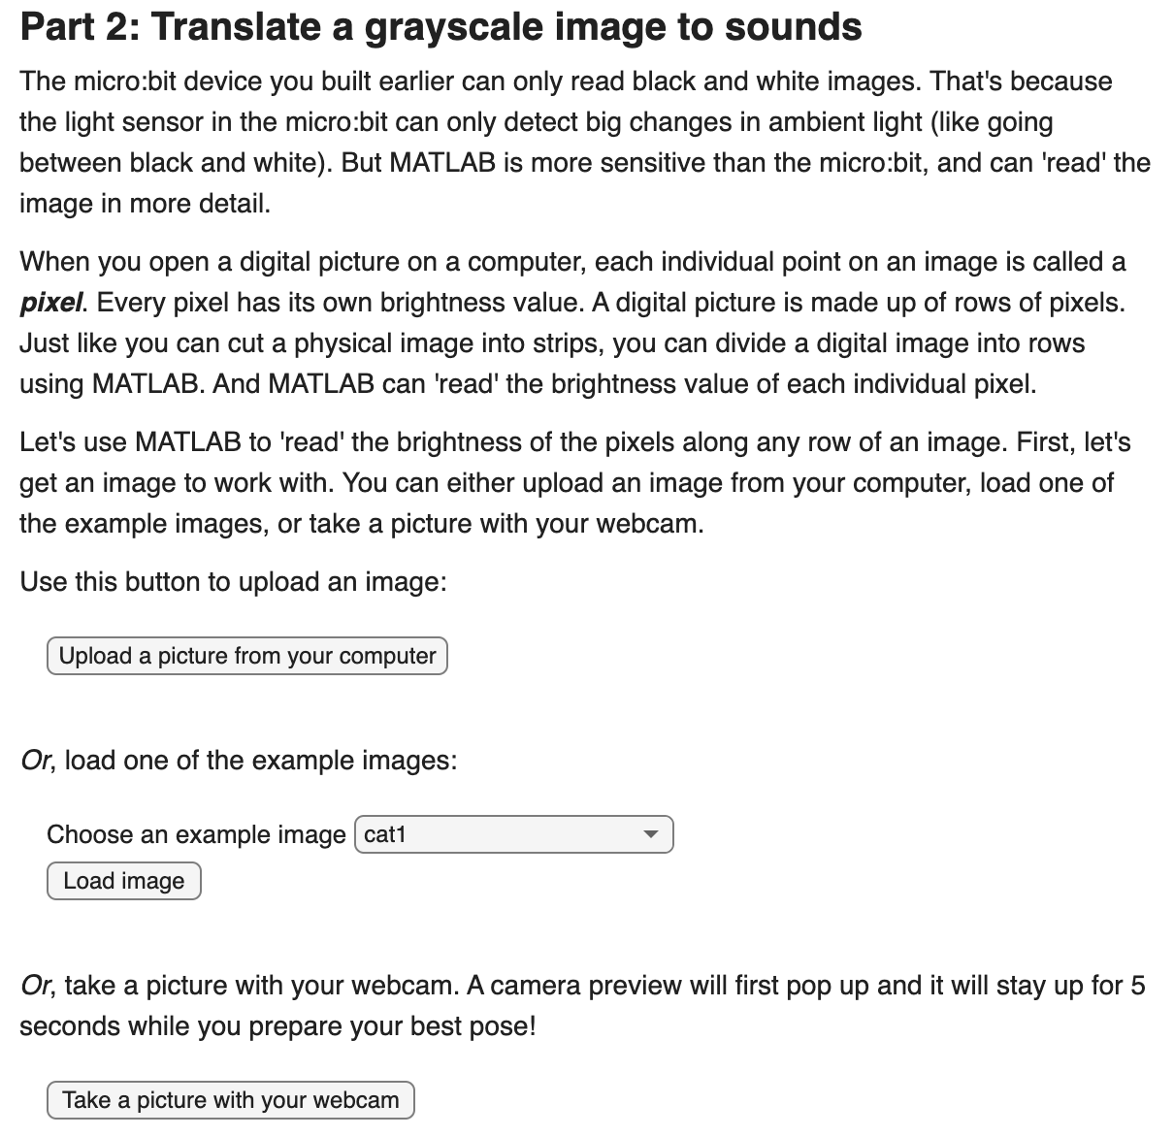

For this activity, you can:
Upload a picture or
Load an example image or
Take a picture with your webcam
One of the example images: ‘cat1’

Slide 32
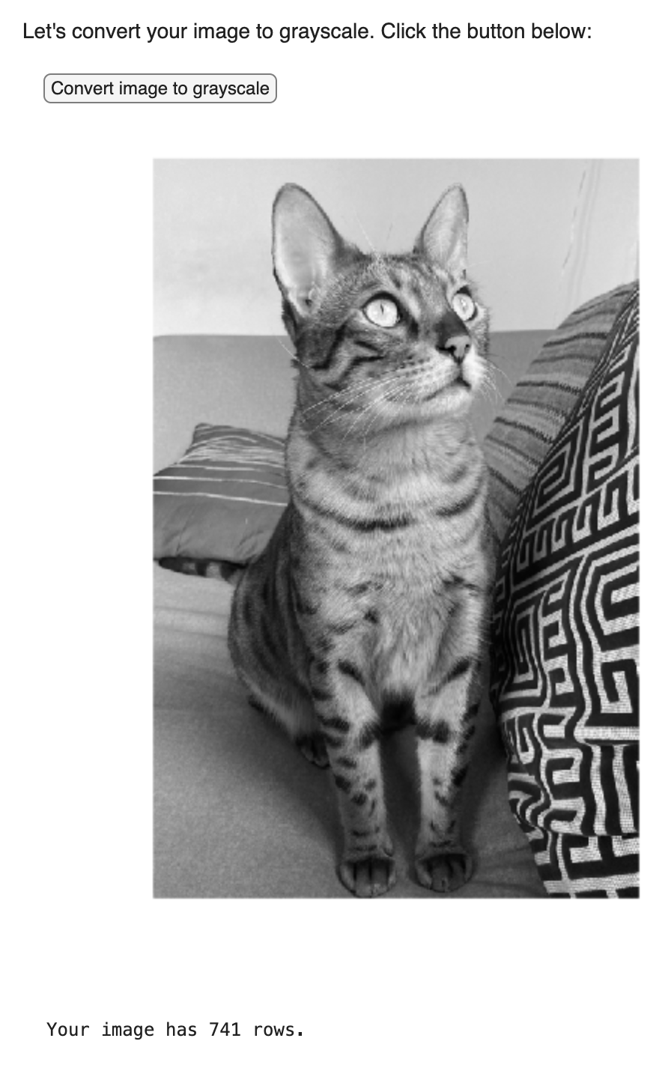
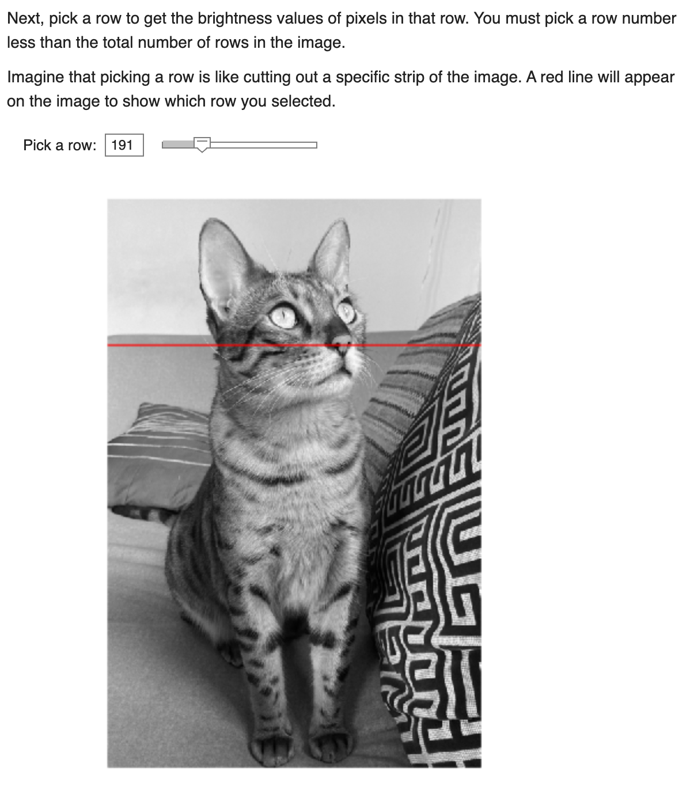
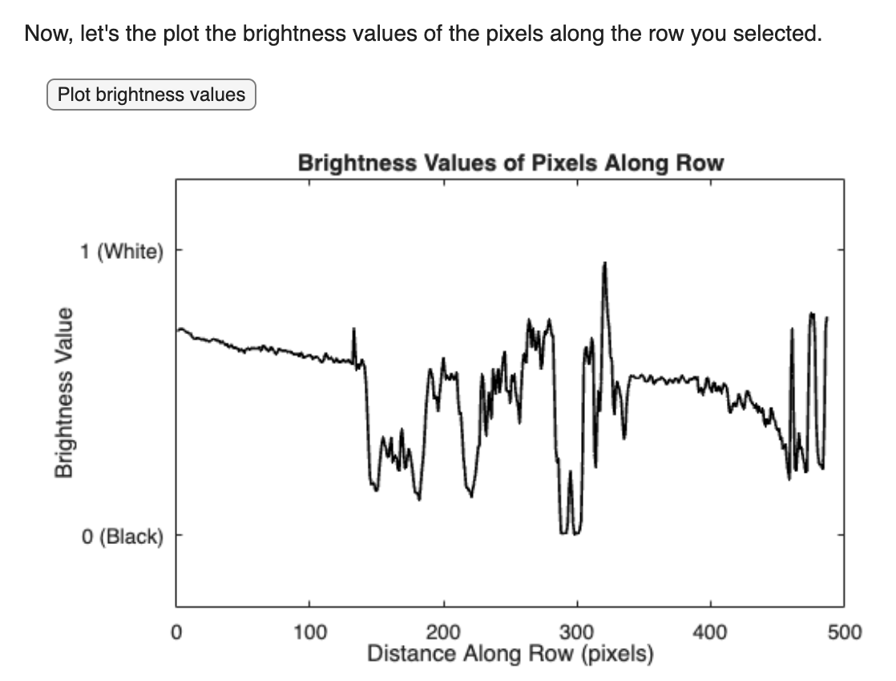
Reflect: Try to match the brightness values to the image row you selected. Does the plot make sense? How well do the brightness values track the dark and bright pixels along the image row?

Slide 33
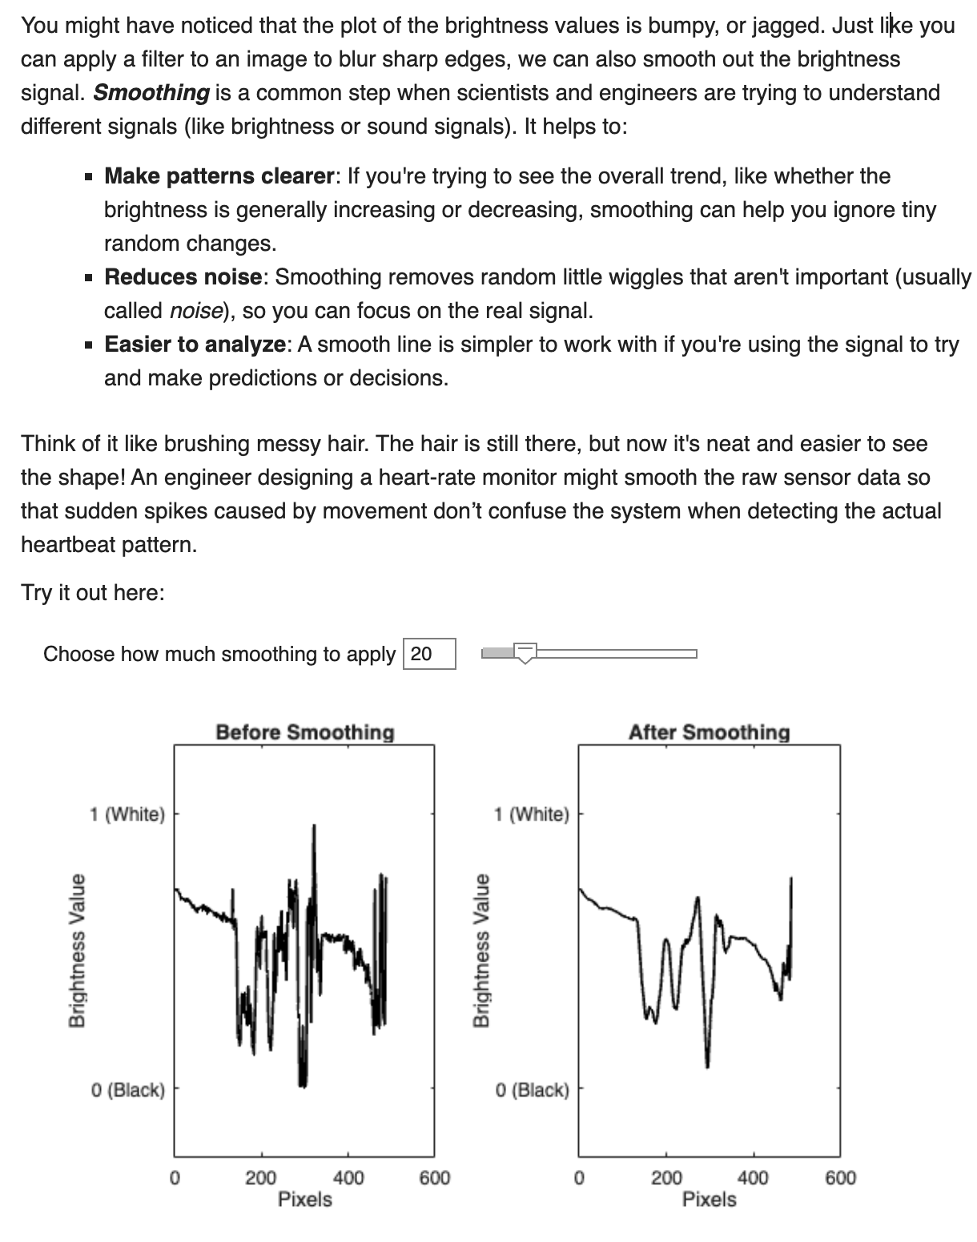
Smoothing: A common step when scientists and engineers are trying to understand different signals (like brightness or sound signals). It helps to make patterns clearer, reduce noise, and make signals easier to analyze.
Try applying different amounts of smoothing. Do you think the smoothed signal provides a more useful representation of the brightness changes in the image? Is there such a thing as too much smoothing?

Slide 34
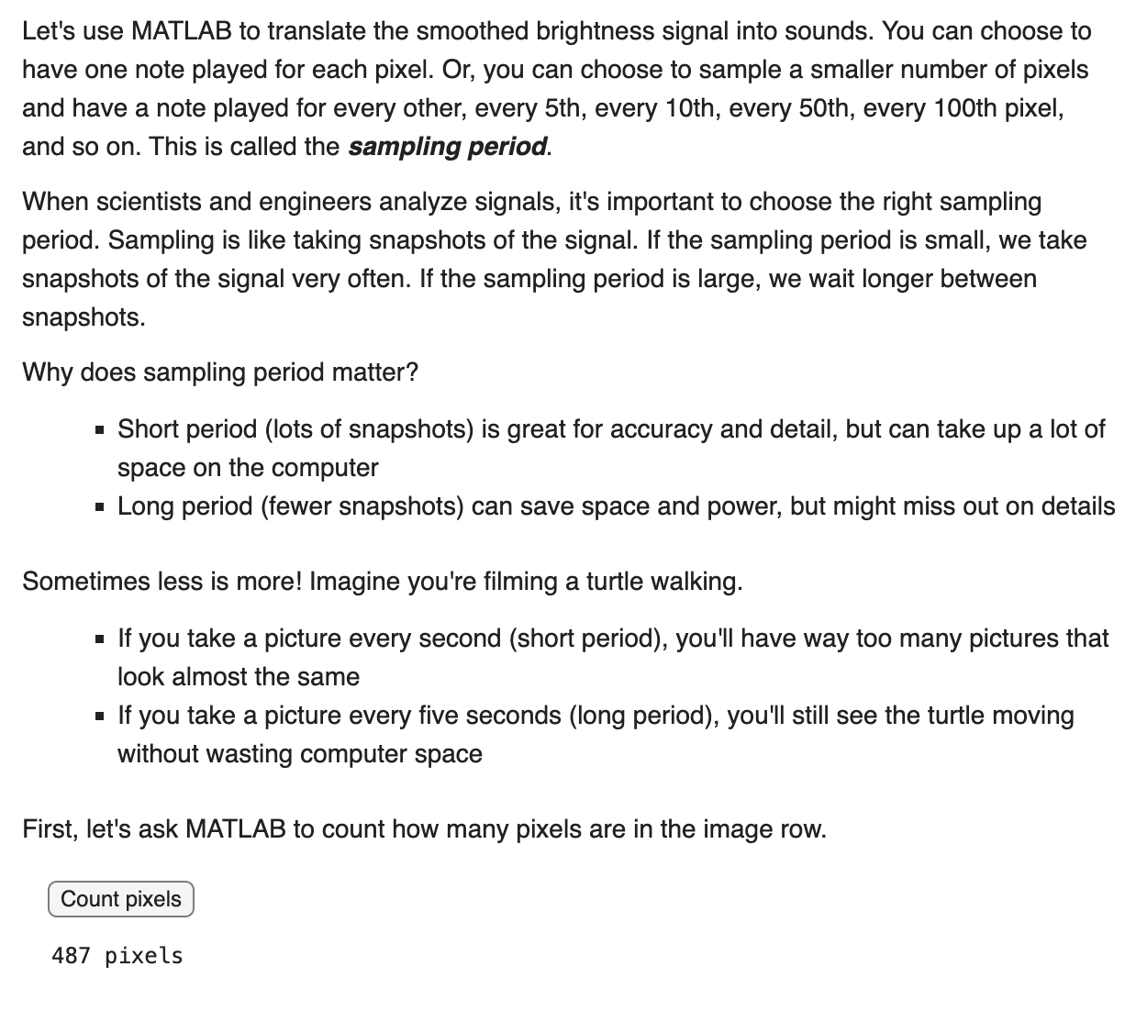
Sampling Period: When scientists and engineers analyze signals, it's important to choose the right sampling period. Sampling is like taking snapshots of the signal.
If the sampling period is small, we take snapshots of the signal very often. If the sampling period is large, we wait longer between snapshots.
Choosing the right sampling period can be tricky: a shorter period (lots of snapshots) is great for detail, but can take up a lot of space while a longer period (fewer snapshots) can save space, but miss out on details.
If we played every single pixel as a sound lasting half a second, how long would it take to play every pixel in the row? Check your answer in MATLAB!

Slide 35
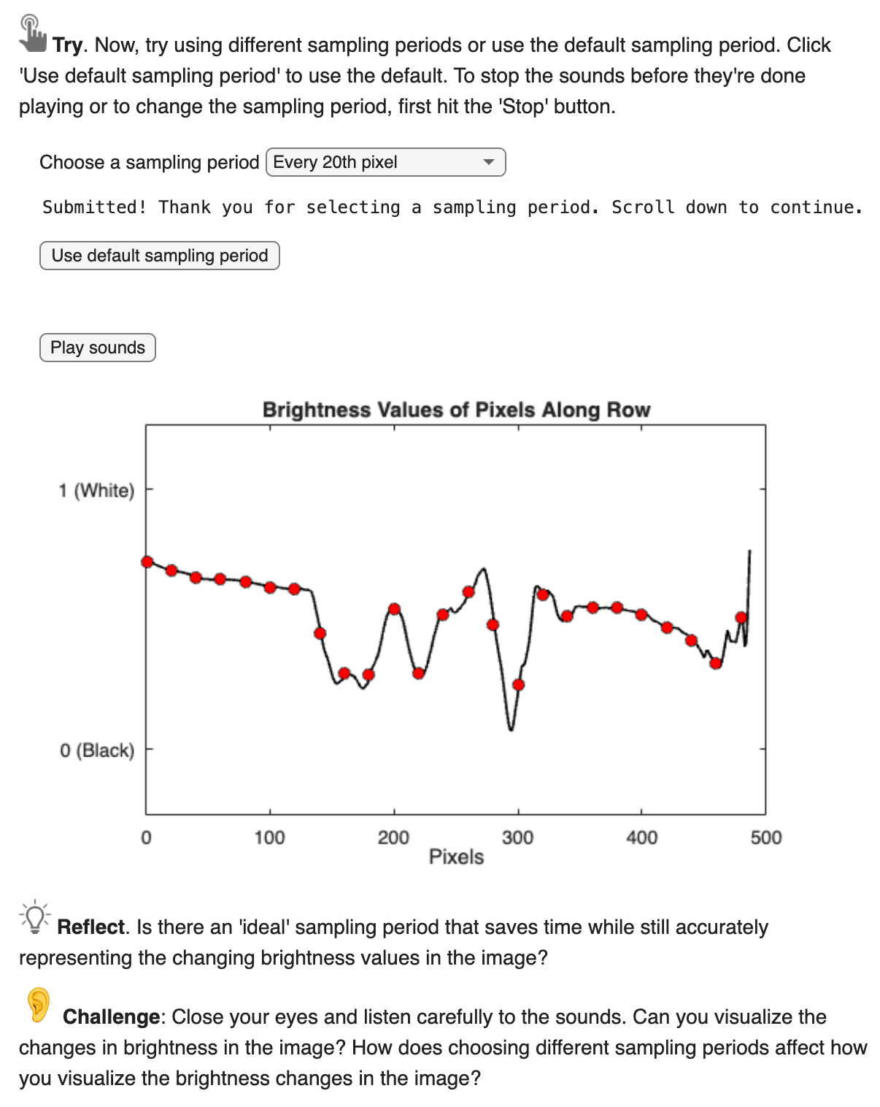
Reflect: Is there an ‘ideal’ sampling period that saves time while still accurately representing the changing brightness values in the image?
Challenge: Close your eyes and listen to the sounds again. Can you visualize the changes in brightness in the image? How does choosing different sampling periods affect how you visualize the brightness changes in the image?

Slide 36
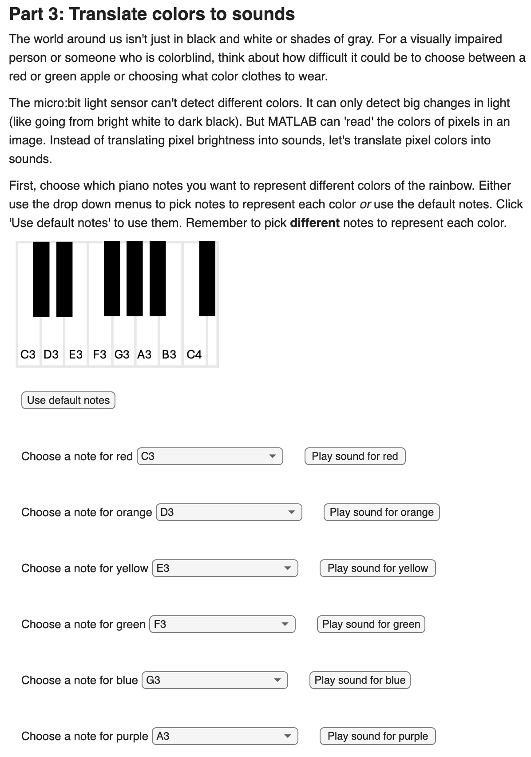
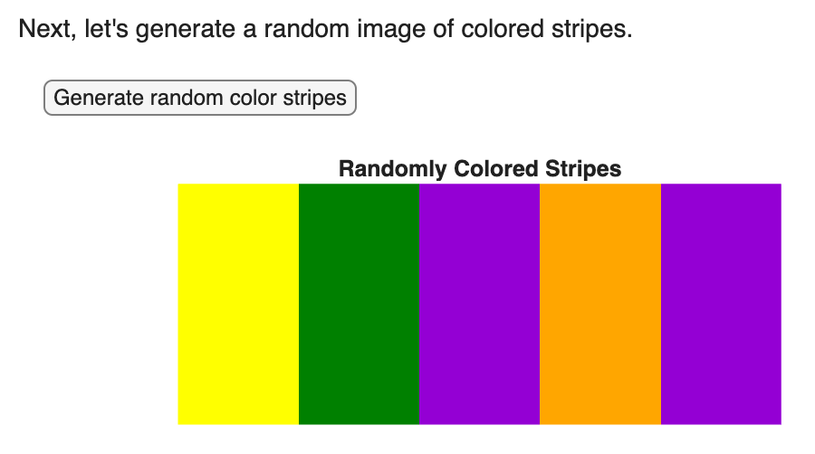
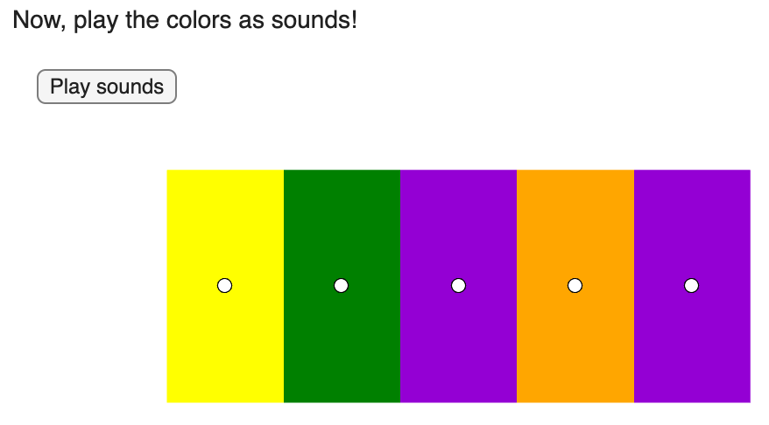
Try generating a few more colored stripe images and playing the sounds. Practice memorizing which sound represents each color.

Slide 37
Challenge: Close your eyes and listen to the sounds again. Can you visualize the colors of each stripe?
Pair up and have your partner generate a new colored stripe image and play the sounds. Guess what color each stripe is based on the sounds. Have your partner check your answers. Compete to see who can get the most correct.
Challenge: Grab a blank strip of paper and colored markers or pencils. Draw the colored striped image generated with MATLAB. Copy it as closely as you can. Pull the strip across the micro:bit device you built earlier. Can the micro:bit light sensor detect the different colors and play different sounds for each color?
Close your eyes and listen to the sounds as you pull the strip through your micro:bit device. Can you guess the color of the stripes based on the sounds?

Slide 38
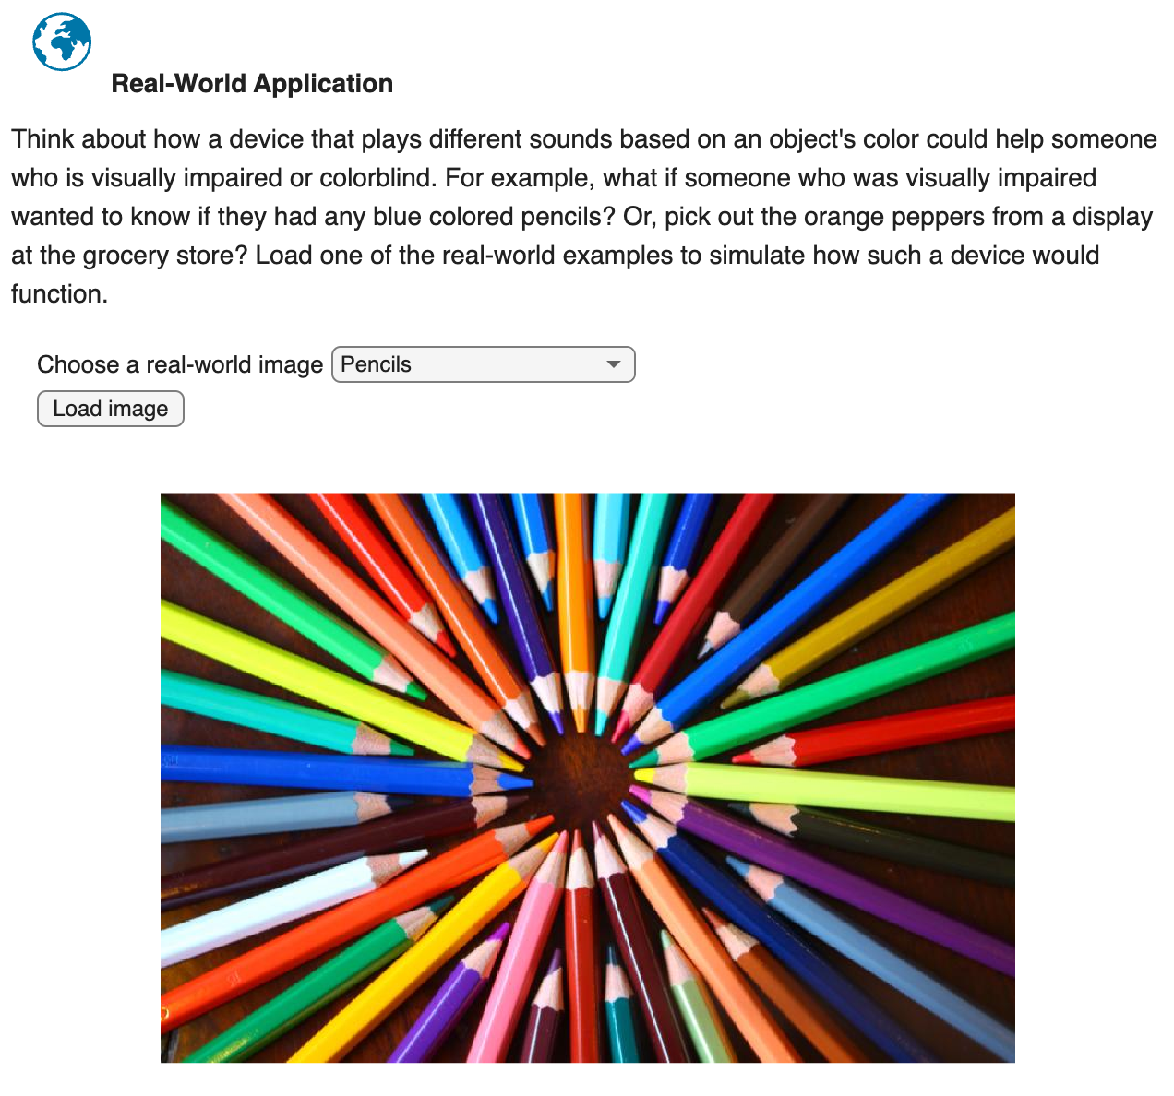
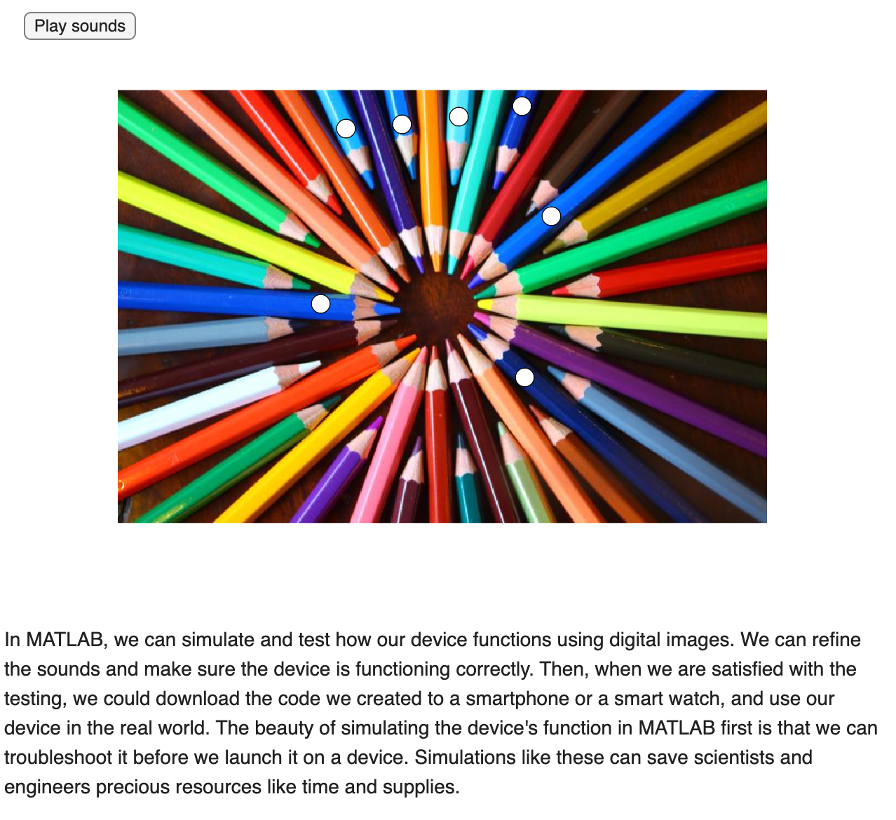

Slide 39
Connection to Signal Processing

Slide 40
Signal Processing Connection
Signal Processing: The challenge uses signal processing by converting light signals from an image into audio signals (musical notes).
Image Processing: "Reading" the black-and-white image with the micro:bit is similar to how computers process images, by interpreting light and dark areas as data. The MATLAB simulation further explores this by showing how computers represent images as grids of pixels.
Translating Data: Both the design challenge and MATLAB simulation involve translating physical signals (light) into numerical data that can be understood and manipulated by a device or computer.

Slide 41
Discuss, Reflect & Debrief

Slide 42
Signal Processing Connection
How did the process of converting light levels to musical notes demonstrate signal processing?
In what ways did the "reading" of the black-and-white image relate to how computers process images?
What challenges did you encounter in translating a visual signal (light from the image) into an audio signal (musical notes)?
How might understanding signal processing and image processing be useful in other real-world applications?
If you were to enhance the "Bright Beats Challenge," what aspects of signal processing or image processing would you try to incorporate or improve?

Slide 43
Reflection
What was the most challenging part of building your light-sensitive musical synthesizer?
How did the micro:bit translate light levels into musical notes?
What did you learn about how computers "see" and interpret images?
In what ways do computers and programs like MATLAB represent images differently from the micro:bit device?
What are key differences between how the micro:bit device functions and how MATLAB represents and transforms images?
How might this project help visually impaired individuals interact with images in new ways?
If you were to do this challenge again, what would you do differently?

Slide 44
MORE RESOURCES:
Vocabulary, Background Knowledge, Dig Deeper, EDP, Engineering Fields

Slide 45
Vocabulary

Slide 46
Vocabulary
Amplitude: How tall the wave is from the middle line to the crest or trough. Bigger amplitude means more energy, like louder sounds or brighter light. Smaller amplitude means softer or dimmer signals.
Frequency (Hz): How fast something vibrates each second. Higher frequency means higher pitch (like a whistle); lower frequency means lower pitch (like a drum). For images, different frequencies correspond to different colors.
Image Processing: How computers transform signals in an image to, for example, make the image clearer or smaller, or transform the image by adding filters, finding faces, or removing blur.
Intensity: How bright a light is shining as measured by a light sensor or represented numerically by computer programs.
LED (Light-Emitting Diode): An LED is a small light that converts electricity into light. It’s super efficient, doesn’t get hot like old bulbs, and comes in lots of colors. LEDs are used in things like flashlights, screens, and even the micro:bit’s 5×5 grid.
Light Sensor: A small tool that measures how bright the light is. Found in phones, cameras, and automatic lights.

Slide 47
Vocabulary
Light Wave: A wave made of light energy that moves super fast and helps us see colors, shapes, and brightness.
MATLAB: MATLAB is a programming platform with the power to perform complex calculations. It’s used by millions of engineers and scientists to analyze data, develop algorithms, and create models.
Pixel: A pixel is a tiny dot that makes up a picture on a screen. When you look at a photo or a game on a computer, tablet, or TV, the picture is made of thousands (or even millions!) of these little dots. Each pixel can be a different color and have different light intensity, and when they all work together, they create the image you see.
Phototransistor: A tiny electronic part that reacts to light. When light shines on it, the phototransistor lets more electricity flow through a circuit. The brighter the light, the more electricity it allows. It’s like a light-sensitive switch that helps devices measure how much light is around. Phototransistors are used in devices such as remote controls and in the micro:bit’s 5x5 grid.

Slide 48
Vocabulary
Propagation: The direction the wave travels. Even though the wave moves up and down, the energy moves forward, like a stadium wave passing through the crowd.
Sampling Period: When scientists and engineers analyze signals, it's important to choose the right sampling period. Sampling is like taking snapshots of the signal. If the sampling period is small, we take snapshots of the signal very often. If the sampling period is large, we wait longer between snapshots. Choosing the right sampling period can be tricky: a shorter period (lots of snapshots) is great for accuracy and detail, but can take up a lot of space on the computer while a longer period (fewer snapshots) can save space and power, but might miss out on details.
Signal Processing: How machines or computers clean up, change, or understand signals like sound, light, or movement.
Smoothing: A common step when scientists and engineers are trying to understand different signals (like brightness or sound signals). It helps to make patterns clearer, reduce noise, and make signals easier to analyze. Think of it like brushing messy hair. The hair is still there, but now it's neat and easier to see the shape!

Slide 49
Vocabulary
Sound Wave: A wave made of vibrating air that travels to our ears so we can hear music, voices, and noises.
Synthesizer: An electronic device or app that creates sound by changing wave patterns. Used in music to make beats and effects.
Velocity: The velocity of a wave is how fast it travels through a material
Wave: A repeating pattern that moves energy from one place to another. Waves can carry sound, light, or motion.
Wavelength: The distance between two matching points on a wave, like crest to crest. Short wavelengths are close together (like a whistle), and long wavelengths are spread out (like a drumbeat).

Slide 50
Background Knowledge

Slide 51
Signal Processing
Have you ever taken a photo or recorded a sound on your phone? That’s signal processing in action! A signal is just a way to carry information, like light from a sunset or sound from your voice. These signals come from the world around us, and they usually travel in waves.
Light and sound are both types of waves.
Light waves move super fast (about 300 million meters per second) and help us see colors, shapes, and brightness.
Sound waves travel much slower through the air (around 340 meters per second) and let us hear music, speech, and noise.

Slide 52
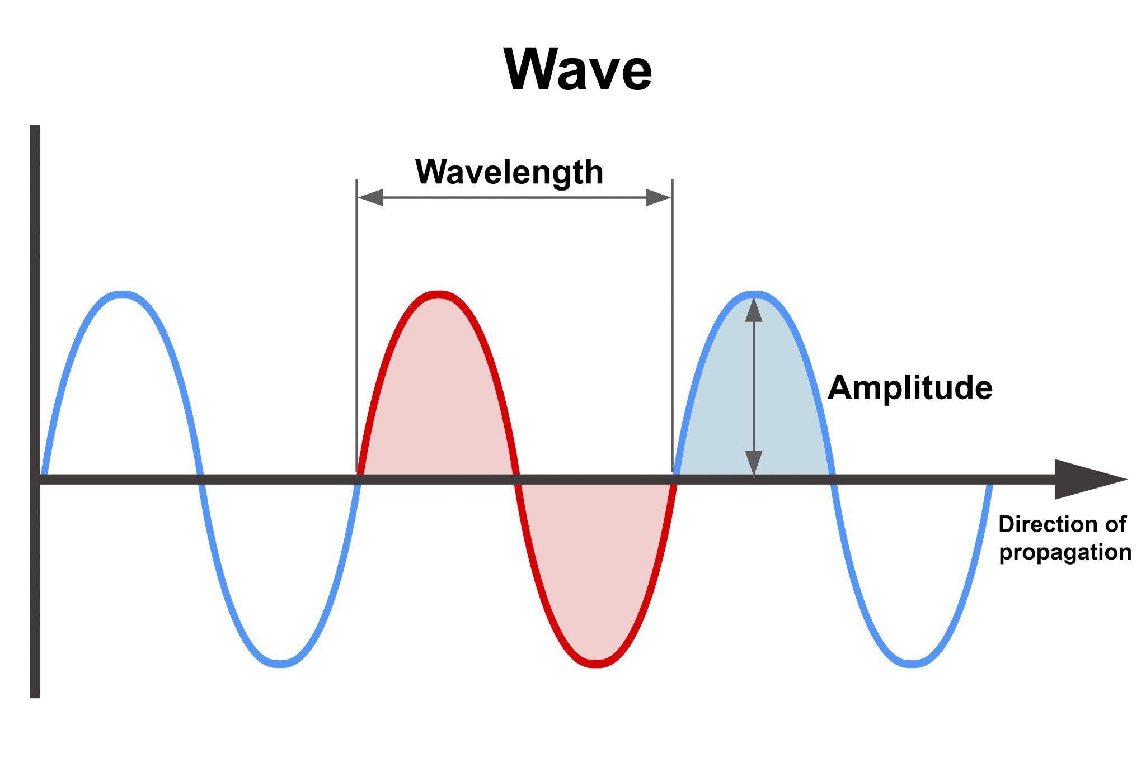
Signal Processing
Each wave has a frequency, which means how fast it oscillates or vibrates.
High frequency means fast vibrations (like a whistle), and low frequency means slow vibrations (like a drumbeat).
The velocity of a wave is how fast it travels through a material, and it depends on the type of wave and what it’s moving through. Light has a much higher velocity than sound, which is why we see lightning before we hear thunder!

Slide 53
Image Processing
Image processing is a type of signal processing. It’s how computers and devices understand, improve, and transform pictures. Just like sound is a wave that carries information to our ears, light is a wave that carries visual information to our eyes (and to cameras!). When you snap a photo, your phone captures light waves bouncing off objects and turns them into digital signals, patterns of numbers that represent colors, brightness, and shapes.
Once the image is captured, it can be digitally transformed using image processing techniques. This can include:
Sharpening a blurry photo so edges look clearer
Smoothing a photo to make it blurry
Adjusting brightness or contrast to make details pop
Removing noise (such as graininess) to make the subject of the image more clear
Detecting edges to find outlines of objects
Recognizing faces or objects using AI
Compressing the image to make it smaller for storage or sharing

Slide 54
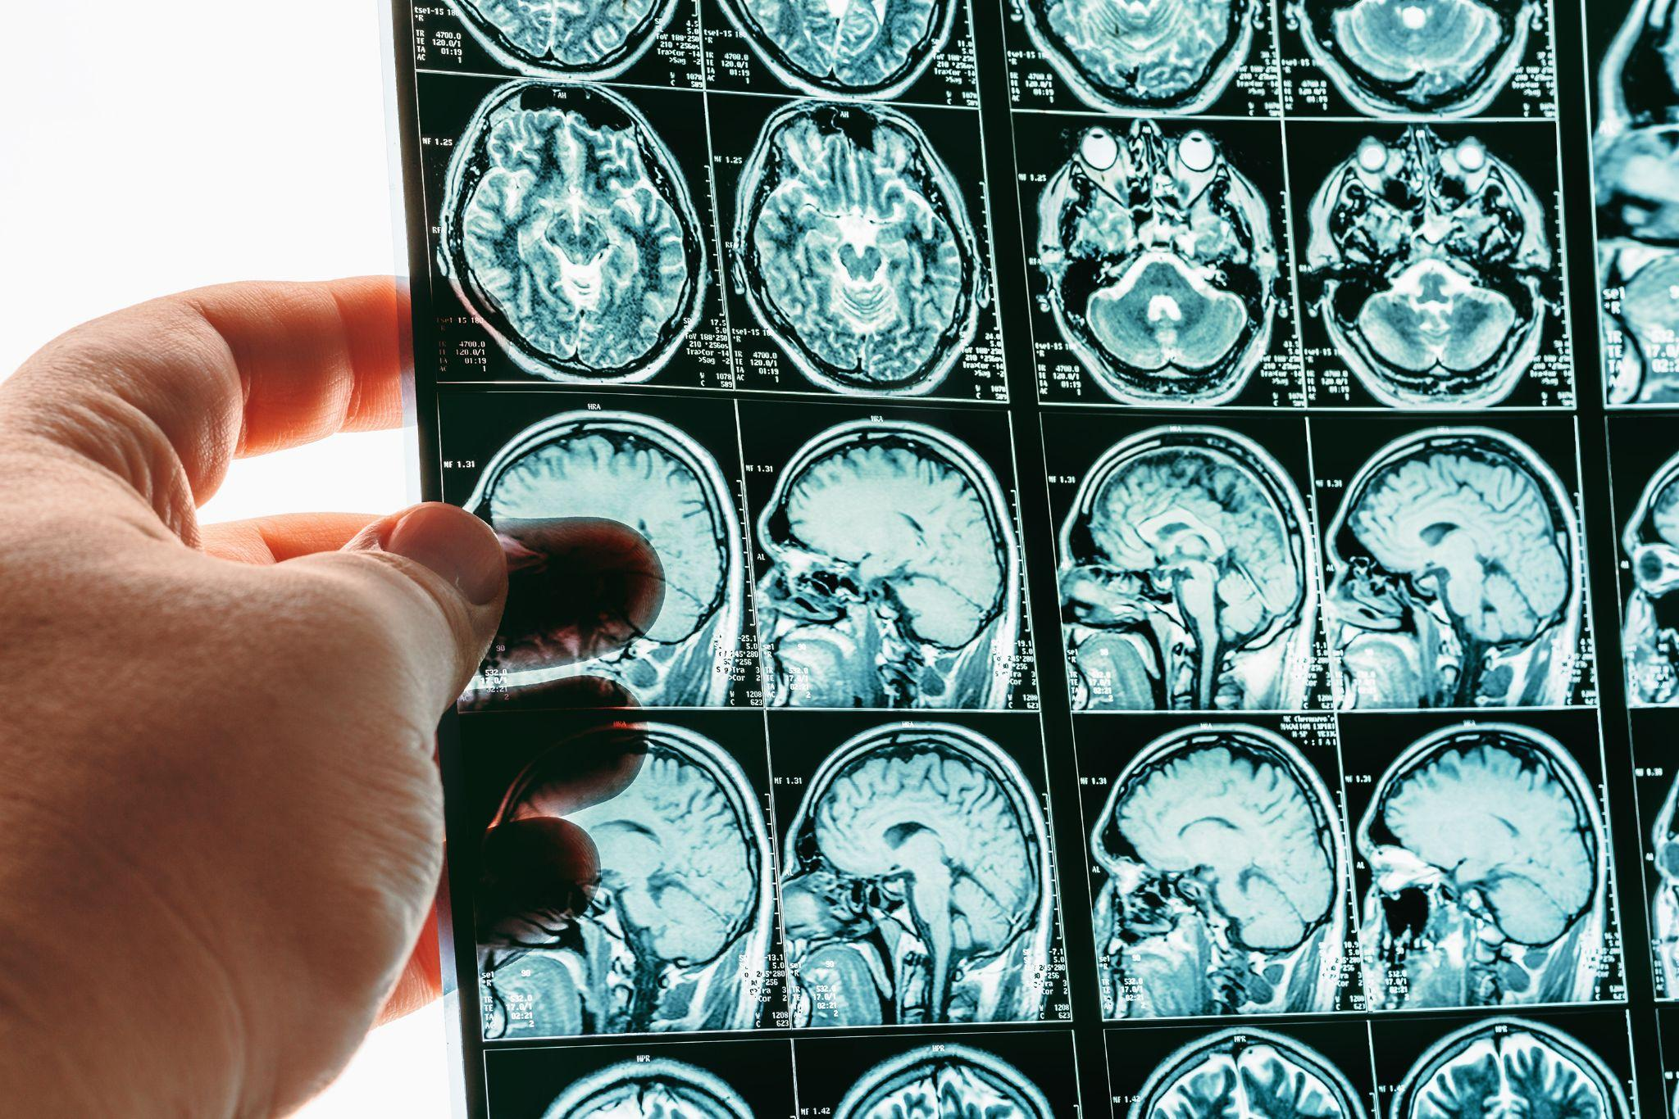
Real World Image Processing
Photo Filters: When you add a filter on Instagram or Snapchat, image processing changes the color balance, contrast, and texture to create a mood or style.
Medical Imaging: MRI and X-ray machines use image processing to highlight tissues, detect tumors, and help doctors make diagnoses.
Self-Driving Cars: Cameras on autonomous vehicles use image processing to detect lanes, signs, pedestrians, and other cars.
Satellite Images: Scientists use image processing to study weather patterns, track wildfires, or monitor forests from space.
Microscope Analysis: In biology labs, image processing helps researchers count cells, measure growth, or detect tiny structures.

Slide 55
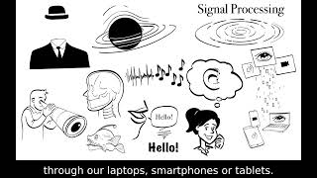
Watch: What is Signal Processing?

Slide 56
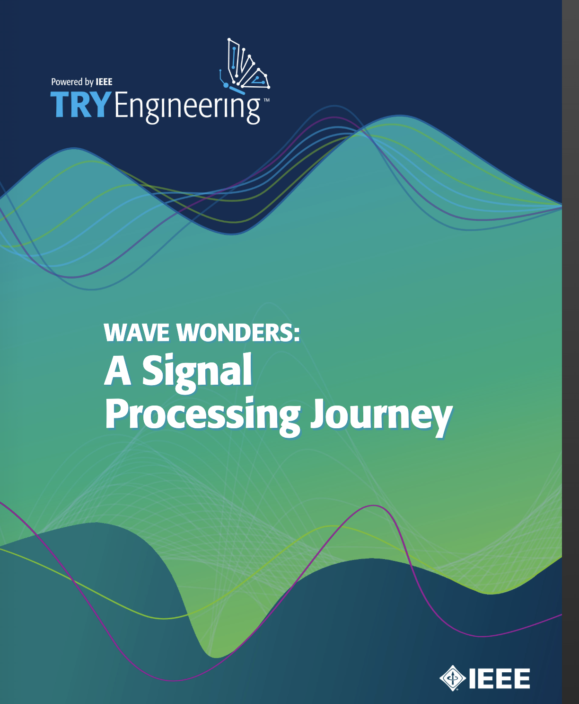
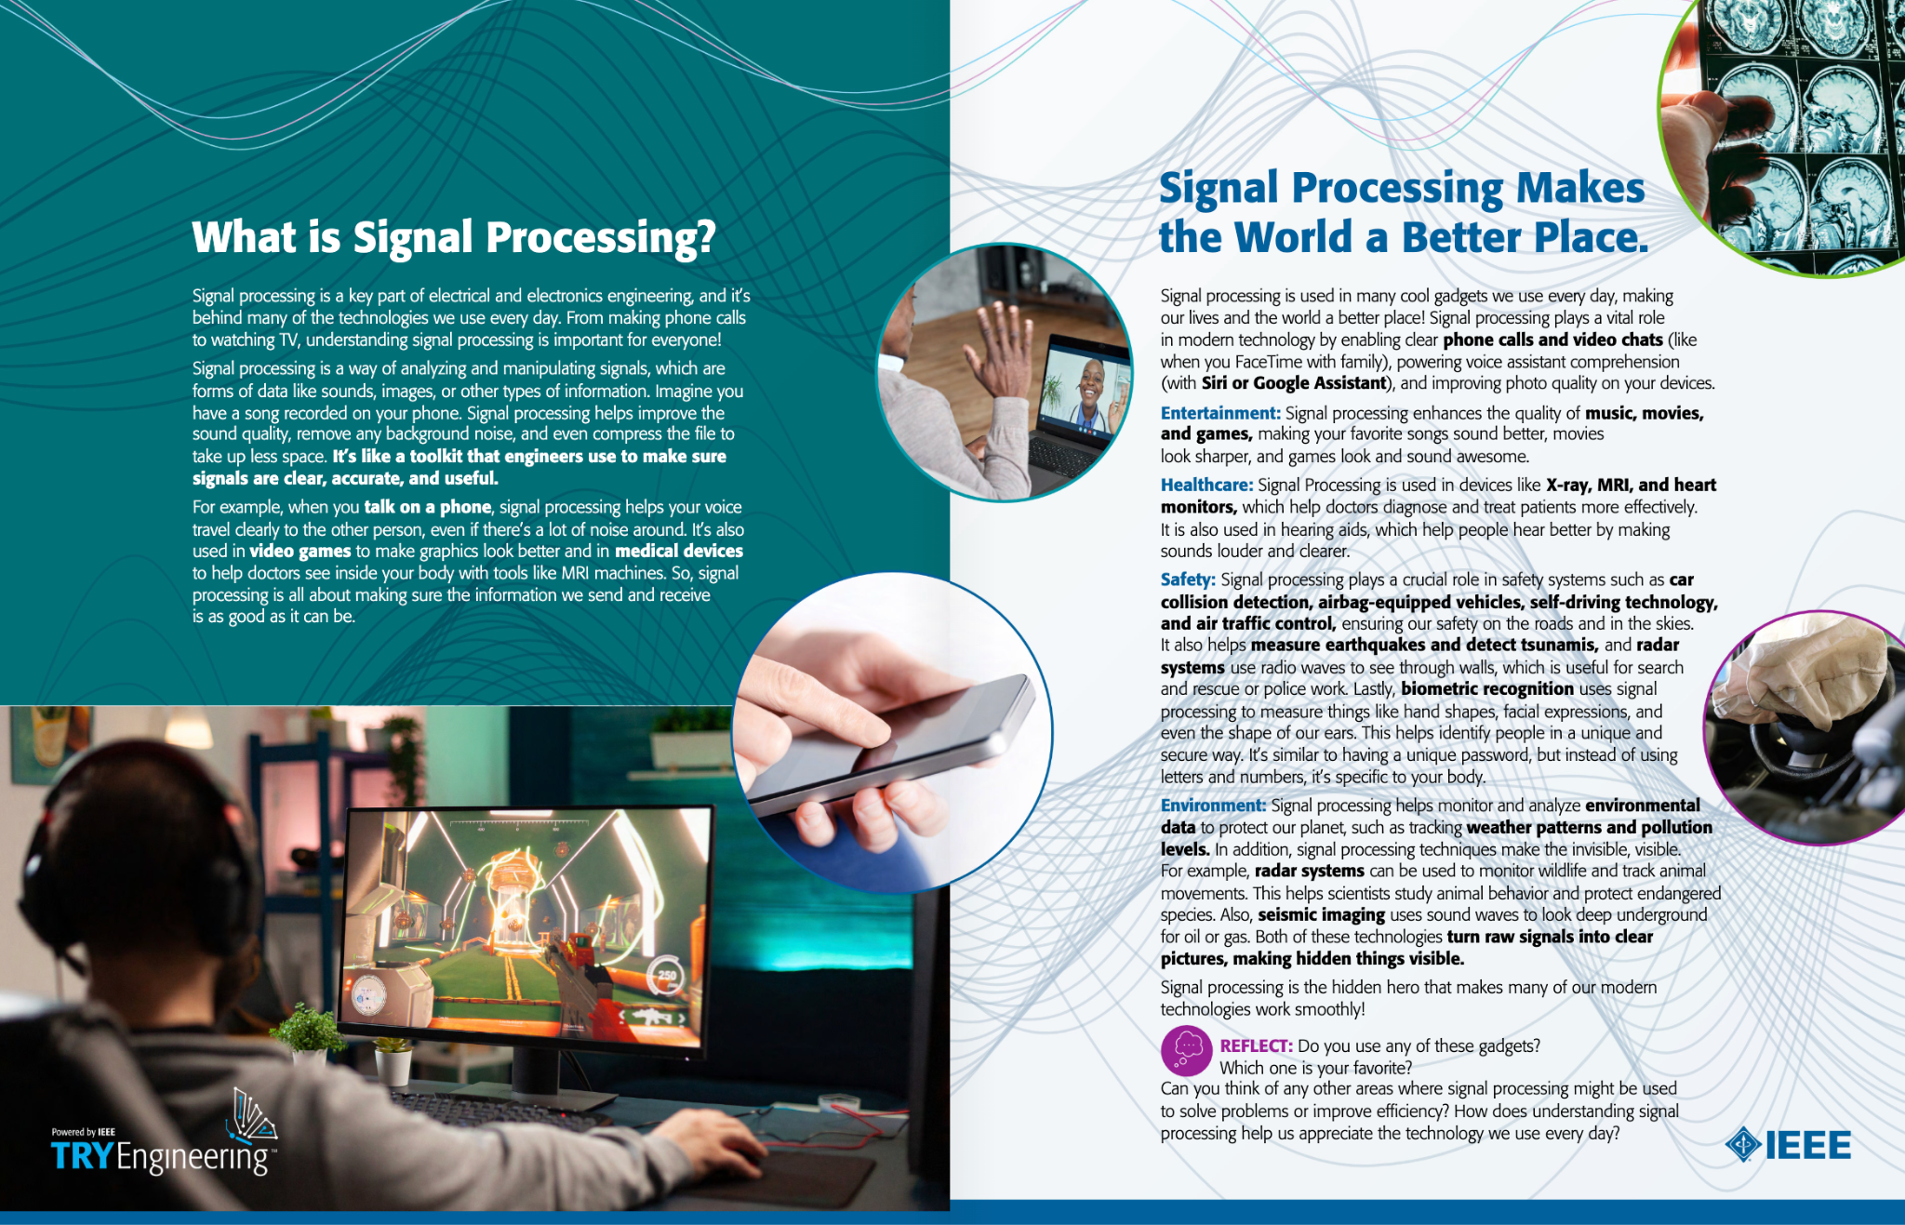
Explore Wave Wonders EBook

Slide 57
Dig Deeper

Slide 58
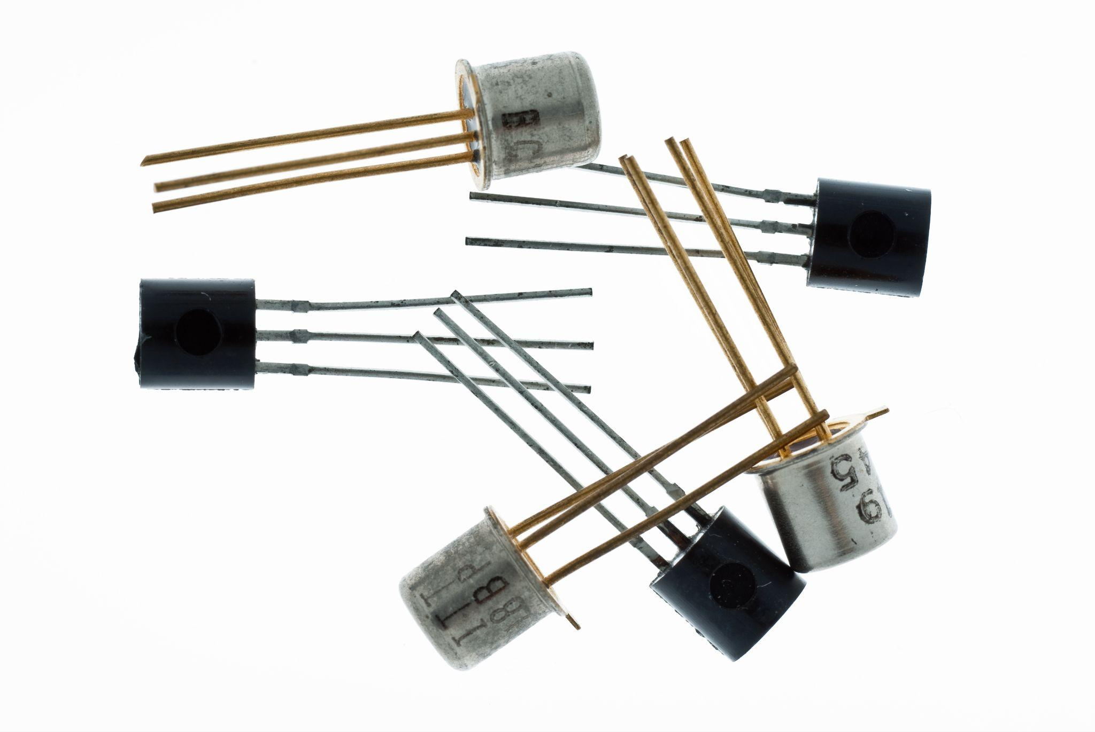
Light Sensors & micro:bit
Light sensors, like the one built into the micro:bit, detect the intensity of ambient light using a component called a phototransistor. A phototransistor is a light-sensitive semiconductor that changes its electrical resistance based on how much light it receives.
In the micro:bit, the LED display doubles as a light sensor by measuring how much light is reflected back into the LEDs. This allows the device to quantify brightness on a scale from 0 (dark) to 255 (very bright), enabling it to respond to environmental lighting conditions.

Slide 59
Can LEDs See Light?
It sounds strange, but yes — the same little lights (LEDs) on the micro:bit that shine can also help sense light! The micro:bit doesn’t have a separate light sensor. Instead, it cleverly uses the LED display to measure how bright the room is.
How It Works: The micro:bit has 25 tiny LED lights arranged in a 5×5 grid, and they’re not just for glowing, they can also sense light. When you ask the micro:bit to check the light level, it briefly turns off the LEDs and measures how much light is bouncing back. Based on what it detects, it gives you a number between 0 and 255, where 0 means super dark and 255 means very bright.

Slide 60
Engineering Design Process

Slide 61

The Engineering Design Process
Learn about the engineering design process (EDP). The process engineers use to solve problems. (Video 1:47)
Source: TeachEngineering YouTube Channel http://www.youtube.com/watch?v=b0ISWaNoz-c

Slide 62
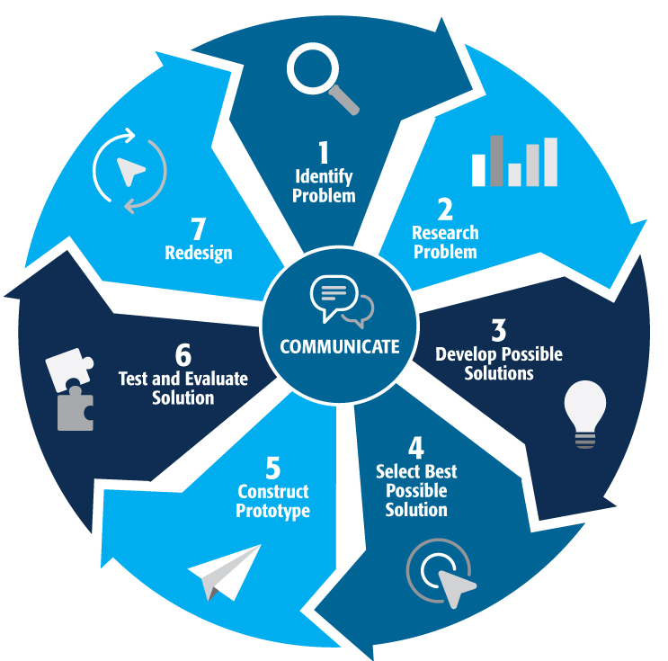
Engineering Design Process
Divide into teams of two (or up to 4 max)
Review the challenge and criteria & constraints
Brainstorm possible solutions (sketch while you brainstorm!)
Choose best solution and build a prototype
Test then redesign until solution is optimized
Reflect as a team and debrief as a class
Notes:
Material bags for teams to build…

Slide 63
Productive Failure
The engineering design process involves productive failure: test, fail, redesign. Iterate again and again until you have the best possible solution.
It is important to document iterations to keep track of each redesign. Use the engineering notebook to sketch ideas, document iterations and any measurement and/or calculations.
It’s also important to showcase the fact that there can be multiple solutions to the same problem. There’s no one “right” solution.

Slide 64
Engineering Fields

Slide 65

What is Engineering?
Learn about engineering and how engineers are creative problem solvers and innovators who work to make the world a better place.
(Video 3:43)
Source: TeachEngineering YouTube Channel - http://www.youtube.com/watch?v=H9VDkvgGmVo

Slide 66
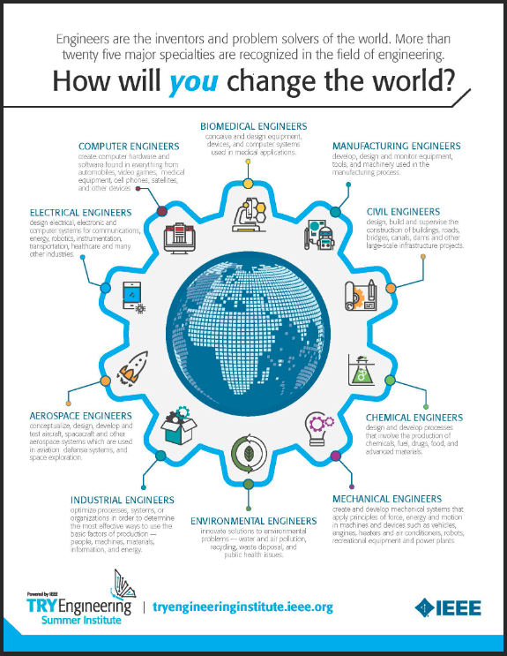
Related Engineering Fields
There are several types of engineering fields that are involved circuits. Here are just some of the related engineering fields.
Computer Engineering
Software Engineering
Electrical Engineering
Download the Engineering Fields Infographic How will YOU change the world? Engineers are the inventors and problem solvers of the world! More than twenty five major specialties are recognized in the field of engineering. Engineers make the world a better place!

Slide 67

For more engineering lesson plans and resources like games, engineering careers, and STEM opportunities visit IEEE’s TryEngineering.org

